Slide 1
Slide Deck Instructions
This customizable slide deck supports the 1st step for organizational readiness described in Q4T (Quality for Teens): A Quality Improvement Package for Adolescent Sexual and Reproductive Health Care developed by the National Association of Community Health Centers in collaboration with Cicatelli Associates Inc. and with support from the Centers for Disease Control and Prevention Division of Reproductive Health.
Quality improvement team members can use this slide deck to engage health center leadership in using Q4T to make improvements in adolescent sexual and reproductive health services.
You may wish to:
  Insert your own logo and use your organization's PPT template.
  Make the title say, “Opportunities for Leaders at “Name of Your Center.”
  Change colors and insert local photos if it helps your message but keep the message brief and to the point.
Notes:
Please delete or hide this instruction slide before presenting to health center leadership.

Slide 2
Quality Improvement In Adolescent Sexual And Reproductive Health Care
OPPORTUNITIES
FOR LEADERS

Slide 3
Rationale
Children comprise about a third of health center patients, with adolescents an estimated 13% (data.hrsa.gov).
Adolescent sexual and reproductive health (ASRH) care is foundational to youth preventive and primary care, but missed opportunities to provide recommended services are common.
Rates of untreated chlamydia and gonorrhea are rising.
National screening and services standards are endorsed by:
  National Association of Community Health Centers (NACHC)
  U.S. Centers for Disease Control and Prevention (CDC), and
  Major medical associations.
Bureau of Primary Health Care (BPHC) UDS measures reflect
ASRH care.
Clinicians and other members of the clinical care team need help to plan and implement this care. Quality for Teens or Q4T is a quality improvement tool that may be used as part of quality improvement goals and/or to meet maintenance of board certification requirements.
Use of Q4T may decrease health disparities in youth receiving care at community health centers.
Notes:
[Note: the content on this slide is available as a PDF handout.]
Though some data change, the estimates of children and adolescents in health centers is fairly stable.
These are some additional talking points you may wish to use when discussing adolescent sexual and reproductive health (ASRH) quality improvement and services with leadership in your organization:
Access to quality ASRH services, including contraception and sexually transmitted infection services, plays an important role in supporting the health and well-being of adolescents and in promoting health equity.
Supporting ASRH care can lay a foundation for health and well-being into adulthood. Unmet health care needs during adolescence are associated with poor health outcomes in adulthood, and consequences of adverse ASRH outcomes can be long term (e.g., infertility associated with untreated chlamydia/gonorrhea).
Adolescence is also a unique developmental period, during which health risks associated with early childhood trauma can be mitigated, and lifelong protective behaviors, including health care seeking, can be established.
Enabling young people to make informed and autonomous decisions about their sexuality and reproductive health is critical for fulfilling their human rights and enables self-management of care.
Pediatric health clinicians play a critical role in supporting youth to make informed decisions about their health, and to delivering or linking young people to the sexual and reproductive health care services they need.
Despite ASRH practice recommendations from national organizations, including the American Academy of Pediatrics (https://www.aap.org/), gaps in implementation persist.
https://www.cdc.gov/teenpregnancy/projects-initiatives/quality-and-access-for-health-equity-teens.html
Brittain AW, Steiner RJ, Fasula AM, Hatfield-Timajchy K, Kulkarni A, Koumans EH. Improving Access to and Quality of Sexual and Reproductive Health Services for Adolescents in the United States. J Womens Health (Larchmt). 2022;31(1):7-12.

Slide 4
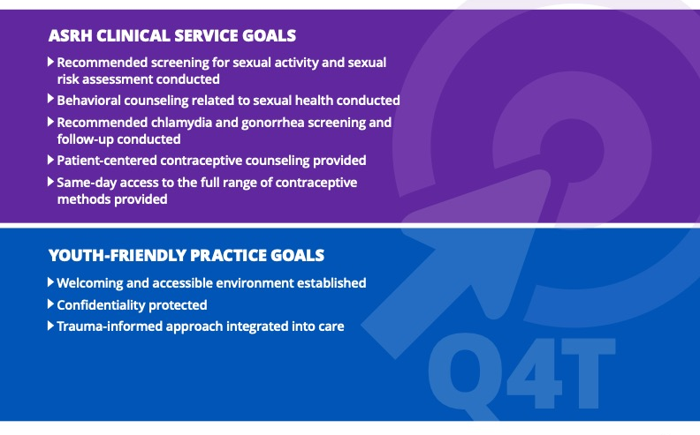
What Are the Goals of Q4T?
Notes:
Explain Q4T is Quality for Teens, a ready-to-use quality improvement resource for health centers to promote optimal adolescent sexual and reproductive health care. It has been piloted and informed by health centers. Q4T is organized around clinical service and youth-friendly improvement goals. Each improvement goal includes change strategies with implementation tips, tools, and resources.

Slide 5
How Important is This?
Reduces Unintended Pregnancies
Limits Spread of Sexually Transmitted Diseases
Improves Access to Primary Care
Improves Adolescent Mental Health
Increases role of trusted adults in adolescent lives
ASRH
Notes:
Pick the arrow you think is most important in your local area.

Slide 6
Is ASRH Care
Expensive?
Can’t Youth
Get That Care Elsewhere?
ASRH care is cost effective and prevents expensive chronic or emergency care.
ASRH care is integrated into primary care homes.
Training clinical care teams in ASRH care improves workforce satisfaction and workflow efficiency.
Keeping teens at the health center improves family-based care and generational continuity at the center.
Notes:
Be prepared to discuss the costs of a quality improvement initiative using Q4T. Are you starting from scratch or singling out a specific improvement task? With the scope and timeline in mind, consider costs for QI team members to contribute their time and the impact this may have on other work. Also consider costs for trainings, new materials, and equipment. Balance these costs with potential revenue related to care visits. Consider costs in light of expected “cost of doing business”--CME, QI, and patient care are all routine investments in health center work.

Slide 7
Staff and Patient Voices
“Quote 1 about ASRH care…content can go here”
“Quote 2 about ASRH care…content can go here”
“Quote 4 about ASRH care…content can go here”
“Quote 5 about ASRH care…content can go here”
“Quote 3 about ASRH care…content can go here”
Notes:
This slide is customizable. Staff opinions and personal reflections humanize why ASRH QI is important. Add quotes from teams and adolescent patients.

Slide 8



Staffing for a QI Initiative Using Q4T
 | Clinical Champion
 | Executive Champion
 | Improvement team including 3-4 staff from all organizational levels
Q4T's action planning tool assists this process!
Notes:
Staffing and time commitment will be dependent on the improvement goal(s) and change strategy(ies) selected for your QI initiative. Consider administrators, care-team members, and staff from the front desk/call-center as well as health informatics, finance, and QI departments.
Regular meetings with the improvement team are needed to keep QI efforts on track and ensure accountability. Q4T's Action Planning Tool keeps the improvement team organized and on track during the QI initiative.

Slide 9
“Center Name” Need for Q4T
The local (center, city, county) rate of sexually transmitted infections (STIs) in adolescents is XX
The state rate is XX
Same day access to all forms of contraceptives are recommended
Our center provides same day access xx% of time to adolescents
The center/local teen pregnancy rate is XX%
Our goal is to impact that by XX%
Notes:
This slide is customizable—you can make it your own. Show what your own center’s needs are. If you have done a Q4T needs assessment, share that data here. Otherwise, the bulleted items on this slide are good examples of data points you might like to share:
Look at rates of STIs in data from your county health department or state health department. Measure the STI rate in adolescents who use your center, if possible. If you don’t have that information, state that this project could help you measure that rate and identify problem areas.
Insert what you know or change the issues to reflect what your own needs are in relation to Q4T improvement goals.
You can also report how many adolescents you serve in a year (UDS).

Slide 10
Health Center Successes Using Q4T
Health center teams that participated in a pilot of Q4T were able to initiate and sustain improvement in ASRH care without additional staff, exam space, or medication funding. Examples include:
Trained pediatric staff in long-acting reversible contraception (LARC) insertion/removal and set up an internal mentorship program.
Created a more youth-friendly environment by dedicating an existing pediatric exam room for same-day adolescent LARC appointments.
Created a more welcoming environment for youth by partnering with local schools to showcase youth artwork on clinic walls.
Convened teens to conduct an environmental assessment of youth-friendly practices resulting in a dedicated teen self-care area, improved inclusive signage/LGBTQIA+ visibility, and a teen advisory group.
Notes:
Use these success examples to demonstrate to leadership that using Q4T can lead to improvements.

Slide 11
How Can Leadership Make a Difference?
Promote
Promote ASRH care as a core service provided by the center
Review and participate
Review and participate in quality improvement tracking of ASRH
Assist
Assist in community and professional partner development for training, implementation, and resources related to ASRH
Support
Support ASRH as a component of Diversity, Equity, Inclusion, and Access work at the center
Encourage
Encourage youth to serve on advisory groups to improve ASRH care
Connect
Tie ASRH to NACHC's Value Transformation Framework and the Quintuple Aim
Celebrate
Celebrate milestones achieved in ASRH efforts
Provide
Protected time and resources for staff engagement in ASRH quality improvement
Notes:
NACHC's Leadership Action Guide (https://www.nachc.org/wp-content/uploads/2023/07/Action-Guide_Leadership.pdf) can provide more talking points on how leadership can support quality improvement and organizational transformation.

