Slide 1
Emerging Best Practices for Monkeypox in Community Health Primary Care
November 2, 2022
3:00pm to 4:30pm EST

Slide 2

Housekeeping
Attendees' cameras and microphones are disabled. If you have trouble hearing, adjust your audio settings.
Webinar is being recorded.
Slides will be shared with all registrants after the webinar.

Slide 3
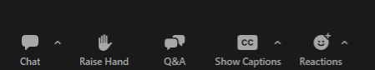
Housekeeping
Use the Chat box to add comments. Take a moment to introduce yourself. We love knowing where you are joining from!
Submit your questions using the Q&A box. This allows us to easily find your questions.

Slide 4

Welcome and Introduction to Presenters
Julia Skapik, MD, MPH, FAMIA
Chief Medical Information Officer
NACHC

Slide 6
NACHC’s STRATEGIC PILLARS
To learn more about NACHC’s Strategic Pillars visit https://www.nachc.org/about/about-nachc/

Slide 7
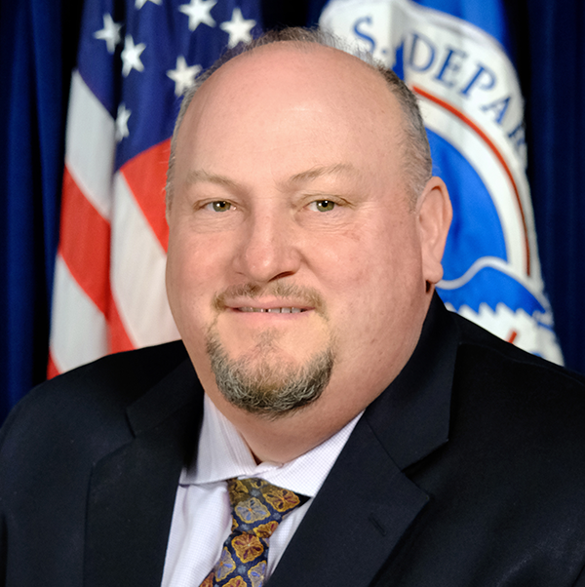

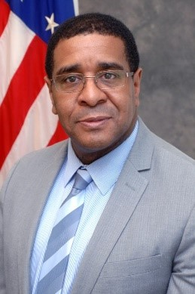


Meet Our Presenters
Robert Fenton
National Monkeypox Response Coordinator
White House
Demetre Daskalakis, MD, MPH
National Monkeypox Response Deputy Coordinator
White House
Harold Phillips, MRP
Director of the Office of National AIDS Policy
White House
Anthony Fortenberry, MSN, RN, NE-BC
Chief Nursing Officer
Callen-Lorde Community Health Center
Kevin Ard, MD, MPH
Medical Director of the National LGBTQIA+ Health Education Center
The Fenway Institute

Slide 8
Agenda
1‣ | Monkeypox Update Presented by Robert Fenton, Demetre Daskalakis and Harold Phillips
2‣ | The 2022 Monkeypox (MPV) Outbreak: Community Health Center Response Presented by Anthony Fortenberry
3‣ | Challenges (and Successes) in the Local MPV Response Presented by Kevin Ard
4‣ | Ask the Experts / Q&A
5‣ | Policy Update Presented by Mallika Yadwad
6‣ | Closing

Slide 9
Monkeypox Update
    Demetre C. Daskalakis, MD, MPH
    Deputy Coordinator
    National Monkeypox Response
November 2, 2022
Notes:
Leandro, 1-11

Slide 10
Agenda
Monkeypox Situation Update
Current Epidemiology
Recent Updates on Response Pillars
  Testing
  Vaccine
  Treatment
  Communication and Outreach

Slide 11
Monkeypox Situation Update

Slide 12
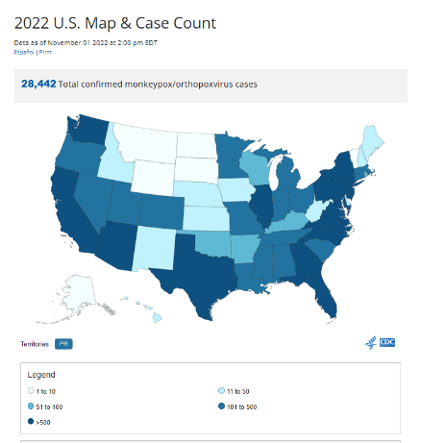
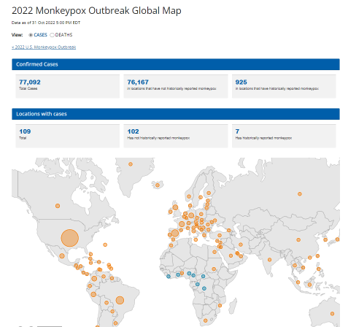
Situation Update- November 1, 2022
*For recent monkeypox case numbers see CDC Situation Summary: https://www.cdc.gov/poxvirus/monkeypox/response/2022/index.html

Slide 13
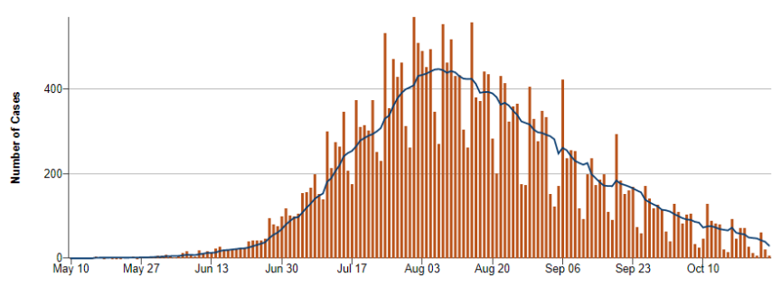
Data as of October 26, 2022

Slide 14
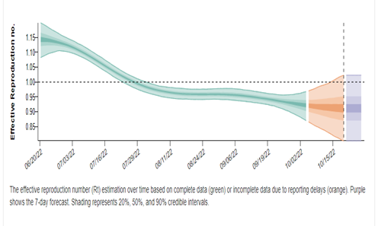
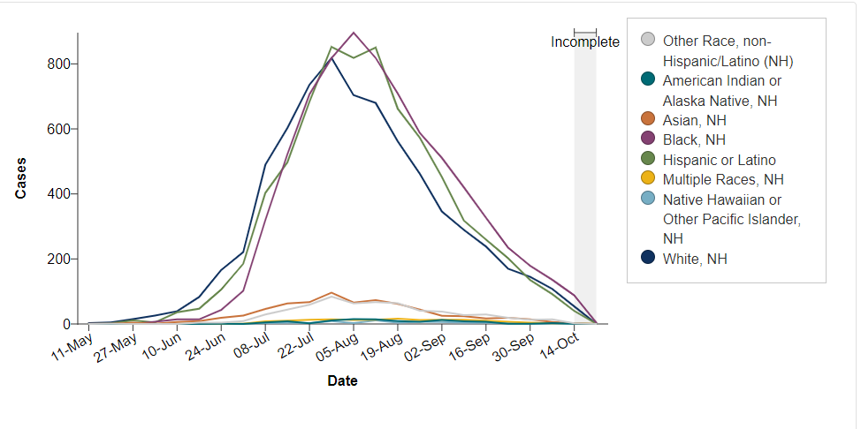
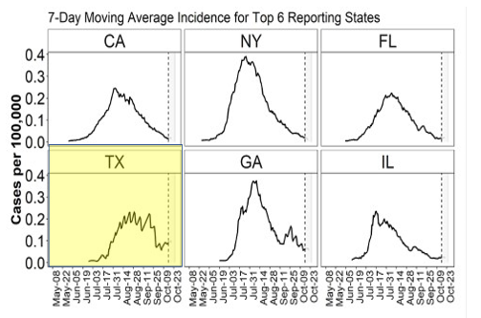
Technical Report 4
October 27, 2022

Slide 15
Current Epidemiology

Slide 16
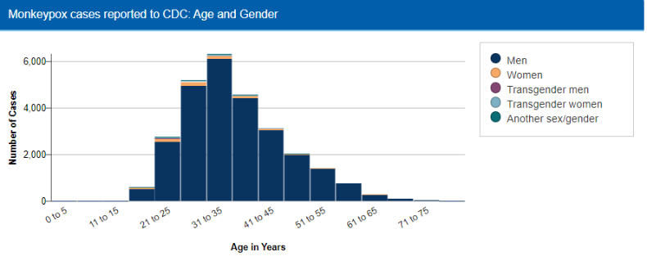
men | 26235 | 96%
woman | 719 | 2.6%
transman | 67 | 0.2%
transwoman | 191 | 0.7%
another s/g | 191 | 0.7%
Data as of October 26, 2022

Slide 17
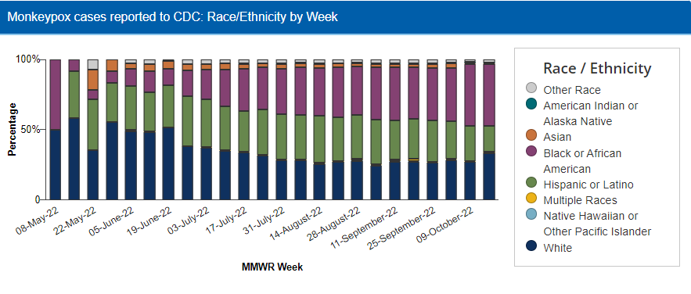
Data as of October 26, 2022

Slide 18
Recent Updates and Response Pillars
Notes:
DEMETRE 12-26

Slide 19
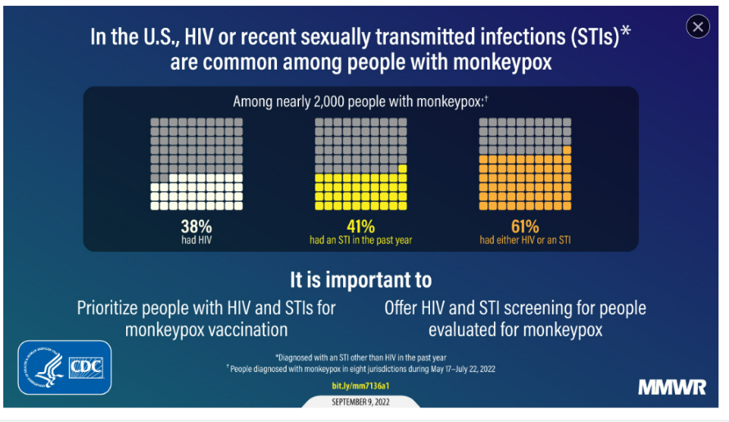
Notes:
HIV or recent sexually transmitted infections are common among people with monkepox
38% had HIV
41% had an STI in the past year
61 5 had either HIV or an STI
We need to look at the synergies between STD, HIV, and Monkeypox programs and activities

Slide 20
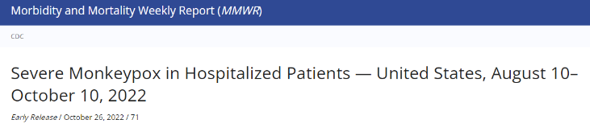

57 people with severe disease reported to CDC for consultation
  82% had HIV, others with non-HIV immunocompromising conditions
  72 % with CD4 count less than 50
  Less than 9% on HIV medications
  68% Black
  23% homeless
12 deaths reported among the 57
  5 confirmed related to Monkeypox
Characteristic (no. with information available) | No. (%)
HIV CD4, cells/mm³ (43)
<50 | 31 (72.1)
50–200 | 9 (20.9)
>200 | 3 (7.0)
HIV Treatment (47)
On ART at the time of monkeypox diagnosis | 4 (8.5)

Slide 21
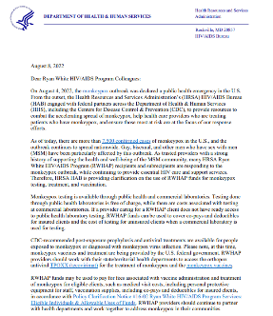
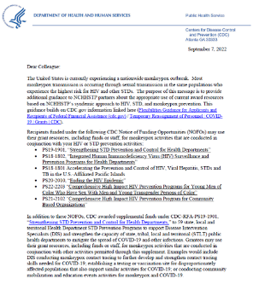
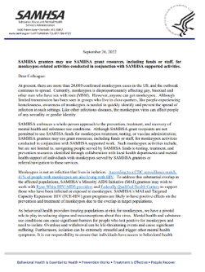
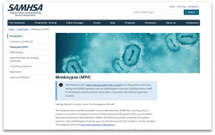
SAMHSA
& Monkeypox
Ryan White
HIV/AIDS
Program
& Monkeypox
CDC HIV/STD
Funding
Opportunities
& Monkeypox
Notes:
On August 8, HRSA Ryan White sent a letter to grantees informing them that RWHAP funds may be used to pay for fees associated with vaccine administration and treatment of monkeypox for eligible clients, such as medical visit costs, including personal protective equipment for staff, vaccination supplies, including co-pays and deductibles for insured clients. RWHAP providers should continue to partner with health departments and work together to address monkeypox in their communities.

Slide 22
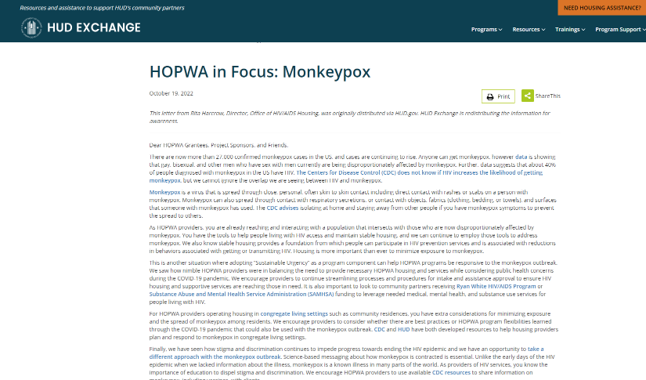
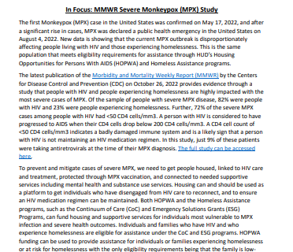


Housing and Urban Development (HUD)
& Monkeypox

Slide 23
Recent Updates: Testing
Notes:
DEMETRE

Slide 24
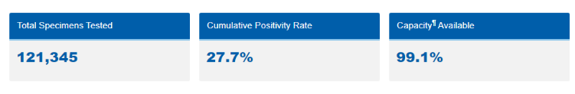
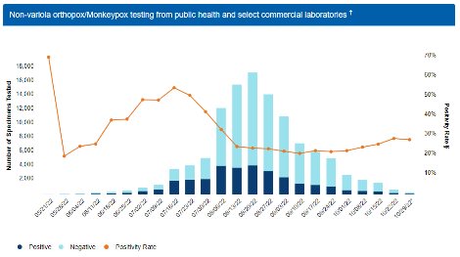
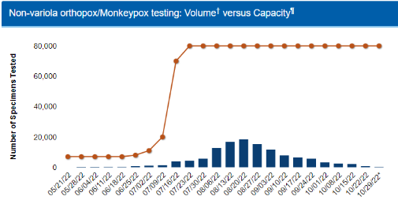

Testing
Data as of October 27, 2022

Slide 25
Recent Updates: Vaccine
Notes:
DEMETRE

Slide 26
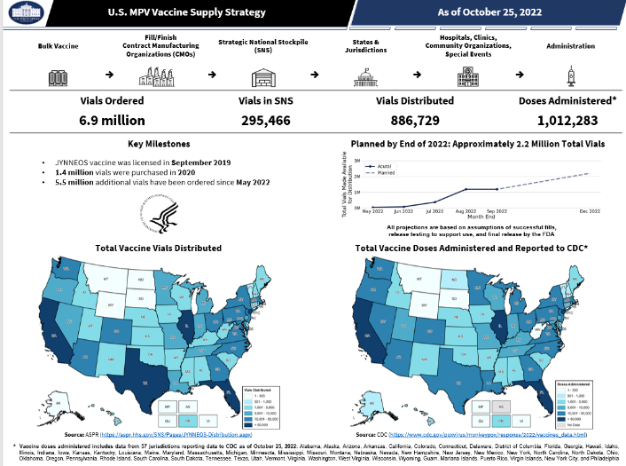

Slide 27
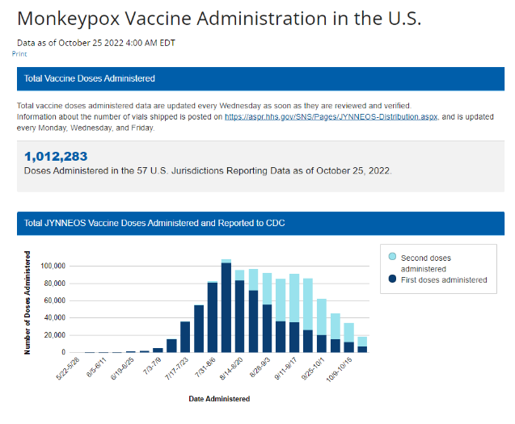

Slide 28
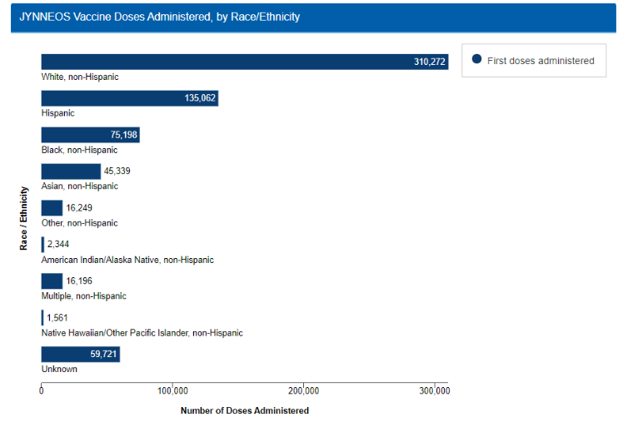
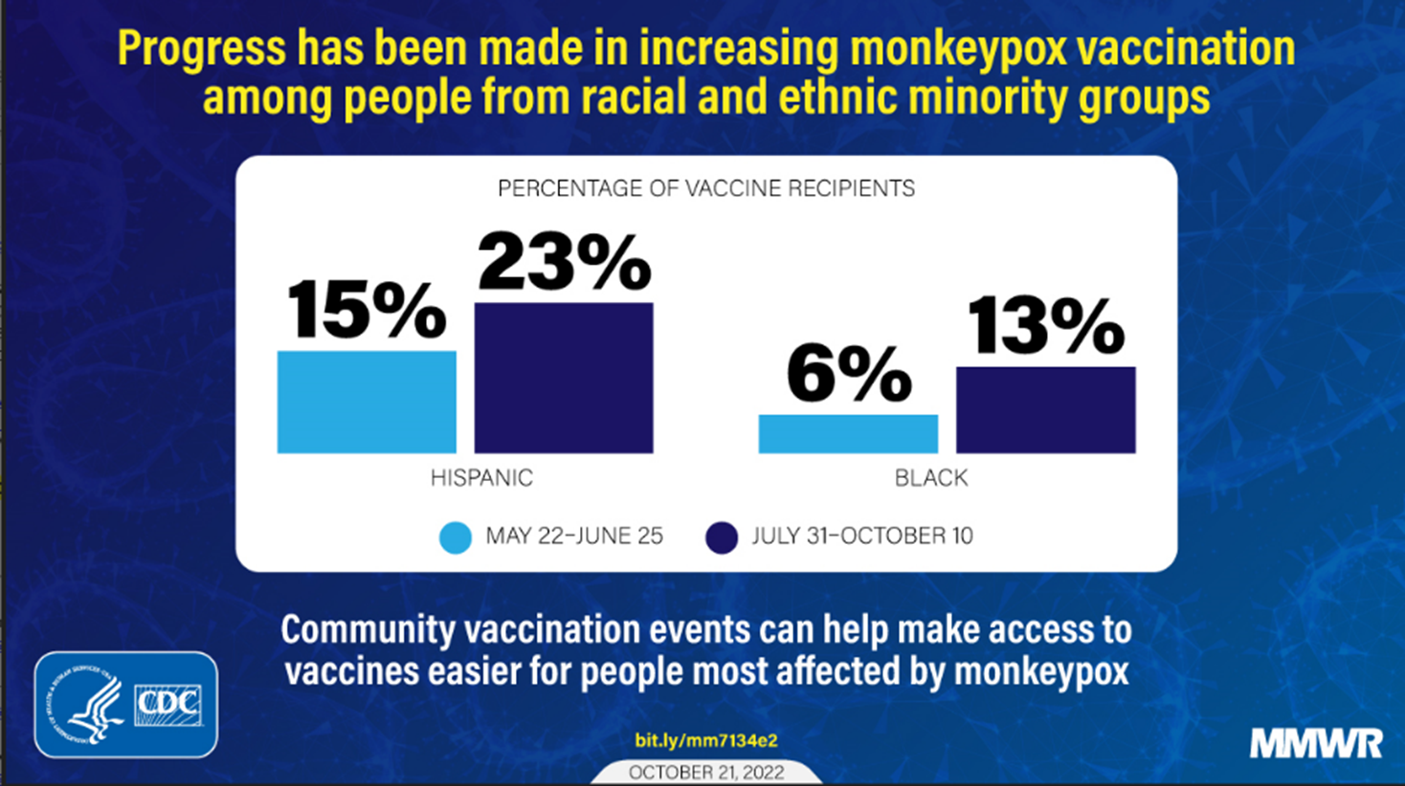
Reported through October 25, 2022

Slide 29
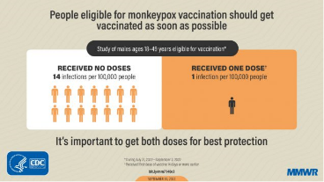

Rates of Monkeypox Cases* by Vaccination Status
July 31, 2022 – September 3, 2022
Posted on CDC Website on September 28, 2022
CDC 2022 Monkeypox Outbreak Cases & Data: https://www.cdc.gov/poxvirus/monkeypox/cases-data/mpx-vaccine-effectiveness.html
*A probable or confirmed case entered into DCIPHER. Confirmed (presence of Monkeypox virus DNA by polymerase chain reaction (PCR) testing or Next-Generation sequencing of a clinical specimen OR isolation of Monkeypox virus in culture from a clinical specimen) and probable (presence of orthopoxvirus DNA by PCR, or orthopoxvirus using immunohistochemical or electron microscopy or detectable levels of anti-orthopoxvirus IgM antibody) monkeypox cases.
† Vaccinated population determined based on cumulative number that received first dose of vaccine 2 weeks prior to week. Unvaccinated population determined based on population eligible for vaccination [estimated population per jurisdiction of men who have sex with men (MSM) who are living with HIV (as of 2020) or MSM who are eligible for HIV pre-exposure prophylaxis (as of 2021)] minus number vaccinated.
§MPX case ≥14 days after first dose: A probable or confirmed case entered into DCIPHER with positive orthopox test for monkeypox date, illness onset date, or specimen collection date (earliest available date) ≥14 days after receiving the first dose of JYNNEOS vaccine.
¶Unvaccinated MPX case: A probable or confirmed case entered into DCIPHER without documented receipt of vaccine or who received first dose of vaccine after illness onset.
Notes:
Summary
Among 32 U.S. jurisdictions, monkeypox incidence among people who are currently recommended to receive vaccine was higher among unvaccinated people compared with those who had received their first vaccine dose 14 days or more earlier.
Several factors likely affect crude case rates by vaccination status. Limitations include the inability to account for possible differences in testing or behaviors between vaccinated and unvaccinated people or possible differences in risk due to patient characteristics such as age or underlying condition status.

Slide 30
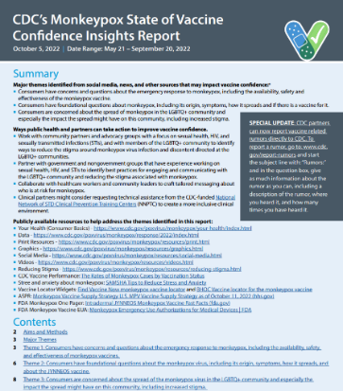
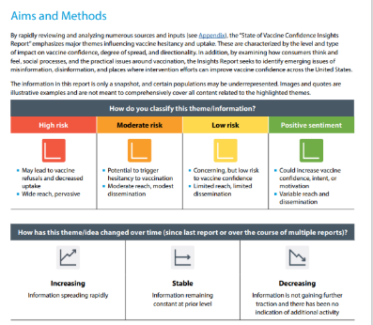

Slide 31
New Vaccine Eligibility Criteria-September 28, 2022
Monkeypox PrEP vaccination should be offered to people with the highest potential for exposure to monkeypox such as:
  Gay, bisexual, and other men who have sex with men, transgender or nonbinary people who in the past 6 months have had
    A new diagnosis of one or more nationally reportable sexually transmitted diseases (i.e., syphilis, gonorrhea, chlamydia, chancroid, or acute HIV)
    More than one sex partner
  People who have had any of the following in the past 6 months:
    Sex at a commercial sex venue
    Sex in association with a large public event in a geographic area where monkeypox transmission is occurring
  Sexual partners of people with the above risks, e.g., commercial sex workers
  People who anticipate experiencing the above risks

Slide 32
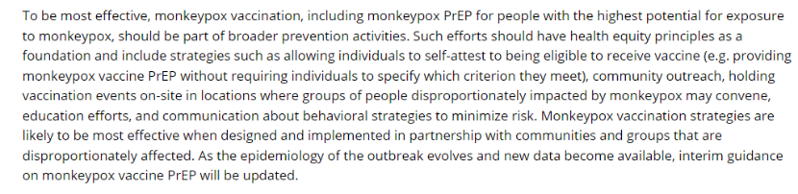
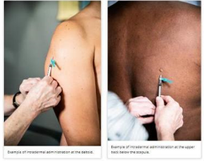
Stigma Mitigation and Vaccines

Slide 33
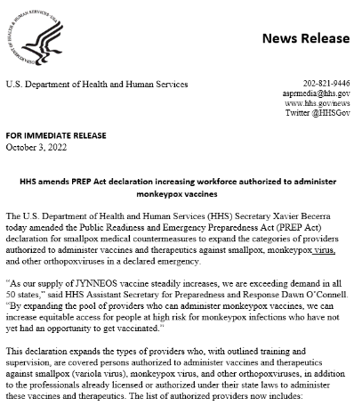

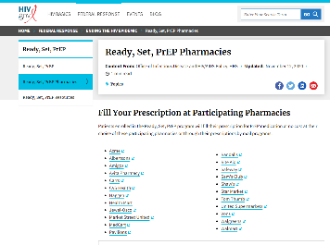

Slide 34
Recent Updates: Equity
Notes:
27-34 Leandro

Slide 35
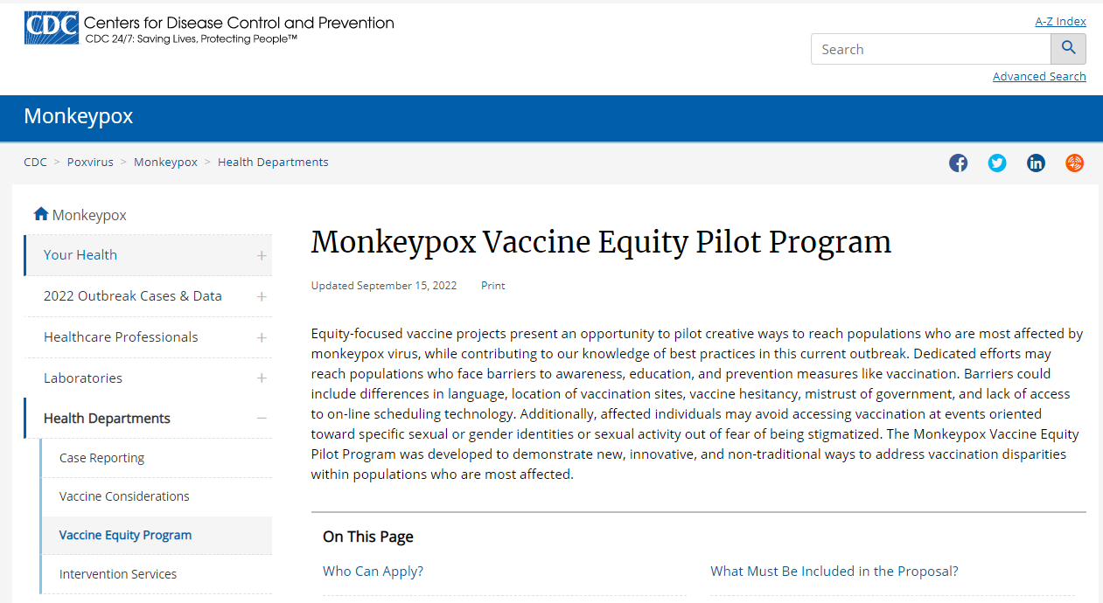
Notes:
On September 15, CDC launched a new equity pilot program to encourage even more innovation vaccine administration outreach.
This initiative will Focus is on addressing disparities in vaccination within most affected populations
Projects will support new, innovative, and non-traditional ways to close vaccine equity gap
USG allocating 10,000 vials of JYNNEOS vaccines for program
Applicants must submit proposals through state or territorial health departments, tribal governments or federally-funded tribal healthcare, or cities currently receiving monkeypox vaccines through the Strategic National Stockpile (SNS)

Slide 36





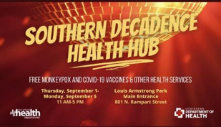

Notes:
On September 15, CDC launched a new equity pilot program to encourage even more innovation vaccine administration outreach.
This initiative will Focus is on addressing disparities in vaccination within most affected populations
Projects will support new, innovative, and non-traditional ways to close vaccine equity gap
USG allocating 10,000 vials of JYNNEOS vaccines for program
Applicants must submit proposals through state or territorial health departments, tribal governments or federally-funded tribal healthcare, or cities currently receiving monkeypox vaccines through the Strategic National Stockpile (SNS)
We are so excited to see the results of several equity Interventions that have been held in the last month.
We have been able to administer over 10,000 vaccines at Pride events.
We started with Charlotte Pride (not pictured) 8/20 – 8/21, and 2040 vaccines were administered with 540 at the pride event + 1500 in post events.
Then, over Labor Day weekend, we had Atlanta Black Pride 8/27 – 9/5 and Southern Decadence 9/1 – 9/5. In Atlanta, over 70% of the vaccines went to person of color, with a total of 4212 vaccines administered.
For Southern Decadence, over 3350 vaccines were administered leading up to, during, and after the event.

Slide 37
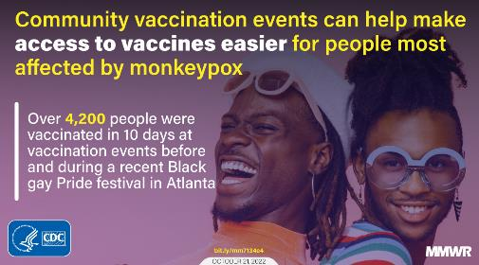
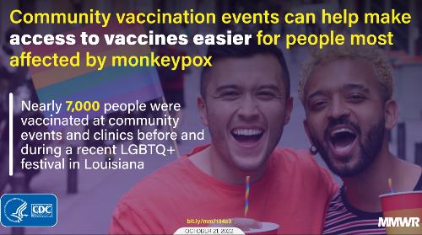

Slide 38
Recent Updates: Communications
Notes:
ADM LEVINE

Slide 39
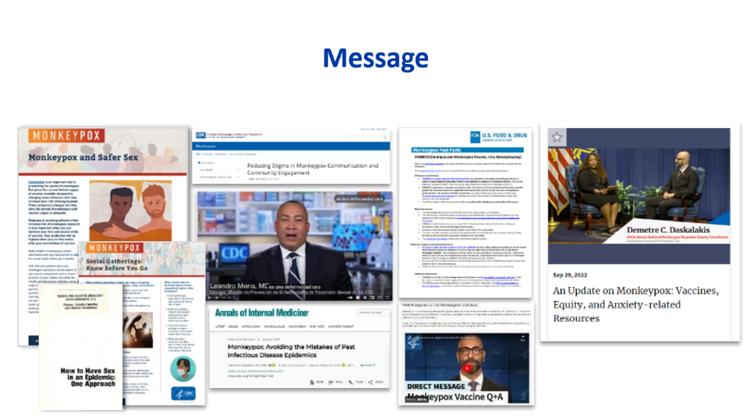

Slide 40
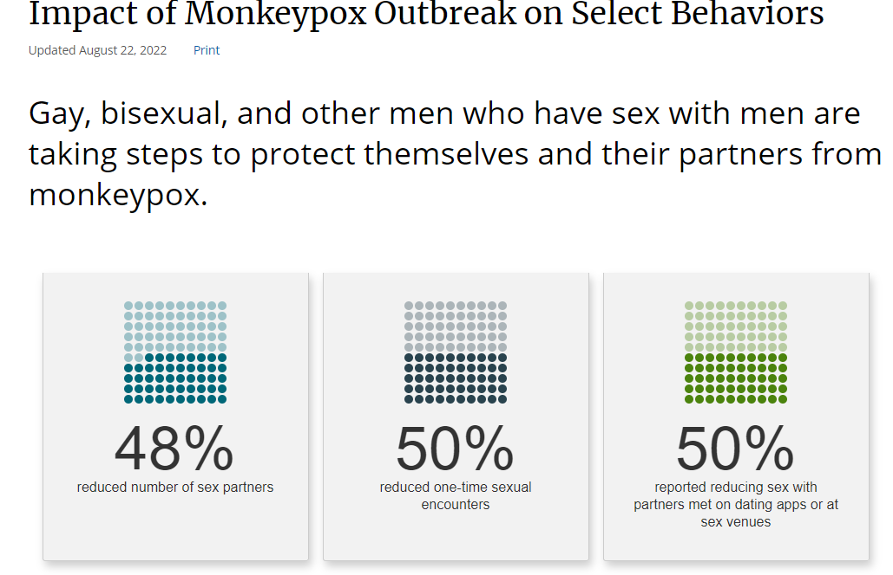
Notes:
We have increasing evidence that our communications are working.
This slide is from an MMWR released in August that shows significant behavior change among gay, bisexual and other men who have sex with en.
48% reduced the number of sex partners
50% reduced one-time sexual encounters
50% reported reducing sex with partners met on dating apps or at sex venues.
These data demonstrate the role of the community changing their behaviors.

Slide 41


Slide 42
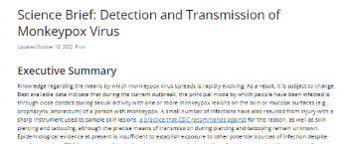
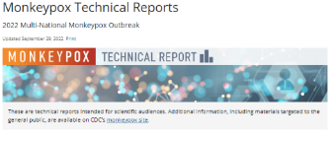

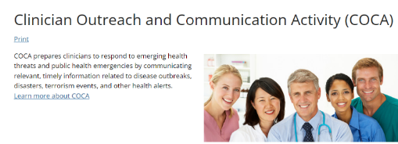
Provider and Public Health Education

Slide 43
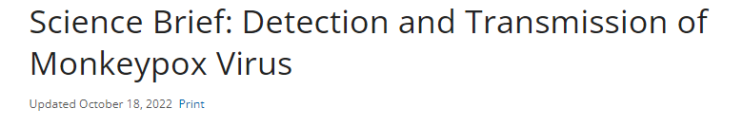

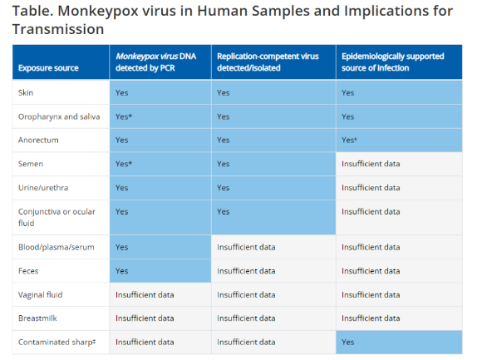

Slide 44
Recent Updates: Treatment
Notes:
35-42 Demetre

Slide 45
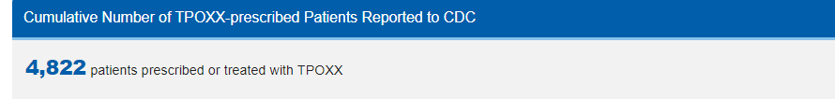
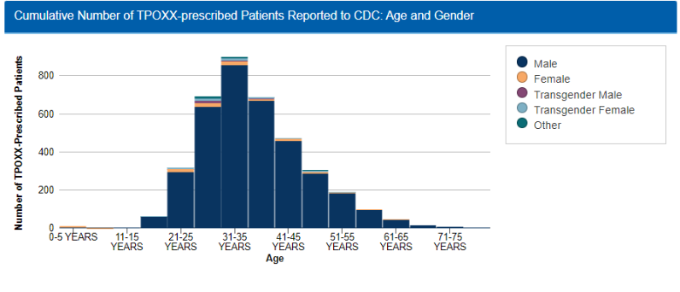
Reported through October 26, 2022

Slide 46
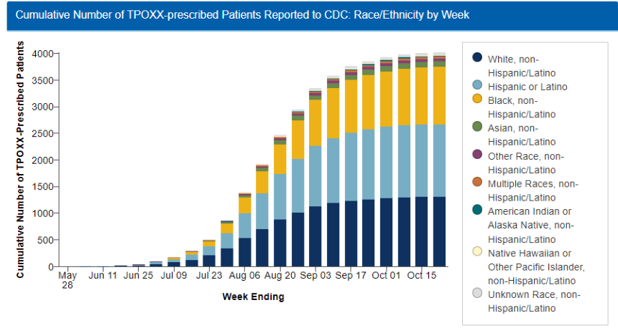
Reported through October 26, 2022

Slide 47
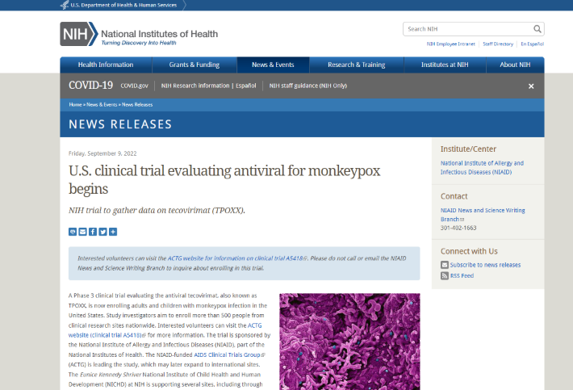
Notes:
NIH has also started the STOMP Study on Sept 9th. The study of Tecovirimat for treatment of human Monkeypox (STOMP) is a NIAID-funded clinical trial led by the AIDS Clinical Trials Group to evaluate the effectiveness of the antiviral tecovirimat, also known as TPOXX, for the treatment of human Monkeypox infection.
Adults and children of any age with Monkeypox are eligible to enroll in this trial.

Slide 48
Recent Updates: Research
Notes:
35-42 Demetre

Slide 49
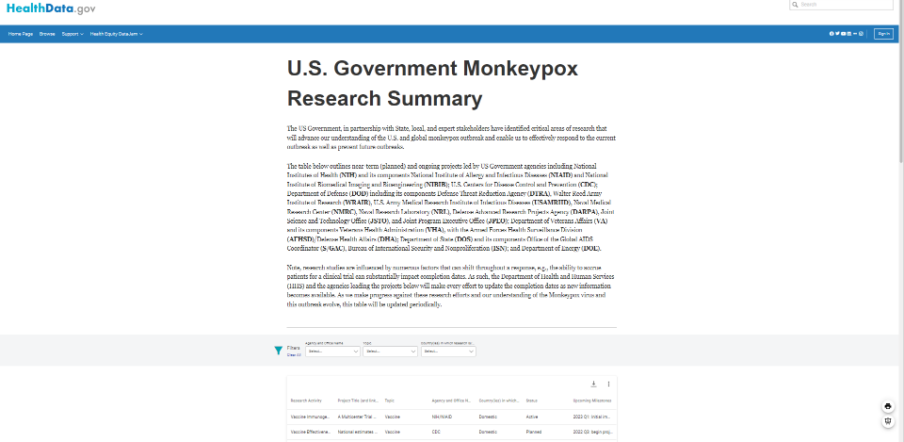
https://healthdata.gov/stories/s/U-S-Government-Monkeypox-Research-Summary/3w47-9e7a/

Slide 50


The 2022 Monkeypox (MPV) Outbreak: Community Health Center Response
Anthony Fortenberry, Chief Nursing Officer
Callen-Lorde Community Health Center

Slide 51

Monkeypox (MPV) Overview
MPV is a disease caused by infection with the monkeypox virus. MPV is part of the same family of viruses as variola virus, the virus that causes Smallpox.
Symptoms usually start in 3 to 17 days. They can last for two to four weeks.
In the recent outbreak, the rash or sores is often seen in the genital/groin area as well as in and around the anal area but can occur all over the body as well as on the palms of the hands and soles of feet.
Complications can include inflammation of the lining of the rectum (proctitis), or sores that could result in scarring of the eye, mouth, anus or urethra.
We do not know if monkeypox causes long-term health problems.
Although MPV can affect anyone regardless of sex, gender, or sexual orientation, recent clusters have disproportionately occurred in men who have sex with men.

Slide 52
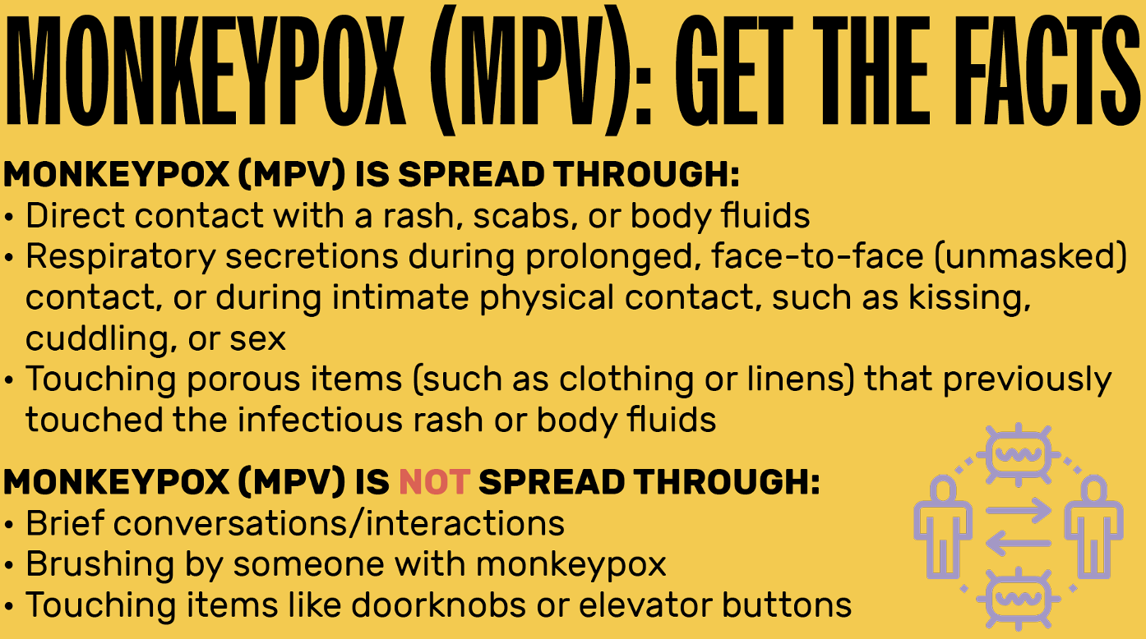
Patient Education: MPV transmission

Slide 53

Patient Education: MPV Stigma

Slide 54
MPV Occupational Safety
Personal Protective Equipment (PPE) should include²:
Gown
Gloves
Eye protection (i.e., goggles or a face shield that covers the front and sides of the face)
NIOSH-approved particulate respirator equipped with N95 filters or higher
Isolation
Isolation or quarantine should be maintained until all lesions have crusted, those crusts have separated, and a fresh layer of healthy skin has formed underneath
Environmental Infection Control
Standard cleaning and disinfection procedures should be performed using an EPA-registered hospital-grade viral disinfectant
Soiled laundry should be gently and promptly contained
Activities such as dry dusting, sweeping, or vacuuming should be avoided. Wet cleaning methods are preferred

Slide 55
MPV Morbidity & Mortality
Hospitalization Rate
  Race & Ethnicity
  HIV Status
Mortality
STI Coinfections

Slide 56

MPV Treatment – Tecovirimat (TPOXX)
Expanded Access IND Protocol: Use of Tecovirimat (TPOXX®) for Treatment of Human
Non-Variola Orthopoxvirus Infections in Adults and Children⁴

Slide 57
JYNNEOS Vaccine
JYNNEOS is a series of two injections administered 28 days apart.
Common side effects include tiredness, headache and muscle pain. There may also be redness, swelling, soreness and itchiness at the injection site. Generally, injection site side effects from an intradermal injections are exacerbated and last longer than those from a subcutaneous injection.
Intradermal injections can result in scarring or discoloration of the skin at the injection site. The risk for these reactions is higher for people with darker skin.
People should be asked prior to vaccination whether they have a history of keloid scars, and those who do should be offered subcutaneous administration.

Slide 58


Vaccine Equity
© 2022 Nationwide Children’s Hospital

Slide 59
Partnership & Resource Allocation
Health Resources and Services Administration
  HRSA Monkeypox Vaccine Distribution Initiative
Centers for Disease Control and Prevention
  Monkeypox Vaccine Equity Pilot Program
National Association of Community Health Centers
State Primary Care Associations
Local Departments of Health
Community Partners

Slide 60
REFERENCES
¹Centers for Disease Control and Prevention. (2022, September 21). U.S. Monkeypox case trends reported to CDC. https://www.cdc.gov/poxvirus/monkeypox/response/2022/mpx-trends.html
²Centers for Disease Control and Prevention. (2022, September 21). Infection prevention and control of Monkeypox in healthcare settings. https://www.cdc.gov/poxvirus/monkeypox/clinicians/infection-control-healthcare.html#anchor_1653508869481
³Centers for Disease Control and Prevention. (2022, September 21). Non-Variola Orthopoxvirus and Monkeypox virus laboratory testing data. https://www.cdc.gov/poxvirus/monkeypox/response/2022/2022-lab-test.html
⁴Centers for Disease Control and Prevention. (2022, September 21). Expanded Access IND Protocol: Use of Tecovirimat (TPOXX®) for treatment of human Non-Variola Orthopoxvirus infections in adults and children. https://www.cdc.gov/poxvirus/monkeypox/pdf/Tecovirimat-IND-Protocol-CDC-IRB.pdf
⁵New York City Department of Health. (2022, September 21). Monkeypox: vaccination. https://www1.nyc.gov/site/doh/health/health-topics/monkeypox-vaccination.page

Slide 61
Thank you
Anthony Fortenberry, MSN, RN, NEA-BC afortenberry@callen-lorde.org

Slide 62
Challenges (and Successes) in the Local MPV Response
Kevin L. Ard, MD, MPH
Medical Director, National LGBTQIA+ Health Education Center, The Fenway Institute
Director, Sexual Health Clinic, Massachusetts General Hospital
Assistant Professor of Medicine, Harvard Medical School

Slide 63

Our experience
First U.S. case identified at our parent institution on May 18, 2022
Our sexual health program began providing testing, treatment, and vaccination soon after:
  Testing/treating up to 4 people per day at the peak of the epidemic curve
  Vaccine demand high; clinic volume increased ~5-fold, with 5,356 vaccine doses given through 10/28/2022
www.mass.gov/doc/weekly-report-monkeypox-cases-and-people-vaccinated-october-27-2022/download

Slide 64
Our experience: Challenges we faced
Operational and logistical complexity
Space and staffing constraints
Preventing and addressing staff burnout
Minimizing impacts on other core services
Embracing and communicating rapid change
Minimizing stigma and its impacts

Slide 65
Our experience: Challenges we faced
Operational and logistical complexity
Space and staffing constraints
Preventing and addressing staff burnout
Minimizing impacts on other core services
Embracing and communicating rapid change
Minimizing stigma and its impacts

Slide 66

MPV response means adapting to rapid change.
What has changed since May 2022?
Clinical reasoning: Considering the diagnosis
Clinical processes and volume for patients with or suspected to have MPV
Testing: Authorization, performing laboratories
Treatment: IND processes, tecovirimat treatment considerations
Vaccination: Strategy, eligibility, route
https://aspr.hhs.gov/SNS/Pages/JYNNEOS-Distribution.aspx

Slide 67
Evolution of MPV vaccine efforts in Massachusetts
2-dose, subcutaneous
1st-dose prioritization, subcutaneous
2-dose, intradermal
2-dose, intradermal
PEP, PEP++
PEP, PEP++, PrEP

Slide 68

Our experience: Strategies for adapting to change
Engage key decision-makers early on and often
Maintain and update documents in a single, electronic location
Communication
  Prepare patients for change
  Convey recommendations with the appropriate level of confidence
  Stay up to date with shifting public health guidance
inc.com

Slide 69


Minimizing stigma and its impact
Types of Stigma
Provide information in a clear, fact-based, sex-positive manner.
Avoid processes that may publicly and unnecessarily “out” people seeking care.
Convey care and empathy for affected people.
Administer intradermal vaccines at alternative sites (upper back, deltoid) if requested by patients.
Create clinical environments that are welcoming and affirming.
doh.wa.gov/community-and-environment/health-equity/stigma, www.cdc.gov/poxvirus/monkeypox/pdf/MonkeyPox-SaferSex-InfoSheet-508.pdf

Slide 70

Summary
Health centers have played, and will continue to play, a key role in response to MPV.
Responding effectively to outbreaks like MPV requires embracing and adapting to change, communicating effectively, and addressing stigma.
Monkeypox virus
health.baltimorecity.gov/monkeypox

Slide 71


Ask the Experts Extended Panel
Mahyar Mofidi, DMD, PhD
Director, Division of Community HIV/AIDS Programs, HIV/AIDS Bureau
Chief Dental Officer, HIV/AIDS Bureau
Health Resources and Services Administration
Rachel Deitch
Director of Federal Policy
National Coalition of STD Directors

Slide 72
HRSA MPx Technical Assistance Resources
HRSA HAB Monkeypox Information: https://ryanwhite.hrsa.gov/resources/monkeypox
HRSA HAB Program Letters: https://ryanwhite.hrsa.gov/grants/program-letters
  August 17, 2022: Monkeypox Vaccine Distribution Initiative for RWHAP Part C Dually Funded Health Center Program Recipients
  August 8, 2022: Monkeypox Guidance for Ryan White HIV/AIDS Program Recipients
HRSA MPx Vaccine Distribution Initiative: https://www.hrsa.gov/monkeypox
MPx FAQs: https://www.hrsa.gov/monkeypox/faqs
Notes:
Susan

Slide 73
Ask the Experts

Slide 74
Policy Update
Mallika Yadwad
Program Associate, Federal and State Policy
NACHC

Slide 75

Payment and Reimbursement
PPS for vaccine-only visits and non-billable providers
Limited supplemental reimbursement
Presidential emergency declaration
In Congress
Public Health Emergency Outbreak Activation Act of 2022
  Increasing PPS rate during PHE
H.R. 9205 – Public Health Emergency Flexibility Act of 2022
  Unspent American Rescue Plan Act funds

Slide 77
FOLLOW US

