Slide 1

www.hivbluprint.org
Implementation Tools and Resources for Enhancing Equity-Focused PrEP Services
Sarit A. Golub
Hunter College, City University of New York
Einstein-Rockefeller-CUNY CFAR
Kathrine A. Meyers
Columbia University
Aaron Diamond AIDS Research Center
NACHC Learning Collaborative
Session #4: June 16, 2022
R01MH123262 (Golub/Meyers MPI)
Notes:
15 minutes

Slide 2

Goals for this Four-session Learning Collaborative
Introduce you to BLUPrInt.
Provide a “deep-dive” into strategies related to PrEP Awareness & Engagement, and help you identify at least one relevant SMART goal in this area.
Discuss progress and pitfalls related to these SMART goals, and share/workshop relevant strategies.
Offer models and tools for future program development and improvement.
Notes:
Get a sense of where your health center is “at” (and wants to be) in terms of your current PrEP program, and share some ways in which BLUPrInt tools or resources might support PrEP program development in your setting.
Provide in-depth information about specific BLUPrInt tools related to PrEP Awareness & Engagement, and help you articulate at least one short-term SMART goal that you will work on between session #2 and #3.
Discuss progress and pitfalls related to that SMART goal share strategies for overcoming common pitfalls and roadblocks, and the facilitators will review the ways in which additional BLUPrInt resources might be useful in these circumstances.
Focus on strategies for using both process and outcome metrics for PrEP program monitoring and improvement.

Slide 3
Six of the most used/useful resources from BLUPrInt
Patient Education Checklists
Provider Guide Comparison Table
Visit Flow and Staffing Models
Financial Navigation Training Manual
Excel Patient Tracker
Planning Roadmap Activities List
What it is
Where you can find it
How you might use it
www.hivbluprint.org

Slide 4
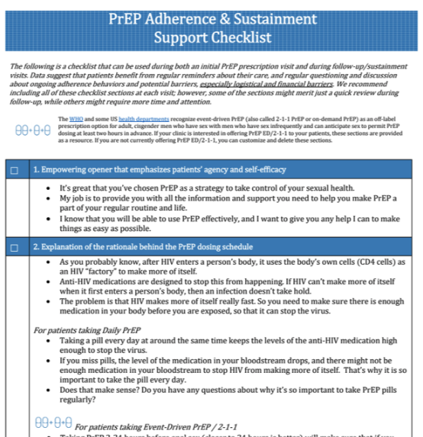
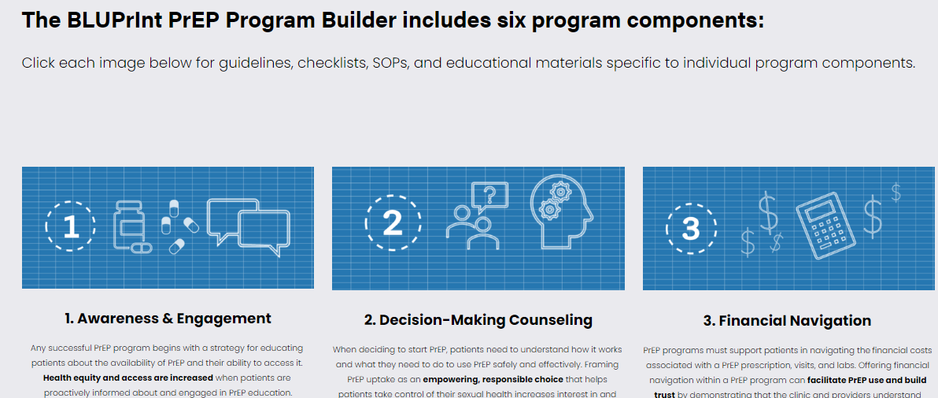
1. Patient Education Checklists
What are they?
  Customizable provider checklists to guide patient education about each PrEP program component.
Where can you find them?
  Program Builder Tab → Specific Program Component

Slide 5
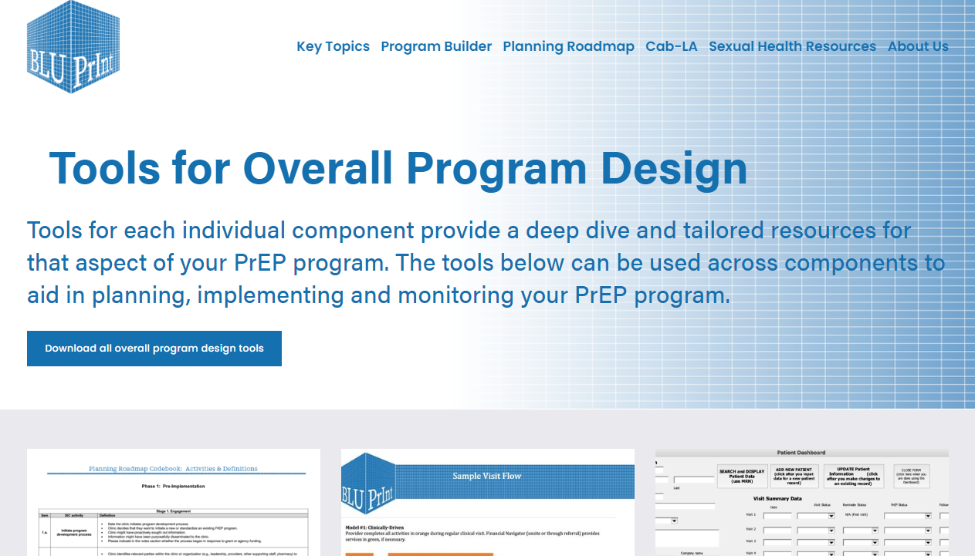
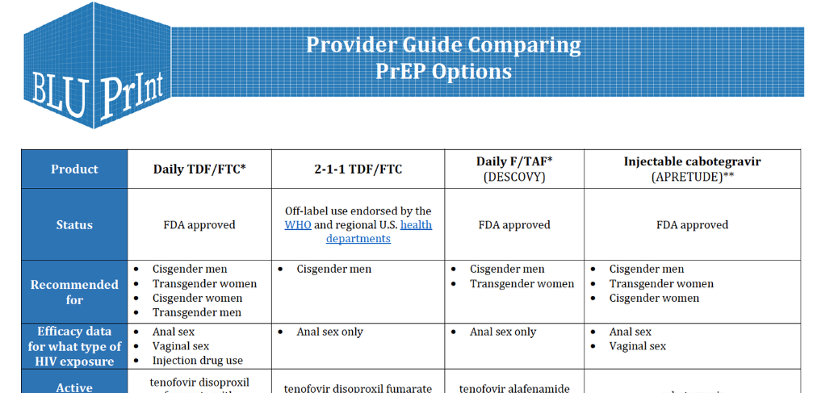
2. Provider Guide Comparison Table
What is it?
  Table comparing PrEP medication and dosing schedules by recommended patient population and type of potential HIV exposure
Where can you find it?
  Program Builder Tab → Tools for Overall Program Implementation

Slide 6
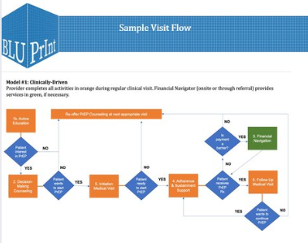
3. Visit Flow and Staffing Models
What is it?
  Editable PowerPoint file with figures and tables depicting sample visit flows and program components for two different PrEP program models.
Where can you find it?
  Program Builder Tab → Tools for Overall Program Implementation

Slide 7
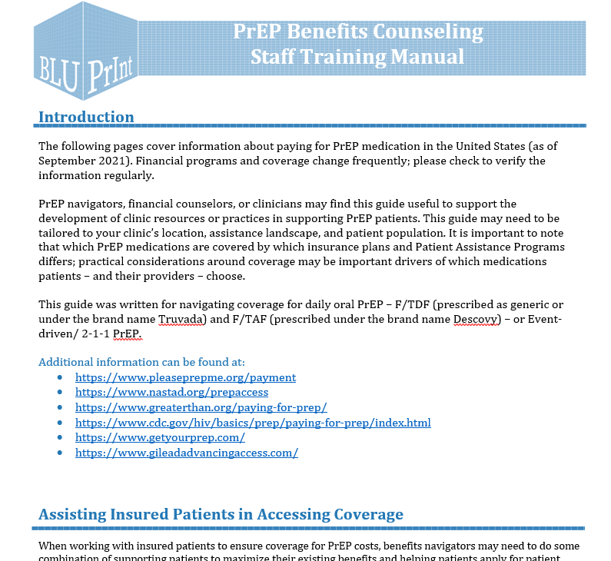
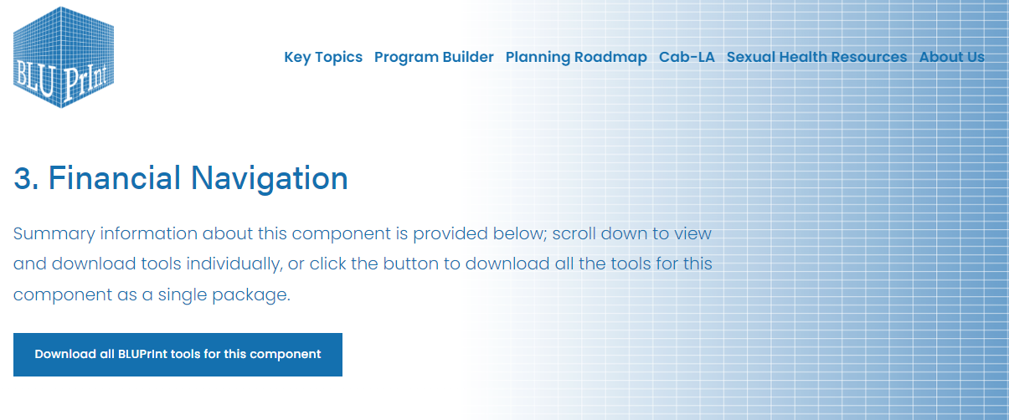
4. Financial Navigation Training Manual
What is it?
  Overview of information about paying for PrEP medication in the United States, including key definitions and links for state-specific information.
Where can you find it?
  Program Builder Tab → Financial Navigation

Slide 8
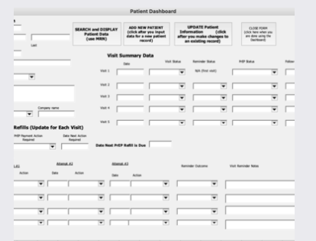
5. Excel Patient Tracker
What is it?
  Excel data entry form and database that can be used to track PrEP patients
Where can you find it?
  Program Builder Tab → Tools for Overall Program Implementation

Slide 9
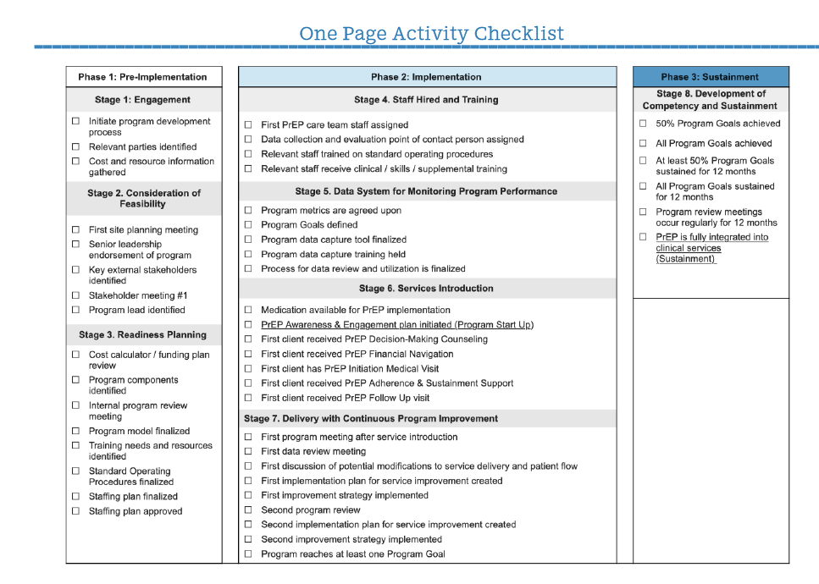
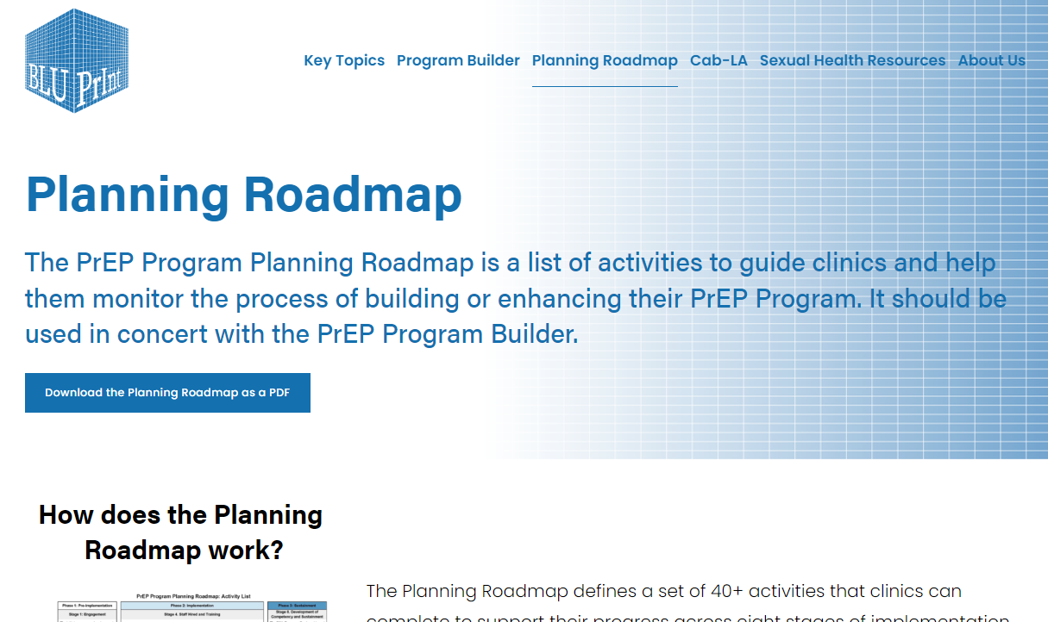
6. Planning Roadmap Activities List
What is it?
  List of activities to guide clinics in the process of building or enhancing their PrEP program
Where can you find it?
  Planning Roadmap Tab → Roadmap Page 5

Slide 10
Ready to learn more?
Go to hivbluprint.org and look around!
When prompted, please register so that we can to add your email to our mailing list.
Give us feedback! Tell us what you like, what’s missing and how we can make these resources more useful for your practice. bluprint@hunter.cuny.edu
www.hivbluprint.org

Slide 11




Thank you!
Sarit A. Golub, PhD, MPH
Hunter Alliance for Research & Translation (HART)
sgolub@hunter.cuny.edu
212.396.6304
www.cunyhart.org
Kathrine A. Meyers, DrPH, MPP, MS
Aaron Diamond AIDS Research Center (ADARC)
Columbia University
kam2157@cumc.Columbia.edu
212.304.6110

