Slide 1
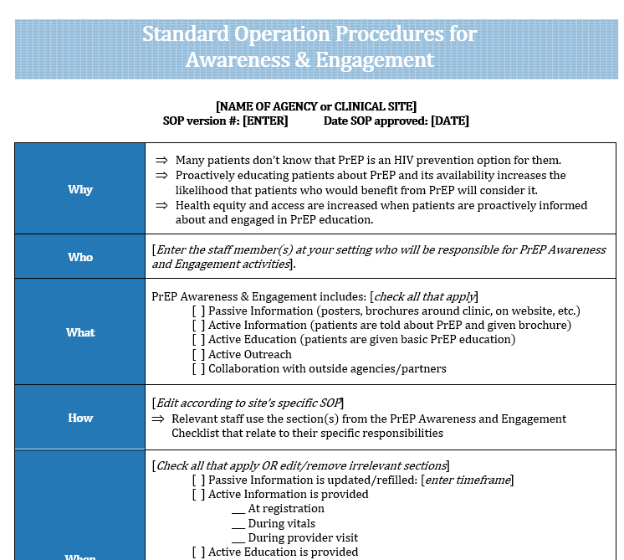

Goals for this Four-session Learning Collaborative
Session #1: Introduce you to BLUPrInt.
Session #2: Share and discuss strategies related to PrEP Awareness & Engagement, and help you identify at least one relevant SMART goal in this area.
Adapt and Specify SOP Template →

Slide 2
Goals for this Four-session Learning Collaborative
Session #1: Introduce you to BLUPrInt.
Session #2: Share and discuss strategies related to PrEP Awareness & Engagement, and help you identify at least one relevant SMART goal in this area.
Session #3: Discuss “progress and pitfalls” related to this SMART goal, and share/workshop relevant strategies.

Slide 3
Progress/Pitfall Discussion
What about working with the SOP was helpful?
What about working with the SOP was challenging?
Did the process of working with the SOP help you with your PrEP program development?
Did it raise questions that you’d like to share or get feedback on?
Did you use other BP resources or identify some that are missing?

Slide 4
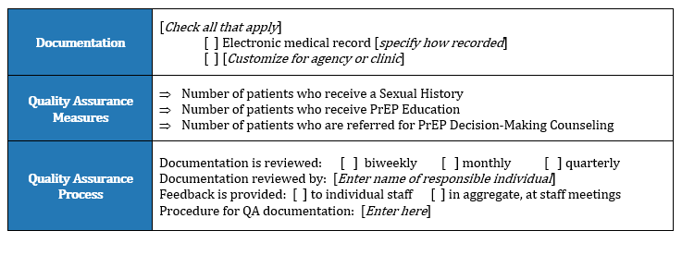
Progress/Pitfalls Discussion
How is (or should) PrEP Awareness activities be documented?
How can PrEP awareness data be used to focus efforts, especially around equity?

Slide 5
PrEP Cascade at Sample Clinic
Seen in Clinic
HIV Tested
Educated about PrEP
Accepted PrEP Rx

Slide 6
HIV Tested
Educated about PrEP
Accepted PrEP Rx

Slide 7
Cascade by Race/Ethnicity – Identifying Gaps
HIV Tested
Educated about PrEP
Accepted PrEP Rx

Slide 8
2. Cascade by Gender at Sample Clinic – Clinic-based Equity

Slide 9
2. Cascade by Gender at Sample Clinic – Incidence-Focused Equity

Slide 10
3. Service Provision by Gender at Sample Clinic

Slide 11
Questions for Discussion
What methods do you currently use to document PrEP Awareness and Education?
What methods do you currently use to review/monitor PrEP Awareness and Education?
What are the benefits and challenges of this monitoring?

