Slide 1
HEALTHY INFLUENCE: Collaborating with social media influencers on health-related campaigns
Thursday, July 14, 2022

Slide 3
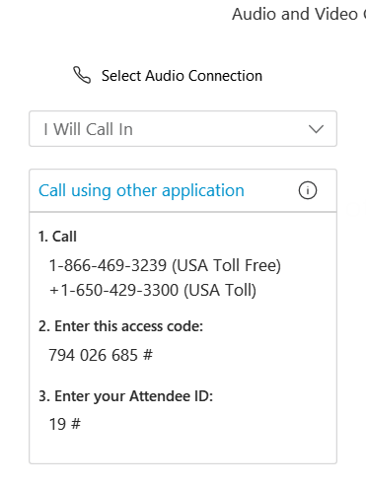
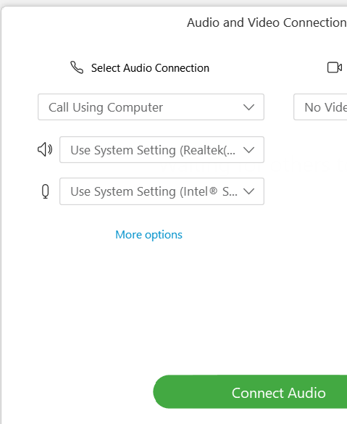


Ensure you’ve connected to audio!
Option 1: “I Will Call In”
Follow the unique 3-step process on your screen
Option 2: “Call Using Computer ”
You must have computer speakers and microphone
After connecting, if you don’t see a phone/headset icon next to your name, please attempt to connect your audio again!

Slide 4
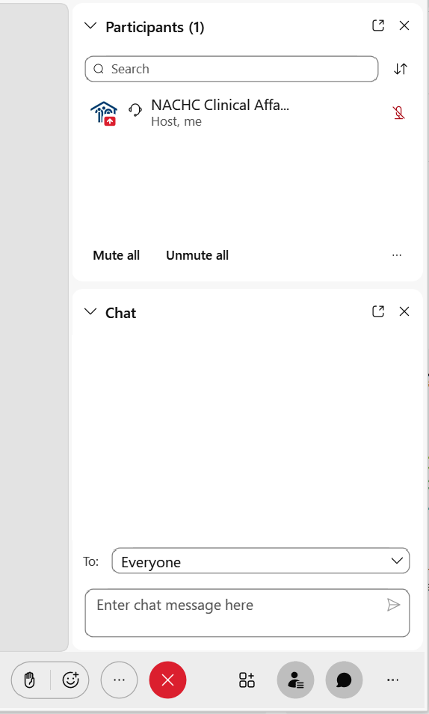
ASKING QUESTIONS VIA CHAT BOX
The chat feature is available to ask questions or make comments anytime.
Click the chat button at the bottom of the WebEx window to open the chat box on the bottom righthand side of the window.
Choose “EVERYONE”, as appropriate.
- Type your question.
- Click “Enter” to send your question.

Slide 5

Friendly Reminders
Today’s Event is being RECORDED
All attendee lines have been MUTED
The CHATBOX is open for the duration of this event
Questions from the CHAT BOX will be answered after the presentation is completed.

Slide 6
National Association of Community Health Centers ⎪ Geben Communication
NACHC COVID-19 and Kids Influencer Pilot Campaign Briefing
July 2022
Notes:
NACHNACHC COVID-19 and Kids Influencer Pilot CampaignC COVID-19 and Kids Influencer Pilot Campaign Briefing
July 2022

Slide 7
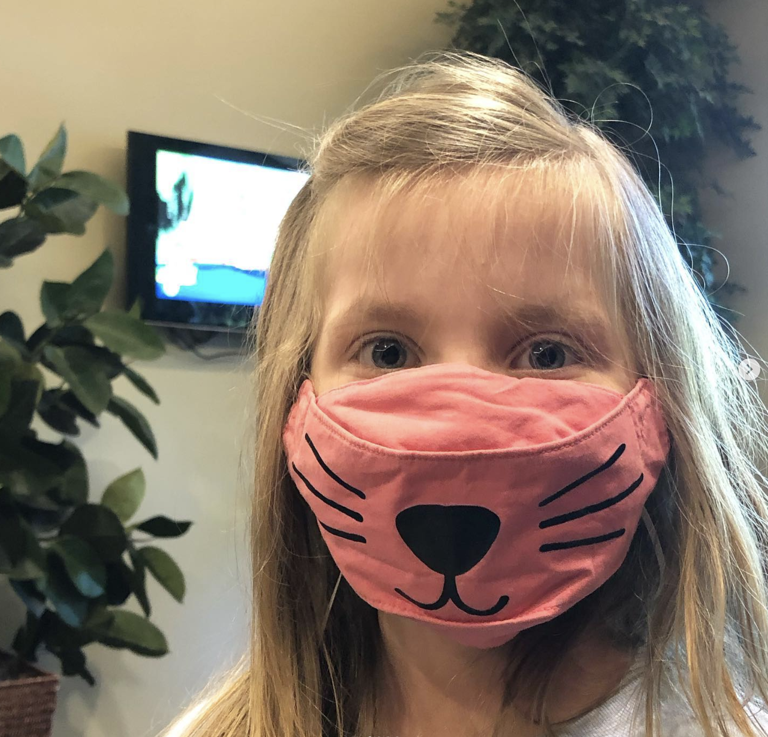
campaign overview
From April 25 – May 13, a team of influencers created original content on social media (Instagram, Facebook, and Twitter primarily) to:
Educate their respective audiences about their local health center and its services, with a focus on COVID vaccination;
Encourage their followers to get vaccinated or boosted and/or vaccinate/boost their children; and
Combat false and harmful mis- and disinformation about the vaccine with factual, science-based information.
Photo credit: @jaimemckee

Slide 8
the campaign process
Prepare
Determine campaign goals, messaging, target audience, measurements of success
05
Analyze, report, identify learnings
01
04
Monitor
Manage campaign outputs
Identify influencers
Research, craft the “ask”, outreach to influencers
02
03
Onboard influencers
Contract, create toolkit, convene briefing (optional)

Slide 9
working with influencers

Slide 10
“As a mom, I want to do everything in my power to keep my children safe and healthy. We all need to be aware that there is a lot of misinformation shared on social media and the internet about COVID-19 and the vaccine.”
@the_zamp_camp

Slide 11
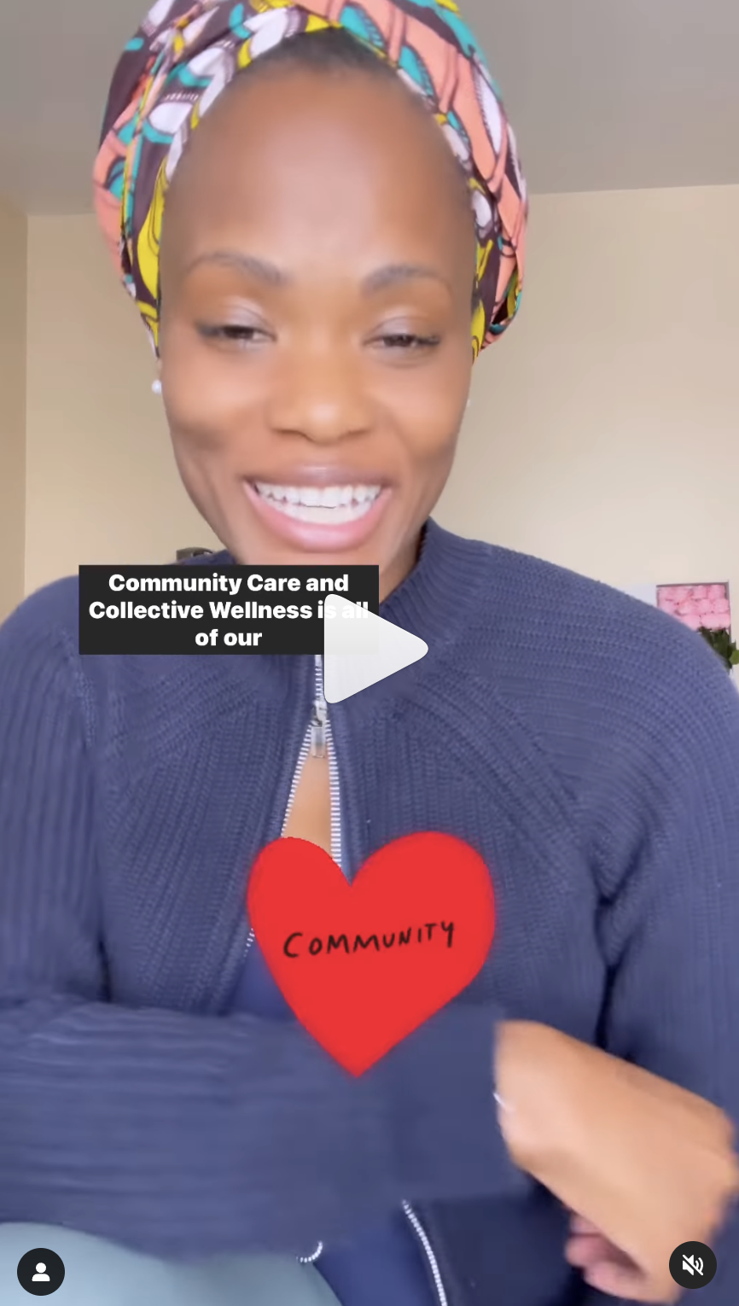
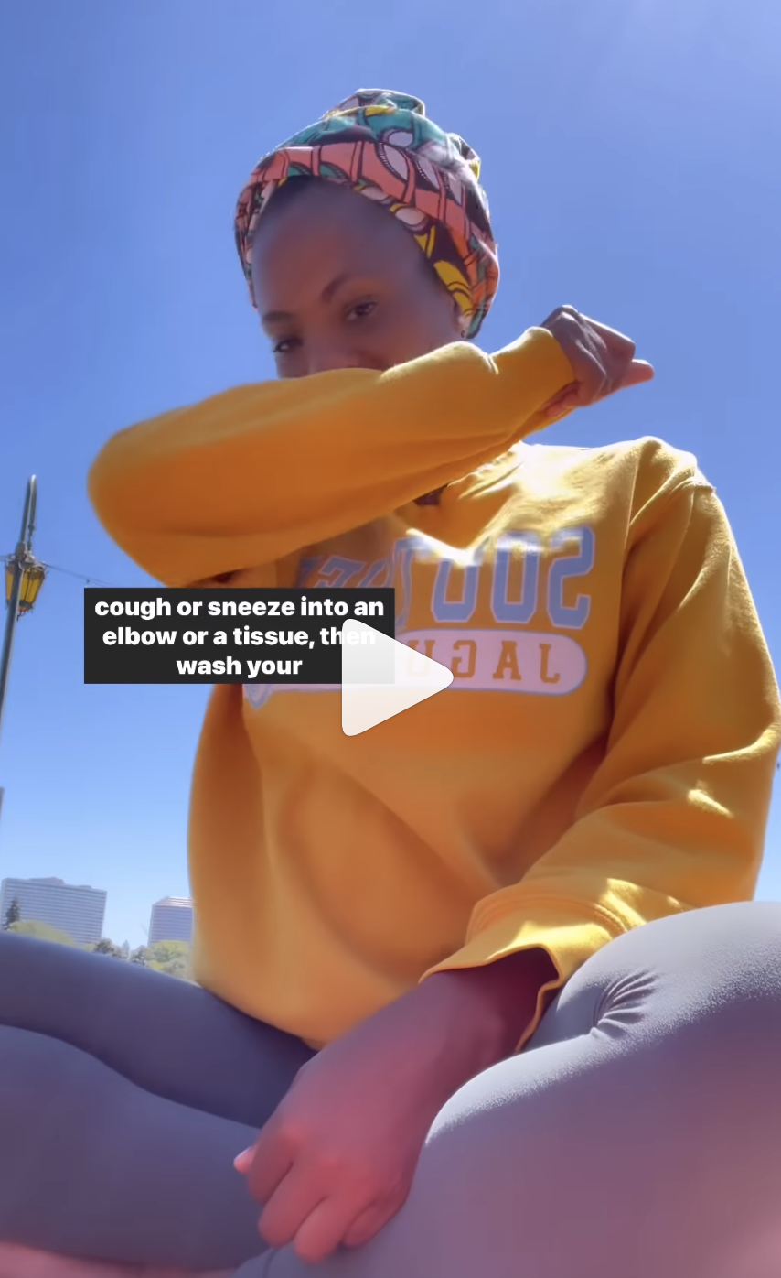
what is an influencer?
Social media influencers use their social media platforms to share insights, perspectives, and information. They have developed a reputation for expertise, advice, and/or compelling content.
In a public health campaign, they can enhance a health center’s communication outreach by bringing a personal story to the public health message.
When influencers collaborate with credible third-party organizations and people, they become part of the choir that supports and promotes your health center’s messages and help drive engagement and awareness.

Slide 12
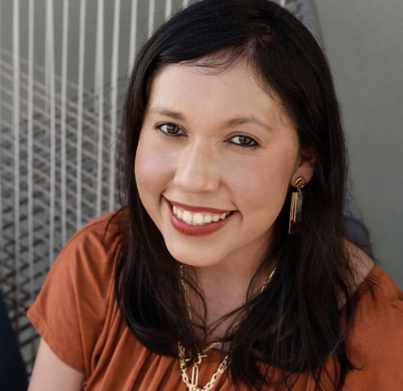
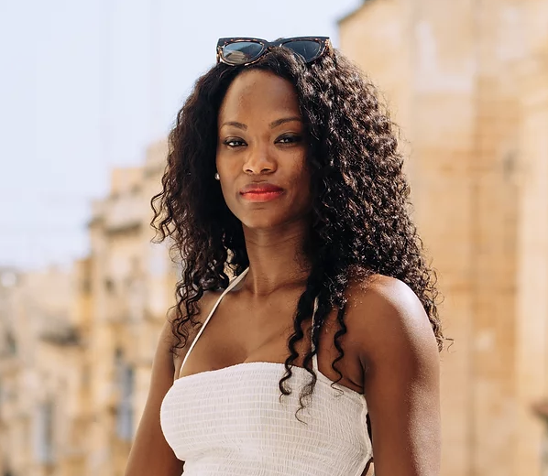
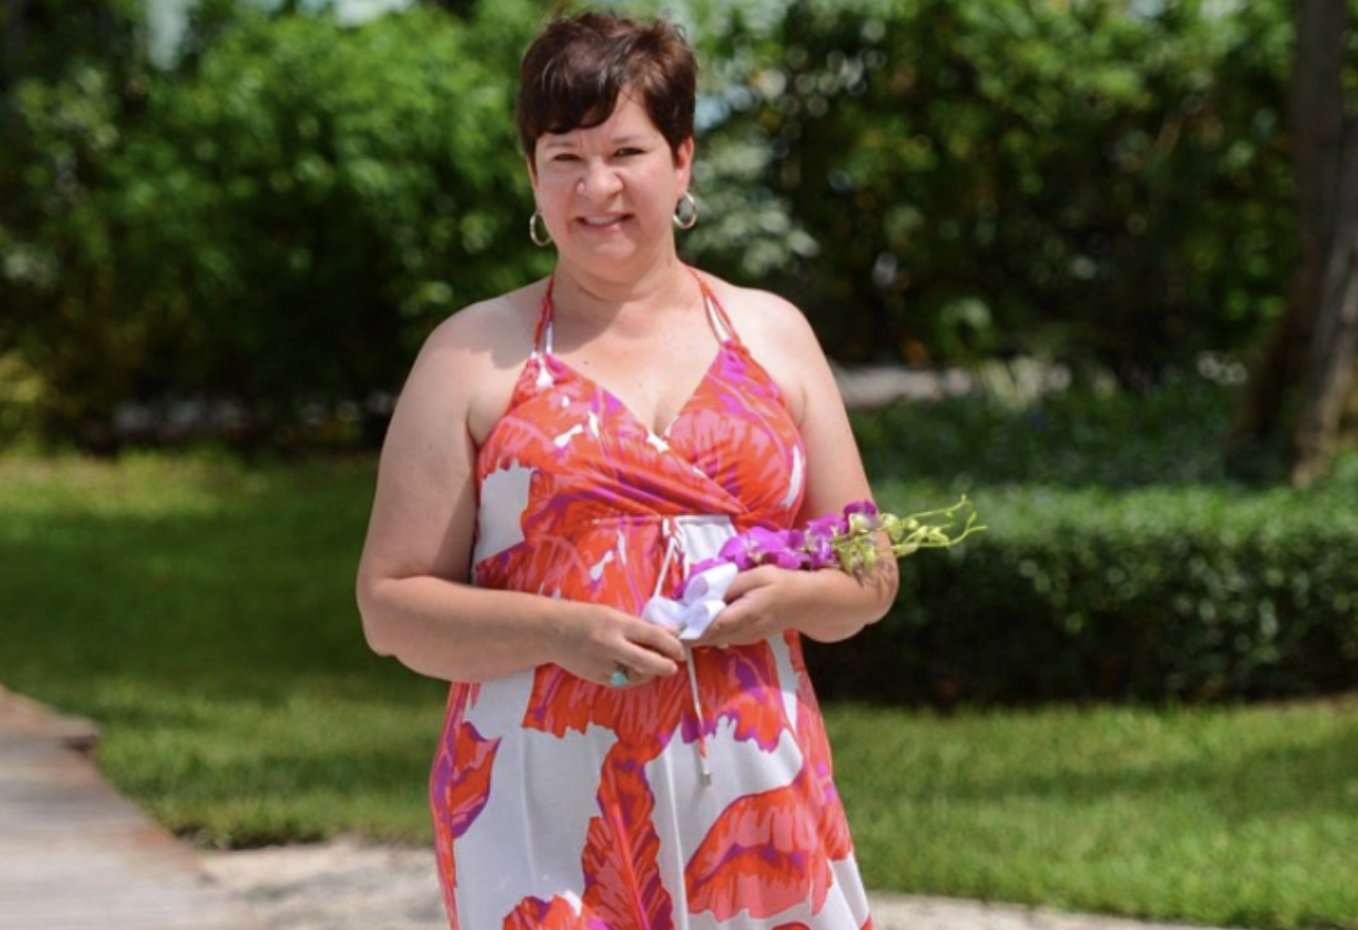


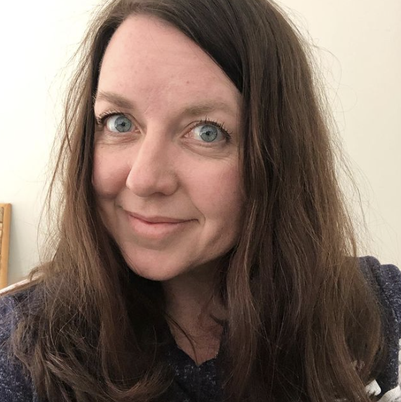
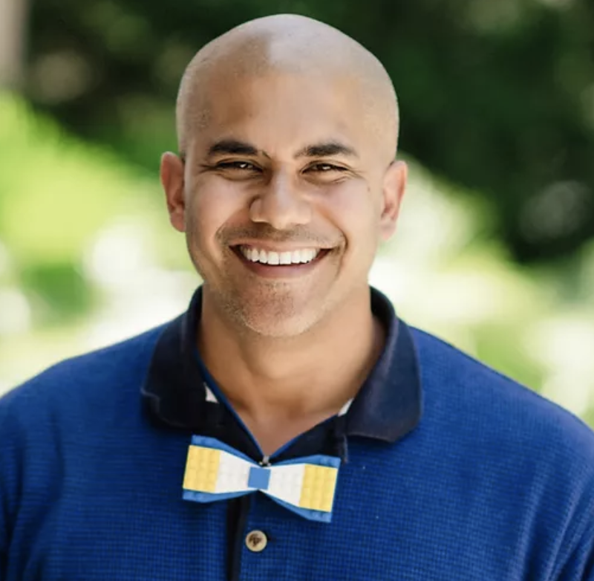
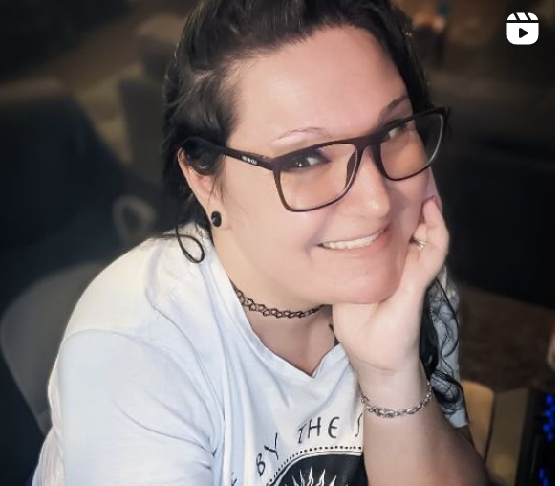
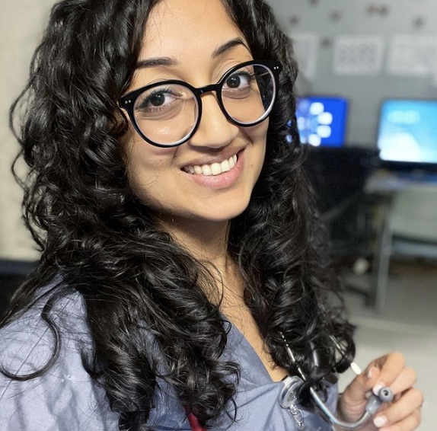

campaign influencer snapshot
A diverse cohort of 10 influencers in 3 states across the U.S. were hand-selected to participate in this campaign.
Valeria Farfan
@inthevalleyofthesun
Arizona
Tyrece Munson
@walkwithree
California
Lynda Thorne
@mommypowers
California
Whitney Moss and Heather Flett
@510families
California
Candy Po
@candypolooza
Arizona
Jaime McKee
@jaimemckee
North Carolina
Jeff Harry
@jeffharryplays
California
Jamie Zamp
@the_zamp_camp
North Carolina
Zeel Shah, MD
@zeelshahmd
North Carolina
Iféoluwa Anani
@stylecommodity
North Carolina

Slide 13
“My mom survived Polio and Tetanus before the vaccines were available. So we are so thankful for vaccines. She had tears the day she got her Covid vaccine and was so thrilled when my husband and I could get ours.”
@allheartnc
Comment on @jaimemckees’ campaign post

Slide 14
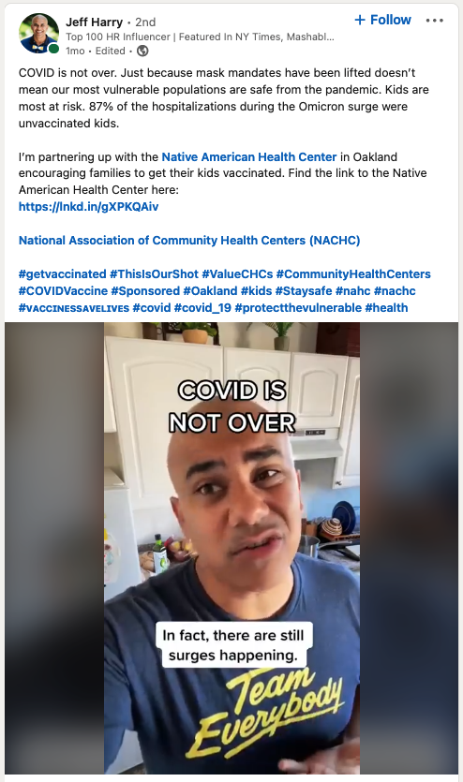
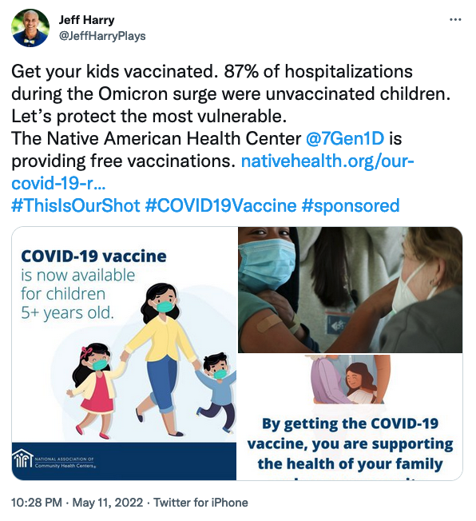
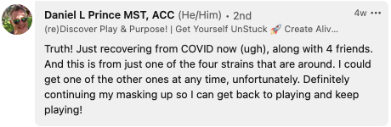
meet Jeff Harry

Slide 15
“👏👏👏👏👏👏👏 !!! Probs one of the most valuable content pieces you've done!!!”
@freenfunindasun
Comment on @jeffharryplays’ campaign post

Slide 16
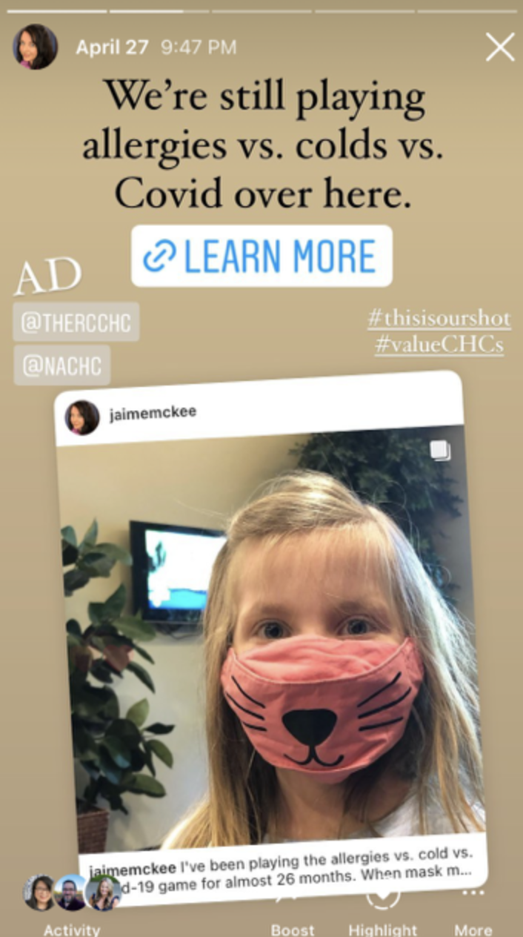
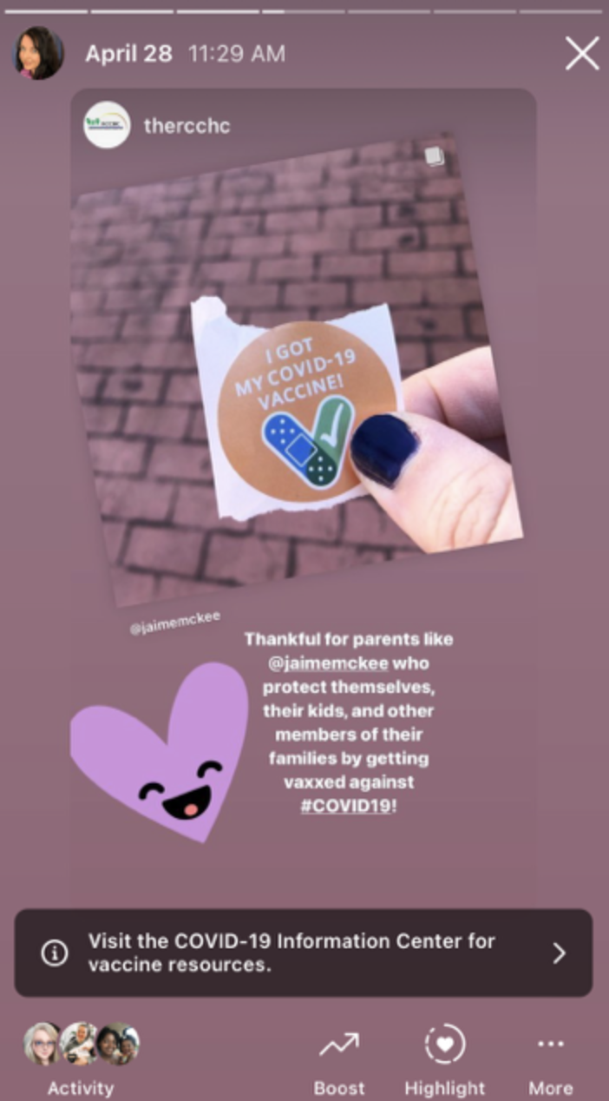
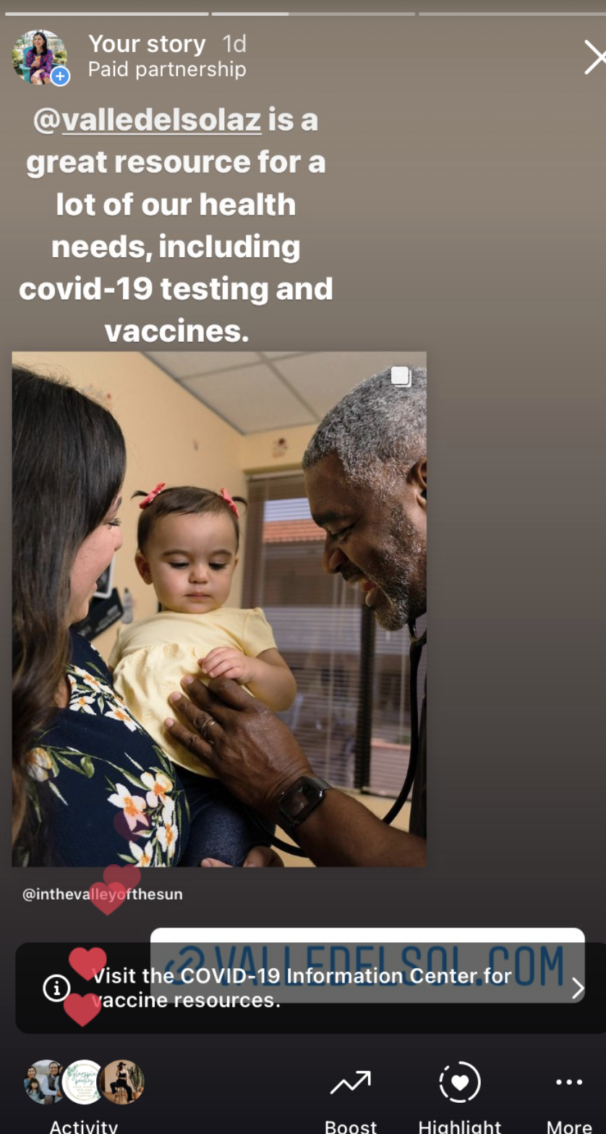
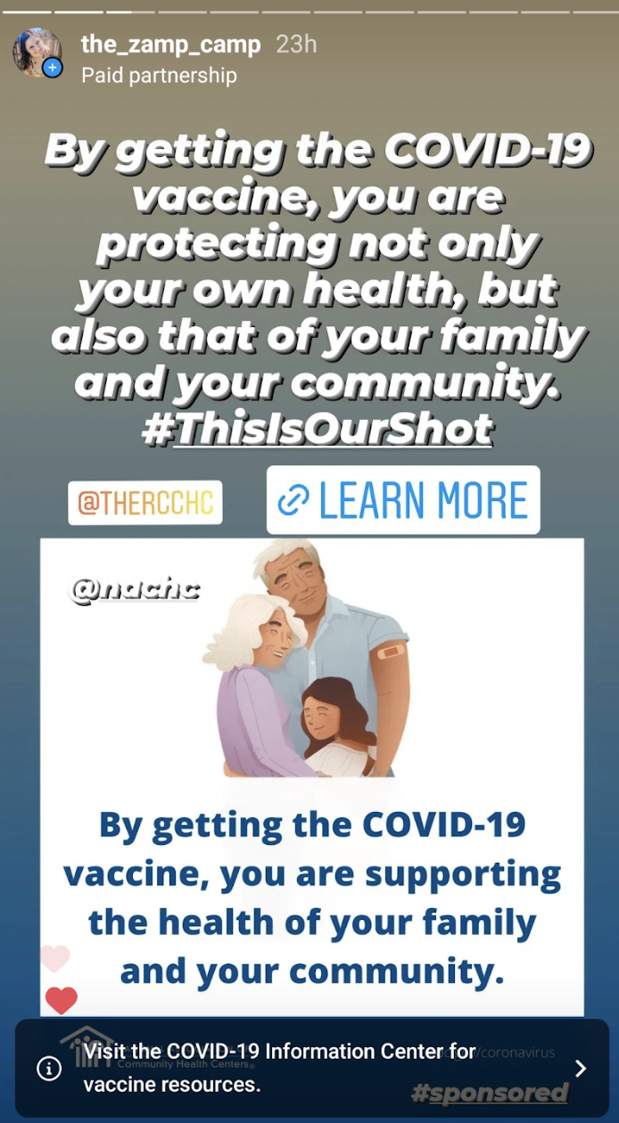
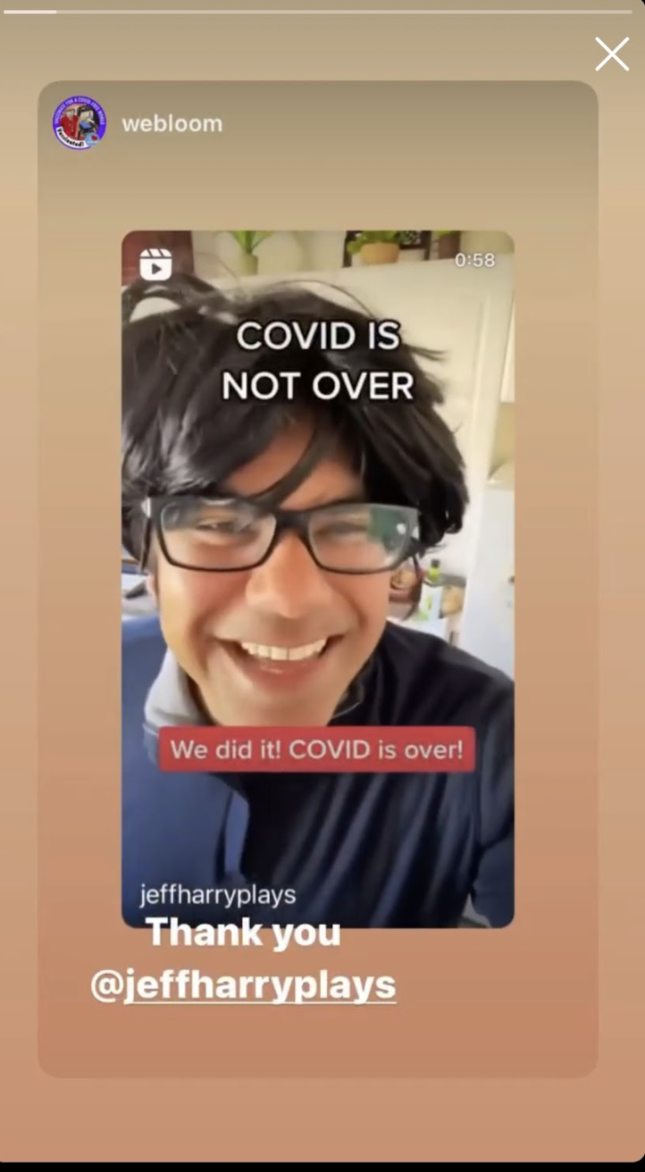
stories spotlight
The graphics were used by almost every influencer.
Engaging content will inspire audience members to share, regardless of of the topic.
It made a difference when the health center shared and the influencer reshared.

Slide 17
influencer feedback
We asked participants to share their feedback on the pilot and here’s what they had to say:
Simple instructions. This was great! It was very easy to follow the instructions along the way. -Jamie Zamp, @the_zamp_camp
Graphics were helpful. I had a couple of DMs about the allergies vs. flu vs. Covid graphic I shared in my stories that it was a really cool/helpful graphic. As someone who has been crazy about data for the past 2 years, I found that to be extra helpful as well! -JaimeMcKee, @JaimeMcKee
Naysayers will comment. The anti-vaxxers were out in full force on my FB post. They left numerous negative/rude comments, which I deleted/hid on my post. -Lynda Thorn, @MommyPowers
Happy to help. The campaign was well thought out and I am happy to have been able to encourage my audience to get vaccinated. -Ifeoluwa Anani, @StyleCommodity
Think through landing pages. A dedicated landing page highlighting relevant resources on health center websites would be helpful for future campaigns. -Whitney Moss, @510Families

Slide 18
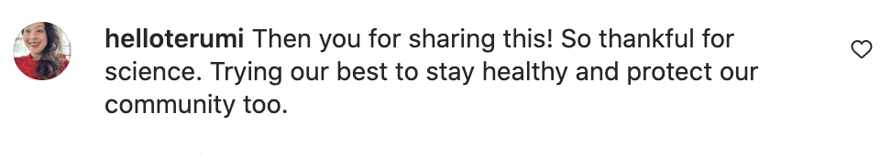
insights + takeaways
Working with NACHC and health center leadership to understand their goals and defining features of the surrounding communities before enlisting influencers allowed us to select the most thoughtfully aligned partners for the topic.
The campaign resulted in over a 4% average engagement rate, well above the non-profit industry standard.
The timing of this campaign came at a unique inflection point in the pandemic, which offered pluses and minuses.
When they feel supported, influencers committed to a cause are willing to offer their platforms to share vetted information – even when there is a potential social risk.

Slide 19
looking ahead: recommendations for CHCs
Based on the initial pilot results, we believe that CHCs can and should continue to test and refine influencer collaborations. Given limited resources, there are several considerations for CHCs to keep in mind in order to make the most of future collaborations:
Start small, but with an eye towards the long term.
Determine a measurable call-to-action.
Foster relationships.
Iterate, co-create, and analyze.
Use small, targeted ad spends.

Slide 20
questions?

Slide 21
THANK YOU!

Slide 22
FOLLOW US

Slide 23


Slide 24

THANK YOU TO ALL COMMUNITY HEALTH CENTERS
#ThankYouCHCs

