Slide 1

Hi from your IT Clinical Champion!
I am here to help improve provider’s workflow!
My goal is to start initiatives to decrease the number of clicks while charting or prescribing
Improving clicks will improve workflow and also improve the time management in the office!
If you have ideas about something that is slowing your workflow, please send me an email. I will do my best to address these issues with Denise and eCW
Expect to receive a tip of the week with updates or shortcuts!
Dr. S

Slide 2

YOUR IT tips of the week!
Creating Templates out of the note you have already done for your patient
If you do a note, that you will use in the future you can save it right there and then!
This is super helpful if for example if you always order the same labs or if you always send the same medications for this .

Slide 3
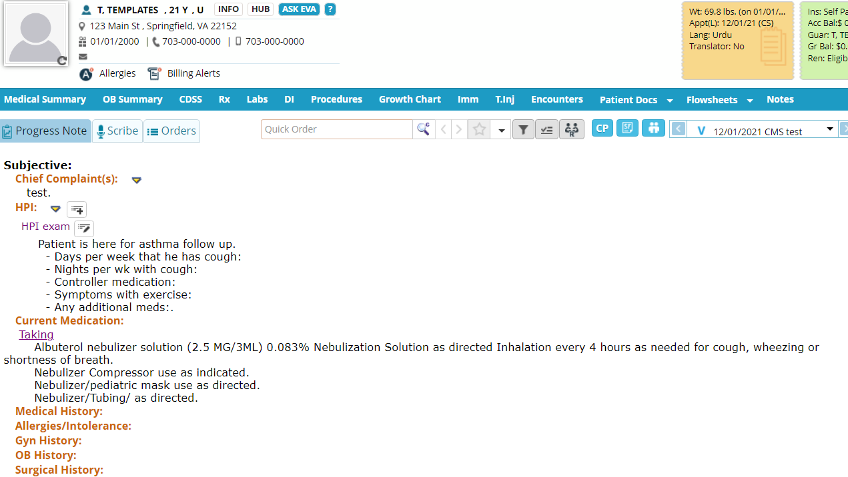
Fill out how you want it.
OR IF you are filling it for your current patient you can just edit this afterwards.

Slide 4
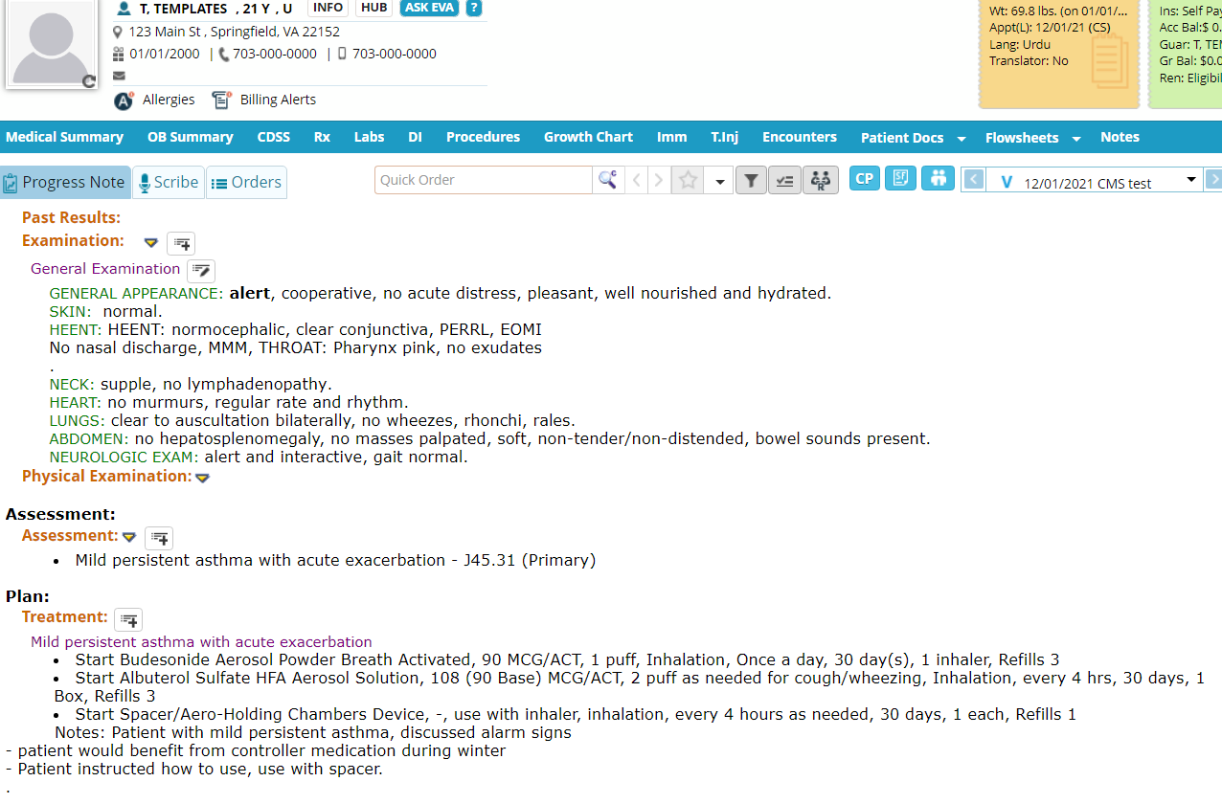
Add your:
EXAM
ASSESSMENT
MEDICATIONS and TREATMENT

Slide 5
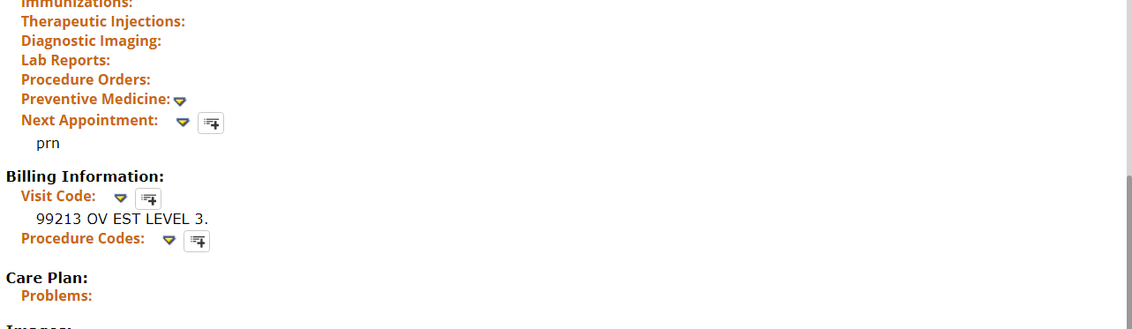
Make sure you add your billing too if you want it to pop-up!

Slide 6
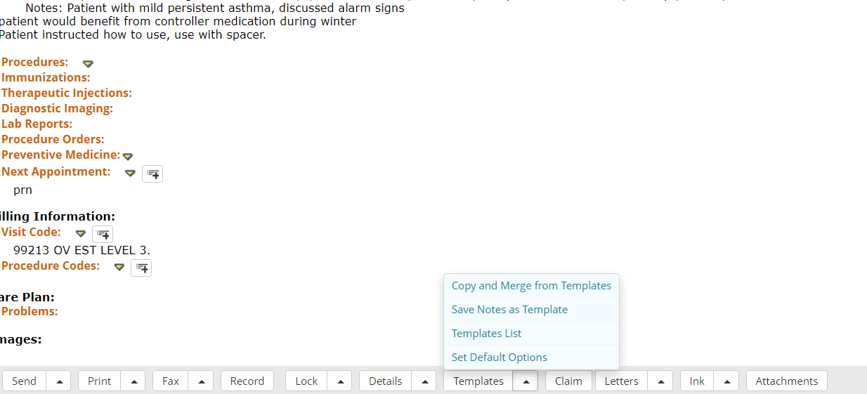
Click on the Arrow beside Templates and “Save note as template”

Slide 7
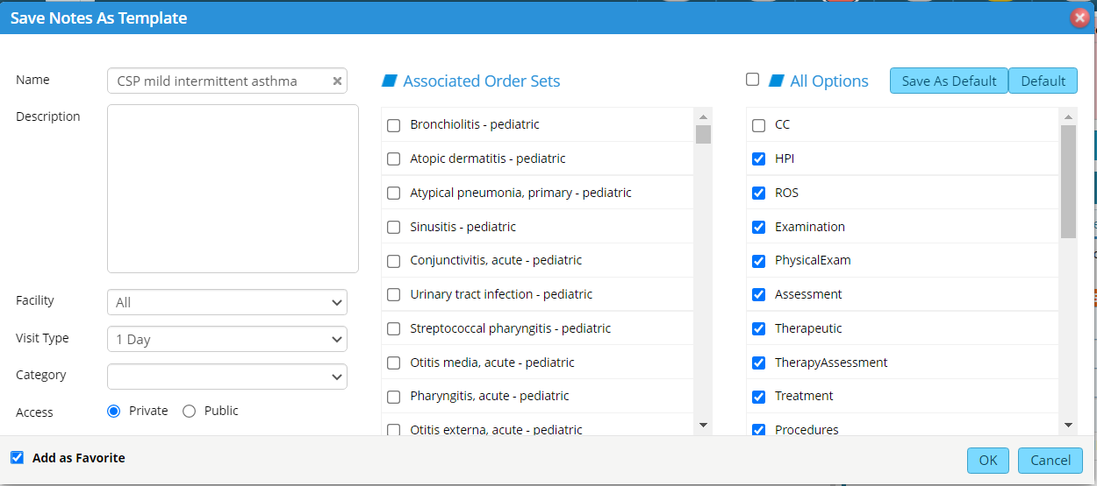
Name it
Make sure to add as favorite, so it comes up on your side panel!

Slide 8
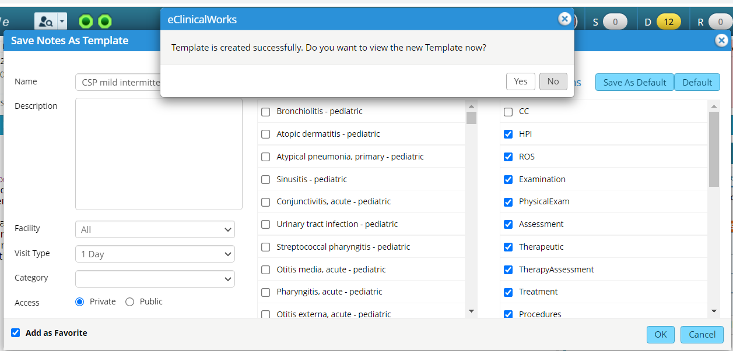
Click “OK” and then it’ll ask if you want to view the template. When you click “YES” it takes you directly to Templates so you can edit as you wish.

Slide 9
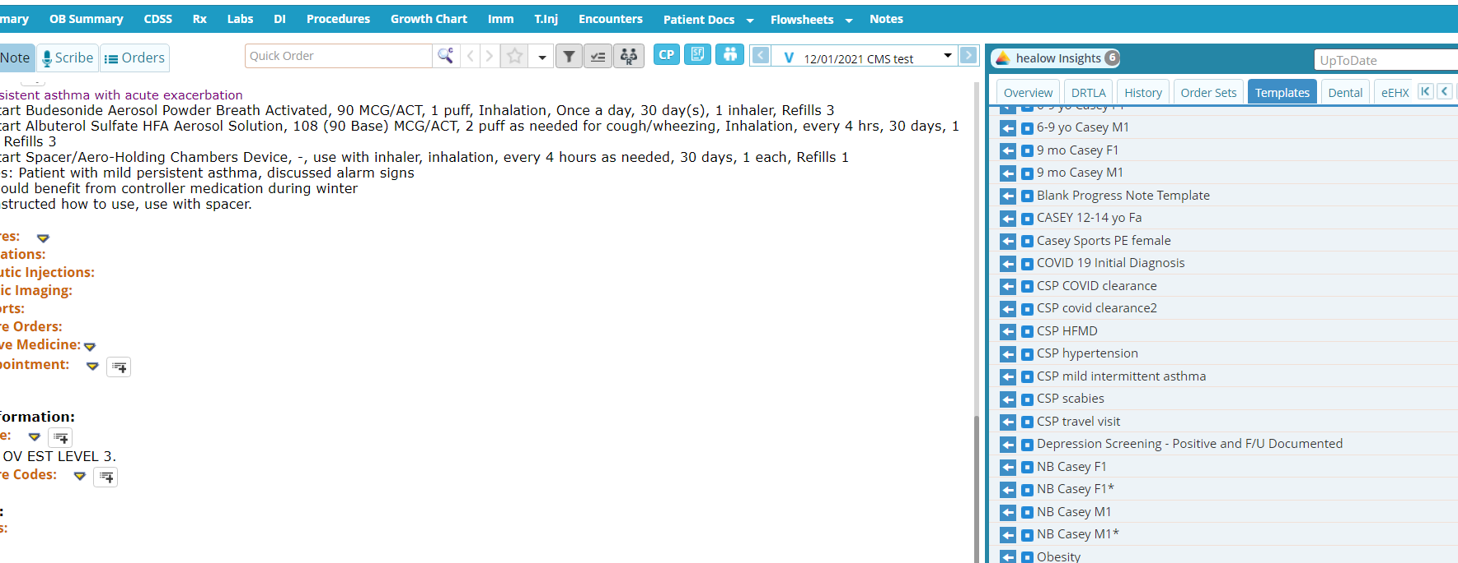
In the future:
It will automatically appear on your side panel so you can quickly use. It will have all medications and assessments/treatment plans and billing!

Slide 10


YOUR IT tips of the week!
How to add the eCW web link to your desktop:
https://vaneigapp.ecwcloud.com/mobiledoc/jsp/webemr/login/newLogin.jsp

