Slide 1


Communicate, Collaborate, Interoperate!
Harmonize Data via the United States Core Data for Interoperability Version 3 (USCDIv3)
What is USCDI and why does it matter?
Julia Skapik, MD, MPH
  Chief Medical Informatics Officer
Raymonde Uy, MD, MBA
  Physician Informaticist

Slide 3
AGENDA
Demographics and Health Insurance
1
Welcome, Intros and What is USCDI and why does it matter?
4
Challenges of USCDI Review and Implementation
Other Areas: Average BP, Lab Data Model
2
5
Health Statuses, Goals and Women's Health
3
6
Discussion/ Q&A and Next Steps

Slide 4
OBJECTIVES
Explore USCDI submissions content outside of the domain of Social Determinants of Health (this is the topic of next session)
Provide examples and templates and invite participants to give NACHC feedback to optimize our own comments to ONC
Provide insight and materials to support our partners making submissions to the USCDI

Slide 5
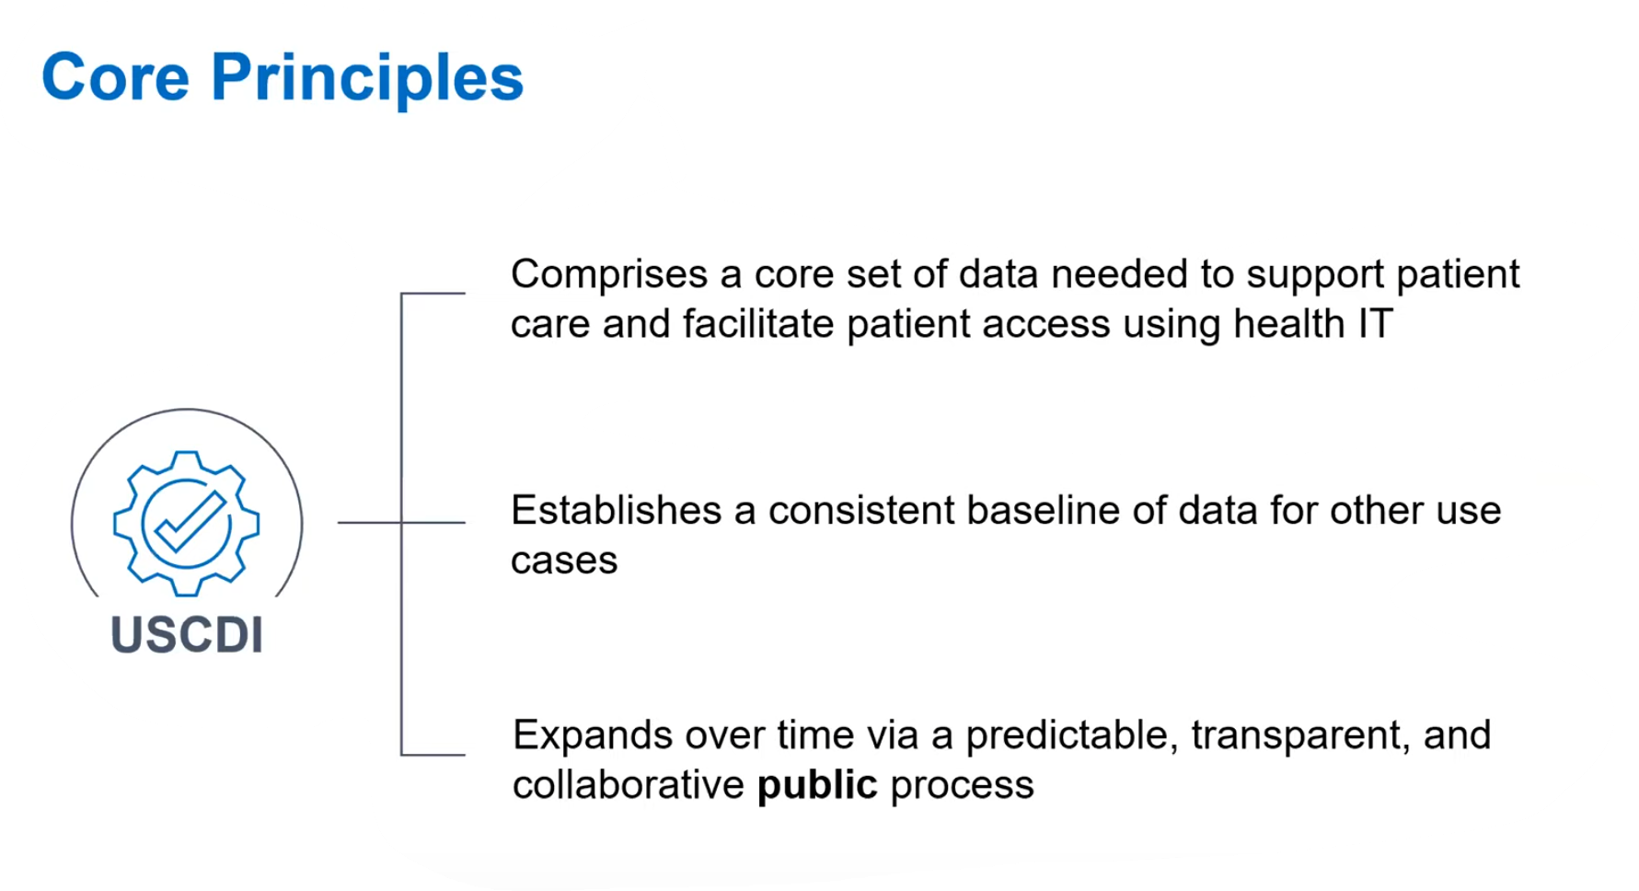

Slide 6

US Core Data for Interoperability (USCDI)
Originally the (Meaningful Use) Common Clinical Dataset, required for exchange at transitions of care
Supported by the 21st Century Cures Act which also requires specialty content to be certified
USCDI creates a framework for annual updates to expand the data classes
In reality, USCDI is a combination of data elements and data class requirements with variable levels of granularity

Slide 7
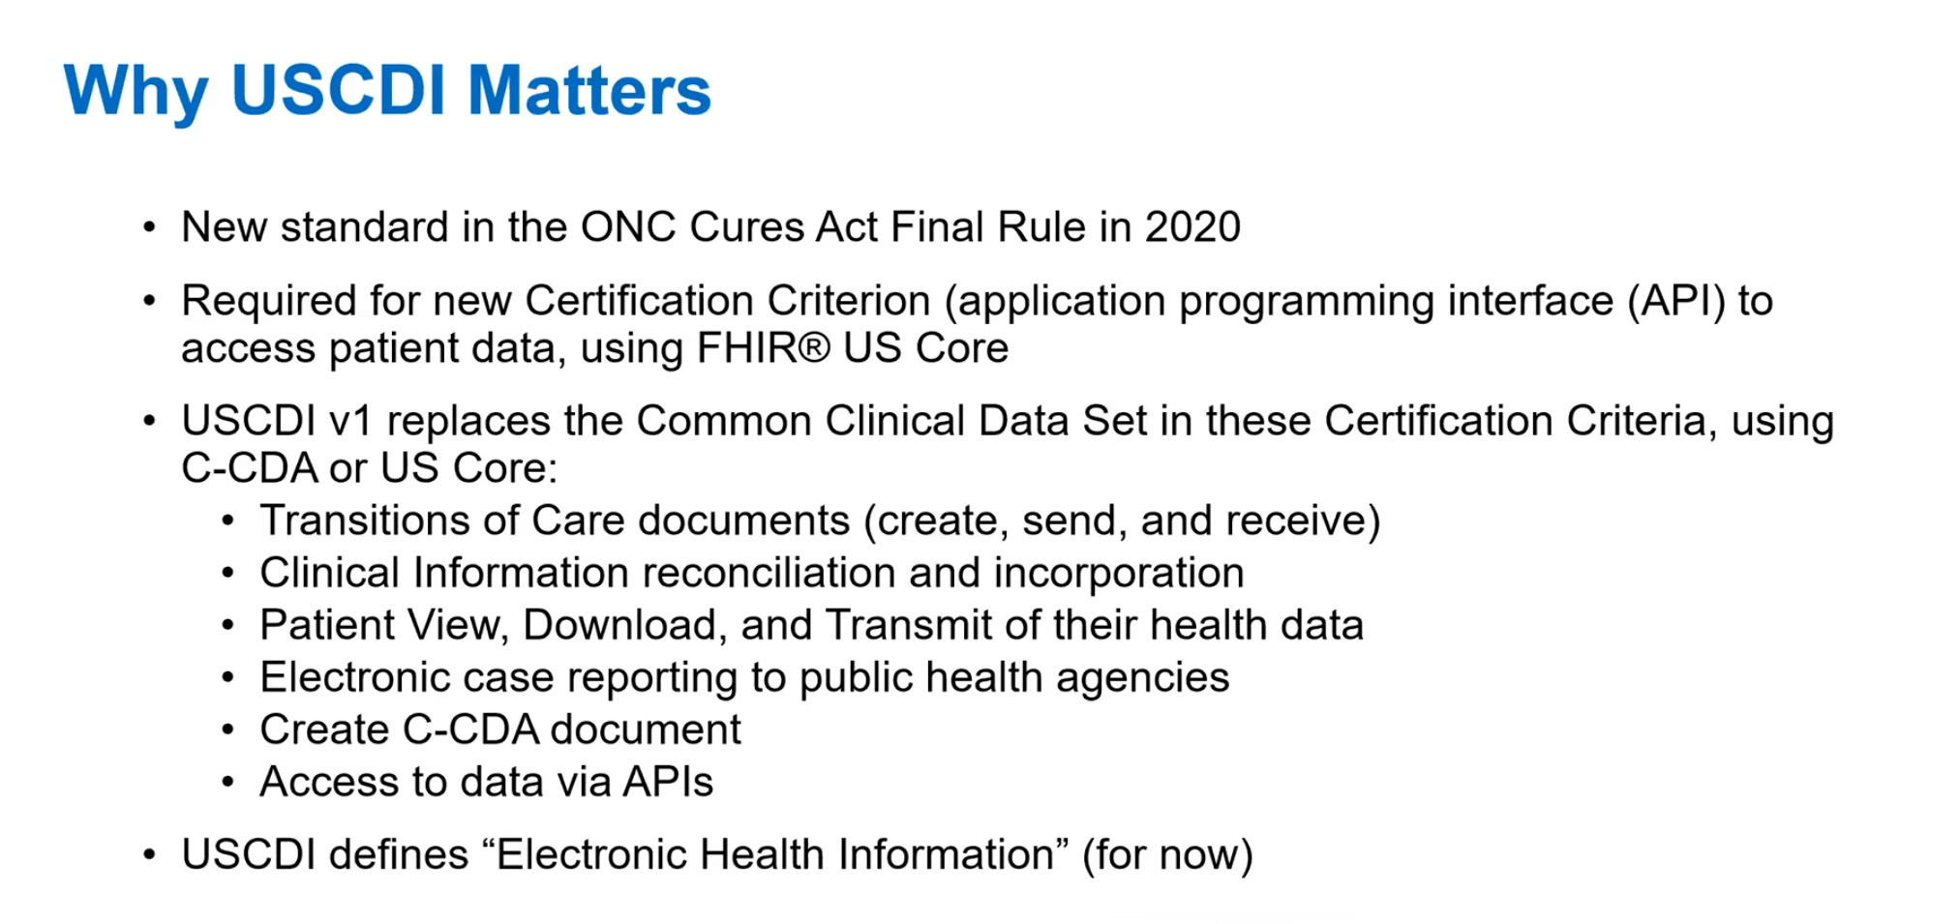

Slide 8
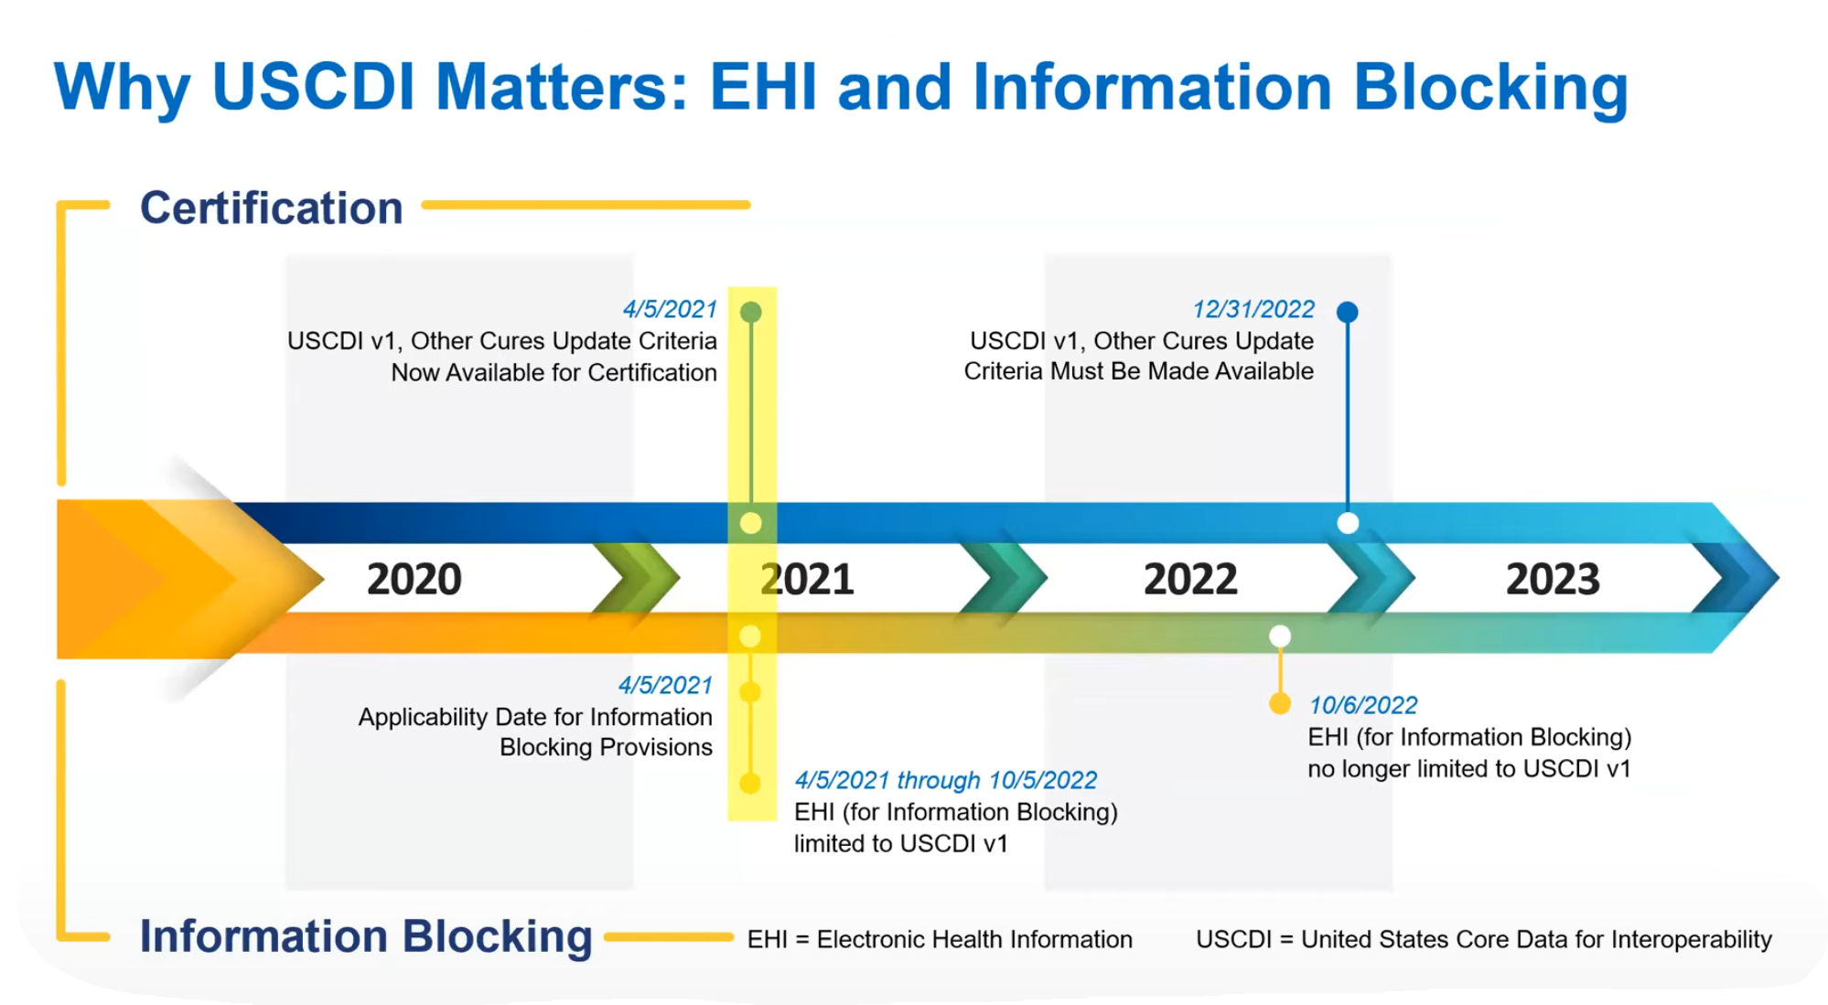

Slide 9
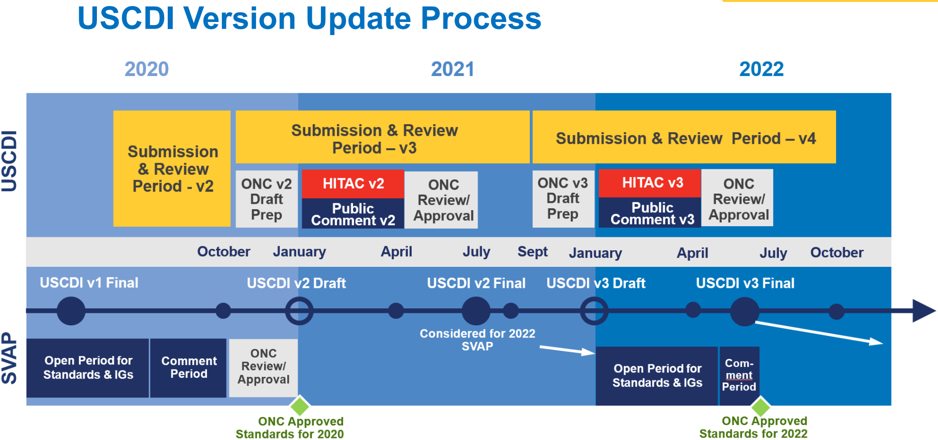

Slide 10
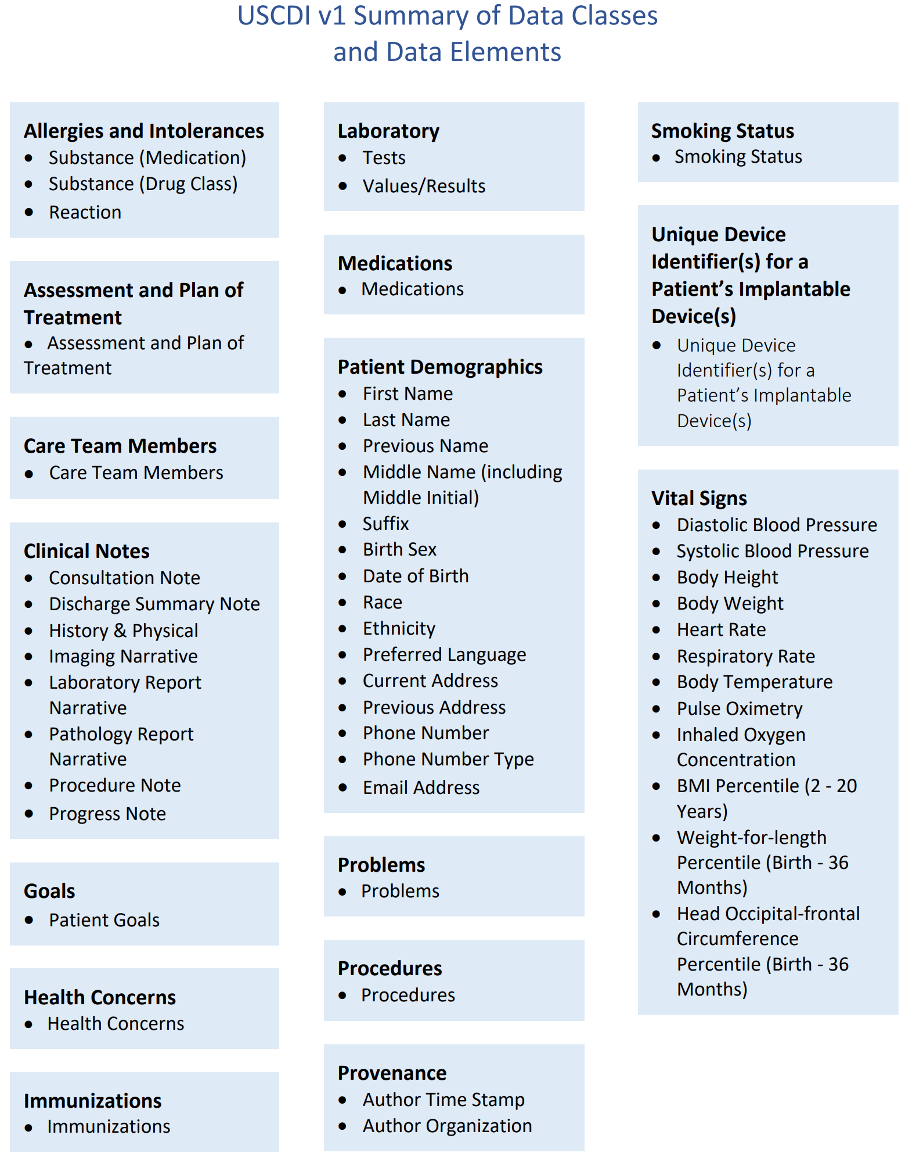
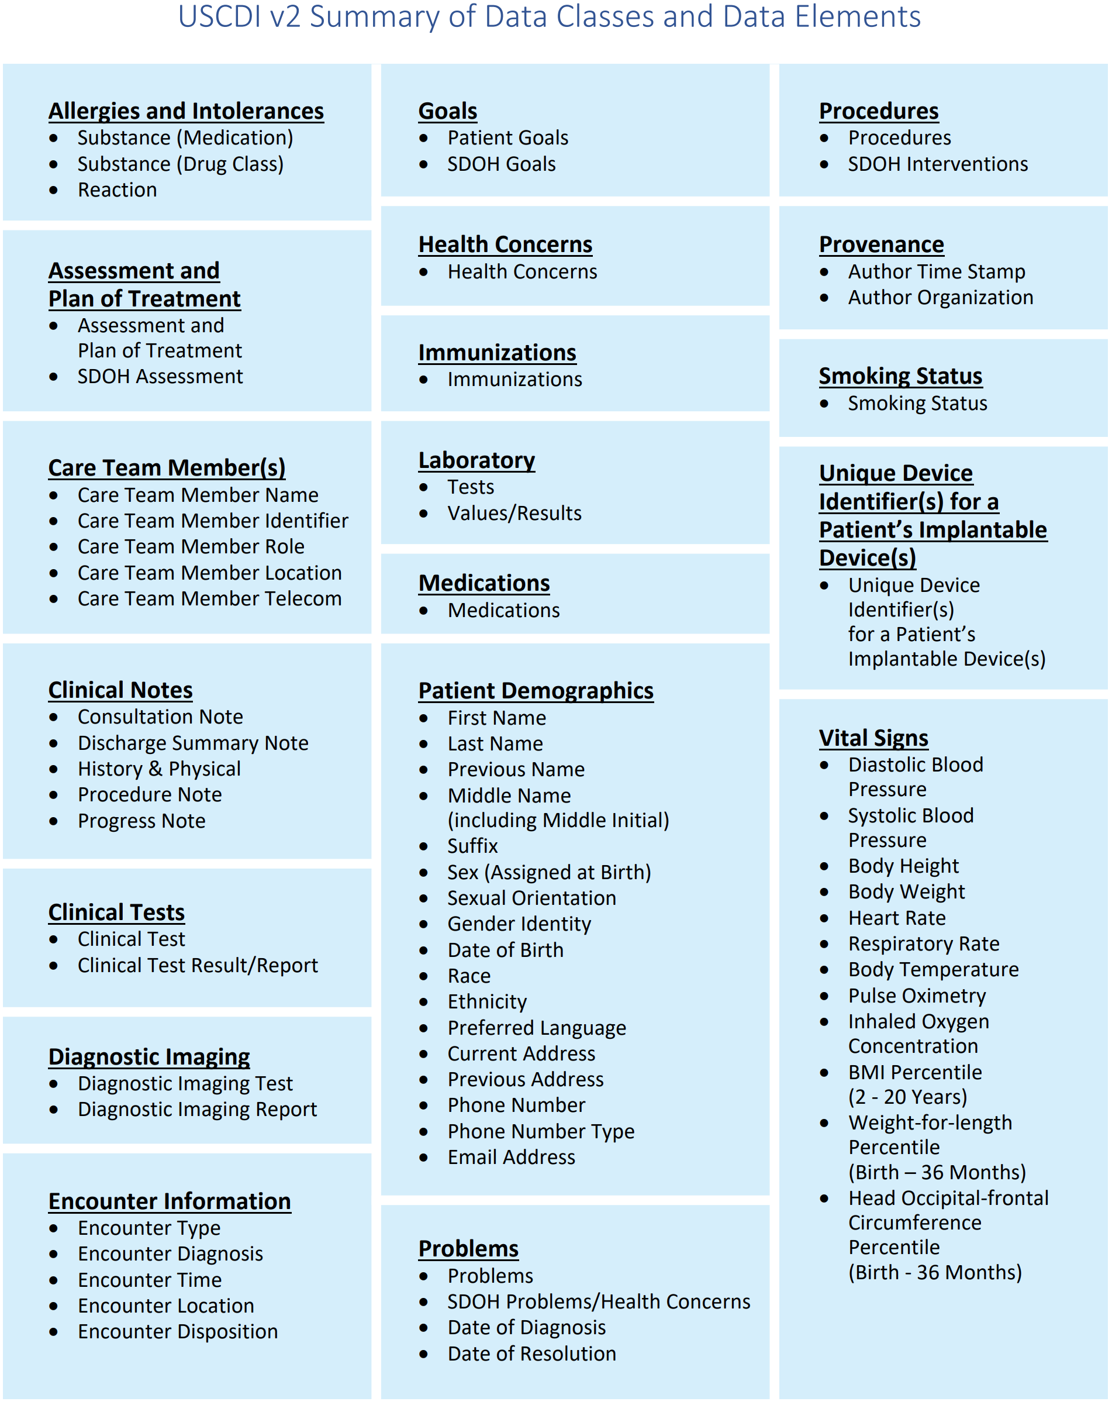
USCDI Version 1
USCDI Version 2

Slide 11
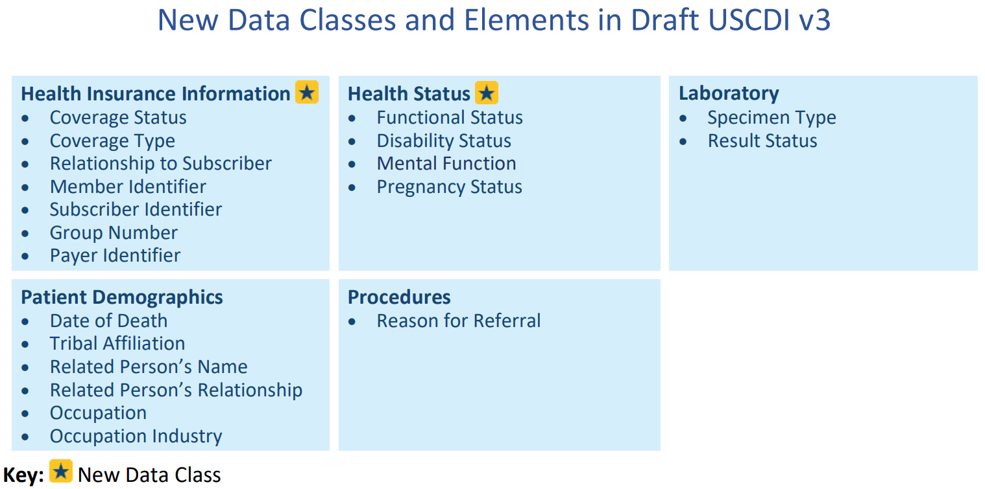

Slide 12
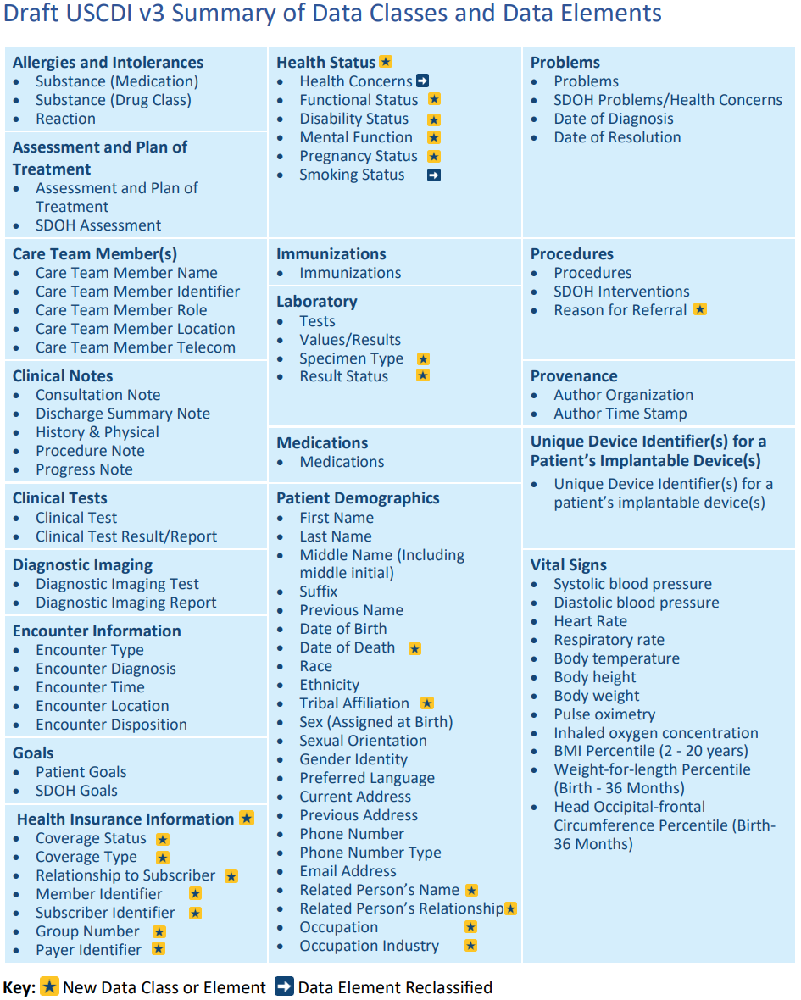

Slide 13
USCDI establishes a minimum set of data classes that are required to be interoperable nationwide
Designed to be expanded in an iterative and predictable way over time
The USCDI ONC New Data Element and Class (ONDEC) Submission System supports this process.
ONC will accept submissions for USCDI Draft v3 through April 30, 2022.

Slide 14
Data Classes? How is that Interoperable?
+
Curated terminology
-
Assumes codes are consistently used
+
Consistent code system
-
One size fits all
+
Provides expectation of shared content
-
Lack of relevant metadata

Slide 15
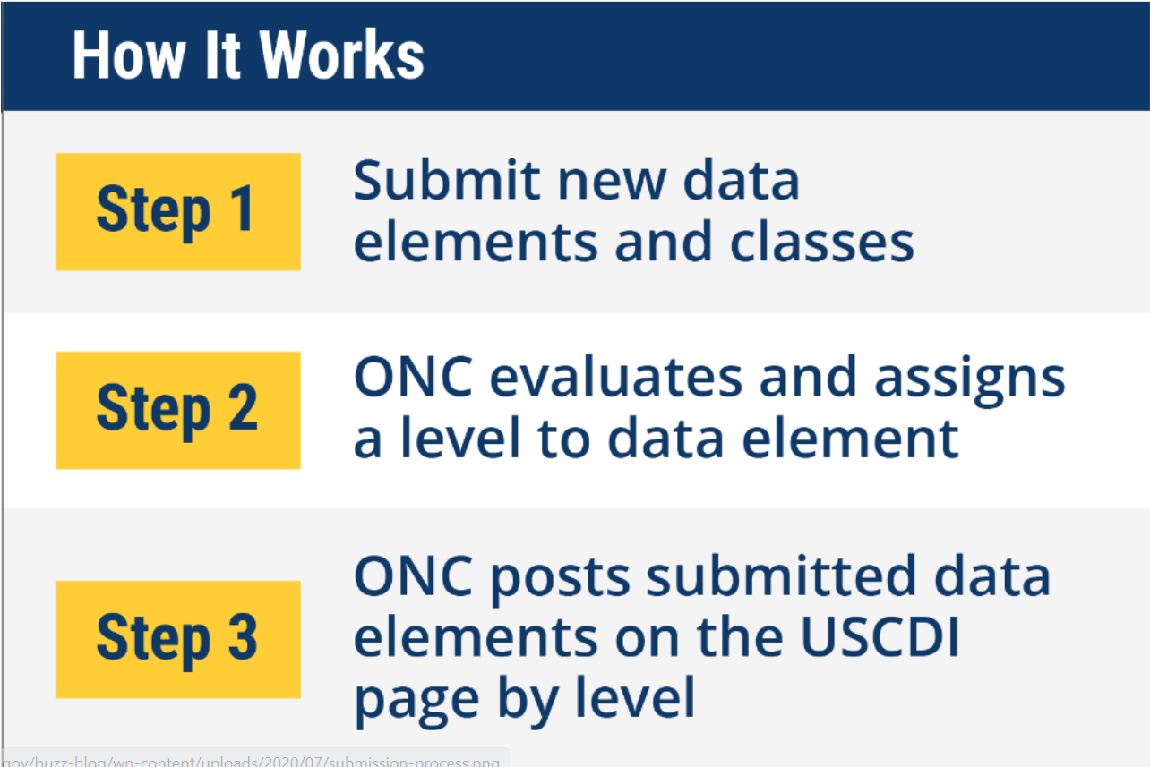
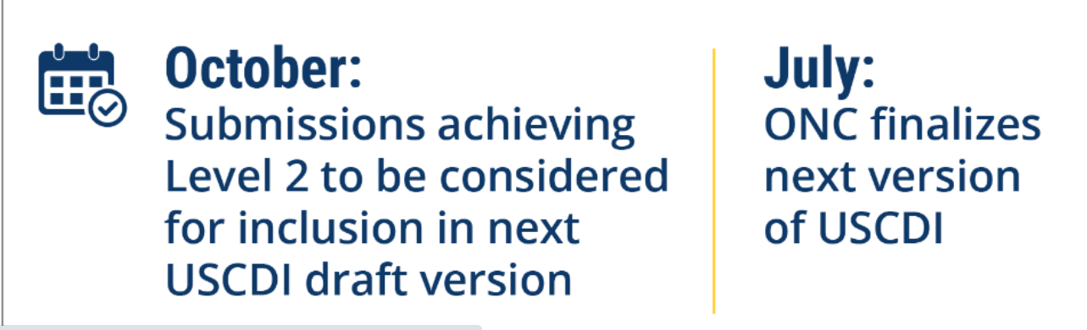
USCDI Submissions using ONDEC

Slide 16
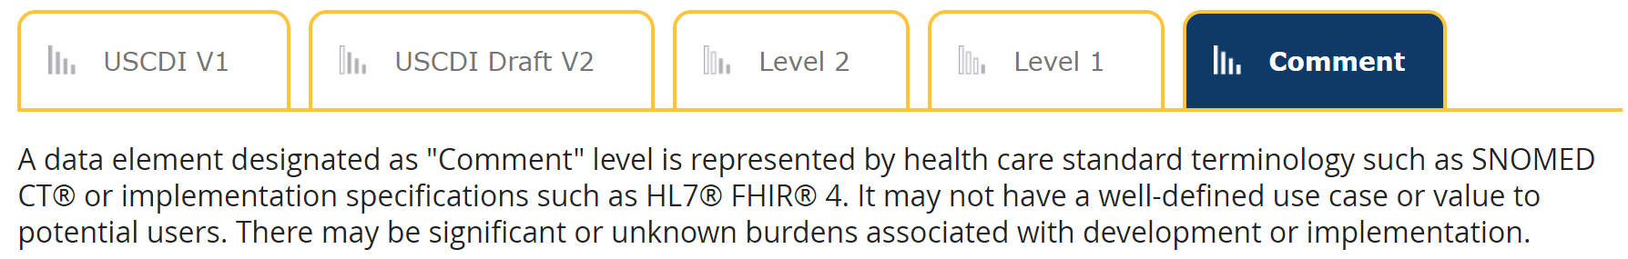
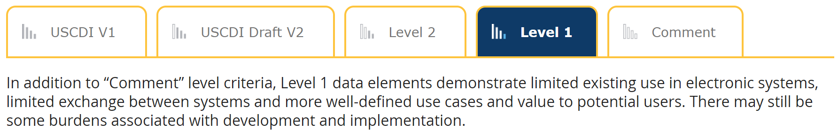
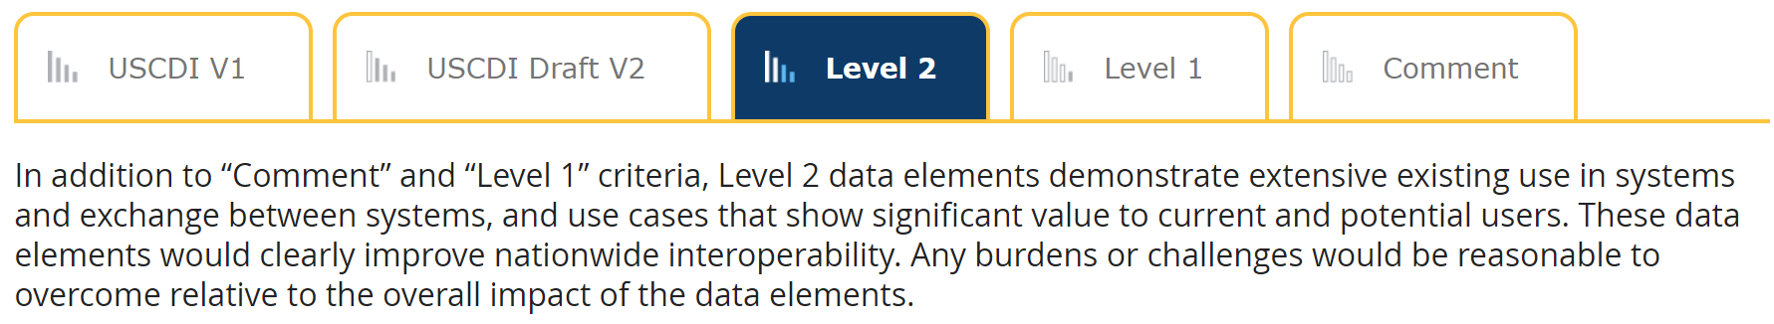
ONC Evaluation and Levels of data elements
https://www.healthit.gov/isa/united-states-core-data-interoperability-uscdi

Slide 17
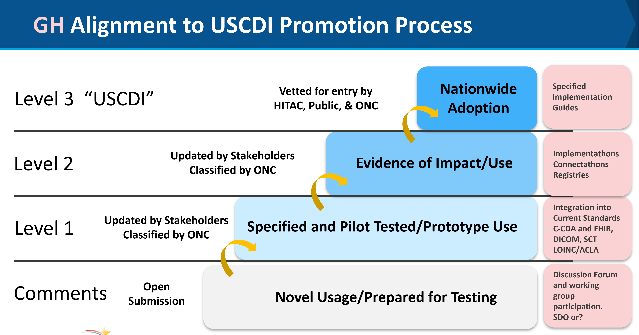

Slide 18
USCDI as a Lever for Interoperability
Could promote data elements and models in large numbers
Real-time, bidirectional certification could approximate real-world data encoding and exchange
May be a required component to large-scale content interoperability

Slide 19
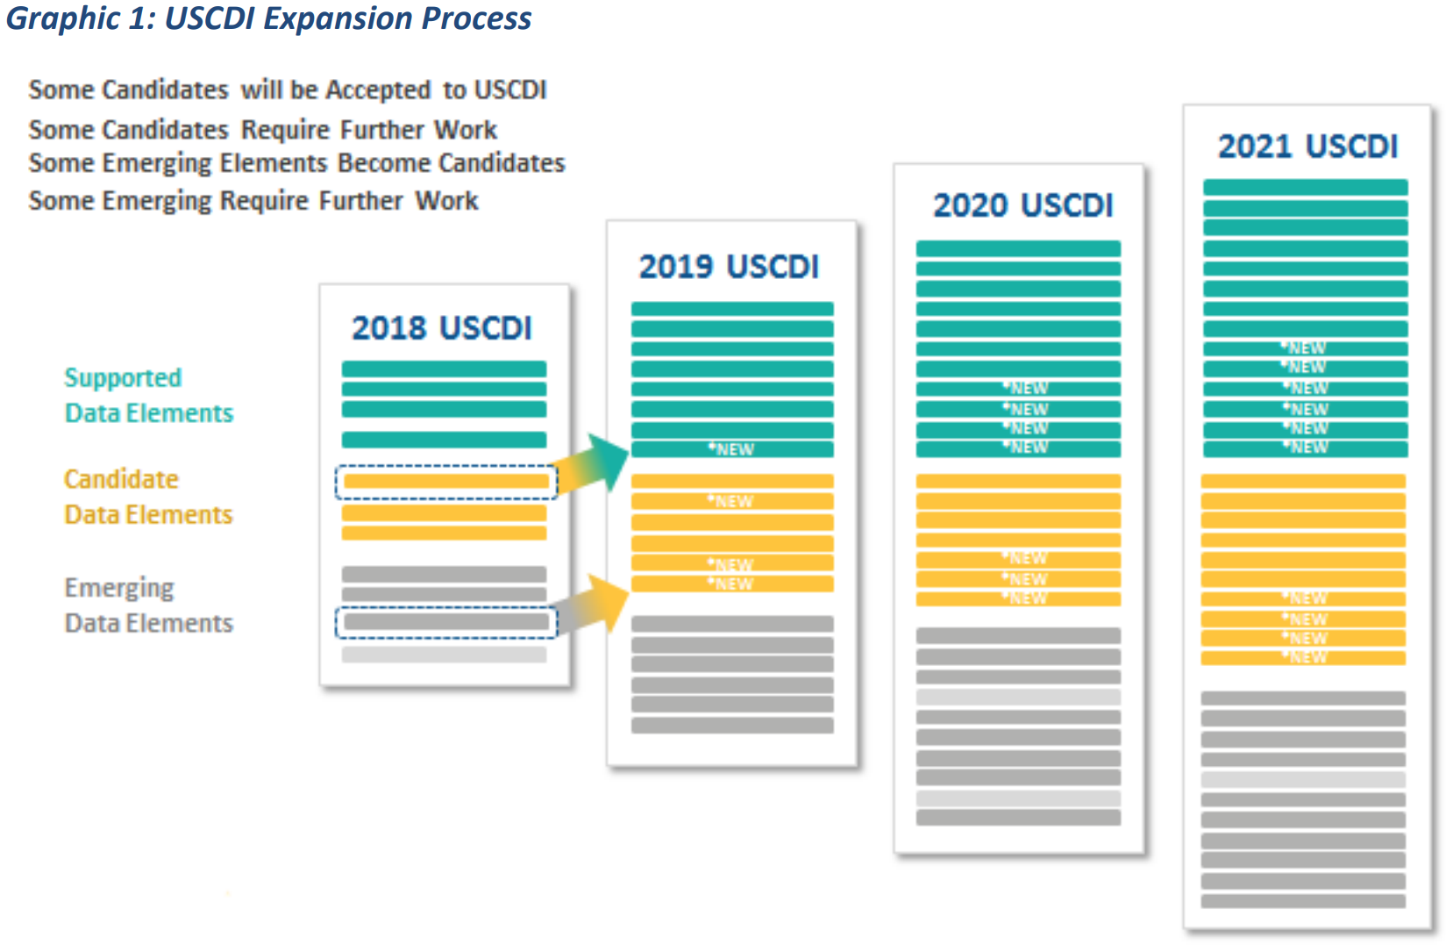

Slide 20
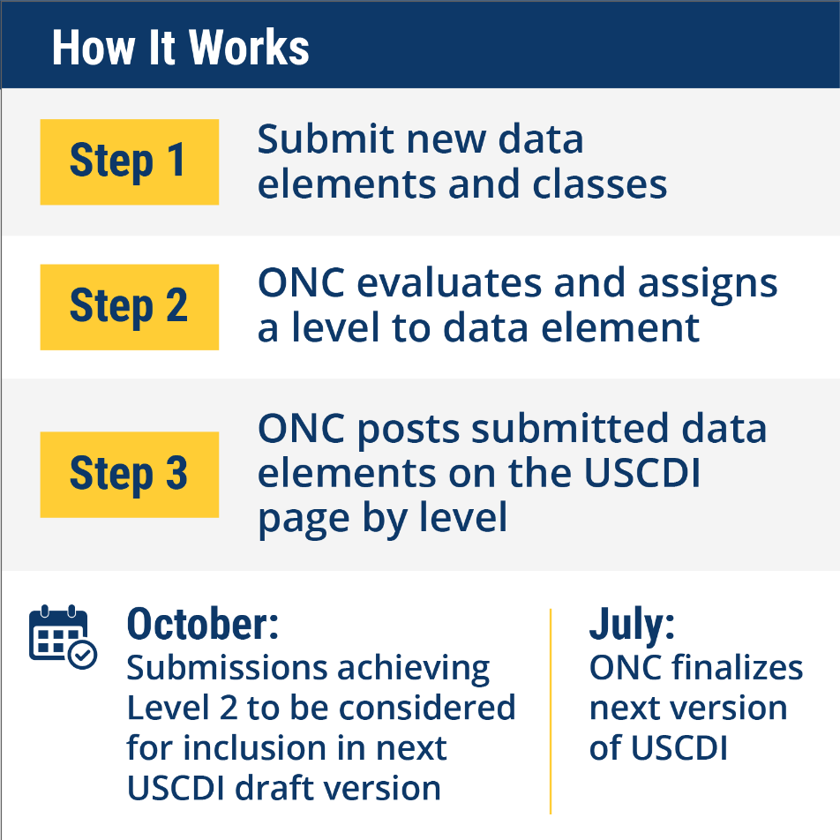
USCDI v3 Open for Comments
Allows content organizations to promote clinical and administrative content
Requires maturity of content
Catch-22: Difficult to mature some content without regulatory lever ensuring implementation

Slide 21
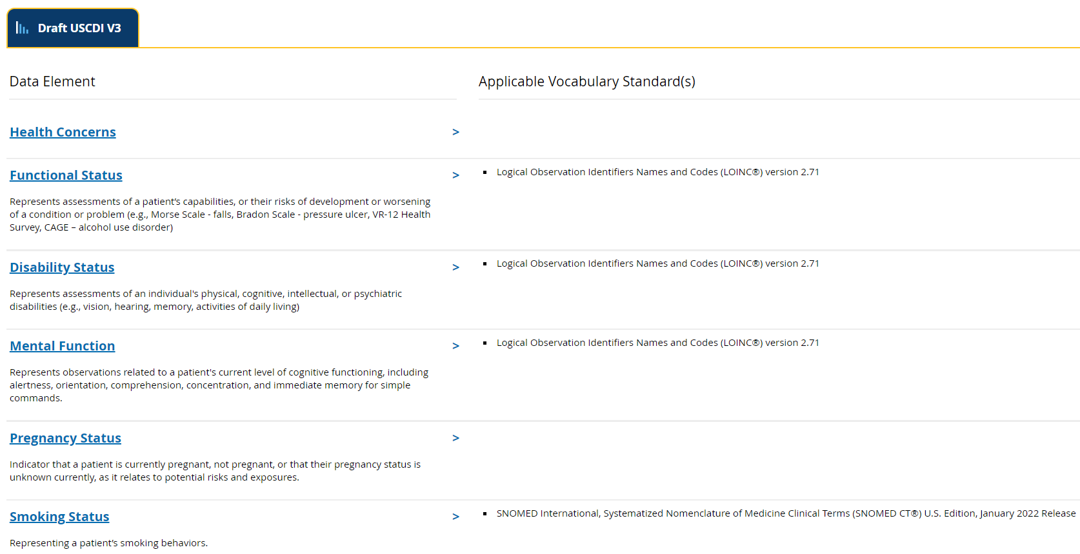

Slide 22
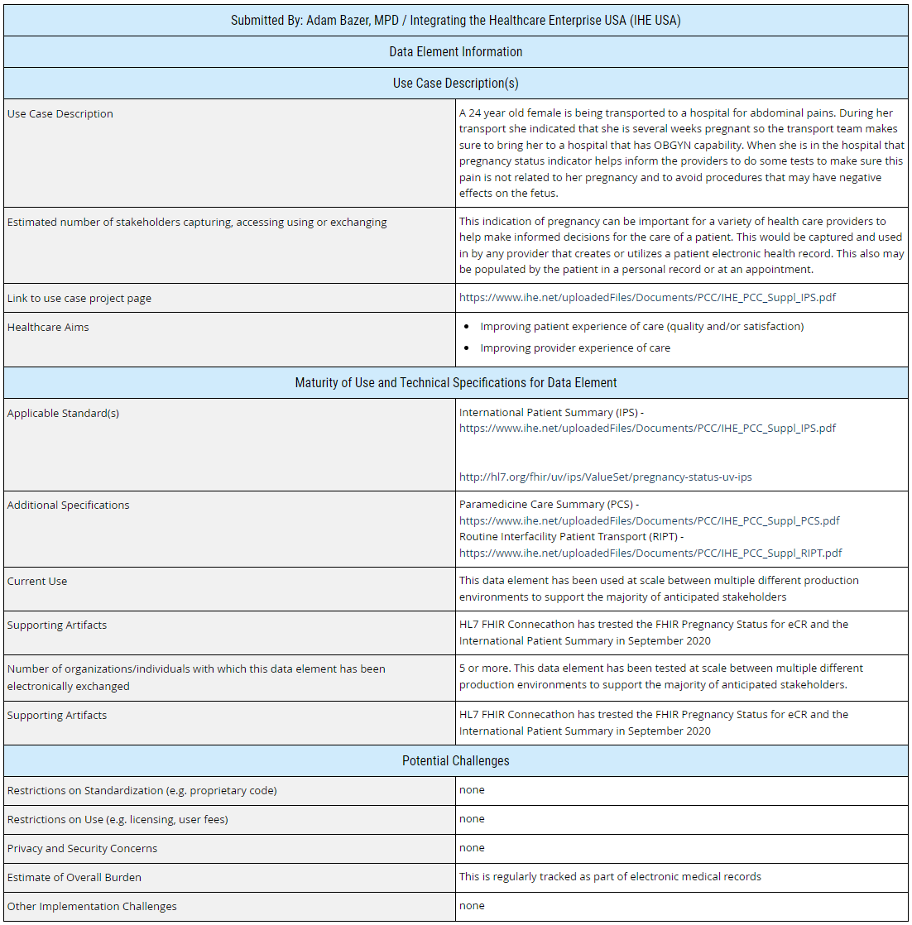
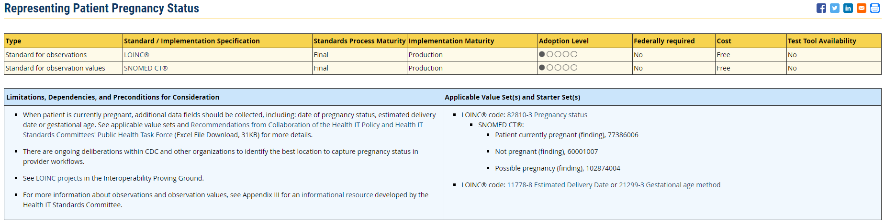
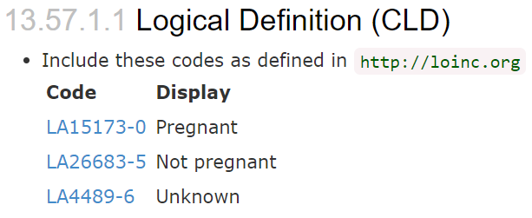
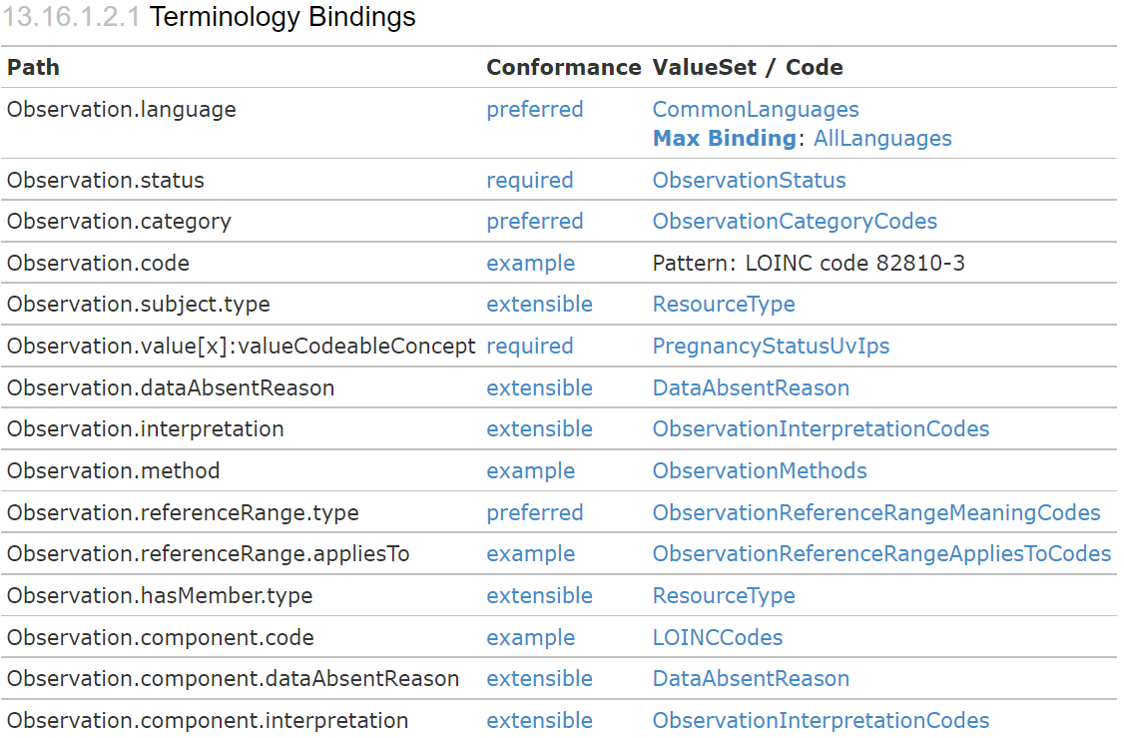
https://nachc.atlassian.net/wiki/spaces/USCDIv3

Slide 23
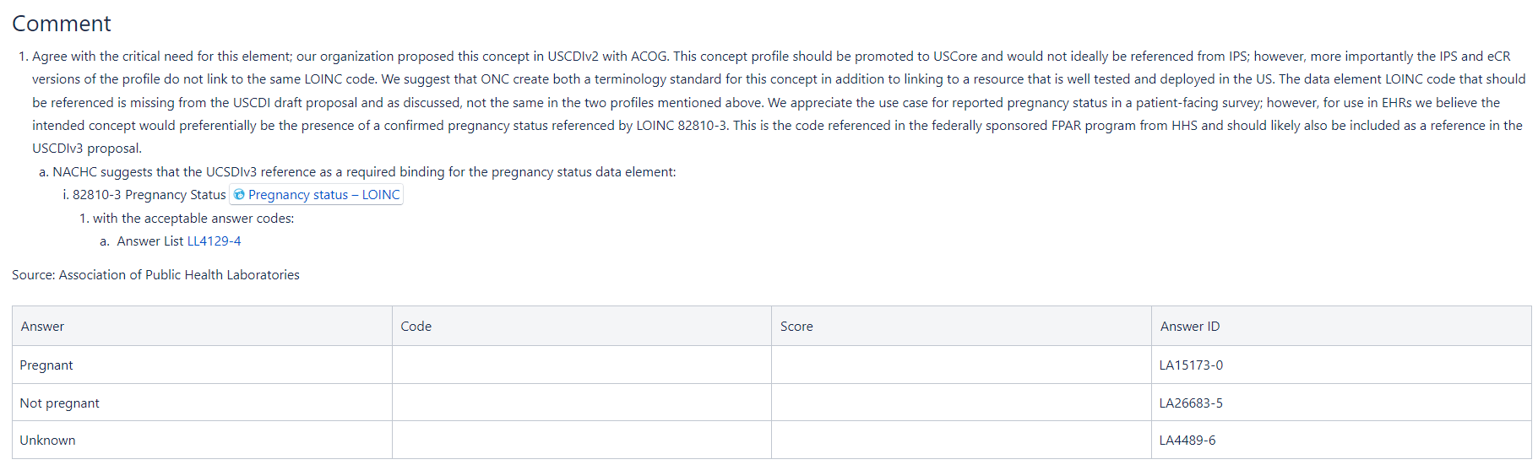

Slide 24
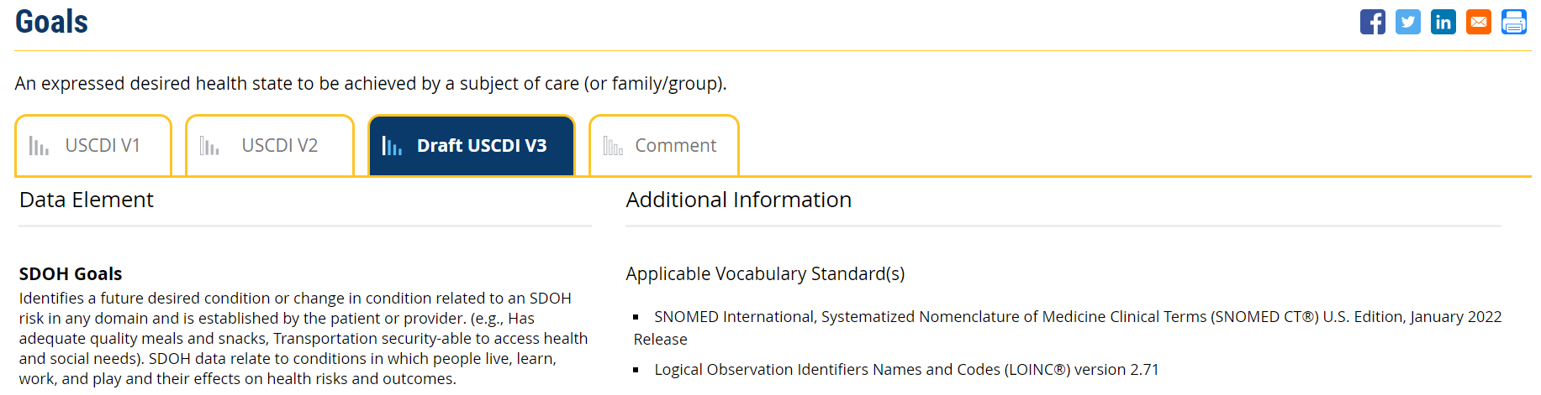
https://www.healthit.gov/isa/taxonomy/term/1836/draft-uscdi-v3
NACHC in support for the submission by the Gravity Project, with defined LOINC value sets mapped to and representing SDOH screening tools (PRAPARE, etc.)

Slide 25
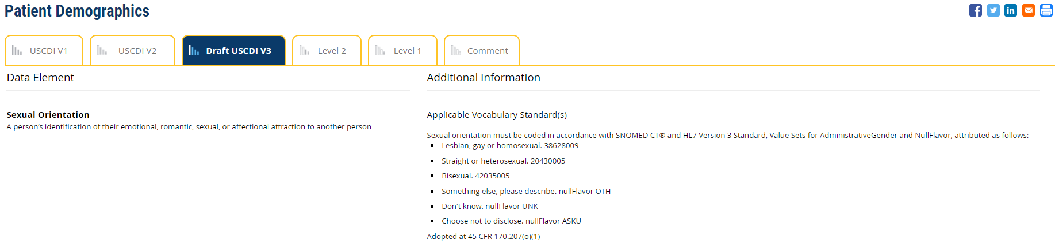
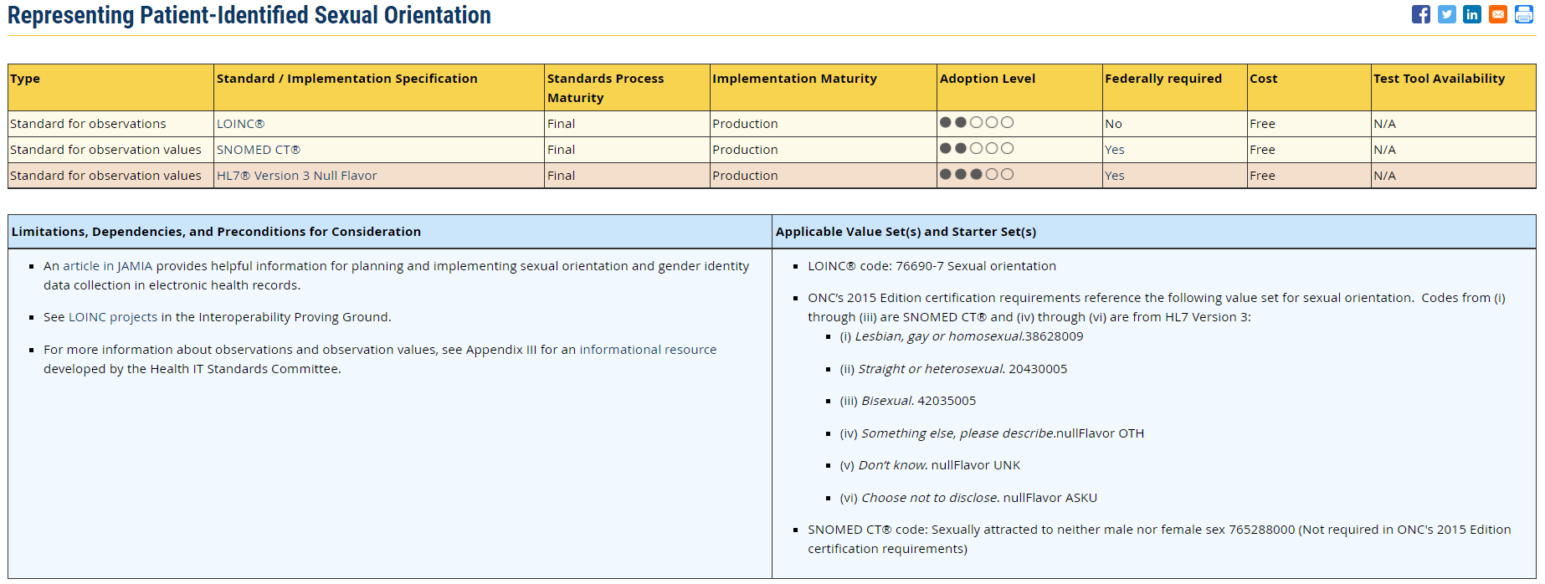

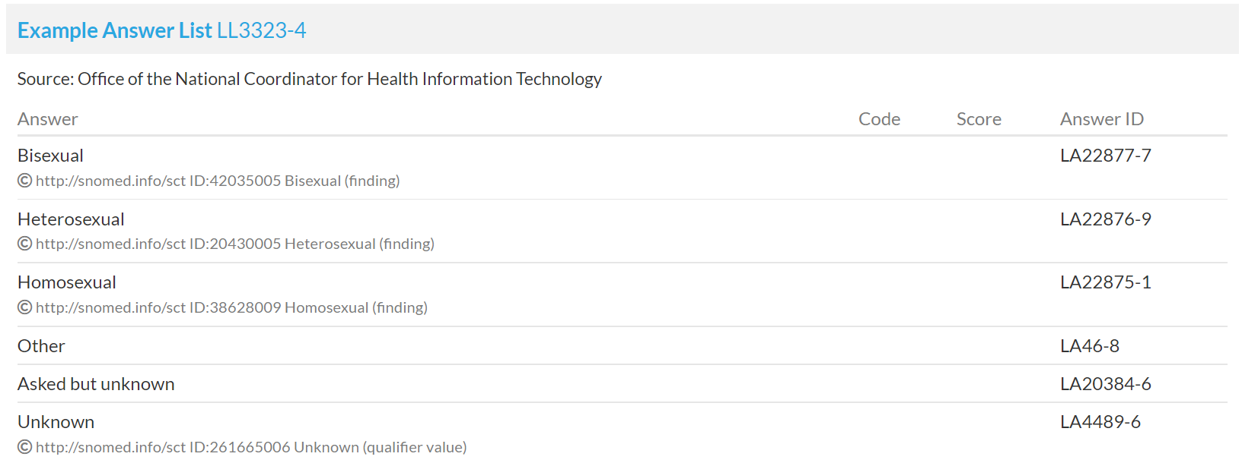

Slide 26
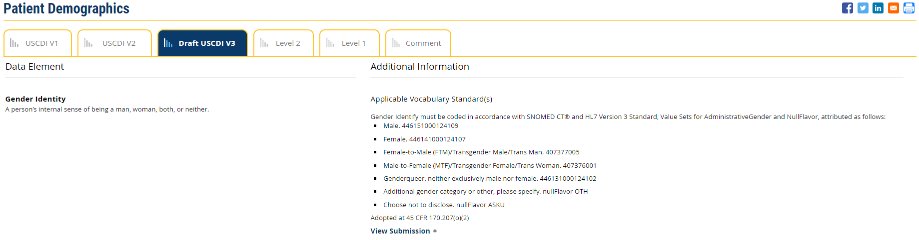
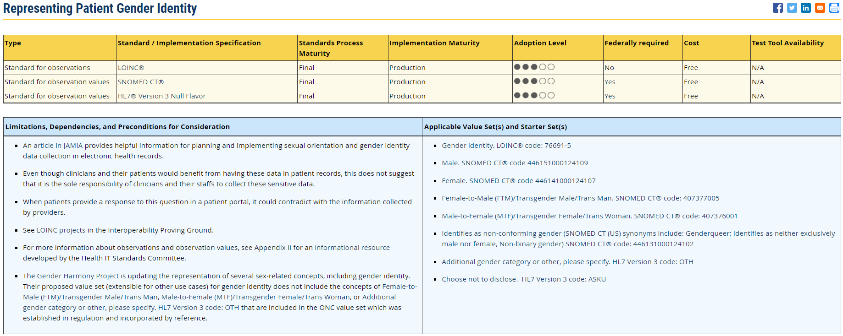

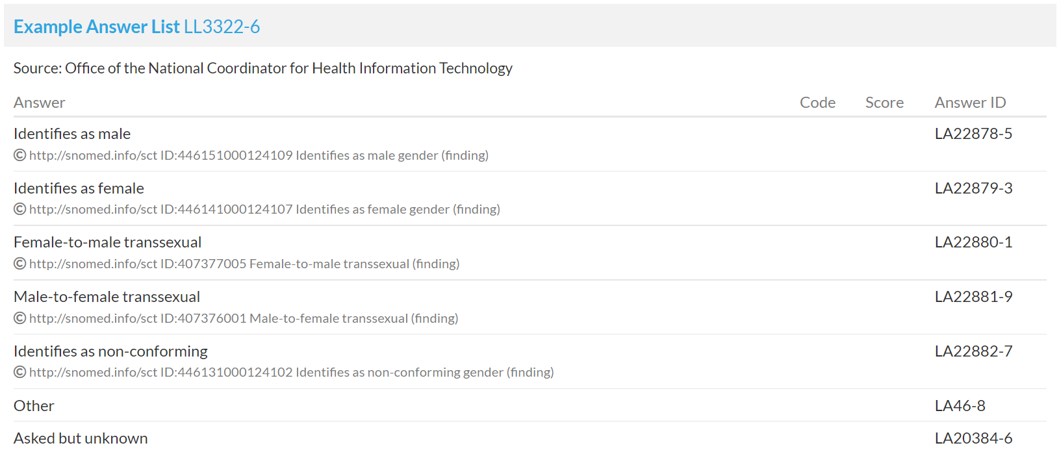

Slide 27
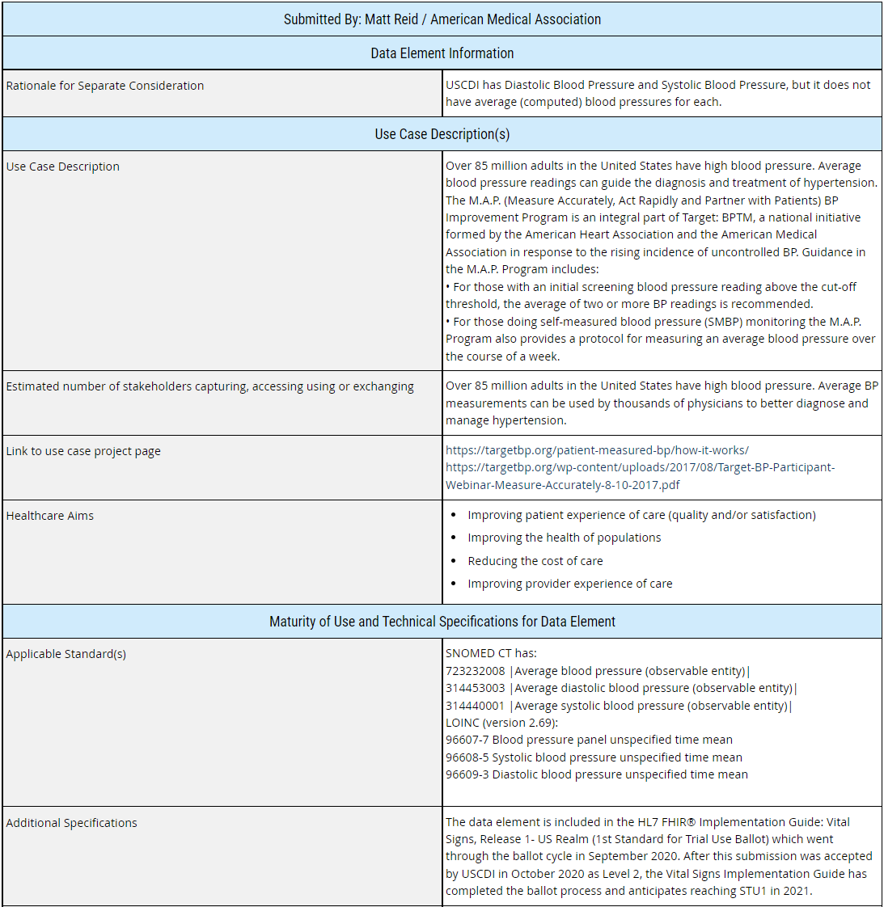
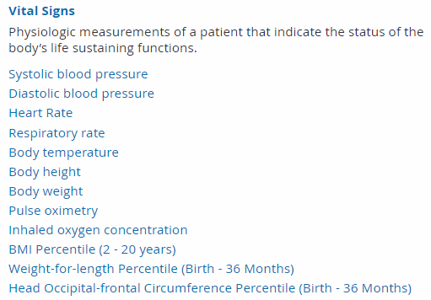
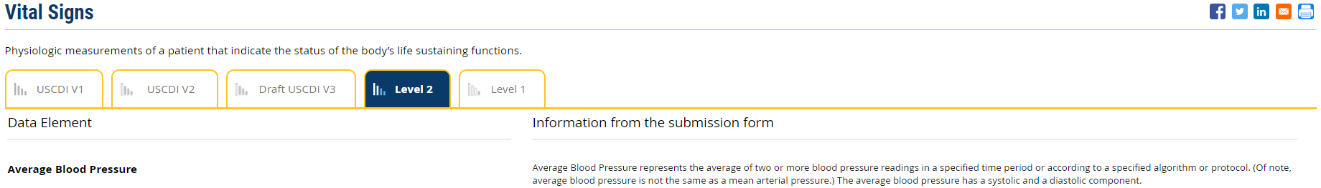

Slide 28
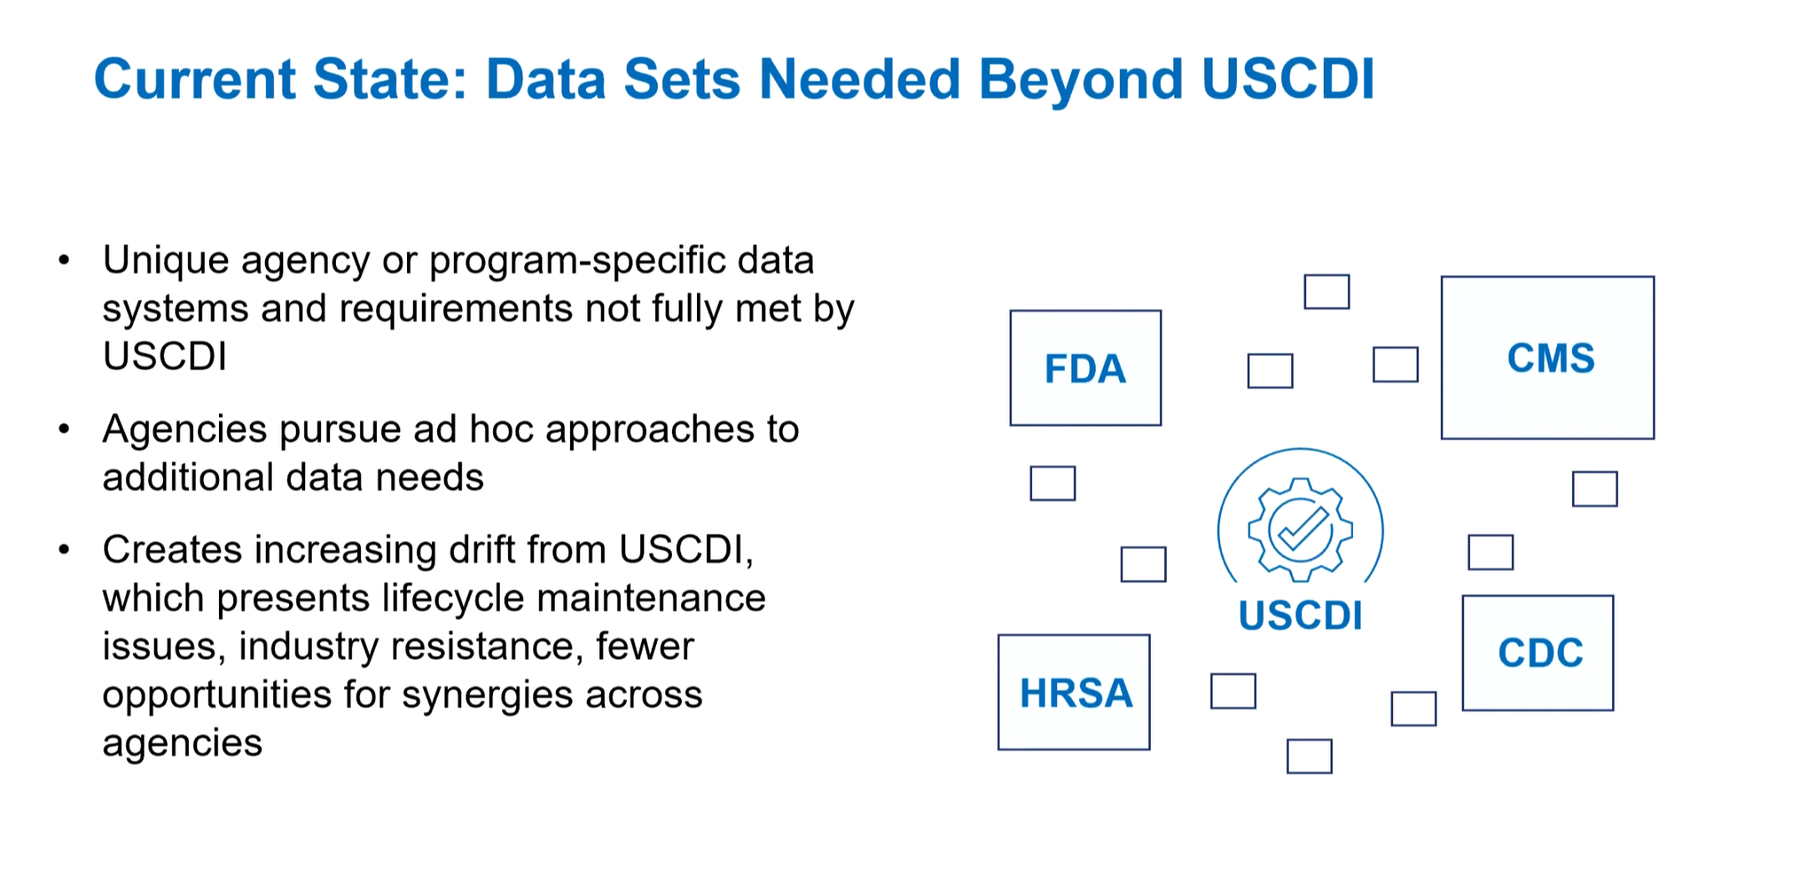

Slide 29
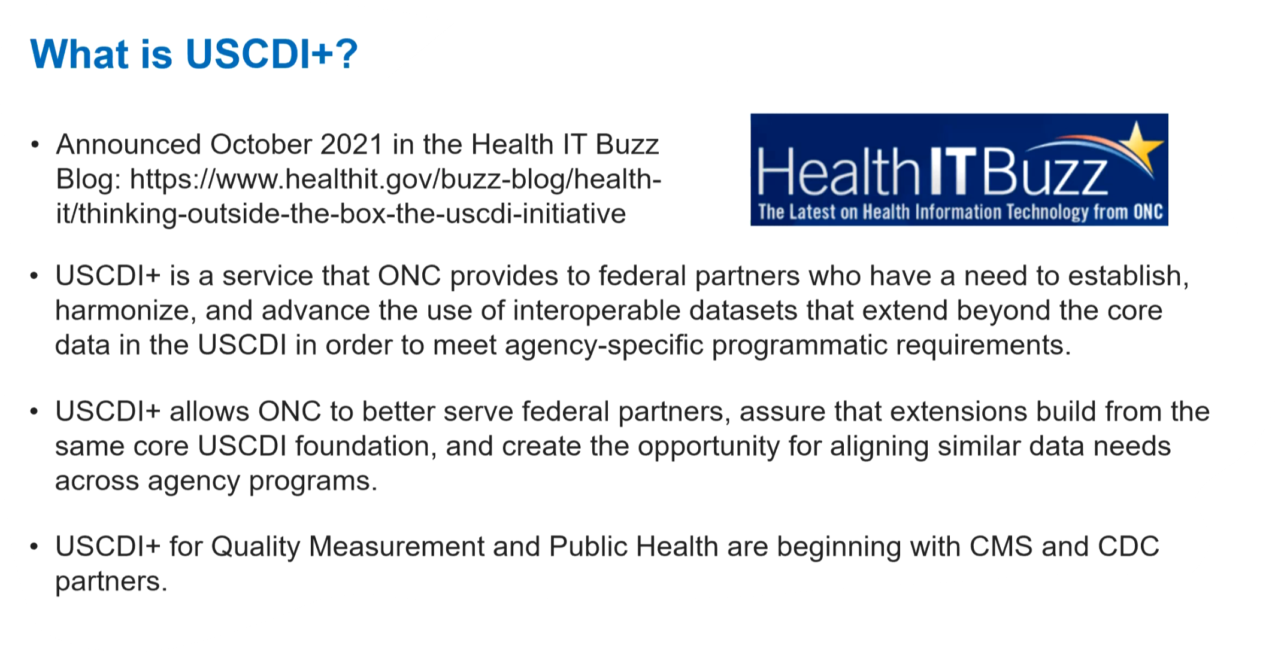

Slide 30
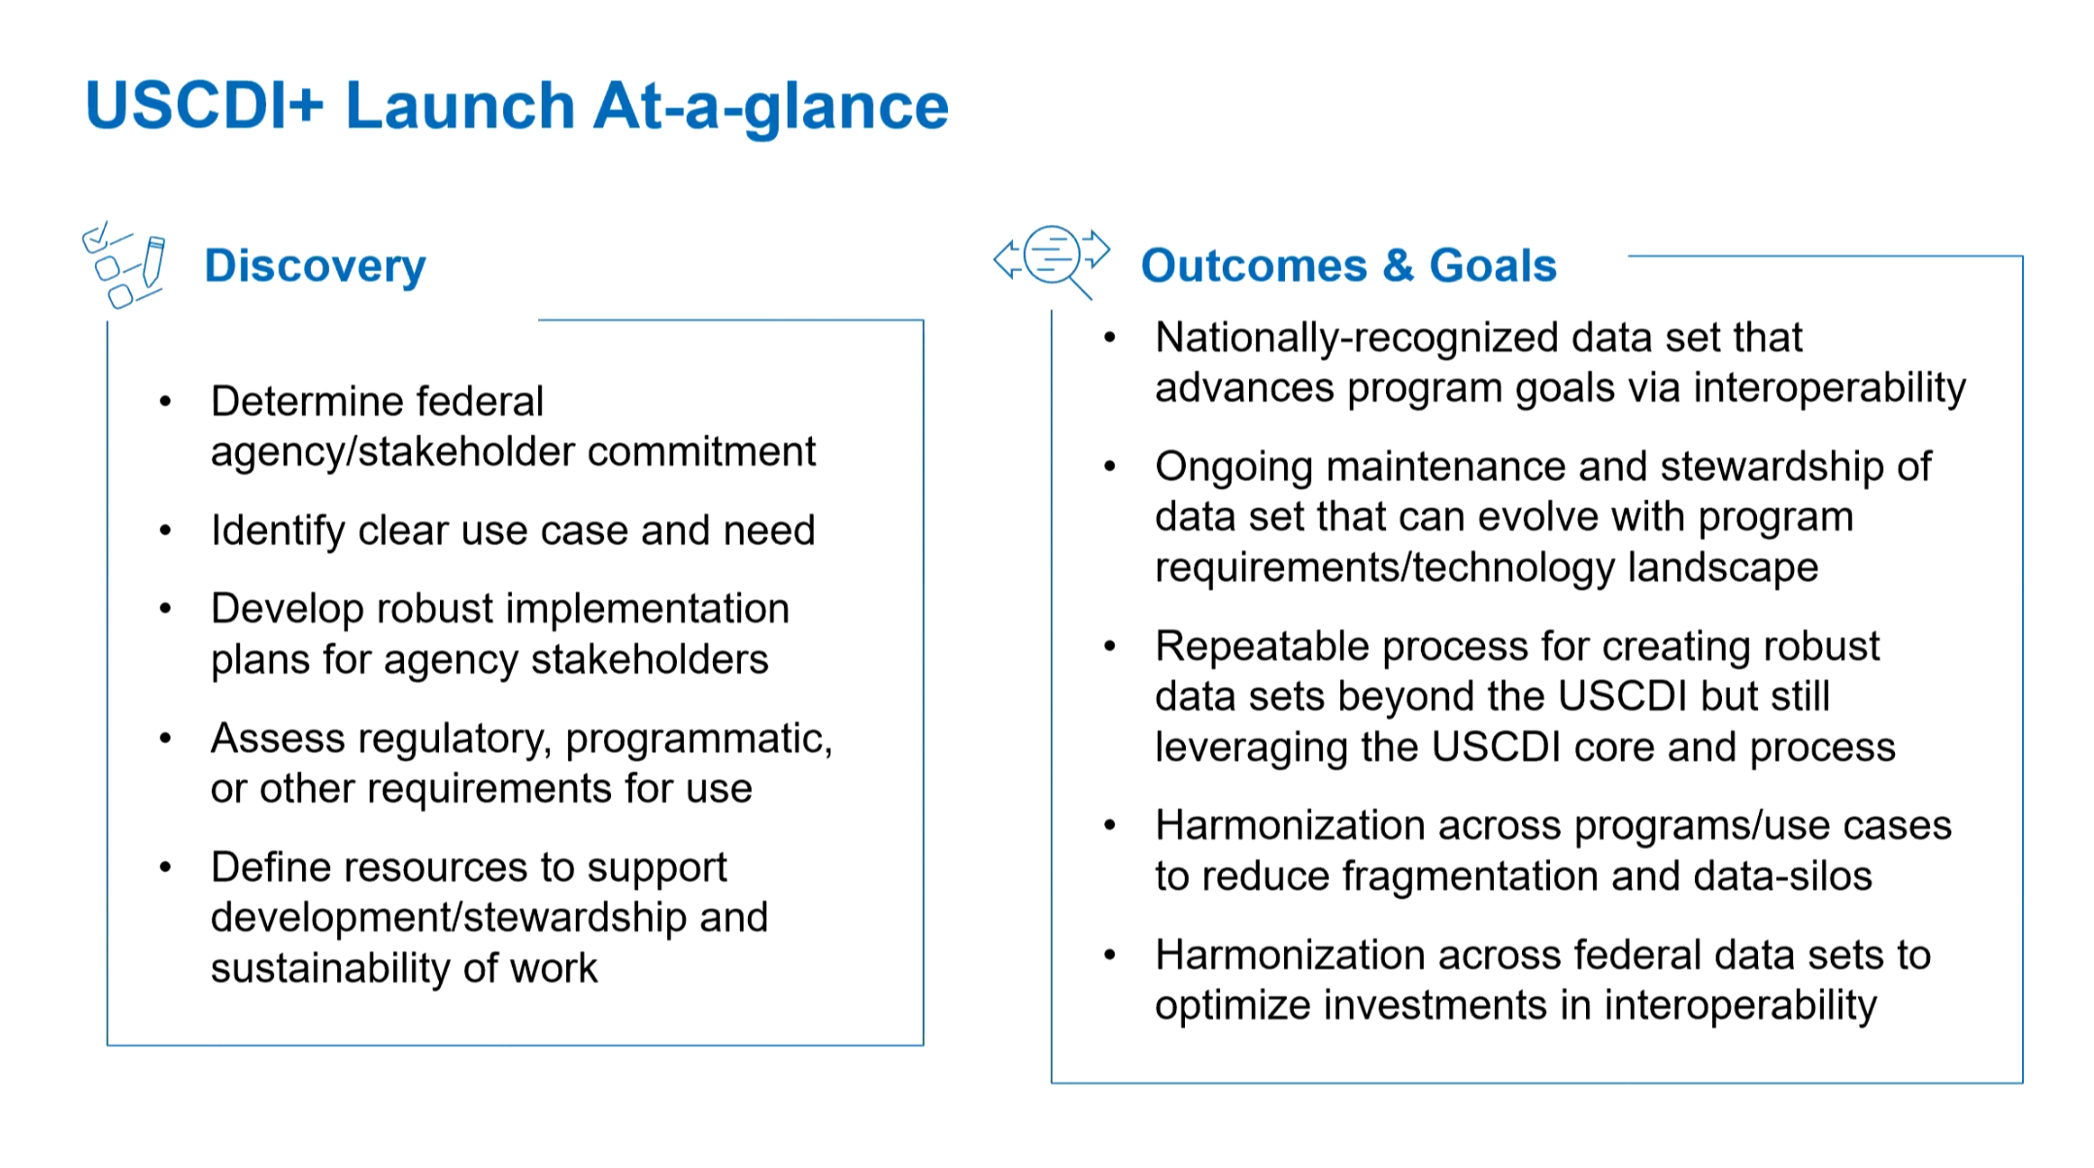

Slide 31
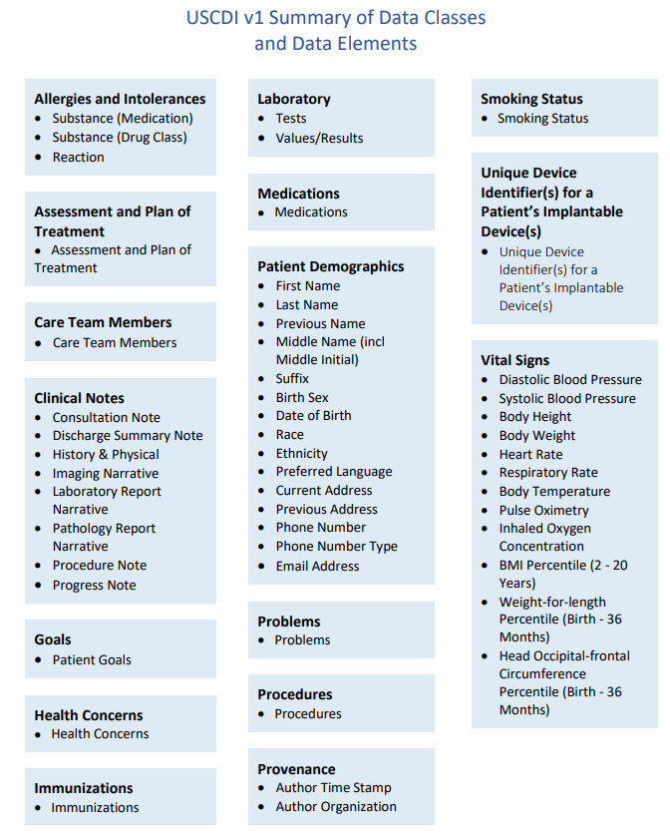
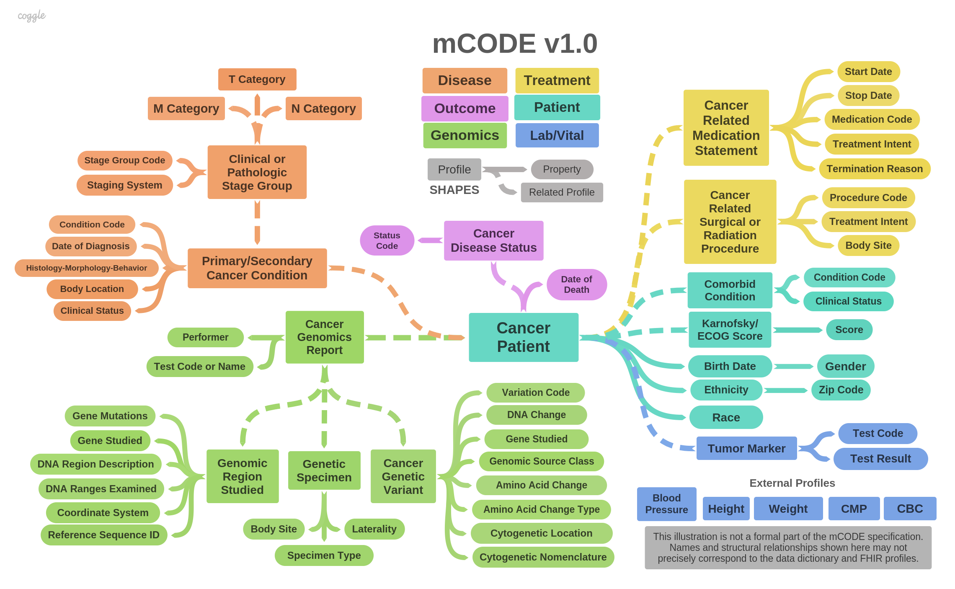
Common Data Elements
Condition-Specific Elements
Notes:
Most common and important clinical terminologies a registry team is likely to encounter include those standards for EHRs that are recognized by CMS and ONC, specifically ICD-10-CM (for clinical diagnoses and problem lists), RxNorm (for medications), LOINC (for laboratory test and results, observations), CPT (for billing codes sent to payers for reimbursement for performed procedures), and SNOMED CT (for clinical concepts on problem lists and as a reference terminology for concepts extracted from free text)
The most commonly used structured data are the billing codes
ICD and CPT codes
These coding systems are mandated
Widely included in different EHR products
Simplify the work of aggregating data across multiple organizations.
Unfortunately, these terminology standards are complex and imprecise, enough to be used differently by different users.
Example: there are hundreds of valid codes for glucose tests in LOINC. Integrating codes that are used differently in different institutions is part of the data curation challenge when building a registry.

Slide 32
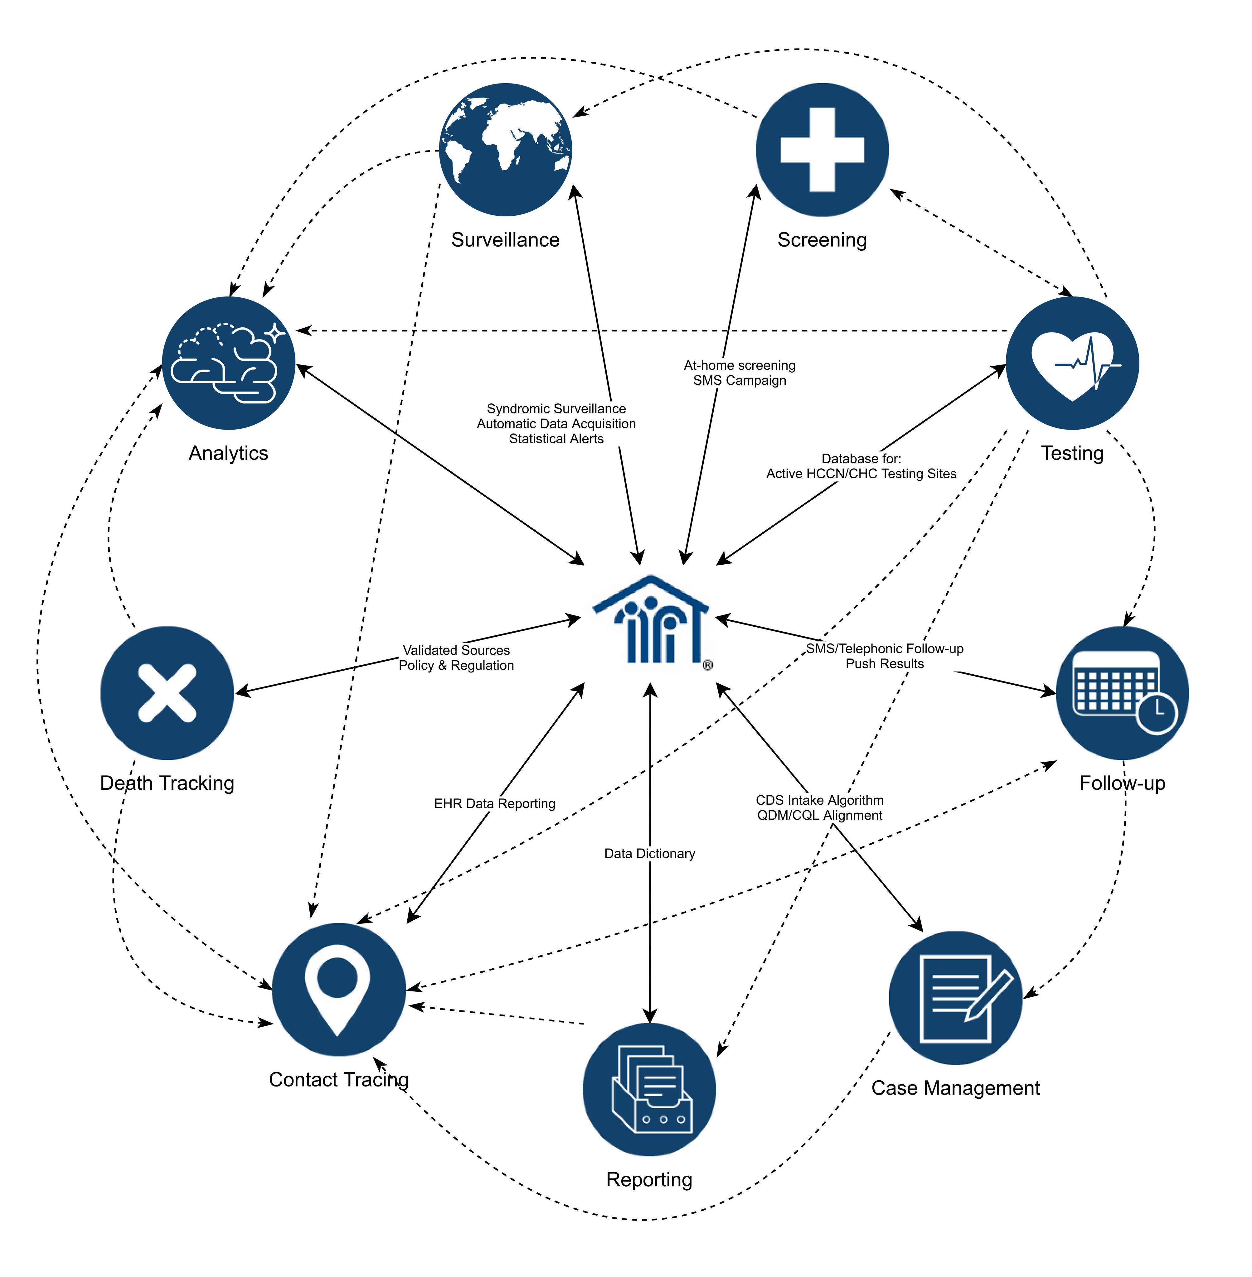
FQHC/Partner Engagement Strategy: Clinician and Informatics Learning Collaborative
Open learning community targeted for PCAs, HCCNs and FQHCs
Stakeholder presentations on services & innovations that can advance partner actions around different areas for data quality, interoperability and quality improvement

Slide 33

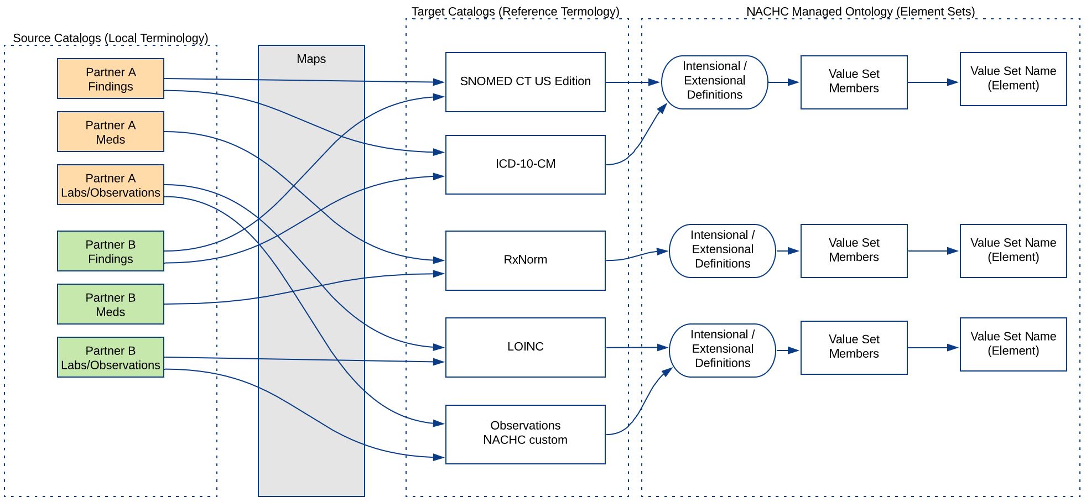
Terminology Normalization and Value Set Data Model

Slide 34
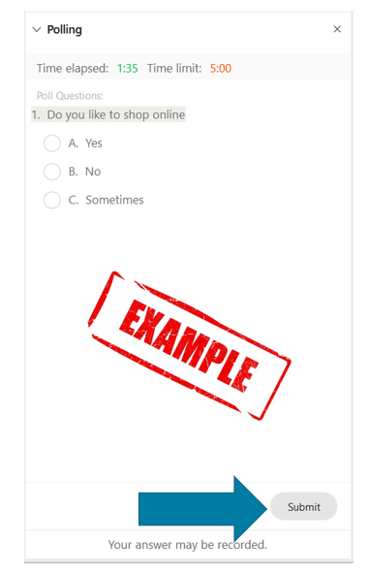
POLL
After reviewing and discussing USCDI v3:
Strongly support USCDIv3 comments on discussed data elements
Valuable, but needs comments for modifications to draft v3 data elements
I’m not sure
Not a priority

