Slide 1
Office Hour for
Clinical Leaders & Care Teams:
Combating Misinformation and Disinformation Related to the COVID-19 Vaccination
Wednesday, January 26, 2022
This project is supported by the Health Resources and Services Administration (HRSA) of the U.S. Department of Health and Human Services (HHS) as part of an award totaling $6,625,000 with 0 percent financed with non-governmental sources. The contents are those of the author(s) and do not necessarily represent the official views of, nor an endorsement, by HRSA, HHS, or the U.S. Government. For more information, please visit HRSA.gov.

Slide 3
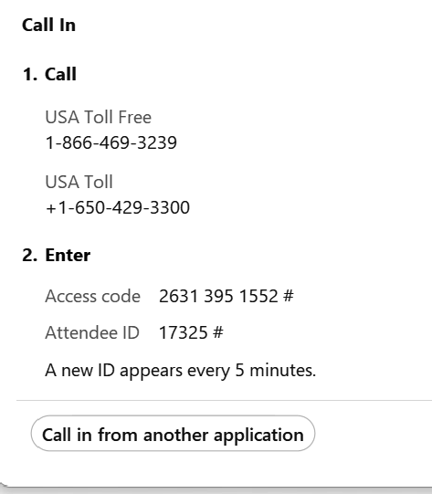
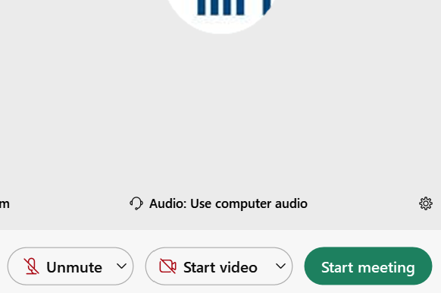


Ensure you’ve connected to audio!
Option 1: “I Will Call In”
Follow the unique 3-step process on your screen
Option 2: “Call Using Computer ”
You must have computer speakers and microphone
After connecting, if you don’t see a phone/headset icon next to your name, please attempt to connect your audio again!

Slide 4
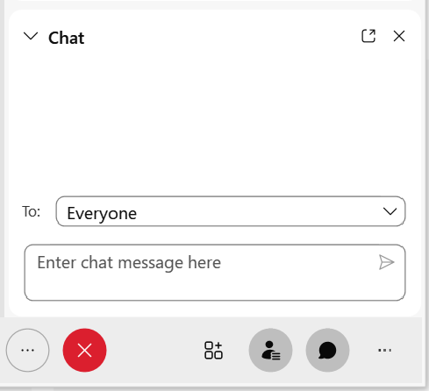
ASKING QUESTIONS VIA CHAT BOX
The chat feature is available to ask questions or make comments anytime.
Click the chat button at the bottom of the WebEx window to open the chat box on the bottom righthand side of the window.
Choose “EVERYONE”, as appropriate.
- Type your question.
- Click “Enter” to send your question.
Questions from the chat will be answered and later posted on the NACHC website (www.nachc.org).

Slide 5

Friendly Reminders
Today’s Event is being RECORDED
All attendee lines have been MUTED
The CHAT BOX is open for the duration of this event
Questions from the CHAT BOX will be answered after the presentation is completed.

Slide 6
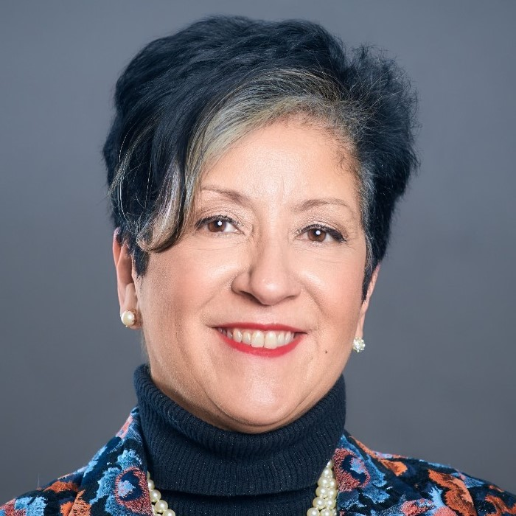
Wanda Montalvo, PhD, RN, FAAN
Senior Fellow, Public Health Integration and Innovation
National Association of Community Health Centers wmontalvo@nachc.com
Twitter: @Montalvo501
Dr. Montalvo is an executive nurse leader and innovator with expertise in quality improvement, health disparities, philanthropy, and research. She is an avid public health advocate with a successful track record of engaging diverse stakeholders from academia, philanthropy, federal agencies, and community-based organizations. Her national work includes the National Health Disparities Collaborative as Northeast Cluster Director. As a Senior Fellow for Public Health Integration, and Innovation at NACHC, Dr. Montalvo provides technical support for public health systems change with a focus on peer learning, health disparities, health equity, and transforming new models of care.
Dr. Montalvo earned her Ph.D. from Columbia University School of Nursing and has several peer-reviewed publications. She has served on several federal and philanthropic national advisory committees, and as a Fellow of the American Academy of Nursing is serving on the Development Committee.

Slide 7
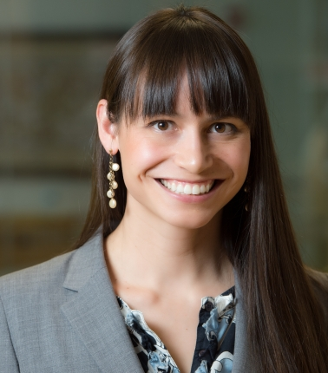
Tara Sell, PhD, MA
Senior Scholar and Assistant Professor
Johns Hopkins University Center for Health Security tksell@jhu.edu
Dr. Sell is a Senior Scholar at the Johns Hopkins Center for Health Security and an Assistant Professor in the Department of Environmental Health and Engineering at the Johns Hopkins Bloomberg School of Public Health. Dr. Sell’s work focuses on improving public health policy and practice in order to reduce the health impacts of disasters and terrorism. She has led several studies on public health communication during the Zika outbreak and misinformation during the 2014 Ebola outbreak. She is now working on misinformation during the COVID-19 outbreak. Prior to her work in academia, she was a professional athlete and won a silver medal in the 2004 Olympics.

Slide 8
Learning
Objectives
Describe the difference between disinformation and misinformation
Understand the subversive tactics and harm disinformation and misinformation has on their community and public health
Identify at least three tactics to discuss misinformation and disinformation with those who may believe it
Leverage communication strategies to better promote health and digital literacy in their local communities related to COVID
Discuss the importance of working with a cross-section of partners to safeguard the community against disinformation and misinformation
Care Team combating mis/disinformation during COVID

Slide 9
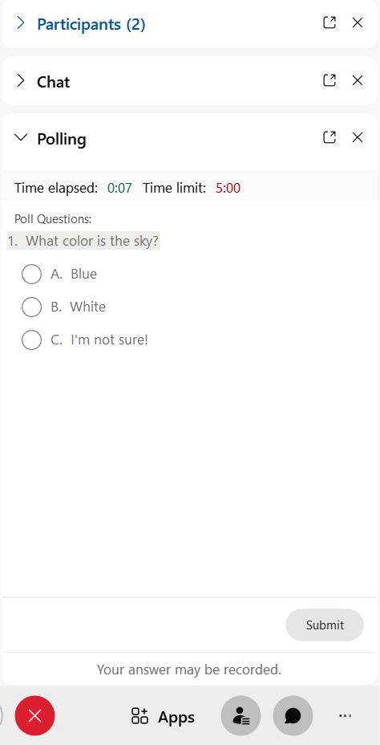
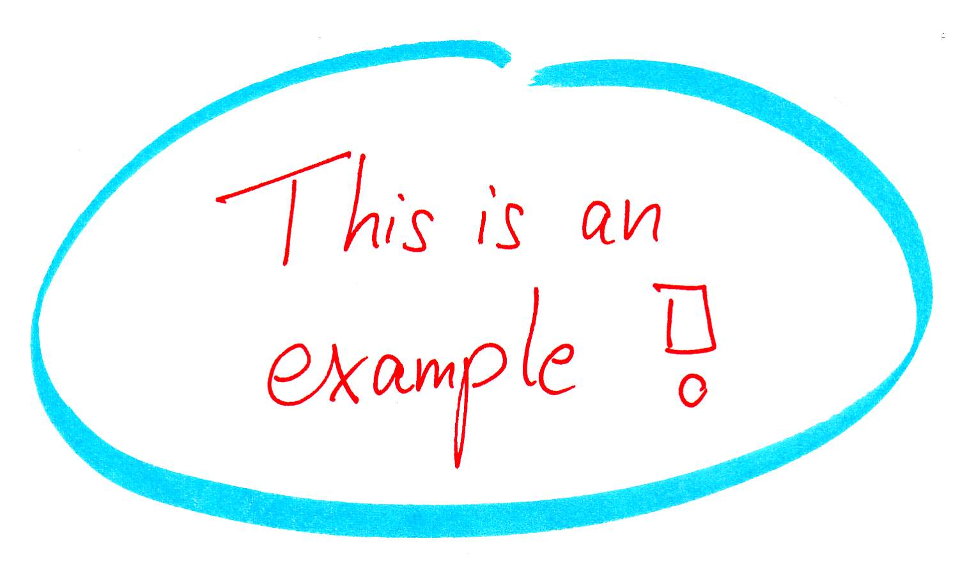

Poll Question #1
During daily patient encounters, how often are you addressing Mis/Disinformation in a 15-20-minute visit?
  Not at all
  A little (1-3 min)
  Much time (4-5 min)
  Very Much time (6-10 min)

Slide 10
Messaging
Matters
Co-design
Listening
Sessions
Special thanks to participating organizations:
Albany Area Health
Eisner
Esperanza
Health Partners of Ohio
Heart of Ohio
FHC of Georgia
Hamilton Health Center
Spectrum Health
Urban Health Plan
And
Community Health Worker Group

Slide 11
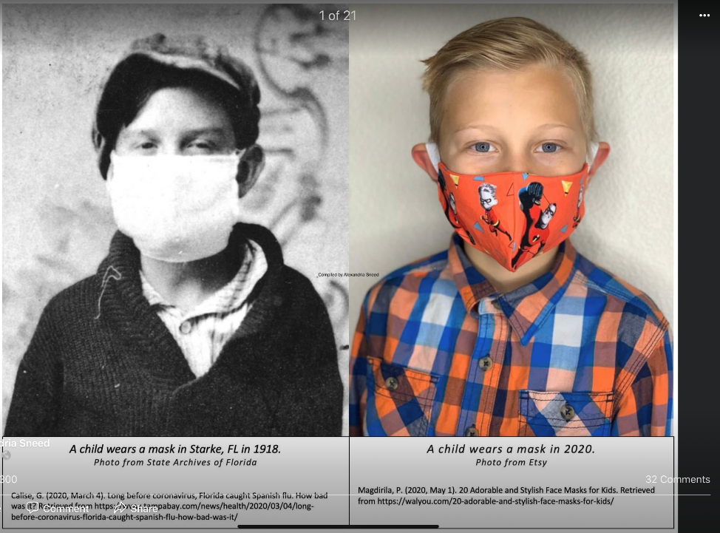

We’ve been
Here
Before
1918
Vs
2020

Slide 12
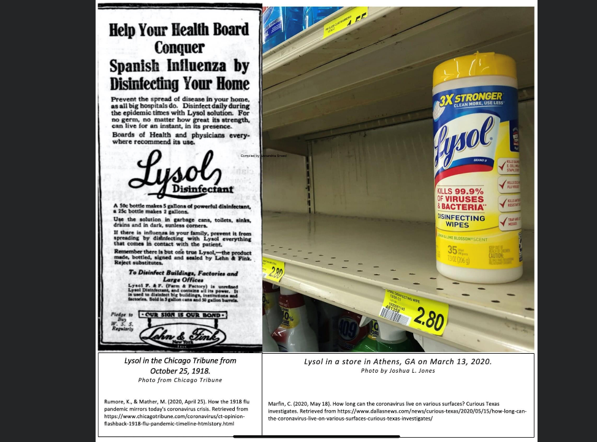

Slide 13
Staff Listening Session
Q 1. Please give us a sense about why you at this point have no plans to get vaccinated?
“There are a lot of other diseases that’s going on around the country for years but have no vaccination, no cure for those things. Then, they just to come up with this pandemic and develop a vaccine overnight?”
“I don’t trust the government”
  “Medicine, it's a lot of money in medicine so it's like, why is this particular one medication free? I gotta pay for the other medicines. Yeah, so some red flags up. But you still have a decision right, me personally.”
“It’s going in my body, it’s scary”
  “What are the ingredients?”
  “What are the side-effects of the vaccine? You don’t hear a lot about people who have had a reaction”
NACHC Messaging Matters

Slide 14
Staff
Listening Session
Q 1. Please give us a sense about why you at this point have no plans to get vaccinated?
“For me is the is the fear mongering that they're doing.”
“Vaccine developed too fast and now you have to get a booster, it’s just too much”
Complexity of the cognitive demands of decision making
“My thing with the vaccine is which one? Had there been only one available, I think that would have been a lot easier to just digest getting it regardless to what the side effects might possibly be”
NACHC Messaging Matters

Slide 15
Staff
Listening Session
Reliability of information
“I don't really think a lot of people find reliable information from reliable sources. It's mostly... I'm not saying all people. Most people. Even for myself. I don't think I've researched it honestly, on a reliable source
“I don’t trust any of the images that came out of NYC, those refrigerator trucks filling up with dead people”
“One pastor showed us a large needle being used to inject a tracking device. But when I went to get my vaccine, the needle was small.”
NACHC Messaging Matters

Slide 16
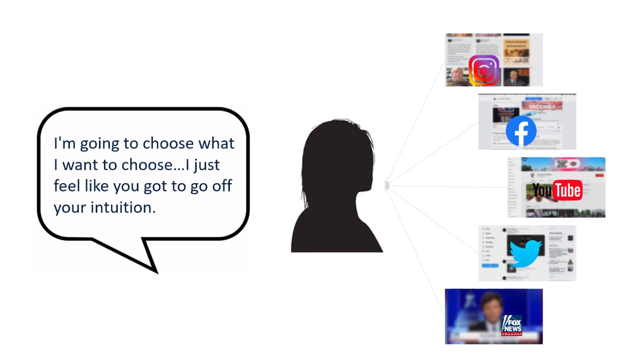

Slide 17
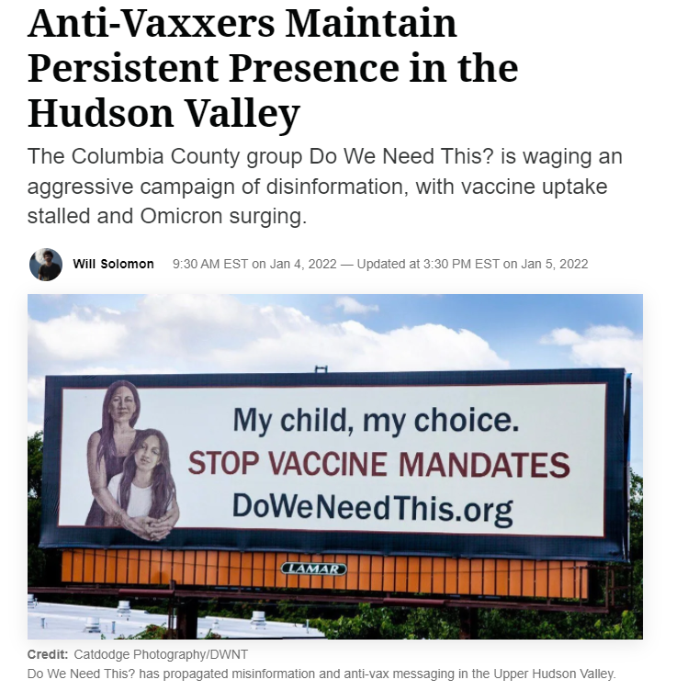

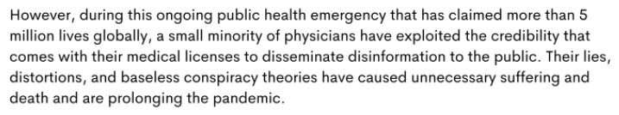

Slide 18
Patient Listening Session
Questions
Care Team Dealing with Stressors
“As a provider, I worry about the people you don't see because they come annually or six months. You haven't had chance for that one-on-one conversation. They’ve getting information on what's on TV or news or anything else. The challenge is having time to discuss COVID vaccine because it doesn't mean they don't still have uncontrolled asthma, or high blood pressure or whatever in your 15-minute visit.”
NACHC Messaging Matters

Slide 19
Core Themes and Still More to Learn
The Big Push
COVID vaccines are unnecessary
COVID vaccines don’t work
What’s the point, why get the vaccine if you can still transmit and/or get COVID
They’re lying about the side effects
It’s my body, it’s my choice
They’re using the vaccine to control us
People are really upset about vaccine mandates
People don’t trust the vaccine for their kids
Messaging Matters

Slide 20
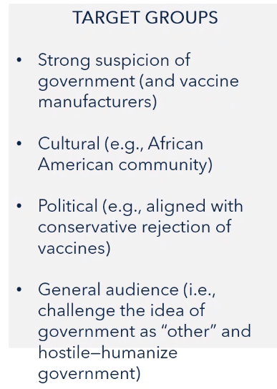
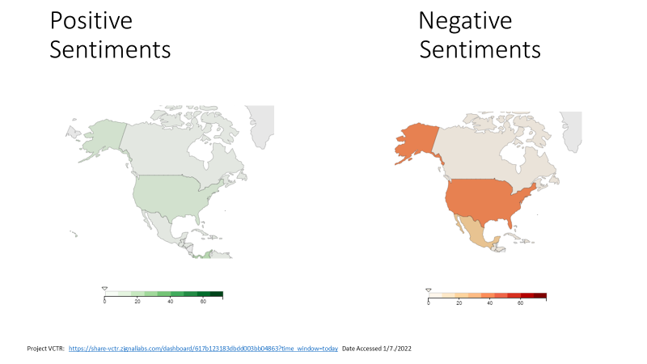
Narrative: It’s about freedom; vaccines are unnecessary; The “Big Push”

Slide 21
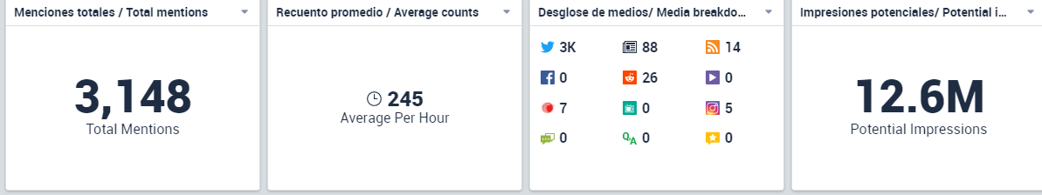
Example: hillmd.substack.com
Vaccine batches vary systematically in toxicity and are distributed to unsuspecting Americans by three companies: researcher

Slide 22
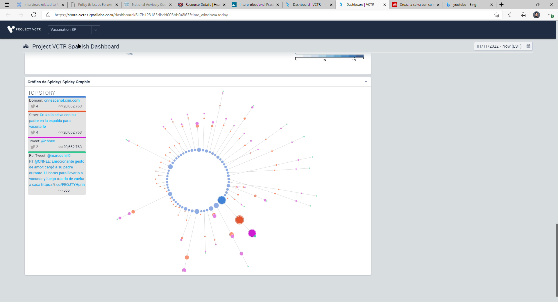
Mis/Disinformation spreading via social media
Resharing, especially by an INFLUENCER with a high number of followers = higher number of “impressions”
More people view and read the message across our communities

Slide 23
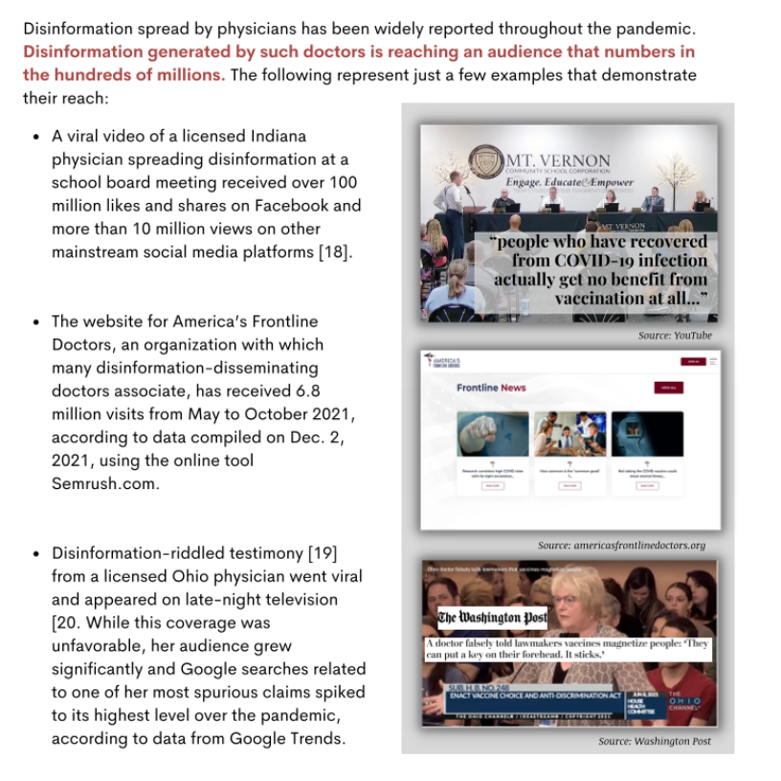
Source: www.disinformationdoctors.com

Slide 24
Poll Question #2
What is the economic impact as a result of Mis/Disinformation per day?
  1 Million per day
  5 Million per day
  10 Million per day
  30 Million per day
  >50 Million per day

Slide 25
Care Team: Critical Stakeholders to Combat Mis/Disinformation Harming Communities During COVID-19
Tara Kirk Sell, PhD
Senior Scholar Johns Hopkins Center for Health Security
Assistant Professor, Department of Environmental Health and Engineering
NACHC Webinar
January 26, 2022

Slide 26
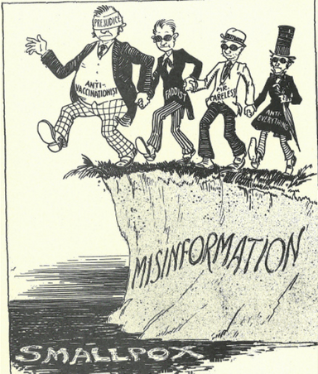
Health-related misinformation – Nothing new
Source: “Health in Pictures,” 1930, American Public Health Association
Fact check: https://www.snopes.com/fact-check/1930s-cartoon-vaccine-warning/

Slide 27
Ways to Check for False Information
Use web-based tools to assess source credibility
Verify with other news sources, fact checking sites
Review other content from the source (evaluate level of editorial oversight)
Be wary of messages designed to appeal to emotions
Increase awareness of disinformation tactics
Understand your own personal biases and capacity to change opinion when presented with new evidence

Slide 28
Misinformation and Disinformation - Definitions
Misinformation – information that is false in the context of scientific understanding of the time, often the result of ignorance or poor understanding
Disinformation – purposefully created and disseminated falsehoods, in the context of scientific information of the time

Slide 29
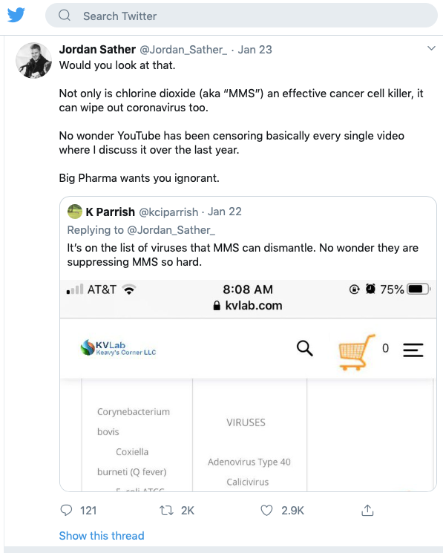
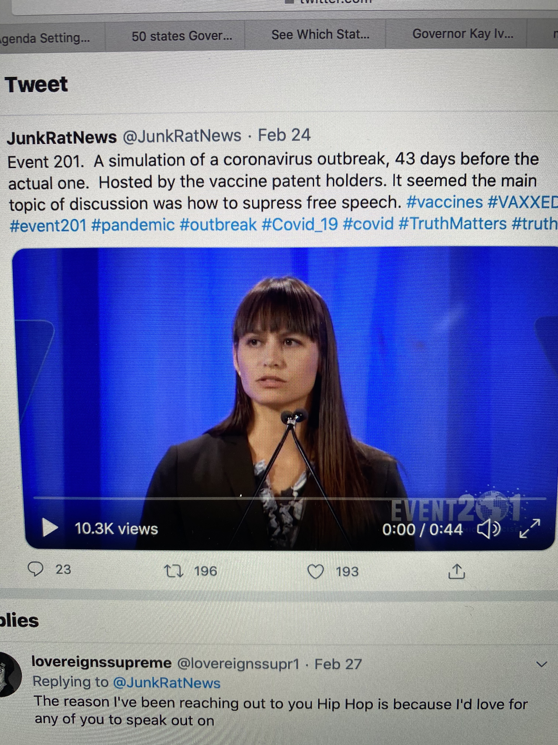
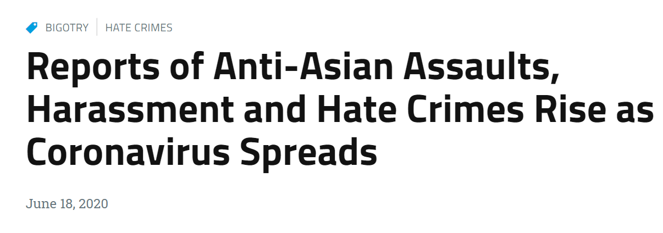
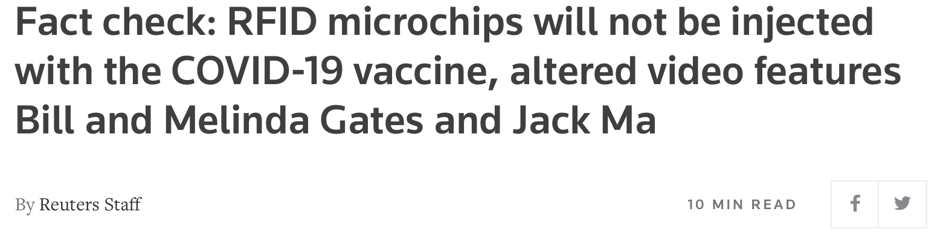
Misinformation Rumor Types
False Cures
Conspiracies (including profiteering)
Mischaracterizing disease or protective measure
Scapegoating

Slide 30
Historical health-related misinformation and disinformation campaigns
(a sample)
Operation Denver - Russian Disinformation campaign suggesting that the US had created HIV/AIDS
Tobacco in the US
Pamphleting related to measles vaccination amongst ultra-Orthodox Jews in New York
Ebola in the US
Notes:
In some ways tobacco has been shaped around America’s core political values such as freedom – the freedom to smoke cigarettes
Measles

Slide 31

Ebola Tweets and Misinformation
True Information
Half-true /
Misinterpreting the Truth
A Texas patient is the first confirmed Ebola case that has been diagnosed in the US
THERE IS AN EBOLA PATIENT IN A FAIRFAX COUNTY HOSPITAL I'M GOING TO CANADA
False Information
Unable to
Ascertain the Truth
Renown #NSA #Whistleblower: #Ebola Could Be Staged Event To Pillage Africa's Natural Resources | EPIC @Infowars #News
Ebola mathematics stark warning of disease's spread http://t.co/1yHn2mMwEW
Sell TK, Hosangadi D, Trotochaud M. Misinformation and the US Ebola Communication Crisis: Analyzing the veracity and content of social media messages related to a fear-inducing infectious disease outbreak. BMC Public Health. 20, 550 (2020)
Image: Pixabay

Slide 32
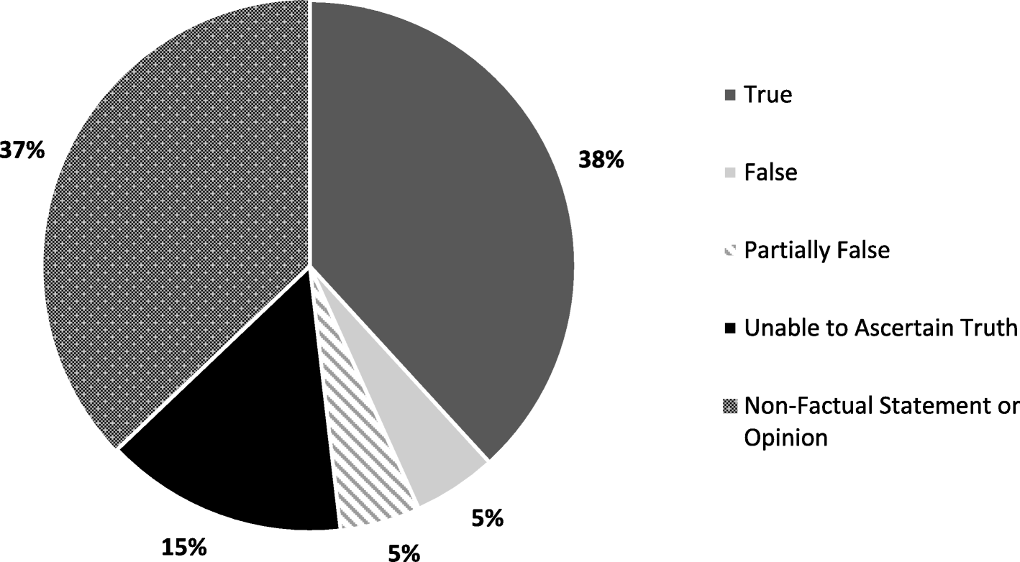
Prevalence of Misinformation and True Information Among Non-Joke Tweets
Notes:
We learned that misinformation can come in many forms, making it harder for people to determine what information is correct. While about 5% of the tweets we reviewed were false, another 5% were partially true or subtle misinterpretations of true information. While it may seem simple to label information as either true or false, we found making this distinction to be incredibly nuanced. In the process of hand coding thousands of tweets, even trained coders with public health expertise sometimes found that distinguishing between true and misleading information was challenging and required the combined judgement of several people. Many people may not be able to take the time to carefully and objectively verify nuanced half-truths, instead making judgements based on their own knowledge, experiences, and worldview.

Slide 33
Promotes Discord or Provokes a Response
We have to fight Obama and stop him from bringing Ebola patients from Africa to US. #BanFlights #NoEbolaPatients #tcot #tiot #WAARMedia
Goodnight. Remember: The GOP healthcare plan will kill you long before #Ebola will: #p2 http://t.co/bW0GMB2F8v
BUSTED! Disaster Teams Were Notified Months Ago They Would Be Activated in October! #Ebola http://t.co/eOC77HUEH4
#GOP is worried about #Ebola getting over the border... Mr. Duncan Flew in Legally [profanity]; he didn't sneak in from Mexico #tcot #p2 #bbc
Sell TK, Hosangadi D, Trotochaud M. Misinformation and the US Ebola Communication Crisis: Analyzing the veracity and content of social media messages related to a fear-inducing infectious disease outbreak. BMC Public Health. 20, 550 (2020)
Image: Pixabay

Slide 34
Other interesting findings
  42% contained risk elevating messages
  The most frequent rumor mentioned focused on government conspiracy.
Tweet Characteristic | Tweets Containing Misinformation | Tweets Without Misinformation | P value
Promotes discord | 45% | 26% | <0.001
Political | 36% | 24% | <0.001
Risk Increasing | 76% | 39% | <0.001
Notes:
We found a strong tie between misinformation and political content. We had initially, and perhaps naively, thought that misinformation during a health event like an Ebola outbreak would primarily be framed in a health context. Instead, we observed great overlap in misinformation, political tweets, and tweets that seemed designed to induce societal discord.Additionally, both the 2014 Ebola outbreak and COVID-19 have occurred during contentious US election years, and there are indications that COVID-19 misinformation has been politicized. An important lesson emerging from this is that public health events, response activities, and communication efforts, while often apolitical in their inception, can be vehicles for messages that serve goals beyond ensuring the health of the public.

Slide 35
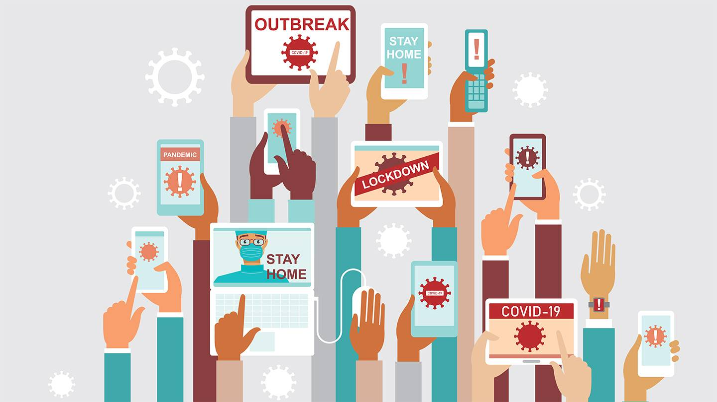
Misinformation and Disinformation During the COVID-19 Pandemic
Photo Courtesy of JHU Bloomberg School of Public Health (2021) https://hub.jhu.edu/2020/03/27/mark-dredze-social-media-misinformation/

Slide 36

Infodemic
Rapid, large-scale spread of health information and misinformation through a variety of media and informational channels
This overabundance of information—some accurate and some not—makes it difficult for people to differentiate between false and true information

Slide 37
Misinformation during COVID-19: A collision of many factors
Novel virus with limited and emerging information
Few medical countermeasures initially
Expansive social, political, and economic dimensions of the pandemic
Existing social unrest and division
Expanding access to and ability to provide content
Large and monetized media market
Declines in science and digital literacy

Slide 38
Sticks and Stones
COVID-19 vaccine misinformation and disinformation costs an estimated $50 to $300 million each day
An effort that reduced or countered misinformation and was able to reduce related non-vaccination by 10% would be worth between $5 and $30 million per day
Bruns R, Hosangadi D, Trotochaud M, Sell TK. COVID-19 Vaccine Misinformation and Disinformation Costs an Estimated $50 to $300 Million Each Day. October 20, 2021. The Johns Hopkins Center for Health Security. Baltimore, MD. https://www.centerforhealthsecurity.org/our-work/publications/covid-19-vaccine-misinformation-and-disinformation-costs-an-estimated-50-to-300-million-each-da
Notes:
But how worth it is it? Our misinformation study group, with the help of our economist Richard Bruns, did a conservative cost analysis to try to get at the idea of this
While the research to establish exact, high-confidence monetary costs is limited by the lack of detailed data, we are trying to begin to fill this gap by looking at the monetized cost of just one facet of this issue – the misinformation and disinformation informed decision to not get a COVID vaccine.
Our bottom line number is that if even 5% of non-vaccination is caused by misinformation and disinformation, it leads to at least $50 million worth of harm every day in a non-Delta surge environment like we saw in June and July and hope to get back to in the next few months
If it’s 30%, that number increases to $300 million dollars per day.
But this means that a public health effort that reduced or countered misinformation and was able to reduce related non-vaccination by 10% would be worth between $5 and $30 million per day
And just to put that in monthly terms – that’s between $150 million and $900 million per month while the pandemic continues.

Slide 39
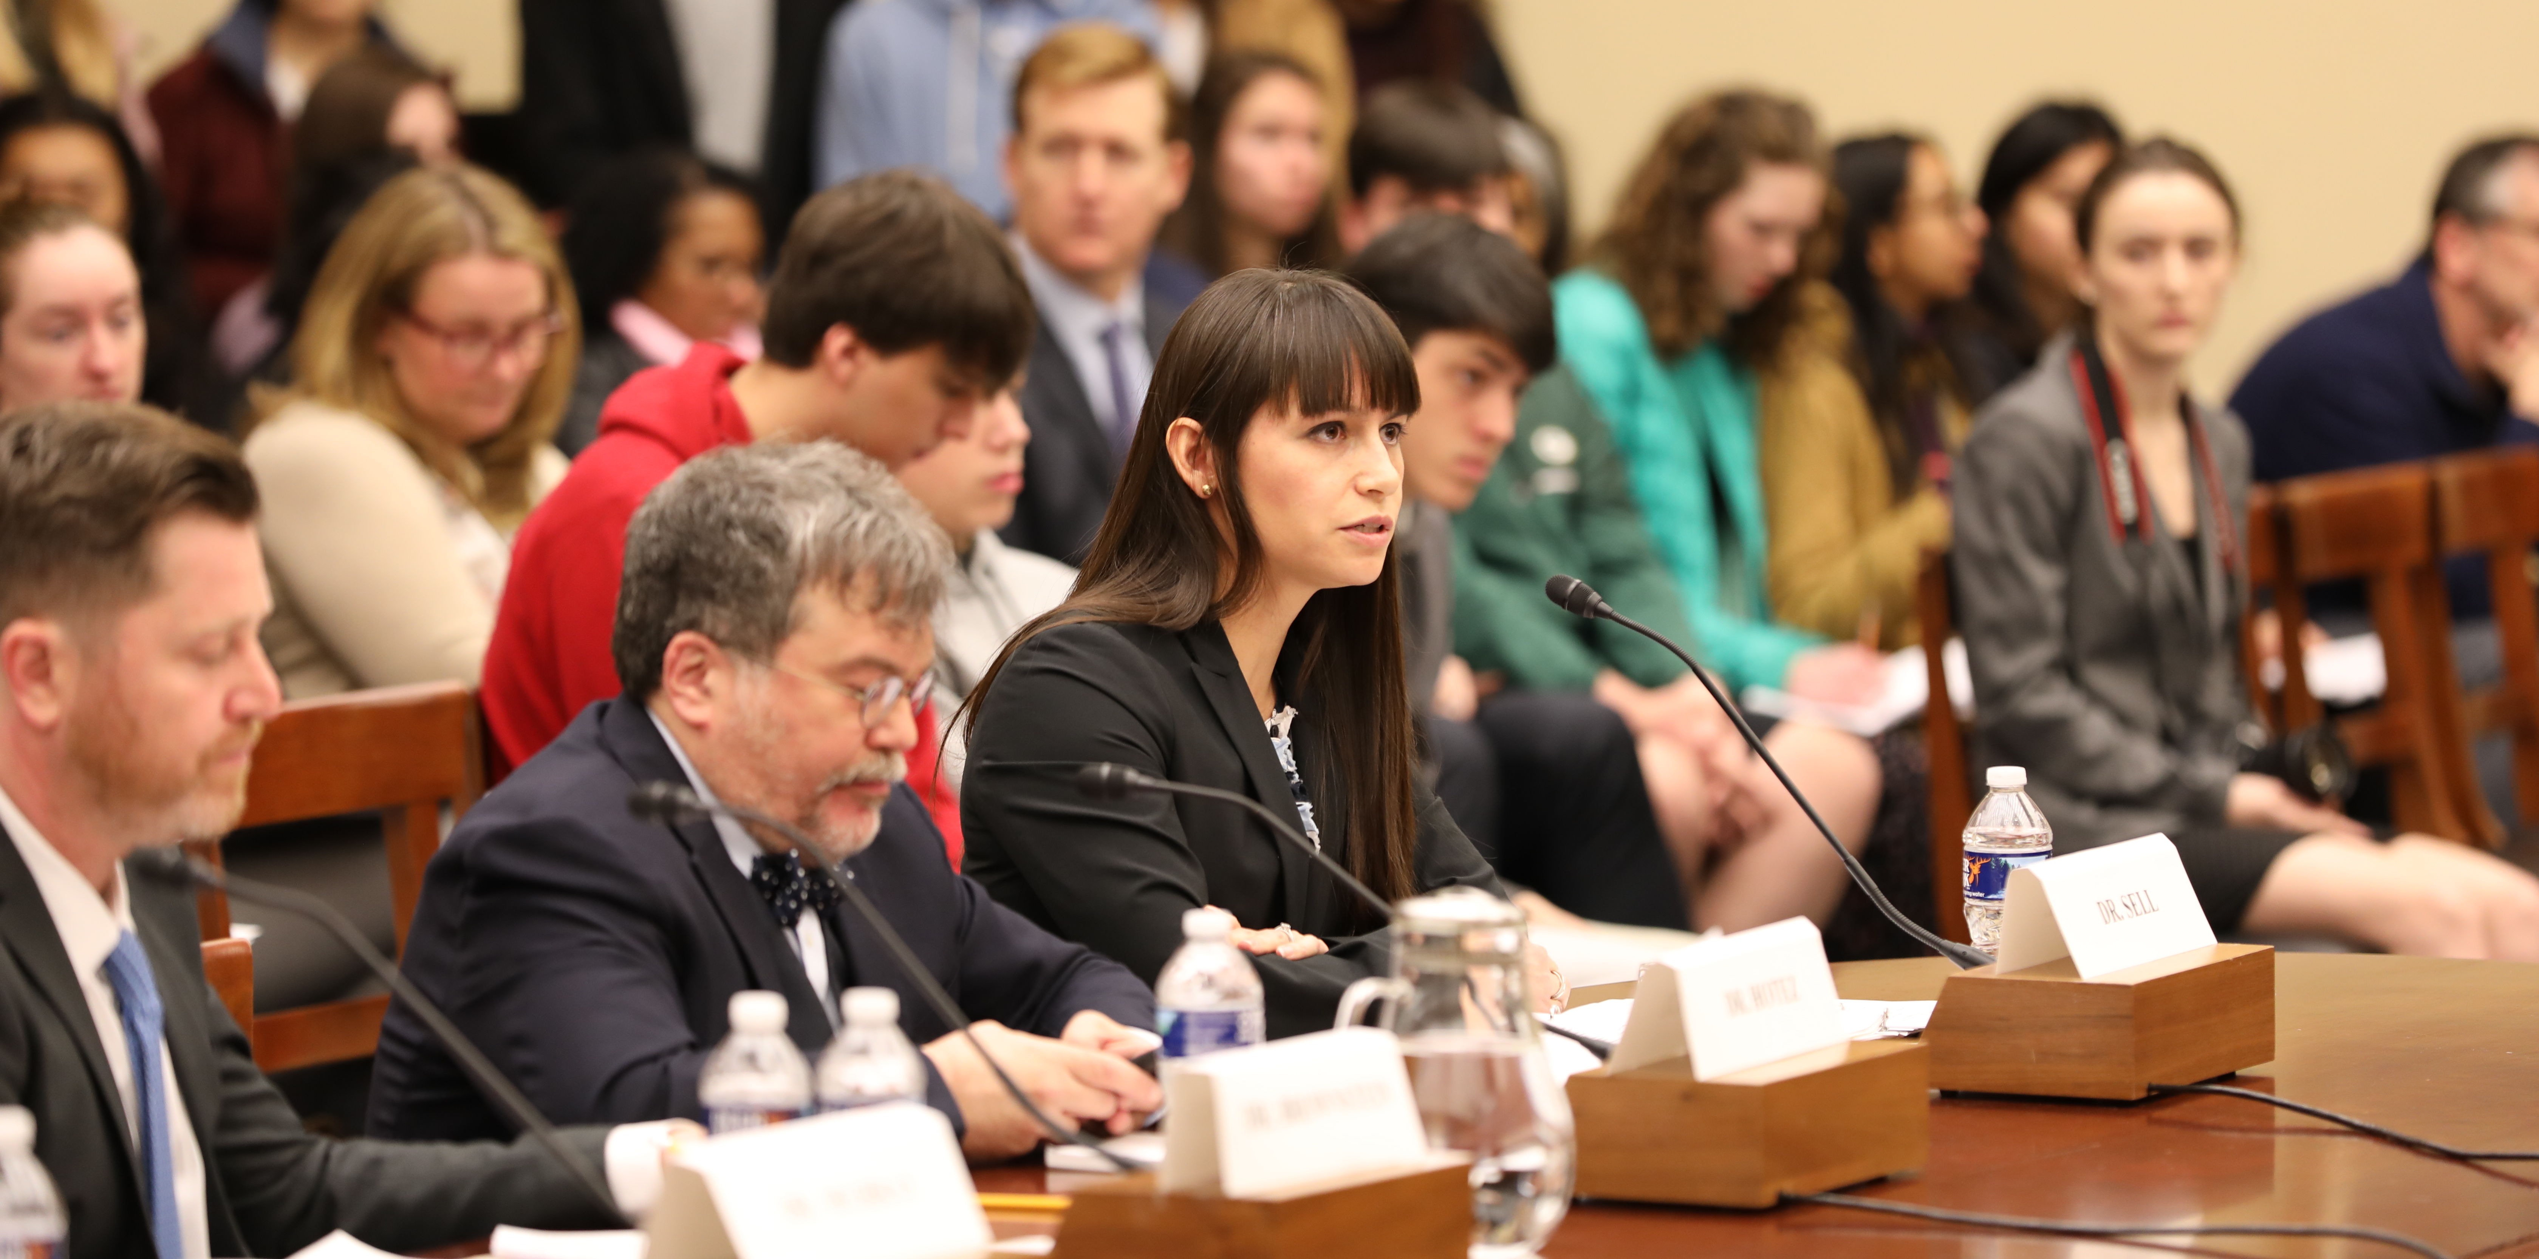
Need for Large-Scale Policy change
National strategy
Inclusion of socio-behavioral concepts in tech development
Forecasting
Investment in public health communication

Slide 40
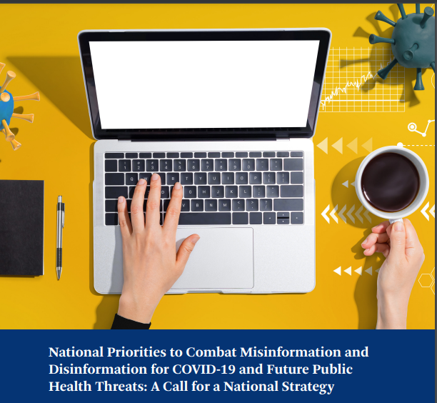
National Priorities to Combat Health Related Misinformation and Disinformation
A Call for a National Strategy
Notes:
Legislation introduced by Rep Swallwell

Slide 41
Pillar 1: Control misleading content and sources
Prioritize as a national security issue
Establish a national commission to provide guidance and recommendations
Encourage active, transparent, intervention from social media and news media companies

Slide 42
Pillar 2: Promote factual information
Prioritize public health risk communication
Increase coordination between public health experts and sources of public information.
  Social media platforms
  News media

Slide 43
Pillar 3: Increase public resilience
Safeguard and promote health and digital literacy
  Schools, community organizations, social media, news media, and others
Improve resources for public verification of questionable content
  Fact-checking sites
  Digital tools to vet sources

Slide 44
Pillar 4: Collaboration of all stakeholders
Ensure multisector collaboration
  Social media, news media, government, national security officials, public health officials, scientists, the public, and others.
Increase coordination across the government
  Department of Defense, Department of Health and Human Services, and Department of Homeland Security as well as intelligence agencies.

Slide 45
Some legislative efforts
Section 230 legislation – Health Misinformation Act (Klobouchar/Lujan)
Hold social media companies liable for harmful health-related misinformation (determined by HHS)
Concerns about transparency
Biosecurity Information Optimization - BIO Defense Act (Swalwell)
National Strategy to combat biodefense misinformation
Local legislation declaring misinformation a public health emergency
San Diego County
Sacramento County
Monterey County
CA State Assembly
(Follows Surgeon General’s report)

Slide 46
Responding to people who believe false information
Engage respectfully
Connect on values
Talk about tactics – how misinformation draws you in
Encourage verification
Provide true information and alternative information sources
Discuss alternative Explanations

Slide 47
When you come across false information
Don’t promote the lie!
If you don’t know the source or the source is not legitimate, limit direct engagement
Report it to social media companies
Provide true information

Slide 48
Critical Needs
Maintaining and building trust
Working with trusted community members
Be transparent – collect data and share it
Engaging with identity
Values, core beliefs, affiliations
Listen to what the concerns are and what personal priorities they relate to
Communicating uncertainty
Foreshadowing change
Identify what is known, unknown, and what is being done to fill gaps

Slide 49

Future efforts
Anticipatory pre-bunking and de-bunking
Long road to rebuilding public trust in public health
Helping select populations – parents
  https://www.coursera.org/learn/covid-vaccine-ambassador
Policy that reflects the needs of today
  Transparent
  Clear definitions
  Restrained
Notes:
So to sum this up – we know that we are going to have to take health related misinformation and disinformation seriously now and for the forseeable future. We can’t be prepared for big events if we haven’t started moving toward solutions. And from our cost analysis – it’s worth it to make big investments to find those solutions. A good place to begin is with a unified national strategy.

Slide 50
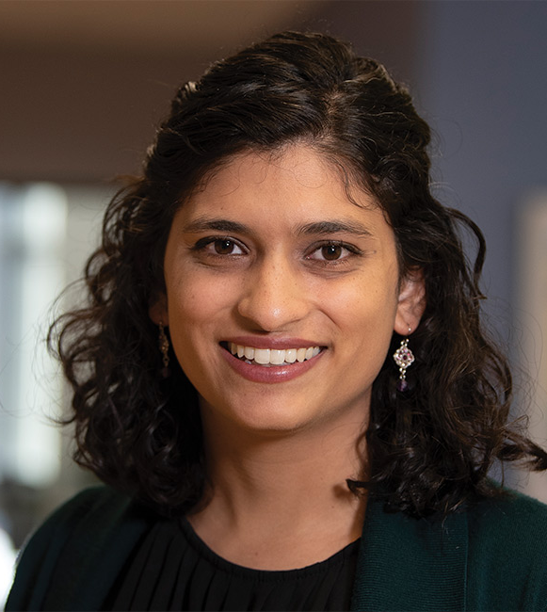
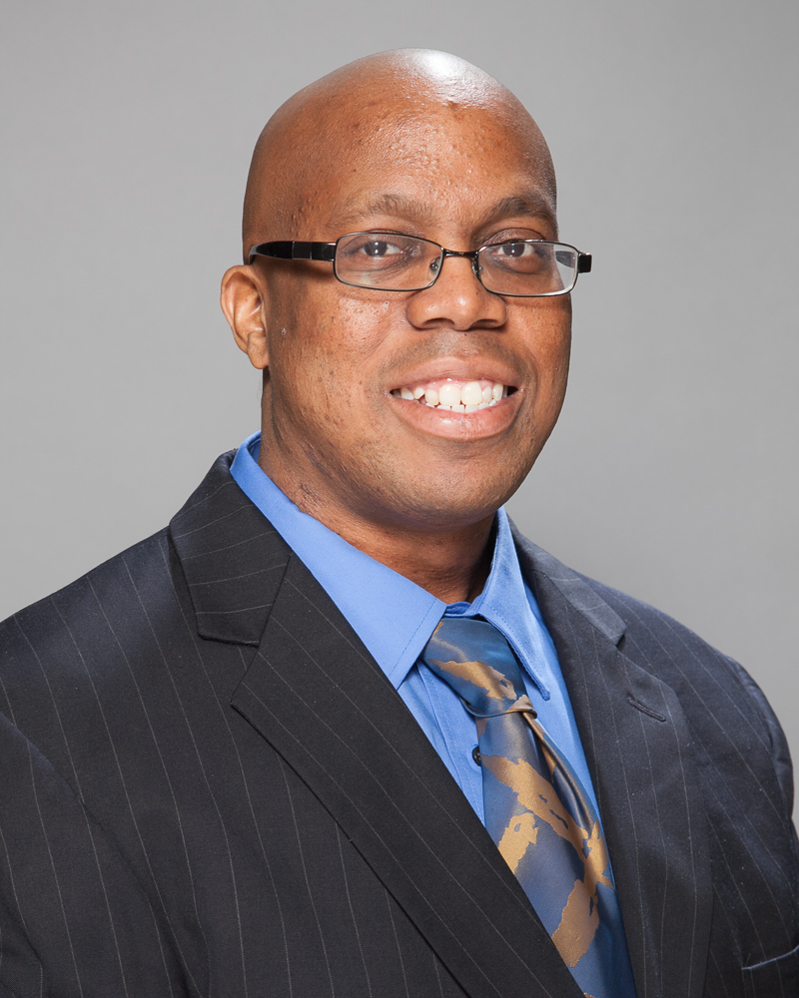
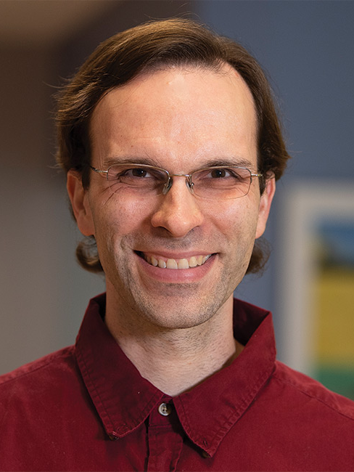
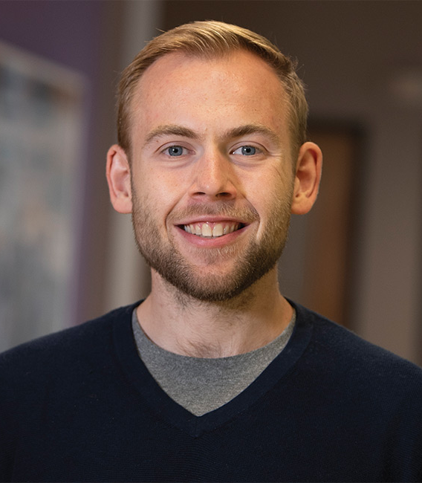
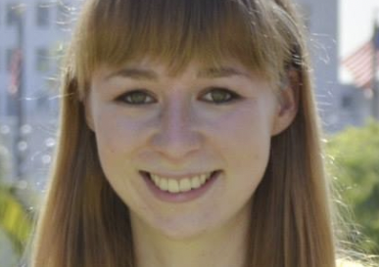
Thanks to the misinformation research team
Richard Bruns, PhD; economist
Divya Hosangadi, MSPH; senior analyst
Marc Tortochaud, MSPH; senior analyst
Annie Sundelson, MS; doctoral student
Johnross Ford, MHS; research assistant

Slide 51

Q&A
www.nachc.org

Slide 52
Resources
A Community Toolkit for Addressing Health Misinformation
American Nurses Association (ANA) COVID-19 Resource Center
COVID Vaccine Ambassador Training: How to Talk to Parents
How Can I Talk to My Friends and Family About Getting Vaccinated for COVID-19?
Learn more about the COVID-19 vaccines
NACHC COVID-19 Information and Resources
Vaccine Insights Flexible Learning Course

Slide 53
FOLLOW US

Slide 54

THANK YOU TO ALL COMMUNITY HEALTH CENTERS
#ThankYouCHCs
This project is supported by the Health Resources and Services Administration (HRSA) of the U.S. Department of Health and Human Services (HHS) as part of an award totaling $6,625,000 with 0 percent financed with non-governmental sources. The contents are those of the author(s) and do not necessarily represent the official views of, nor an endorsement, by HRSA, HHS, or the U.S. Government. For more information, please visit HRSA.gov.

