Slide 1

Community
Health
Center
Chartbook
2022

Slide 2
About Community Health Centers
The National Association of Community Health Centers (NACHC) is pleased to present the Community Health Center Chartbook, an overview of the Health Center Program and the communities they serve. Health centers began over fifty years ago as part of President Lyndon B. Johnson’s “War on Poverty.” Their aim then, as it is now, is to provide affordable, high quality, comprehensive primary care to medically underserved populations, regardless of their insurance status or ability to pay for services. A growing number of health centers also provide dental, behavioral health, pharmacy, and other important services. No two health centers are alike, but they all share one common purpose: to provide primary and preventive health care services that are coordinated, culturally and linguistically competent, and community-directed.
Health centers play a critical role in the U.S. health care system, delivering care to over 29 million* people today. They stand as evidence that communities can improve health, reduce health disparities, generate taxpayer savings, and deal with a multitude of costly and significant public health and social problems – including substance use disorder, mental illness, natural disasters, and homelessness – if they have the resources to do so. In response to COVID-19, health centers quickly pivoted their operations to test and vaccinate hundreds of thousands of patients each month, while continuing to provide important health care services. Their work during this time has been vital to slowing the virus’s spread and reopening communities. Across the country, health centers produce positive results for their patients and for the communities they serve before and during the pandemic. Federal and state support, along with third party reimbursement, are critically important to keep pace with escalating health care needs and rising costs among populations served by health centers.
Who health centers serve, what they do, and their impressive record of accomplishments in keeping communities healthy are represented in this chartbook.
* Includes patients of federally-funded health centers and look-alikes.

Slide 3
About this Chartbook
The Community Health Center Chartbook highlights important research and data on Health Center Program Grantees, as well as other Federally-Qualified Health Centers (FQHCs). In this document, unless otherwise noted, the term “health center” is generally used to refer to organizations that receive grants under the Health Center Program as authorized under section 330 of the Public Health Service Act, as amended (referred to as “grantees”). Data and research sources can be found at the bottom of each figure. Most slides draw from the Uniform Data System (UDS) maintained by the Bureau of Primary Health Care, HRSA, DHHS. UDS data included in this chartbook are limited to health centers that meet the federal grant requirements and receive federal funding from the Bureau of Primary Health Care. For more information about UDS data, visit https://bphc.hrsa.gov/uds/datacenter.aspx.

Slide 4
Table of Contents
Section 1: Who Health Centers Serve
1-1 Health Centers Serve…
1-2 Health Centers Serve Many Special Populations
1-3 Health Centers Serve Greater Proportions of Special Populations
1-4 Health Center Patients are Predominately Low-Income
1-5 Most Health Center Patients are Uninsured or Publicly Insured
1-6 Health Center Patients are Disproportionately Poor, Uninsured, and Publicly Insured
1-7 Health Center Patients are Disproportionately Members of Racial/Ethnic Minority Groups
1-8 Health Center Patients Suffer from Chronic Conditions at Higher Rates than the General Population
1-9 Health Center Patients are Growing Increasingly Complex, with Higher Rates of Chronic Conditions than in Previous Years
1-10 Health Centers are More Likely to Have Patients with Chronic Conditions than Private Practices
1-11 Health Centers Serve Patients Throughout the Life Cycle
1-12 Health Center Patients Ages 65 and Older are the Fastest Growing Age Group
Section 2: Expanding Access to Care
2-1 Number of Federally-Funded Health Center Organizations, 2020
2-2 Growth in Health Center Organizations and Sites, 2010 – 2020
2-3 Growth in Health Center Patients and Visits, 2010 – 2020
2-4 Health Centers Have Expanded Their Capacity To Provide More Services Onsite
2-5 Health Centers Have Higher Rates of Accepting New Patients Compared to Other Primary Care Providers

Slide 5
Table of Contents
Section 2: Expanding Access to Care (Continued…)
2-6 Health Center Patients by Insurance Status, 2010 - 2020
2-7 Percent of Medicaid Beneficiaries Served by Health Centers, 2020
2-8 Percent of Uninsured Population Served by Health Centers, 2020
Section 3: High Quality Care and Reducing Health Disparities
3-1 Health Centers Achieve Higher Rates of Hypertension and Diabetes Control than the National Average, Despite Serving More At-Risk Patients
3-2 Health Center Patients Have Lower Rates of Low Birth Weight than Their U.S. Counterparts, Despite Serving More At-Risk Patients
3-3 Enabling Services are a Defining Characteristic of Health Centers and Help Improve Access to Care and Patient Satisfaction
3-4 Health Centers Exceed Medicaid Managed Care Organization (MCO) High Performance Benchmark Scores
3-5 Health Centers Provide More Preventive Services than Other Primary Care Providers
3-6 Health Centers Reduce Unmet Health Care Needs
3-7 Women at Health Centers are More Likely to Receive Mammograms than Their Counterparts Nationally
3-8 Women at Health Centers are More Likely to Receive Pap Smears than Their Counterparts Nationally
3-9 Health Center Patients are More Likely to Receive Colorectal Cancer Screenings than Their Counterparts Nationally
3-10 Percent of Health Centers with Patient-Centered Medical Home Recognition, December 2020
3-11 Health Centers are Leaders in Patient-Centered Medical Home (PCMH) Certification and Adoption of PCMH Elements

Slide 6
Table of Contents
Section 4: Cost-Effective Care
4-1 Health Centers are Increasingly Participating in New Payment and Delivery System Models
4-2 Health Centers Save 24% Per Medicaid Patient Compared to Other Providers
4-3 Health Centers Have Lower Total Spending Per Medicaid Patient Compared to Other Providers
4-4 Health Center Medicaid Revenues as a Percent of Total Medicaid Expenditures
4-5 Health Centers are Associated with Lower Total Costs of Care for Medicare Patients Compared to Other Providers
4-6 Medicare Spending is Lower in Areas Where Health Centers Serve More Low-Income Residents
4-7 Health Centers Save 35% Per Child Compared to Other Providers
4-8 Health Centers Save $1,263 (or 24%) Per Patient Per Year
Section 5: Health Center Services and Staffing
5-1 Growth in Health Center Clinical Staff, 2010 - 2020
5-2 Health Center Care Team Staff Provide a Broad Array of Services
5-3 Health Centers Test Hundreds of Thousands of Patients for COVID-19 Each Week in 2020
5-4 Health Centers Rapidly Expanded Their Ability to Test Patients for COVID-19
5-5 Health Center Medical Services Staff, 2020
5-6 Health Centers are Hiring Non-Physician Providers at Higher Rates than Physicians
5-7 Health Center Enabling Services and Other Programs Staff, 2020
5-8 Health Center Dental Staff, 2020
5-9 Percent of Health Centers Offering Dental Services Onsite, 2020
5-10 Health Center Behavioral Health Staff, 2020

Slide 7
Table of Contents
Section 5: Health Center Services and Staffing (Continued...)
5-11 Health Centers Have Responded to an Increasing Need For Substance Use Disorder (SUD) Treatment and Therapy By Building Their Capacity and Integrating Care
5-12 Health Centers Have Responded to an Increasing Need for Substance Use Disorder (SUD) Treatment and Therapy by Seeing More Patients
5-13 Percent of Health Centers Offering Vision Services Onsite, 2020
5-14 Percent of Health Centers Offering Pharmacy Services Onsite, 2020
5-15 Percent of Health Centers Offering Four or More Services Onsite, in Addition to Medical Care
5-16 Health Centers are Using Telehealth to Expand Access to Needed Services
5-17 Health Centers’ Telehealth Utilization Increased Dramatically from 2019 - 2020
5-18 Health Centers are Adopting Innovative Telehealth Services at Higher Rates than Other Primary Care Providers
5-19 Medical Services Were the Most Common Service Delivered Virtually by Health Centers in 2020
Section 6: Challenges in Meeting Demand for Care
6-1 Payments from Third Party Payers are Less than Cost
6-2 Federal Health Center Appropriation History, FY10 – FY21
6-3 Health Center Funding Per Uninsured Patient is Well Below Total Per Patient Cost
6-4 Health Centers Experience Difficulty Recruiting Many Clinical Staff
6-5 Health Centers Have Unique Challenges Recruiting and Retaining Staff
6-6 Estimated Percent of County Residents Experiencing Shortages of Primary Care Physicians
6-7 Health Center Capital Project Plans and Funding Needs

Slide 8
Section 1
Who Health Centers Serve

Slide 9


Figure 1-1
Health Centers Serve
1 in 11 People in the U.S.
Including…
1 in 8 Children
1 in 7 Racial/Ethnic Minorities
1 in 5 Medicaid Beneficiaries
1 in 5 Uninsured Persons
1 in 3 People in Poverty
Sources: (1) NACHC, 2020. Based on 2019 Uniform Data System data on federally-funded and look-alike health centers, estimates for annual patient growth, and national data sources. (2) Bureau of Primary Health Care. 2020. Health Center Program Impact and Growth Factsheet. Available from https://bphc.hrsa.gov/about/healthcenterprogram/index.html

Slide 10











Figure 1-2
Health Centers Serve Many Special Populations
376,634
Veterans
658,551
School-Based Health Center Patients
1,287,854
Patients Experiencing Homelessness
977,744
Agricultural Worker Patients
5,187,617
Public Housing Patients
6,968,664
Patients Best Served in a Language Other than English
Source: 2020 Uniform Data System. Bureau of Primary Health Care, HRSA, DHHS.

Slide 11
Figure 1-3
Health Centers Serve Greater Proportions of Special Populations
* Health center population defined as residents of public housing includes all patients served at a health center located in or immediately accessible to a public housing site.
Sources: (1) 2020 Uniform Data System, Bureau of Primary Health Care, HRSA, DHHS. (2) Legal Services Corporation: Agricultural-Worker Population Estimates, Final Estimates, November 2021. (3) U.S. Department of Housing and Urban Development. The 2020 Annual Homeless Assessment Report (AHAR) to Congress, March 2021. (4) U.S. Department of Housing and Urban Development. Picture of Subsidized Households Dataset, 2020.

Slide 12
Figure 1-4
Health Center Patients are Predominately Low-Income
91% of health center patients are in or near poverty.
Note: FPL = federal poverty level. Percentages of health center patients in each category are based on patients with known income.
Source: 2020 Uniform Data System, Bureau of Primary Health Care, HRSA, DHHS.

Slide 13
Figure 1-5
Most Health Center Patients are Uninsured or Publicly Insured
79% of health center patients are uninsured or publicly insured.
Note: Percentage for “Other Public Insurance” includes non-Medicaid CHIP, or coverage where states contract CHIP through private third-party payers and not Medicaid.
Source: 2020 Uniform Data System, Bureau of Primary Health Care, HRSA, DHHS.

Slide 14
Figure 1-6
Health Center Patients are
Disproportionately Poor, Uninsured, and Publicly Insured
Note: FPL = federal poverty level.
* Medicaid alone and not in combination with other insurance.
Sources: (1) 2019 Uniform Data System, Bureau of Primary Health Care, HRSA, DHHS. (2) U.S. Census Bureau, 2019 American Community Survey 1-Year Estimates, Tables S1701, S2704, S2701

Slide 15
Figure 1-7
Health Center Patients are
Disproportionately Members of Racial/Ethnic Minority Groups
Nationally, 63% of the health center patients are members of racial/ethnic minorities compared to 42% of the general U.S. population.
Notes: Figures may not add to 100% due to rounding and patients of Hispanic ethnicity can identify with any racial category. Based on known race and/or ethnicity.
Sources: (1) 2020 Uniform Data System, Bureau of Primary Health Care, HRSA, DHHS. Note: National racial/ethnic minority estimate calculated using the Reference Guide for UDS Data Reports Available to Health Centers, CY 2019, Bureau of Primary Health Care, HRSA, DHHS. (2) U.S. Census Bureau, 2020 ACS 1-Year Experimental Data Table

Slide 16
Figure 1-8
Health Center Patients Suffer from Chronic Conditions
at Higher Rates than the General Population
Percent of Adults who Report Ever Being Told They Have:
Percent of Adults Reporting:
* Other than during pregnancy.
Note: Includes only adult population ages 18 and older.
Sources: (1) 2014 Health Center Patient Survey. Bureau of Primary Health Care, HRSA, DHHS. (2) Kaiser Family Foundation. Health Status Indicators. 2015. Note: Used for High Cholesterol, Hypertension, Diabetes, and Self-Reported Health Status. Centers for Disease Control and Prevention. (3) Behavioral Risk Factor Surveillance System. BRFSS Prevalence Trends and Data. 2016. Note: Used for Asthma; estimate is the median crude prevalence rate for all U.S. States, Territories, and D.C.

Slide 17
Figure 1-9
Health Center Patients are Growing Increasingly Complex,
with Higher Rates of Chronic Conditions than in Previous Years
Percent Growth in Health Center Patients Diagnosed with Selected Chronic Conditions, 2013 - 2017
* COPD = chronic obstructive pulmonary disease
** Excludes tobacco and alcohol use disorders
Source: National Association of Community Health Centers. Health Centers are Providing Care to Growing Numbers of Patients with Complex Needs. May 2019. Available from http://www.nachc.org/research-and-data/research-fact-sheets-and-infographics/

Slide 18
Figure 1-10
Health Centers are More Likely to Have
Patients with Chronic Conditions than Private Practices
Health Centers have 35% Higher Odds than Private Practices
Health Centers have 31% Higher Odds than Private Practices
Note: Rates are based on primary care and mental health visits.
Source: Corallo, B.; Proser, M.; Nocon, R. Comparing Rates of Multiple Chronic Conditions at Primary Care and Mental Health Visits to Community Health Centers Versus Private Practice Providers, Journal of Ambulatory Care Management: 43(2) - p 136-147. April/June 2020. https://pubmed.ncbi.nlm.nih.gov/32011414/ .

Slide 19
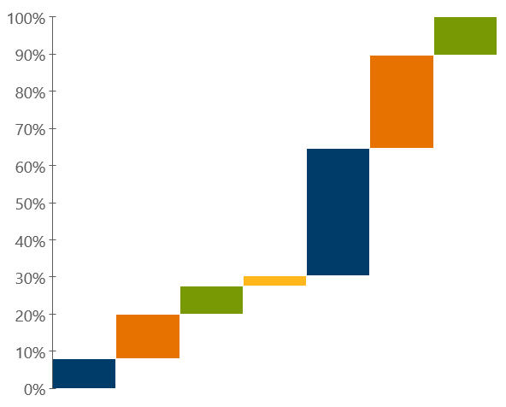
Figure 1-11
Health Centers Serve Patients Throughout the Life Cycle
Selected Age Groups, Represented Two Ways
Ages 65+
10%
Ages 45-64
25%
Ages 65+ (10%)
Ages 45-64
25%
Ages 20-44
34%
Ages 18-44
37%
Ages 13-17
8%
Ages 18-19
3%
Ages 5-12
12%
Under 18
28%
Under 5
8%
Source: 2020 Uniform Data System, Bureau of Primary Health Care, HRSA, DHHS.

Slide 20
Figure 1-12
Health Center Patients Ages 65 and Older are the Fastest Growing
Age Group Over the Past Decade
Number of Health Center Patients by Age Group, 2010 – 2020
Ages 18 – 44
42% Growth
Under 18
26% Growth
Ages 65+
120% Growth
Ages 45-64
63% Growth
Source: 2010 & 2020 Uniform Data System, Bureau of Primary Health Care, HRSA, DHHS.

Slide 21
Section 2
Expanding Access to Care

Slide 22
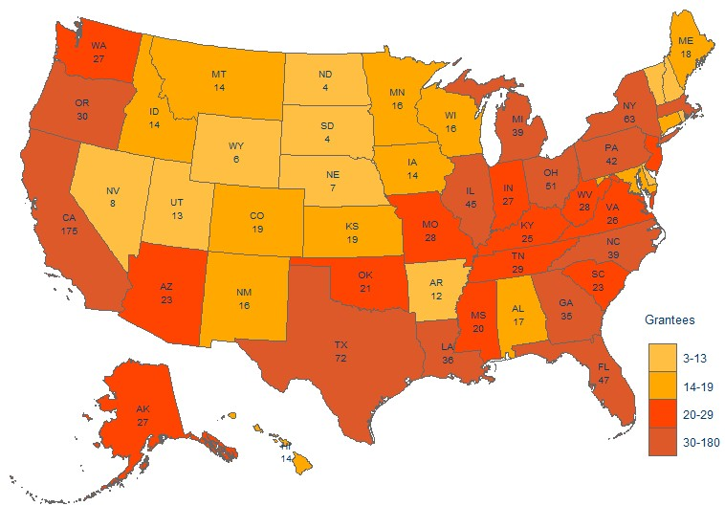
Figure 2-1
Number of Federally-Funded Health Center Organizations, 2020
Nationally, there are 1,375 federally-funded health
center organizations.
Notes: National figure includes health centers in every state, territory, and D.C. Some territories are not shown in the map above. Binned by quartile for states and territories shown.
Source: 2020 Uniform Data System, Bureau of Primary Health Care, HRSA, DHHS.

Slide 23
Figure 2-2
Growth in Health Center Organizations and Sites, 2010 - 2020
Source: 2010 - 2020 Uniform Data System, Bureau of Primary Health Care, HRSA, DHHS.

Slide 24
Figure 2-3
Growth in Health Center Patients and Visits, 2010 - 2020
Source: 2010 - 2020 Uniform Data System, Bureau of Primary Health Care, HRSA, DHHS.

Slide 25
Figure 2-4
Health Centers Have Expanded Their Capacity
to Provide More Services Onsite
Number of Health Centers Employing Staff for Selected Services
63% Growth
29% Growth
32% Growth
46% Growth
54% Growth
77% Growth
* The Health Resources and Services Administration (HRSA) defines enabling services as, “non-clinical services that do not include direct patient services that enable individuals to access health care and improve health outcomes.“ Examples of enabling services include case management, translation/interpretation, transportation, and health education.
Source: 2010 & 2020 Uniform Data System, Bureau of Primary Health Care, HRSA, DHHS.

Slide 26
Figure 2-5
Health Center Physicians Receive Higher Rates of Payments from Public Insurance Than Physicians in Other Practices
Sources: 2014 National Ambulatory Medical Care Survey – Community Health Centers Sample Summary Tables and National Summary Tables. National Center for Health Statistics.

Slide 27
Figure 2-6
Health Center Patients by Insurance Status, 2010 – 2020
(In Millions)
Medicaid
Uninsured
Private
Medicare
Other
Source: 2010 - 2020 Uniform Data System. Bureau of Primary Health Care, HRSA, DHHS.

Slide 28
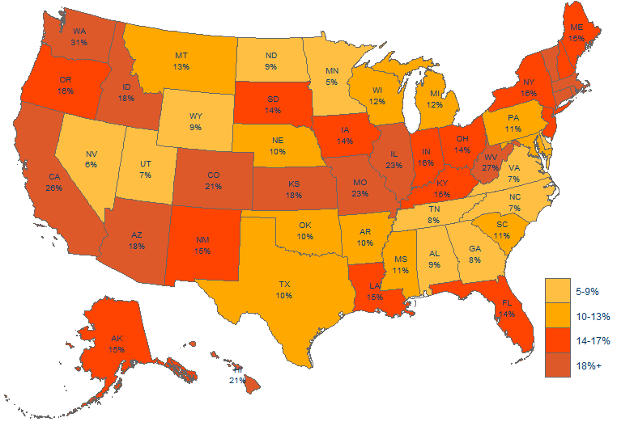
Figure 2-7
Percent of Medicaid Beneficiaries Served by Health Centers, 2020
Nationally, health centers serve 17% of all Medicaid beneficiaries.
Notes: National figure excludes health center Medicaid patients in territories and does not include Puerto Rico. Binned by quartile for states and territories shown.
Sources: NACHC Analysis of (1) 2020 Uniform Data System (UDS). Bureau of Primary Health Care, HRSA, BPHC. (2) Kaiser Family Foundation. Monthly Medicaid and CHIP Enrollment, December 2020.

Slide 29
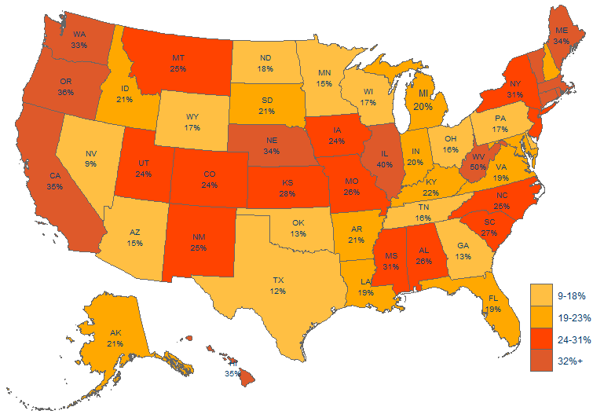
Figure 2-8
Percent of the Uninsured Population Served by Health Centers, 2020
Nationally, health centers provide care to 22% of the uninsured population.
Notes: National figure includes health centers in every state, DC, and Puerto Rico. Binned by quartile for states and territories shown.
Sources: (1) NACHC Analysis of 2020 Uniform Data System, Bureau of Primary Health Care, HRSA, DHHS. (2) Kaiser Family Foundation.. Health Insurance Coverage of the Total Population.

Slide 30
Section 3
High Quality Care and Reducing Health Disparities

Slide 31
Figure 3-1
Health Centers Achieve Higher Rates of
Hypertension and Diabetes Control than the National Average,
Despite Serving More At-Risk Patients
Sources: (1) NACHC Analysis of 2020 Uniform Data System, Bureau of Primary Health Care, HRSA, DHHS. (2) CDC, Million Hearts. March 2021. Estimated Hypertension Prevalence, Treatment, and Control Among U.S. Adults. (3) CDC. 2020. National Diabetes Statistics Report.

Slide 32
Figure 3-2
Health Center Patients Have Lower Rates of
Low Birth Weight (LBW) than National Average,
Despite Health Centers Serving More At-Risk Patients
Health Centers have a 15 percentage point lower LBW
Sources: (1) 2020 Uniform Data System, Bureau of Primary Health Care, HRSA, DHHS. (2) NACHC analysis of CDC WONDER. Data downloaded November 5, 2021.

Slide 33




Figure 3-3
Enabling Services* are a Defining Characteristic of Health Centers
and Help Improve Access to Care and Patient Satisfaction
Health Center Patients Who Used Enabling Services* Had:
1.9 more health center visits in the past year (on average)
A 12 percentage-point higher likelihood of getting a routine checkup
A 16 percentage-point higher likelihood of getting a flu shot
An 8 percentage-point higher likelihood of being satisfied with care
* The Health Resources and Services Administration (HRSA) defines enabling services as, “non-clinical services that do not include direct patient services that enable individuals to access health care and improve health outcomes.“ Examples of enabling services include case management, translation/interpretation, transportation, and health education. (HRSA Health Center Program Terms and Definitions, n.d.).
Note: This figure compares health center patients who used enabling services to patients that did not use enabling services.
Source: Yue et al. Enabling Services Improve Access to Care, Preventive Services, and Satisfaction Among Health Center Patients. Health Affairs 38(9). September 2019.

Slide 34
Figure 3-4
Health Centers Exceed Medicaid Managed Care Organization (MCO)
High Performance Benchmark Scores
Medicaid MCO High Performance Benchmark (75th Percentile)
72%
62%
62%
Notes: Quality measures include control of diabetes: share of patients with diabetes with HbA1c between 7% and 9%; control of hypertension: share of patients with hypertension with blood pressure < 140/90; Pap tests: share of female patients age 24 – 64 who received Pap test within past three years.
Source: Shin P, Sharac J, Rosenbaum S, Paradise J. Quality of Care in Community Health Centers and Factors Associated with Performance. Kaiser Commission on Medicaid and the Uninsured Report #8447 (June 2013).

Slide 35
Figure 3-5
Health Centers Provide More Preventive Services
than Other Primary Care Providers
Sources: (1) Shi L, Tsai J, Higgins PC, Lebrun La. (2009). Racial/Ethnic and Socioeconomic Disparities in Access to Care and Quality of Care for U.S. Health Center Patients Compared with Non-Health Center Patients. J Ambul Care Manage 32(4): 342 – 50. (2) Shi L, Leburn L, Tsai J and Zhu J. (2010). Characteristics of Ambulatory Care Patients and Services: A Comparison of Community Health Centers and Physicians' Offices J Health Care for Poor and Underserved 21(4): 1169-83. (3) Hing E, Hooker RS, Ashman JJ. (2010). Primary Health Care in Community Health Centers and Comparison with Office-Based Practice. J Community Health. 2011 Jun; 36(3): 406 - 13. (4) Fontil et al. Management of Hypertension in Primary Care Safety-Net Clinics in the United States: A Comparison of Community Health Centers and Private Physicians’ Offices. Health Services Research. April 2017. 52:2.

Slide 36
Figure 3-6
Health Centers Reduce Unmet Health Care Needs
Percent of Patients Experiencing Unmet Care Needs or Delayed Care by Source of Care
Source: Pourat, N.; Chen, X.; Lee, C; et al. HRSA-funded Health Centers Are an Important Source of Care and Reduce Unmet Needs in Primary Care Services, Medical Care 57(12) - p 996-1001 . December 2019.

Slide 37
Figure 3-7
Women at Health Centers are More Likely to Receive Mammograms
than Their Counterparts Nationally
* Includes women below 100% FPL or at 100% FPL and below.
Sources: (1) Health Resources and Services Administration, 2014 Health Center Patient Survey. Female Health Center Patients Aged 40+ Who Had a Mammogram in the Past 2 Years. (2) National Center for Health Statistics. Health, United States, 2016: With Chartbook on Long-term Trends in Health. Hyattsville, MD. 2017. Table 70. Use of Mammography Among Women Aged 40 and Over, by Selected Characteristics: United States, Selected Years 1987 - 2015.

Slide 38
Figure 3-8
Women at Health Centers are More Likely to Receive Pap Smears
than Their Counterparts Nationally
* Includes women below 100% FPL or at 100% FPL and below.
Sources: (1) Health Resources and Services Administration, 2014 Health Center Patient Survey. Female Health Center Patients Aged 18+ Who Had a Pap Smear in the Past 3 Years. (2) National Center for Health Statistics. Health, United States, 2016: With Chartbook on Long-term Trends in Health. Hyattsville, MD. 2017. Table 71. Use of Pap Smears Among Women Aged 18 and Over, by Selected Characteristics: United States, Selected Years 1987 – 2015.

Slide 39
Figure 3-9
Health Center Patients are More Likely to Receive Colorectal Cancer
Screenings than Their Counterparts Nationally
* Includes individuals below 100% FPL or at 100% FPL and below.
Sources: (1) Health Resources and Services Administration, 2014 Health Center Patient Survey. Health Center Patients Aged 50+ Who Ever Had a Colonoscopy. (2) National Center for Health Statistics. Health, United States, 2016: With Chartbook on Long-term Trends in Health. Hyattsville, MD. 2017. Table 72. Use of Colorectal Tests or Procedures Among Adults Aged 50-75, by Selected Characteristics: United States, Selected Years 2000 - 2015.

Slide 40
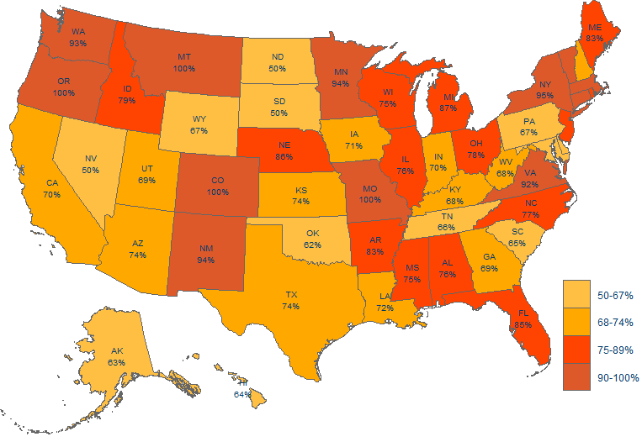
Figure 3-10
Percent of Health Centers with
Patient-Centered Medical Home Recognition, 2020
Nationally, 77% of health centers have achieved Patient-Centered Medical Home recognition.
Notes: National figure includes all 1,75 health centers in every state, territory, and D.C. Some territories are not shown in the map above. Binned by quantile for states and territories shown.
Source: Communication with the Bureau of Primary Health Care, HRSA, DHHS, October 2020.

Slide 41
Figure 3-11
Health Centers are Leaders in Patient-Centered Medical Home (PCMH) Certification and Adoption of PCMH Elements
8 Greater Odds of Attaining PCMH Certification.
Patient Centered Medical Home Certification
Likelihood by Practice
Health Centers have higher odds of PCMH certification compared to other health care practices
Source: Rittenhouse, D.; Wiley, J. A.; Peterson, L..; Phillips Jr, R. L. Meaningful Use and Medical Home Functionality in Primary Care Practice. Journal of Health Affairs.
39(11) – p. 1977-1983. November 2020. https://www.healthaffairs.org/doi/pdf/10.1377/hlthaff.2020.00782

Slide 42
Section 4
Cost-Effective Care

Slide 43
Figure 4-1
Health Centers are Increasingly Participating in
New Payment and Delivery System Models
Percent of Health Centers Reporting that Their Organization:
Source: Lewis et al. Changes at Community Health Centers, and How Patients are Benefiting: Results from the Commonwealth Fund National Survey of Federally Qualified Health Centers, 2013-2018. The Commonwealth Fund. August 2019. Available from https://www.commonwealthfund.org/publications/issue-briefs/2019/aug/changes-at-community-health-centers-how-patients-are-benefiting

Slide 44
Figure 4-2
Health Centers Save 24% Per Medicaid Patient
Compared to Other Providers
24% Lower Total Spending
33% Lower Spending
14% Lower Spending
23% Lower Spending
27% Lower Spending
11% Lower Spending
Note: Non-health centers include private physician offices and outpatient clinics.
Source: Nocon et al. Health Care Use and Spending for Medicaid Enrollees in Federally Qualified Health Centers Versus Other Primary Care Settings. AJPH. November 2016. 106(11): 1981-1989.

Slide 45
Figure 4-3
Health Centers Have Lower Total Spending Per Medicaid Patient
Compared to Other Providers
Notes: Other Providers (or “non-health centers”) include private physician offices and outpatient clinics. MT was included in the national-level analyses but did not have a large enough sample size to be included in the adjusted state-level analyses.
Source: Nocon et al. Health Care Use and Spending for Medicaid Enrollees in Federally Qualified Health Centers Versus Other Primary Care Settings. AJPH. November 2016. 106(11): 1981-1989.

Slide 46
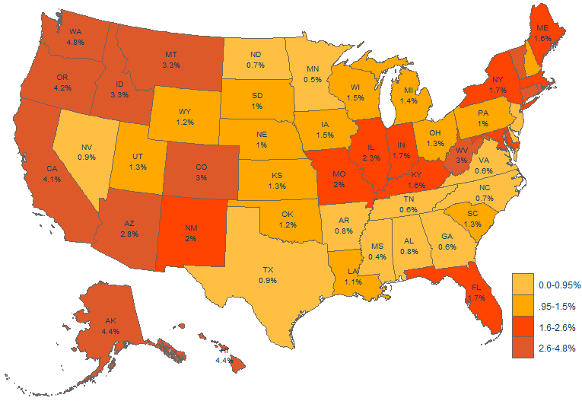
Figure 4-4
Health Center Medicaid Revenues as a Percent
of Total Medicaid Expenditures
Nationally, health center
revenues account for 2.1% of Medicaid service expenditures…
…While serving 17% of all Medicaid beneficiaries.
(see figure 2-7)
Note: Medicaid expenditures do not include administrative costs, accounting adjustments or U.S. territories. National figure only includes health centers in the 50 states and DC. Sources: NACHC analysis of (1) 2020 Uniform Data System. Bureau of Primary Health Care, HRSA, DHHS. (2) Kaiser Family Foundation. Total Medicaid Spending FY 2020. State Health Facts.

Slide 47
Figure 4-5
Health Centers are Associated with Lower Total Costs of Care for Medicare
Patients Compared to Other Providers
Costs for health center Medicare patients are 10% lower than physician office patients and 30% lower than outpatient clinics.
Source: Mukamel, D.B., White, L.M., Nocon R.S., et al. Comparing the Cost of Caring for Medicare Beneficiaries in Federally Funded Health Centers to Other Care Settings. Health Serv Res. April 2016. 51(2): 625-644.

Slide 48
Figure 4-6
Medicare Spending is Lower in Areas Where Health Centers
Serve More Low-Income Residents
Areas with high health center penetration have 10% ($926) lower Medicare spending per beneficiary.
Note: High health center penetration corresponds to a 54% health center penetration rate among low-income residents; low health center penetration corresponds to 3% health center penetration rate among low-income residents; average health center penetration rate among low-income residents was 21%.
Source: Sharma R, Lebrun-Harris L, Ngo-Metzger Q. Costs and Clinical Quality Among Medicare Beneficiaries: Associations with Health Center Penetration of Low-Income Residents. Medicare and Medicaid Research Review. 2014; 4(3):E1-E17.58.

Slide 49
Figure 4-7
Health Centers Save 35% Per Child Compared to Other Providers
35% Lower Total Spending
40% Lower Spending
49% Lower Spending
69% Higher Spending
Source: Bruen B, Ku L. Community Health Centers Reduce the Costs of Children’s Health Care. Geiger Gibson/RCHN Community Health Foundation Research Collaborative. Policy Research Brief #48. June 20, 2017.

Slide 50
Figure 4-8
Health Centers Save $1,263 (or 24%) Per Patient Per Year
Total Health Expenditures Per Patient Per Year
Sources: NACHC analysis based on Ku et al. Using Primary Care to Bend the Curve: Estimating the Impact of a Health Center Expansion on Health Care Costs. GWU Department of Health Policy. Policy Research Brief No. 14. September 2009.

Slide 51
Section 5
Health Center Services and Staffing

Slide 52
Figure 5-1
Growth in Health Center Clinical Staff, 2010 – 2020
In Full-Time Equivalent
74% Increase
230% Increase
86% Increase
49% Increase
140% Increase
Notes: NP, PA, CNM stand for Nurse Practitioners, Physician Assistants, Certified Nurse Midwives, respectively. Behavioral health staff includes mental health and substance abuse staff.
Source: 2010 & 2020 Uniform Data System, Bureau of Primary Health Care, HRSA, DHHS

Slide 53
Figure 5-2
Health Center Care Team Staff Provide a Broad Array of Services
Total Care Team: 155,595 Full-Time Equivalent (FTE)
Other Professional Services
1.%
Vision Services
1%
Source: 2020 Uniform Data System. Bureau of Primary Health Care, HRSA, DHHS.

Slide 54
Figure 5-3
Health Centers Tested and Vaccinated Hundreds of Thousands of People Each Week in 2021
Each week, health centers tested 150,000 patients and administered 253,000 vaccines.*
*Percentages are based on an average of weekly data collected between January 1, 2021 and December 17, 2021; response rate varied from 56% to 72%.
Note: Survey data are preliminary and do not reflect all health centers. Some duplication of patients and staff tested from week to week may occur. For more information, please visit https://bphc.hrsa.gov or contact research@nachc.org.
Source: Bureau of Primary Health Care, Health Resources and Services Administration, Health Center COVID-19 Survey.

Slide 55
Figure 5-4
Health Centers Rapidly Expanded Their Ability to Test Patients for COVID-19
Note: Data is from survey collected between April 3 and November 6 2020, response rate varied from 68% - 72%. For more information, please visit https://bphc.hrsa.gov or contact research@nachc.org.
Source: Bureau of Primary Health Care, Health Resources and Services Administration, Health Center COVID-19 Survey.

Slide 56
Figure 5-5
Health Center Medical Services Staff
Total Medical Team: 88,091 Full-Time Equivalent
Share of Total Care Team*
Other Specialty Physicians
4%
General Practitioners
4%
* Total Care Team is shown in Figure 5-2.
Notes: NP/PA/CNM stands for Nurse Practitioners, Physician Assistants, and Certified Nurse Midwives. Other Medical Personnel include, but are not limited to, medical assistants, nurses’ aides, laboratory personnel and X-Ray personnel. Percentages may not add to 100% due to rounding.
Source: 2020 Uniform Data System. Bureau of Primary Health Care, HRSA, DHHS.

Slide 57
Figure 5-6
Health Centers are Hiring Non-Physician Providers
at Higher Rates than Physicians
Since 2018, health centers have employed more NP/PA/CNMs than physicians.
Notes: NP, PA, and CNM stand for Nurse Practitioner, Physician Assistant, and Certified Nurse Midwife, respectively.
Source: 2010 - 2020 Uniform Data System. Bureau of Primary Health Care, HRSA, DHHS.
Notes:
Can you make the ratio label fonts a little larger?

Slide 58
Figure 5-7
Health Center Enabling Services & Other Programs Staff
Total: 30,008 Full-Time Equivalent
Share of Total Care Team*
Other Enabling Services
2%
Transportation Staff
3%
Interpretation Staff
4%
* Total Care Team is shown in Figure 5-2.
Note: Percentages may not add to 100% due to rounding.
Source: 2020 Uniform Data System. Bureau of Primary Health Care, HRSA, DHHS.

Slide 59
Figure 5-8
Health Center Dental Staff
Total: 17,583 Full-Time Equivalent
Share of Total Care Team*
* Total Care Team is shown in Figure 5-2.
Note: Percentages may not add to 100% due to rounding.
Source: 2020 Uniform Data System. Bureau of Primary Health Care, HRSA, DHHS.

Slide 60
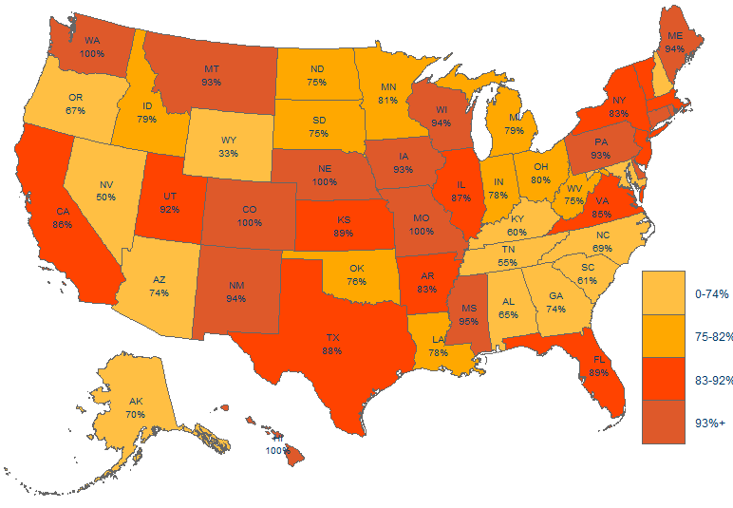
Figure 5-9
Percent of Health Centers with the Capacity to Offer
Dental Services Onsite, 2020
Nationally, 82% of health centers provide dental services onsite.
Notes: National figure includes all 1,375 health centers in every state, territory, and D.C. Some territories are not shown in the map above. Binned by quartile for states and territories shown. Based on the number of health centers employing more than 0 full-time equivalent dental staff.
Source: 2020 Uniform Data System. Bureau of Primary Health Care, HRSA, DHHS.

Slide 61
Figure 5-10
Health Center Behavioral Health Staff
Total: 16,811 Full-Time Equivalent
Share of Total Care Team*
* Total Care Team is shown in Figure 5-2.
Note: Percentages may not add to 100% due to rounding.
Source: 2020 Uniform Data System. Bureau of Primary Health Care, HRSA, DHHS.

Slide 62







Figure 5-11
Health Centers Have Responded to an Increasing Need for
Substance Use Disorder (SUD) Treatment and Therapy
By Building Their Capacity and Integrating Care
There are 8,400 health center physicians, certified nurse practitioners, and physician assistants with authorization to provide medication-assisted treatment for opioid addiction.
Health centers have tripled their behavioral health staff over the past 10 years.
Health center providers performed evidence-based screening, intervention, and referral procedure (SBIRT) for almost 1.3 million patients in 2020.
Nearly 182,000 patients received medication-assisted treatment for opioid use disorder in 2020.
Source: 2010 & 2020 Uniform Data System, Bureau of Primary Health Care, HRSA, DHHS.

Slide 63
Figure 5-12
Health Centers Have Responded to an Increasing Need for Substance
Use Disorder (SUD) Treatment and Therapy by Seeing More Patients
Patients for SUD Services
2010 vs. 2020
2010
Visits for SUD Services
2010 vs. 2020
2020
Tobacco
Cessation
Health centers have experienced a more
than 600% increase
in patients seeking treatment for opioids and other SUDs.
Other SUD
(Including Opioids)
Alcohol
Dependence
K = Thousands
Source: 2010 & 2020 Uniform Data System. Bureau of Primary Health Care, HRSA, DHHS.

Slide 64
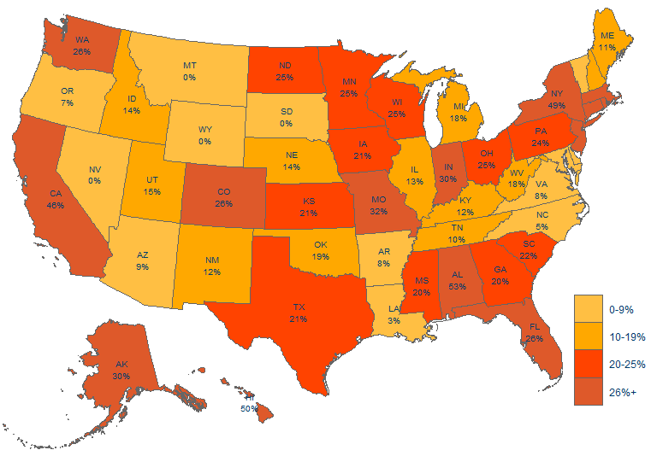
Figure 5-13
Percent of Health Centers with Capacity to Offer
Vision Services Onsite, 2020
Nationally, 26% of health centers provide vision services onsite.
Notes: National figure includes all 1,375 health centers in every state, territory, and D.C. Some territories are not shown in the map above. Binned by quartile for states and territories shown. Based on the number of health centers employing more than 0 full-time equivalent vision staff.
Source: 2020 Uniform Data System. Bureau of Primary Health Care, HRSA, DHHS.

Slide 65
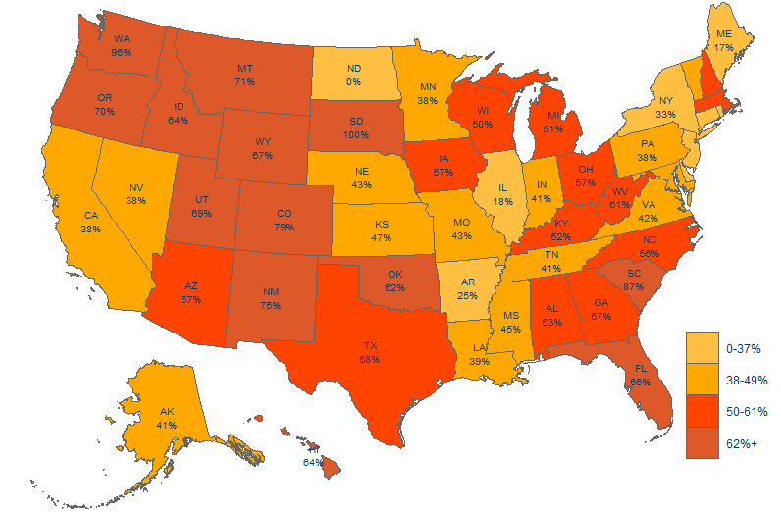
Figure 5-14
Percent of Health Centers with Capacity to Offer
Pharmacy Services Onsite, 2020
Nationally, 49% of health center provide pharmacy services onsite.
Notes: Figures do not include contract pharmacies operating in health centers. Based on the number of health centers employing more than 0 full-time equivalent pharmacy staff. National estimate includes all 1,375 health centers in every state, territory, and D.C. Some territories are not shown in the map above. Binned by quartile for states and territories shown.
Source: 2020 Uniform Data System. Bureau of Primary Health Care, HRSA, DHHS.

Slide 66
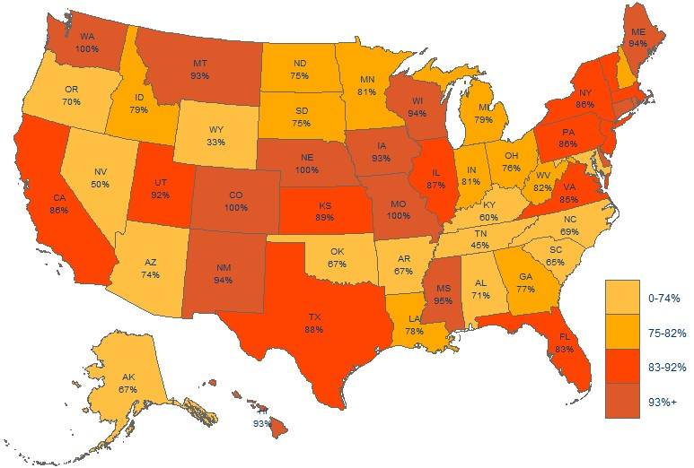
Figure 5-15
Percent of Health Centers with Capacity to Offer Three or More Services,
in Addition to Medical Care
(Services include Enabling, Dental, Behavioral Health, and Vision)
Nationally, 82% of health centers offer three or more services in addition to medical care.
Source: 2020 Uniform Data System. Bureau of Primary Health Care, HRSA, DHHS. 98% of health centers provide behavioral health services and 99% provide enabling services.

Slide 67
Figure 5-16
Health Centers are Using Telehealth to
Expand Access to Needed Services
Number of Health Centers Offering Selected Telehealth Services by Location, 2020
Nationally, 1,362 (99%)
of health centers use telehealth for a variety of services.
Source: 2020 Uniform Data System. Bureau of Primary Health Care, HRSA, DHHS.
*Primary care includes radiology
**Health Consultation and Education includes consumer health education, provider-to-provider consultation, nutrition and dietary consultation

Slide 68
Figure 5-17
Health Centers’ Telehealth Utilization Increased
Dramatically from 2018 - 2020
% of Health Centers Offering Telehealth Services by Location
Source: 2020 Uniform Data System. Bureau of Primary Health Care, HRSA, DHHS.

Slide 69
Figure 5-18
Health Centers are Adopting Innovative Telehealth Services
At Higher Rates than Other Primary Care Providers
Providers Using Telehealth for:
Telehealth Modalities Used:
Note: Percentages for health centers based on all health centers, including those that do or do not use telehealth in 2018.
Sources: (1) 2018 Uniform Data System. Bureau of Primary Health Care, HRSA, DHHS. (2) Kane, C. K. and Gillis, K. The Use of Telemedicine by Physicians: Still the Exception Rather than the Rule. Health Affairs 37(12). December 2018.

Slide 70
Figure 5-19
Medical Services Were the Most Common Services Delivered Virtually by Health Centers in 2020
Percent of Virtual Visits by Service
28.7 million visits were conducted virtually in 2020
Note: Behavioral health includes services for mental health and substance use disorder; Enabling services includes case management and education specialist services; Other services includes vision, dental, and other professional services.
Source: 2020 Uniform Data System. Bureau of Primary Health Care, HRSA, DHHS.

Slide 71
Section 6
Challenges in Meeting Demand for Care

Slide 72
Figure 6-1
Payments from Third Party Payers are Less than Cost
Note: Health centers are non-profits, and thus charges are a proxy for costs.
Source: 2020 Uniform Data System, Bureau of Primary Health Care, HRSA, DHHS.

Slide 73
Figure 6-2
Federal Health Center Appropriation History, FY10-FY21
CHCF Extended,
2-Year
Authorization
CHCF Extended,
2-Year
Authorization
Short-Term Extension*
First Year of 3-Year Extension*
Community Health Center Fund (CHCF) Created, 5-Year Authorization
B = Billions.
*Includes Continuing Resolutions and Health Extender Legislation; Health center mandatory funding for FY20 and the first quarter of FY21 was not the result of a full reauthorization of the Community Health Center Fund (CHCF), but was covered by a collection of short-term extensions of the previous authorization of the CHCF which occurred in 2018 and initially expired on September 30, 2019.
Source: Federal appropriations are for consolidated health centers under PHSA Section 330. Federally-funded health centers only.

Slide 74
Figure 6-3
Health Center Funding Per Uninsured Patient
Is Well Below Total Per Patient Cost
Annual Health Center Total Cost Per Patient (All Patients)
Cost of Care Gap
Cost of Care Gap
Health centers cared for over
6.2 million uninsured individuals
in 2020, leaving a cost of care gap of over $2 billion*
Annual Health Center Funding Per Uninsured Patient
* Calculated by taking the difference between 2020 health center total cost per patient (all patients) and 2020 health center funding per uninsured patient, then multiplying by the number of health center uninsured patients in 2020.
Source: 2010 - 2020 Uniform Data System, Bureau of Primary Health Care, HRSA, DHHS.

Slide 75
Figure 6-4
Health Centers Experience Difficulty Recruiting Many Clinical Staff
Percent of Health Centers Reporting a Vacancy for Specific Clinical Positions
Source: NACHC. Staffing the Safety Net: Building the Primary Care Workforce at America’s Health Centers. 2016. Available from: http://www.nachc.org/research-and-data/

Slide 76
Figure 6-5
Health Centers Have Unique Challenges Recruiting and Retaining Staff
Percent of Health Centers Reporting Specific Challenges for Recruitment and Retention
Salary that is Competitive
Community Amenities and Other Health Center Location Factors
Benefits Package that is Competitive
Candidates’ Language Proficiency and/or Cultural Competency
Health Center’s Current Workload and/or Call Schedule
Health Center Facility Condition
Health Information Technology Capacity
Source: NACHC. Staffing the Safety Net: Building the Primary Care Workforce at America’s Health Centers. 2016. Retrieved from: http://www.nachc.org/research-and-data/research-fact-sheets-and-infographics/

Slide 77
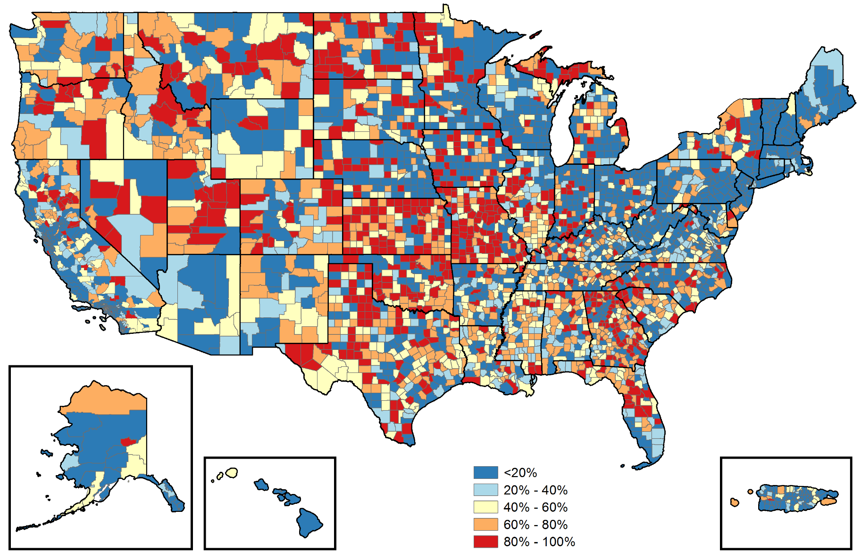
Figure 6-6
Estimated Percent of County Residents Experiencing
Shortages of Primary Care Physicians
As of 2013, 62 million people experience inadequate or no access to primary care because of shortages of physicians in their communities.
Sources: Created by The Robert Graham Center (2014). U.S. Census 2010; HRSA Data Warehouse 2014 HPSA and MUA/P shapefiles; AMA Masterfile 2013; UDS Mapper 2014. The Medically Disenfranchised and the Shortage of Primary Care: The Role of Health Centers in Improving Access to Care. NACHC. March 2014. Retrieved from:
http://www.nachc.org/wp-content/uploads/2015/11/MDFS.pdf

Slide 78

Figure 6-7
Health Center Capital Project Plans and Funding Needs
As of 2021, 97% of health centers had plans to initiate capital projects within the next several years. These plans represent more than 2,000 capital projects.
These planned projects are estimated to cost $17.5 billion, resulting in 38.5 million patients by 2025
However, almost half of health centers report they are uncertain they can secure funding for these planned projects.
Source: Capital Link. Capital Investment Trends and Needs of FQHCs. 2021

Slide 79

© National Association of Community Health Centers
For more information, email research@nachc.org.
This publication was supported by the Health Resources and Services Administration (HRSA) of the U.S. Department of Health and Human Services (HHS) as part of an award totaling $6,625,000 with 0 percentage financed with non­governmental sources. The contents are those of the authors and do not necessarily represent the official views of, nor an endorsement, by HRSA, HHS, or the U.S. Government. For more information, please visit HRSA.gov.
Suggested Citation:
National Association of Community Health Centers. Community Health Center Chartbook. January 2022.

