Slide 1
Leveraging the Power of Social Media Influencers to Combat COVID-19 Misinformation among Parents of Unvaccinated Youth
Tuesday, January 18, 2022

Slide 3
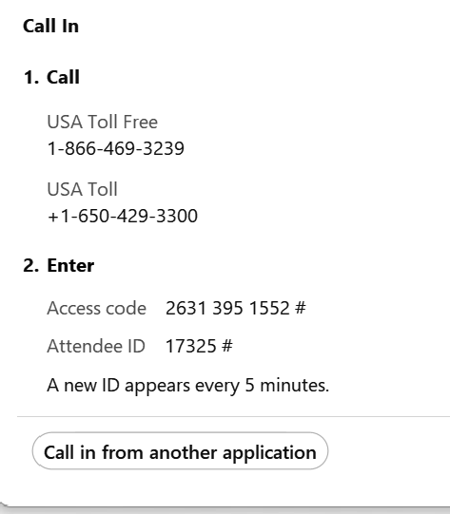
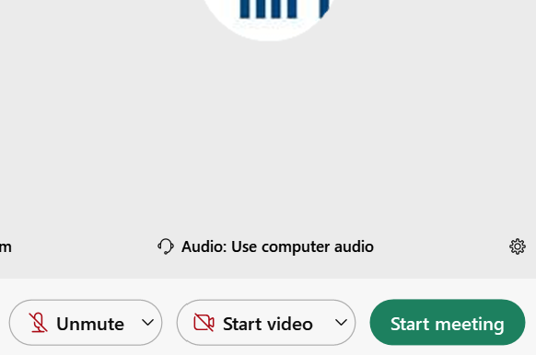


Ensure you’ve connected to audio!
Option 1: “I Will Call In”
Follow the unique 3-step process on your screen
Option 2: “Call Using Computer ”
You must have computer speakers and microphone
After connecting, if you don’t see a phone/headset icon next to your name, please attempt to connect your audio again!

Slide 4
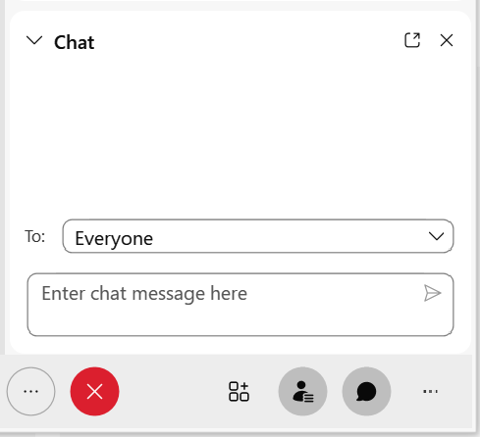
ASKING QUESTIONS VIA CHAT BOX
The chat feature is available to ask questions or make comments anytime.
Click the chat button at the bottom of the WebEx window to open the chat box on the bottom righthand side of the window.
Choose “EVERYONE”, as appropriate.
- Type your question.
- Click “Enter” to send your question.
Questions from the chat will be answered and later posted on the NACHC website (www.nachc.org).

Slide 5

Friendly Reminders
Today’s Event is being RECORDED
All attendee lines have been MUTED
The CHAT BOX is open for the duration of this event
Questions from the CHAT BOX will be answered after the presentation is completed.

Slide 6
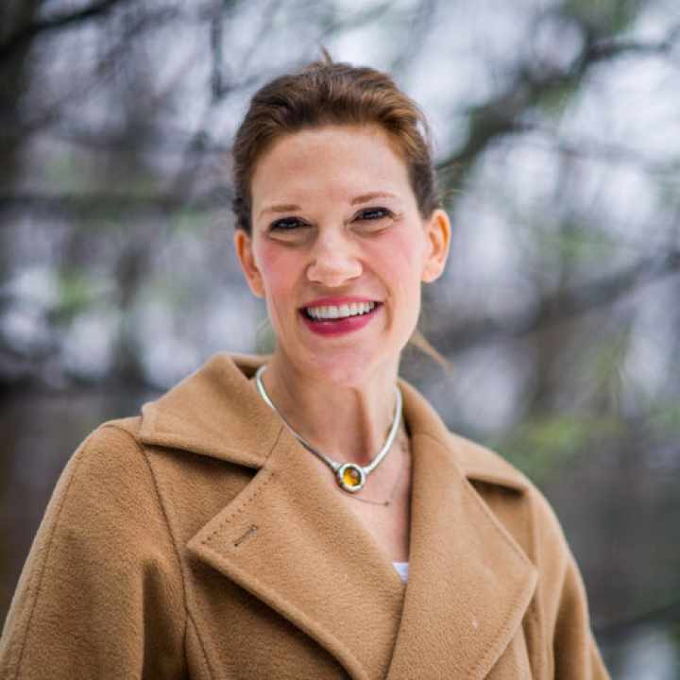
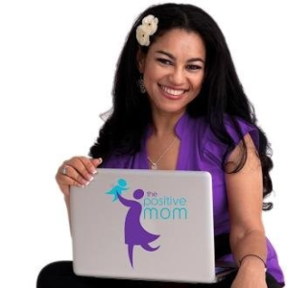
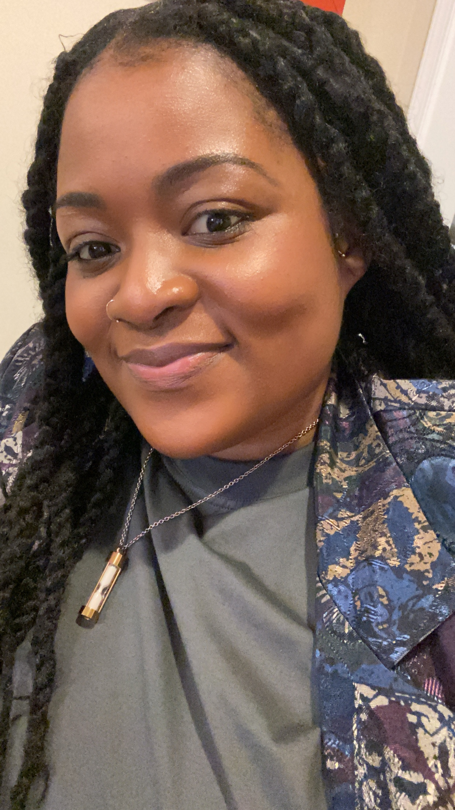
Today’s Presenters
Morra Aarons-Mele
EVP of Social Impact at Geben Communications
Elayna Fernández
Founder -thePositiveMOM.com
Ramatoulaye Keita, MHA
Sr. Manager of Community Health - Whitman-Walker

Slide 7
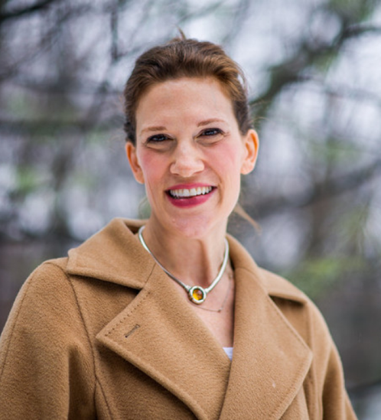
Morra Aarons-Mele
EVP of Social Impact at Geben Communications

Slide 8
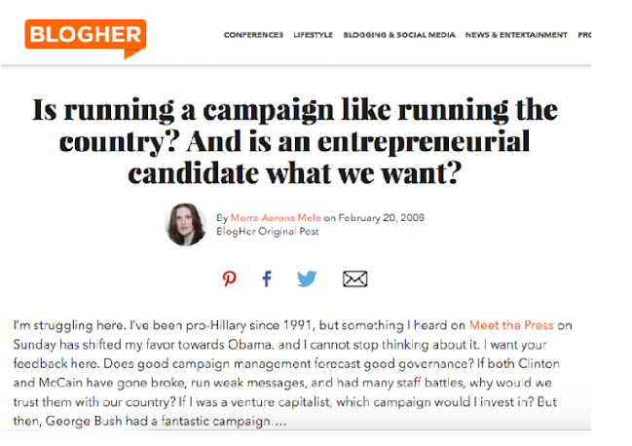

Slide 9
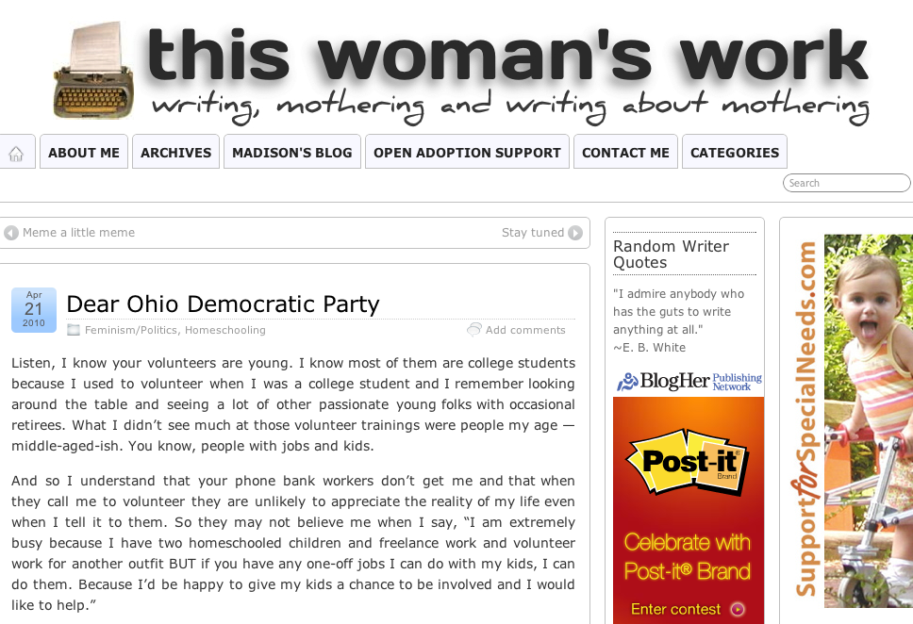

Slide 10
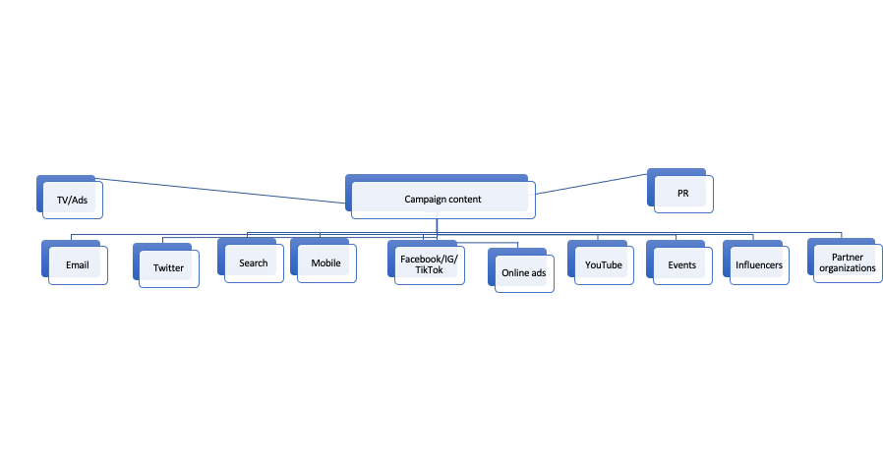
What is Marketing?
Marketing is the activity, set of institutions, and processes for creating, communicating, delivering, and exchanging offerings that have value for customers, clients, partners, and society at large.
Marketing is delivered through channels.
*AMA
Notes:
Sometimes called the marketing mix, or multi channel marketing

Slide 11
What is Influencer Marketing?
Influencers are people who have developed a reputation for expertise, good advice, or compelling content. They use social media to share their insights and content. Influencer marketing involves a brand collaborating with an online influencer to market one of its products or services.
As the digital world has become more and more social, people are increasingly influenced by each other more than brands. Influencer marketing opens up a new channel for brands to connect with consumers in an authentic and direct way, by learning from voices they trust and admire.
Influencer and community based word of mouth marketing has been shown to generate more than twice the sales of paid advertising, with a 37% higher retention rate.*
*McKinsey, Forbes

Slide 12
Types of Influencers
As the market has matured, influencers can be defined by category.
Reach
Macro: 100,000-1,000,000+ followers
Micro: >100,000
Nano: >10,000
Platform
Instagram/Facebook
TikTok
Twitter
Blog
YouTube
Reddit
Twitch/Discord
Topic/Focus
Lifestyle
Wellness
Health
Parenting
Tech
Gaming
Food
Culture
Politics
Hyper-local

Slide 13
The WIIFM
Influencers are professionals who create content and offer their platforms to select brands and organizations.
You need to compensate them.
But also remember the “What’s in it for me?”

Slide 14

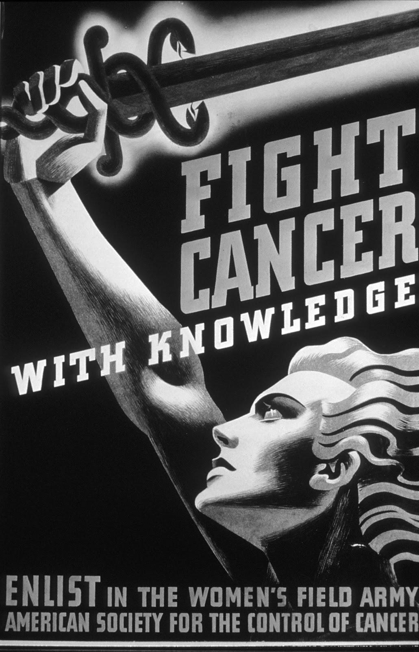
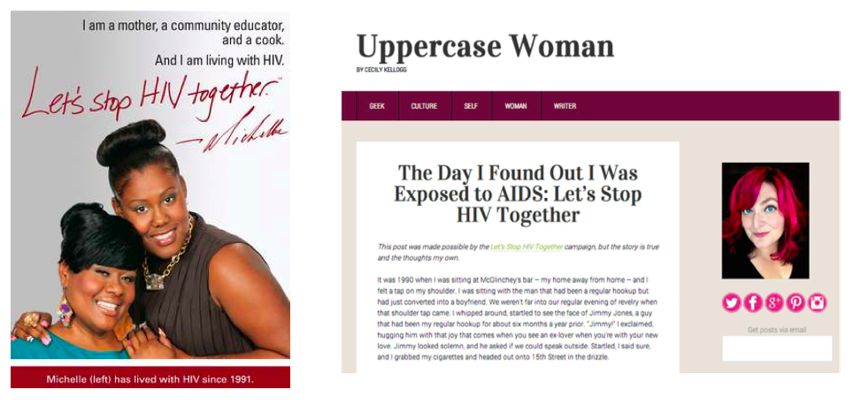
Why Does it Work For Public Health?
Influencers are validators.
Influencers understand the nuances of their local communities, how to create good storytelling, and impact on social media.
Influencer marketing has always existed! We carry on a long history of activism and advocacy.
14
Notes:
Influencer marketing is a key component of any public health campaign. It enhances the sometimes sterile messaging and brings the personal reputation of the influencer- acting as a validator. I like to think of influencer marketing in public health as more akin to bringing in 3rd party, trusted voices: like you would a primary care physician, trusted educator or community leader, columnist in a newspaper or anchor you trust…in this way it’s different from an advertisement or even the own web page of an organization

Slide 15
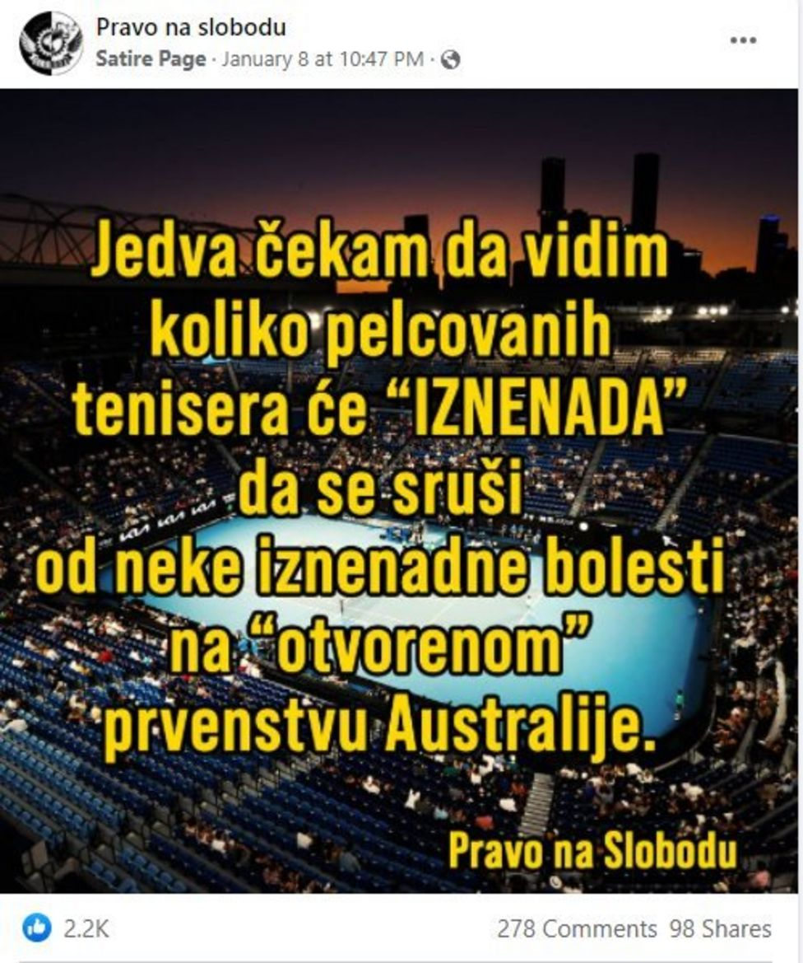
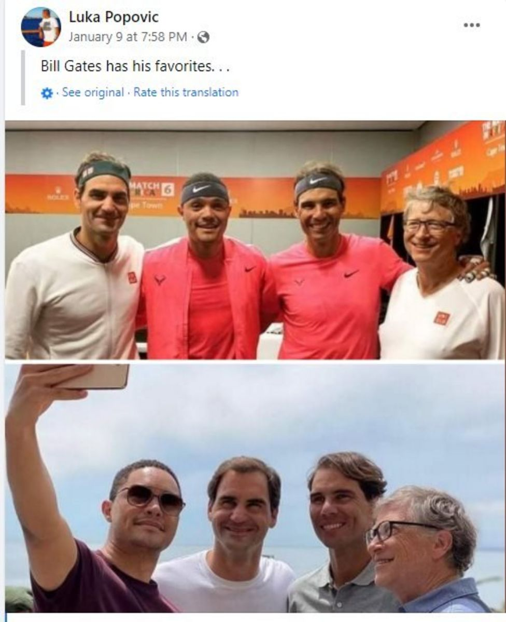
Why Does it Work Against Public Health?
All the reasons above plus:
Algorithms reward this content
Images are memorable and language is clear and compelling (facts don’t matter)
Low distrust in institutions gives perceived power to influencers
“
A news article about a doctor who died after receiving a Covid-19 vaccination was Facebook's most viewed link in the US in the first quarter of 2021.
“
New York Times
Source: https://www.bbc.com/news/world-59974888
15
Notes:
The recent example of Novak Djovic
In one video on Facebook, which has been viewed tens of thousands of times and shared widely amongst Serbian anti-vax groups, false claims are made suggesting that the Tennis Association of Australia were banning fans from supporting Djokovic in the Australian Open.
"There's a high distrust in government institutions and social norms aren't positive regarding vaccination because we have different stars and politicians talking against the vaccination, and that's what's critical for this Djokovic case - the creation of social norms in support of vaccination" Ms Vucic says.

Slide 16
Why Does it Work Against Public Health?
“
There is an asymmetry of passion on social networks…. Just because the anti-vaxxers know how to speak louder doesn’t mean that there are actually more of them.
The anti vaccine groups are louder, more social media savvy, and give the perception of being bigger than they are. This has the side effect of swaying uncommitted parents and making pro-vaccine parents second guess themselves.
Social media is most parents’ public square. It’s replaced the carpool line for parents seeking advice and updates.
It changes the picture on Google, making anti-vaccine content prominent when parents are searching for health information.
The silent majority is confused and intimidated.
“
Renee DiResta
Vaccinate California

Slide 17
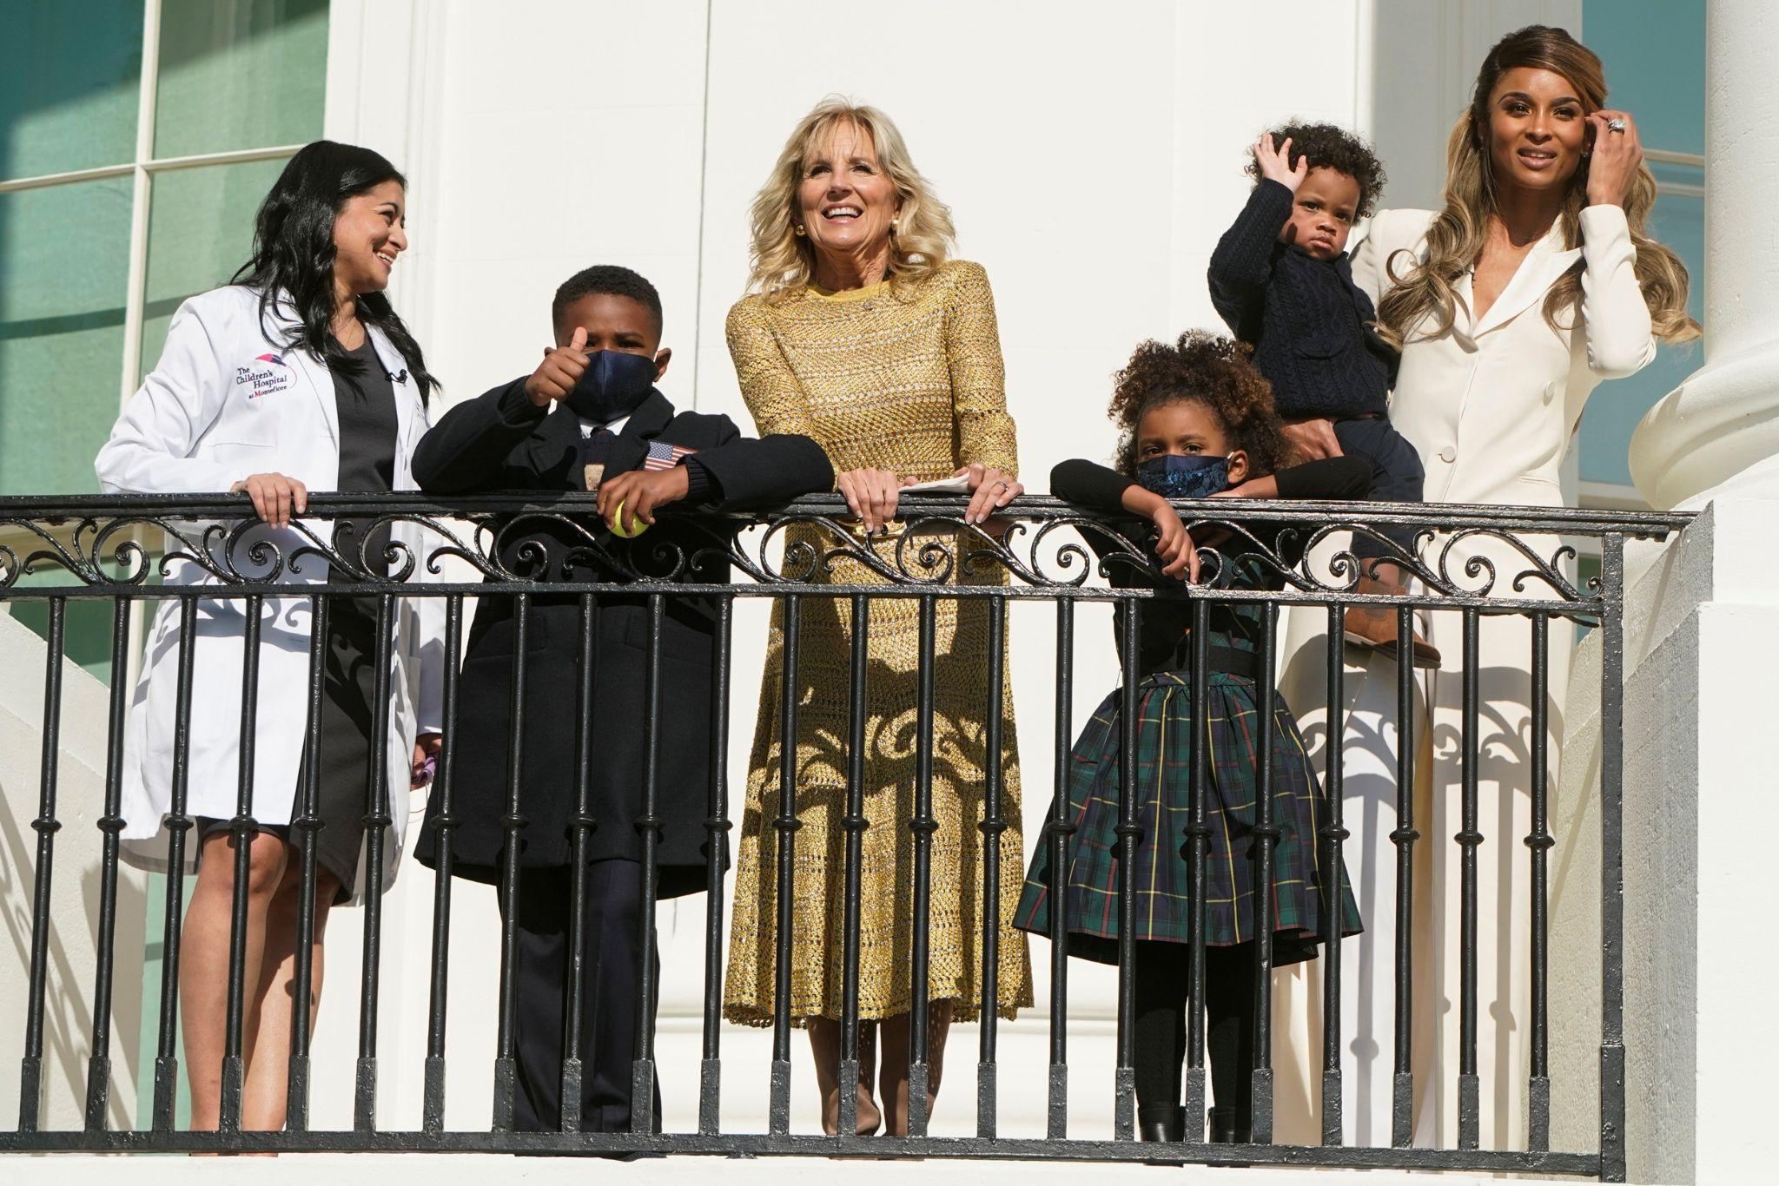
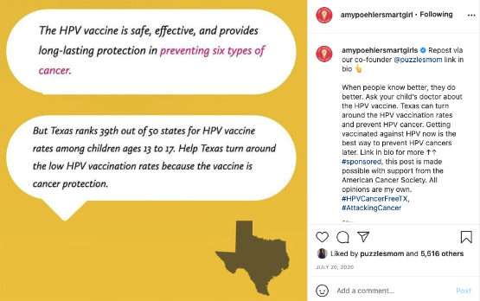
Combating Dis/Misinformation
Ask for help!
Provide access to experts, graphics and information that’s easily digestible.
Allow influencers to use their own voice and storytelling skills.
Prepare influencers to take on tough issues, lead with the facts, and manage difficult comments, giving advice and support every step of the way.
HPV Vaccine campaign for American Cancer Society, with Amy Poehler’s Smart Girls
Dr. Jill Biden is joined at the White House by Ciara, her children, and pediatrician influencer Dr. Hina Talib to discuss COVID vaccines for children

Slide 18
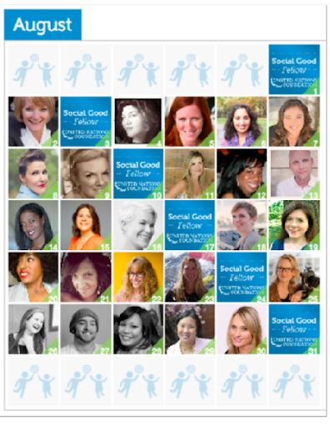
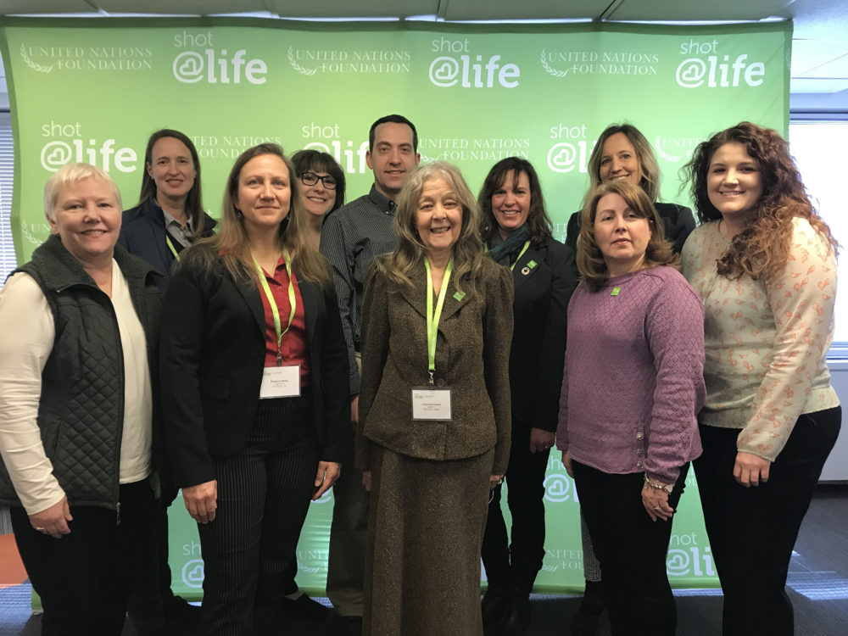
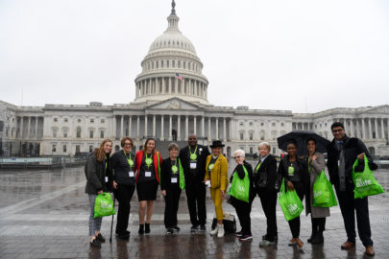
Building a pro-vaccine movement: UN Foundation Shot@Life
Shot@Life is an integrated program that mobilizes online influencers, practitioners, and grassroots “Champions” to advocate for funding for lifesaving childhood vaccines.
Assoc. of Nurse Practitioners rally for vaccines
Champions Lobby day
Influencers raised over 200,000 vaccines for those in need!

Slide 19
Building an Influencer Marketing Program
TARGET AUDIENCE
GOAL OF CAMPAIGN
WHAT DOES SUCCESS LOOK LIKE?
ASSETS
ASK TO INFLUENCERS
TIMELINE + BUDGET

Slide 20
Sample Strategy
AUDIENCE
Parents of kids 5-11
Vaccine neutral
Information-seeking, trust in doctors and professionals
GOAL
Create great materials designed to be shared: social media graphics, giveaways, widgets
Create presence in local media, parenting events, PTA, etc
Illustrate strength in numbers, data, evidence
SUCCESS LOOKS LIKE?
Change in behavior
Uplift in mentions, metrics (# mentions, links, site visits, form signups, share of voice)
Increased foot traffic in centers

Slide 21
Sample Strategy
ASSETS
Experts to interview
Graphics, infographics
Landing page, website, video
Special event or webinar
ASK
Share expert info, talking points/graphics
Ask audiences to get vaccinated and share their story
Share a #, post an image, retweet
TIMELINE + BUDGET
X weeks to recruit, onboard, design assets
X week campaign flight
Budget: compensation for influencers, costs for asset creation or out of pockets (can also include staff time or other human resources)

Slide 22
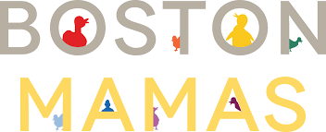
Recruiting
Start with Google, Twitter, IG, TikTok # searches
Ask around!
Build relationships with local influencers…just as you would media contacts

Slide 23
Pricing
Guidelines for Influencer Campaigns
Most influencers have rate sheets
1 influencer for a post = 4 pieces of content (blog post + three social shares)
1 influencer for a video = 1 video (video + three social shares)
MOU
Boost: Many influencers appreciate if you build in a budget for them to boost their posts on social platforms. This is a really cost-effective way to amplify content. On targeted ads our average cost-per-click (CPC) is 10 cents (average cost per click for Facebook ads: 28 cents in the US and 35 cents, globally) and click-through-rate (CTR) is 6.43% (average CTR across industries: 0.9%). Each three-day, $100, targeted ad will shown to about 27,000 additional people beyond the influencer’s initial reach.

Slide 24
Measurement
What does success mean to you?
Measuring a hashtag is an easy, low cost way to track success
Track Google Analytics, or download metrics
Ask influencers to self report views/engagements
If you have software use that and set up parameters around the campaign

Slide 25
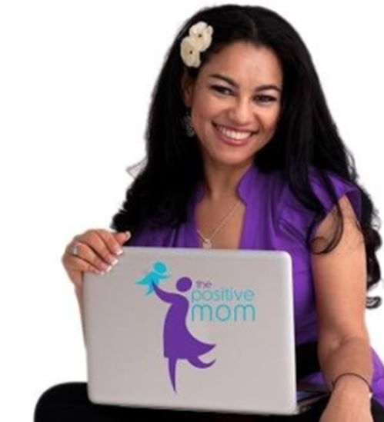
Elayna Fernández
Founder -thePositiveMOM.com

Slide 26
Leveraging the power of
Mom influencers
Elayna Fernández
@thePositiveMOM_
@thepositivemom

Slide 27
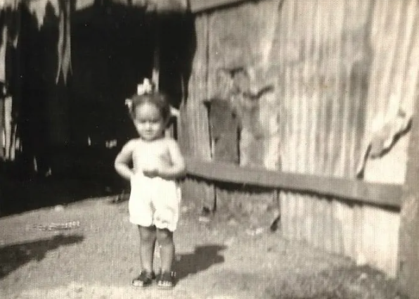
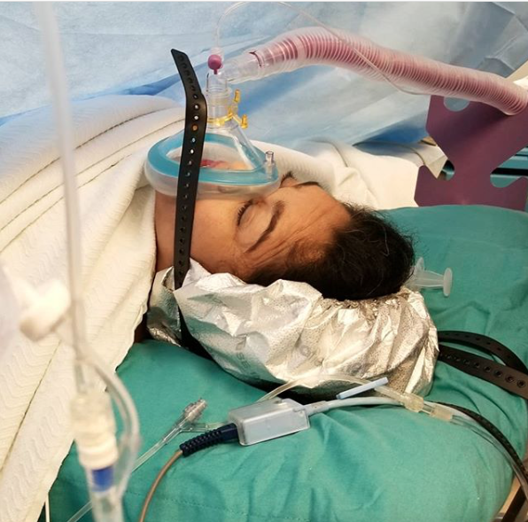
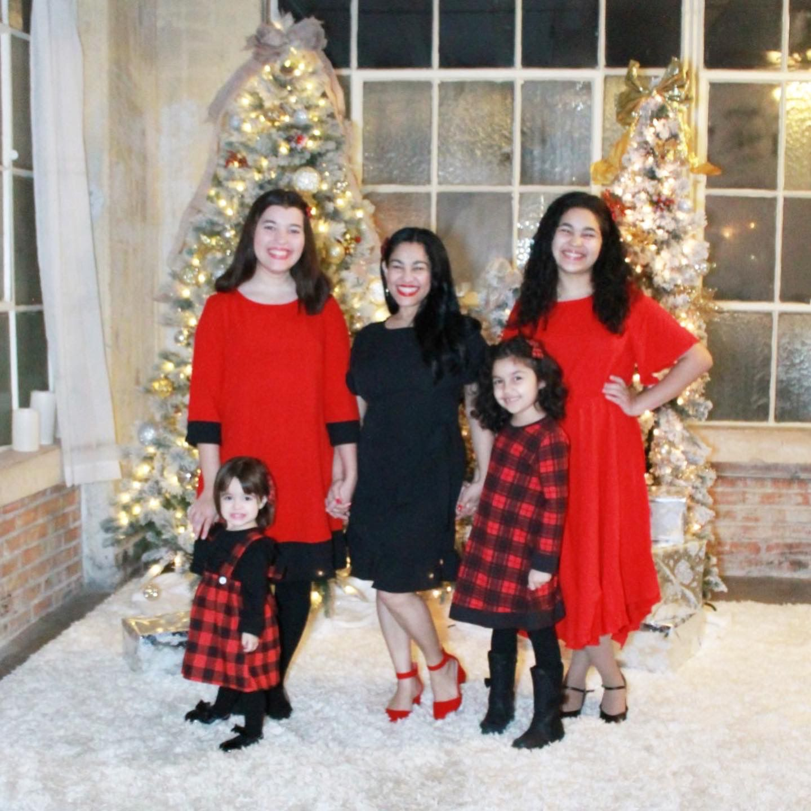
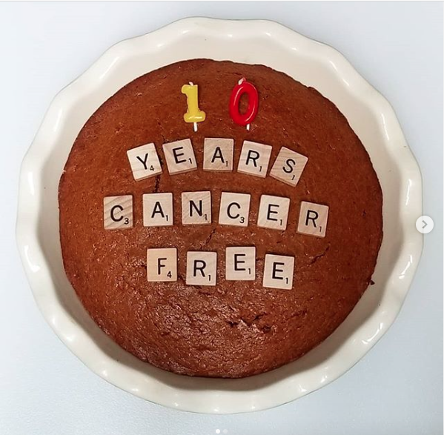
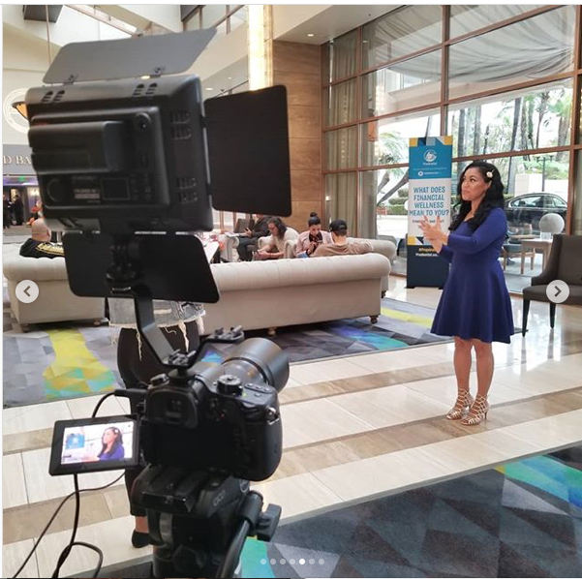

Slide 28













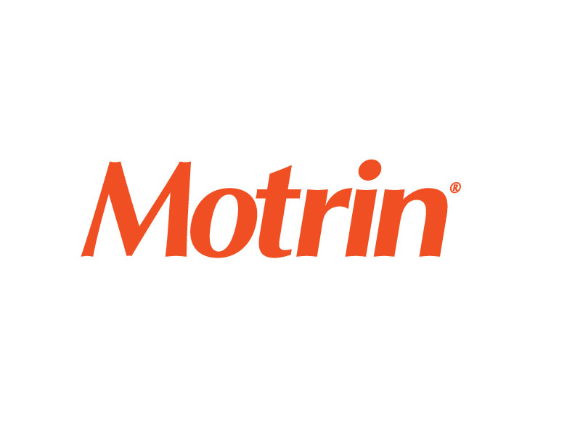












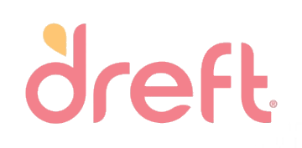






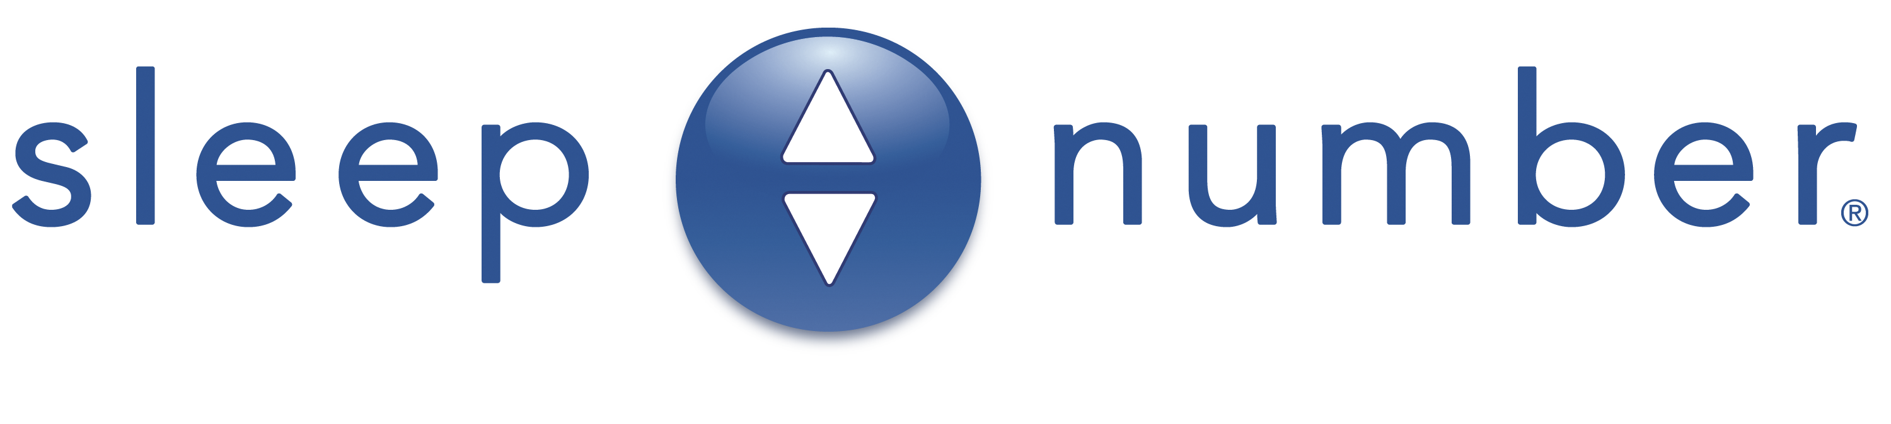




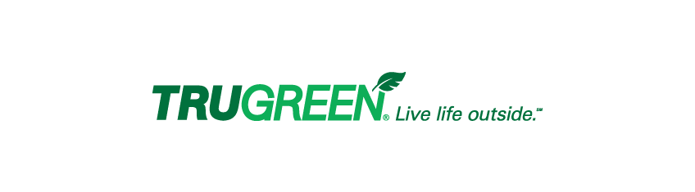
































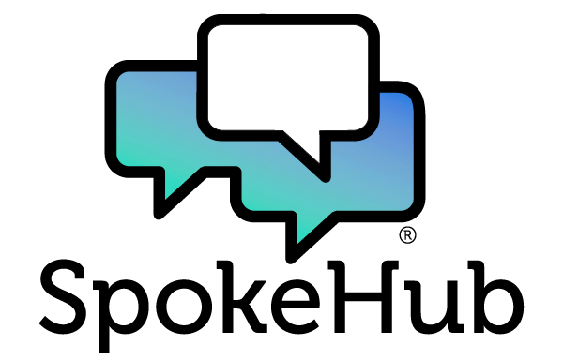



































Slide 29


Micro Influencers
10,000 – 50,000 Social Media Followers
Celebrities? Journalists? Writers? Experts?
Storytellers
Community Builders
Highly engaging
Evergreen Content
Authentic – Know/Like/Trust
Reach your intended audience
Personality and Passion

Slide 30
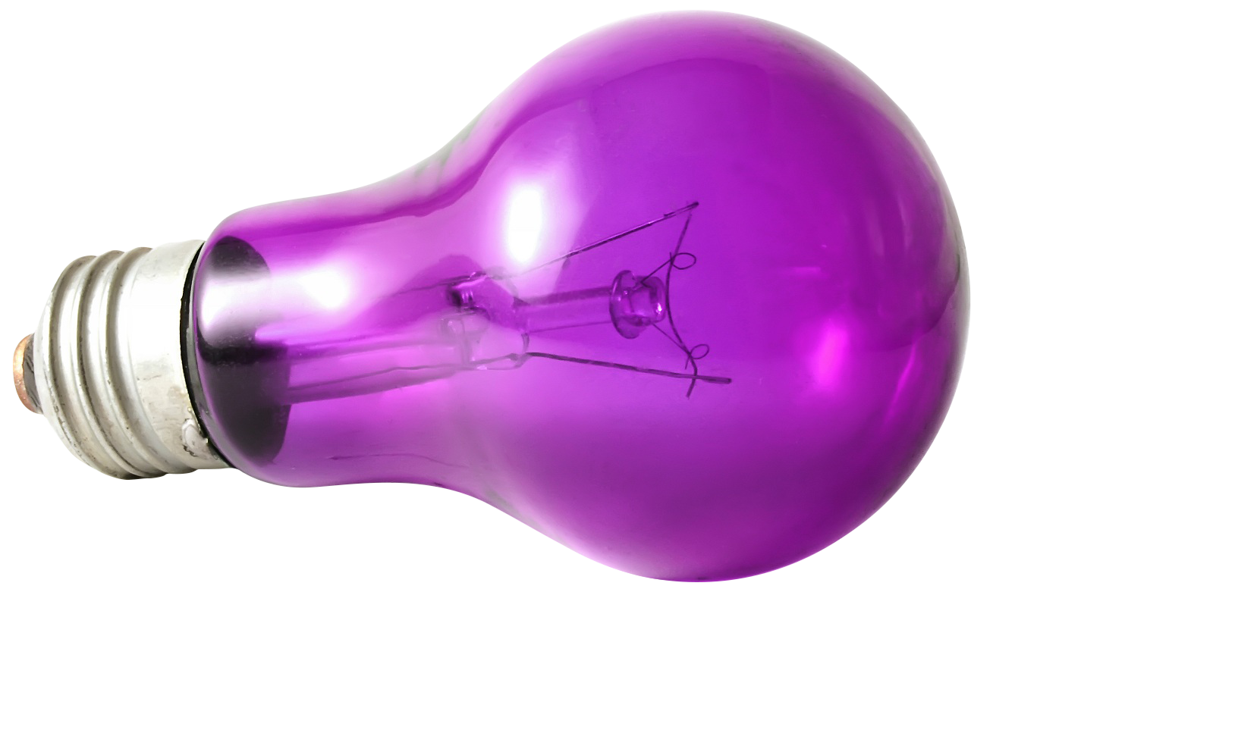
Content Creation
Written | Visual + Motion | Video: Prerecorded/Broadcast
Personal story | Aggregation + Roundups | Collaborations
Amplification: Social channels / Repurposing
Sources: Research | Brand Content | Personal Experience

Slide 31

Best Practices
Research: DREAM 100 List
Storytellers
Aligned – Voice and Value
Advocacy-friendly
Any niche: Relevant audience | Engagement | Quality content
Intake
Application form | Clear SOW / Information + Mutual Expectations
Collaboration
Keep lines of communication open
Approve drafts promptly
Amplify their content

Slide 32
Ramatoulaye Keita, MHA
Sr. Manager of Community Health - Whitman-Walker

Slide 33
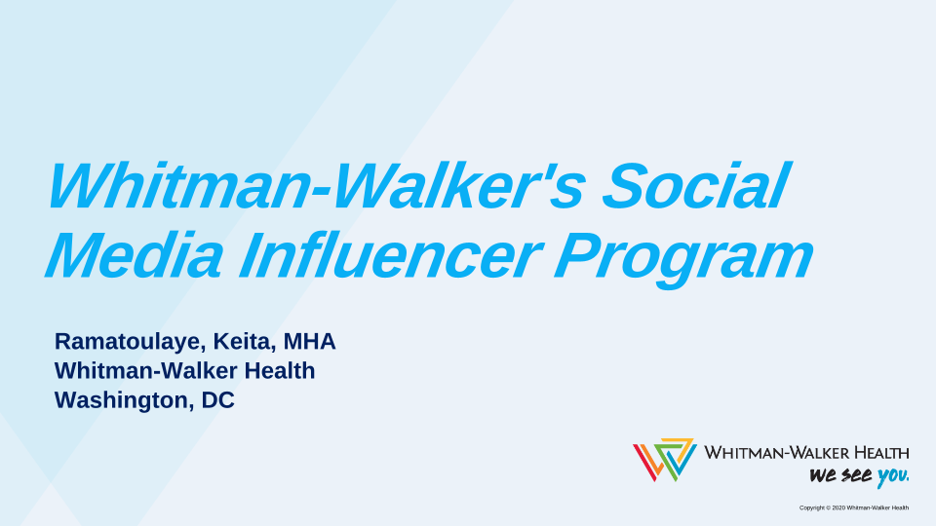

Slide 34
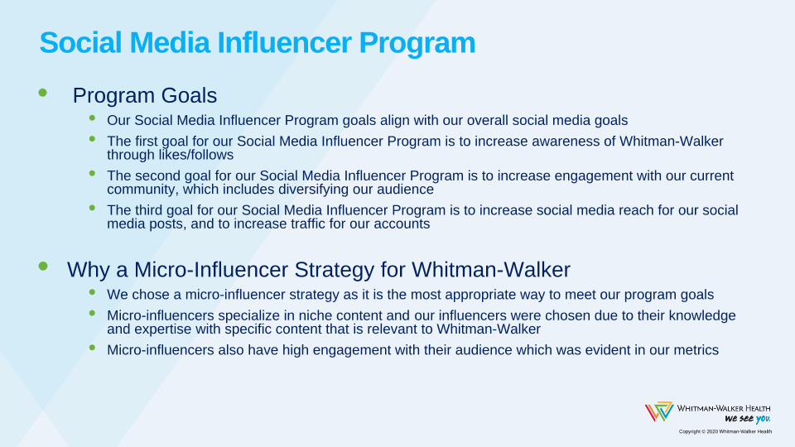

Slide 35
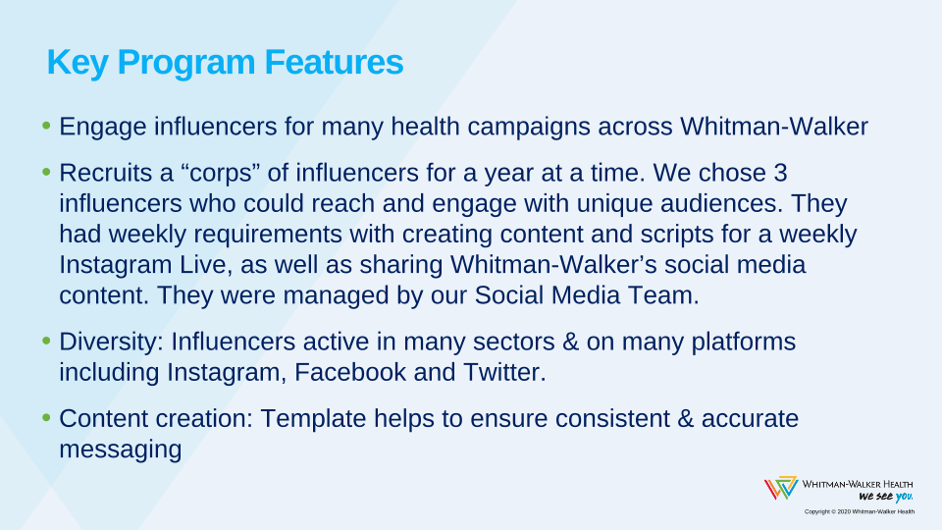

Slide 36
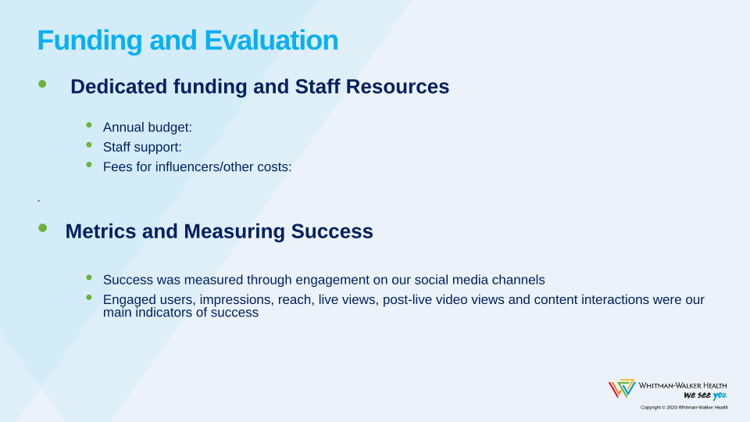

Slide 37
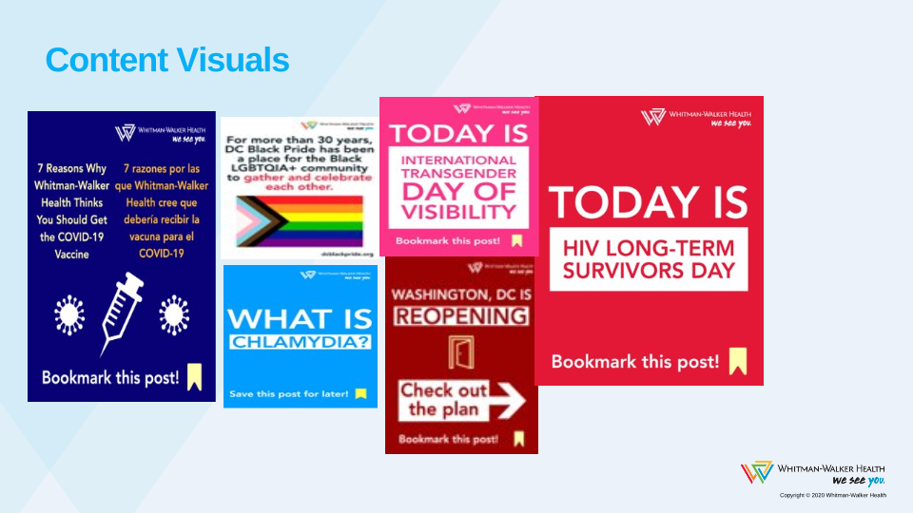

Slide 38

Q&A
www.nachc.org

Slide 39
SAVE THE DATE

Slide 41

THANK YOU TO ALL COMMUNITY HEALTH CENTERS
#ThankYouCHCs

