Slide 1
Business Continuity Institute
Session 3: Ensuring a Human Resource Strategy
Wednesday, May 26, 2021

Slide 3
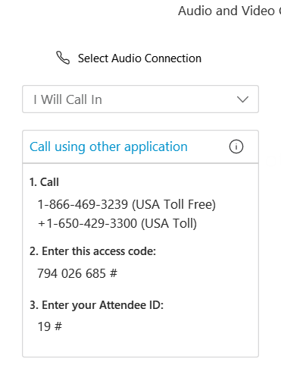
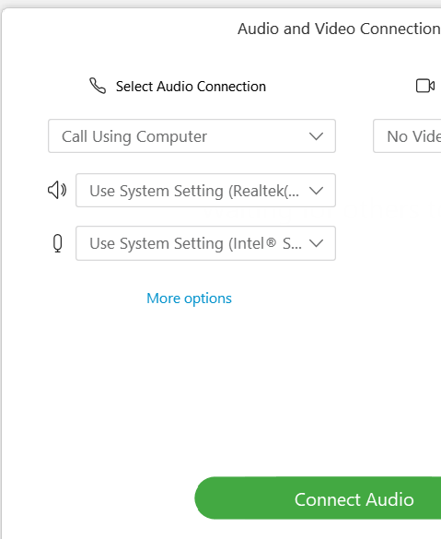


AUDIO CONNECTIONS
Option 1: “I Will Call In”
Follow the unique 3-step process on your screen
Option 2: “Call Using Computer ”
You must have computer
speakers and microphone
After connecting, if you don’t see a phone/headset icon next to your name, please attempt to connect your audio again!

Slide 4
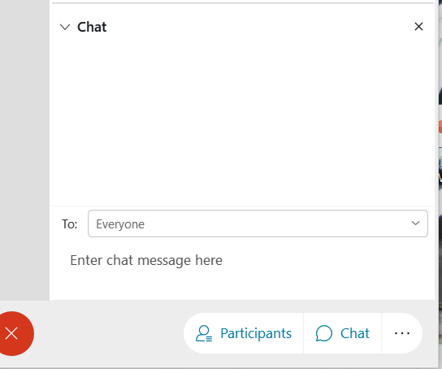

ASKING QUESTIONS VIA CHAT BOX
The chat feature is available to ask questions or make comments anytime.
Click the chat button at the bottom of the WebEx window to open the chat box on the bottom righthand side of the window.
Choose “Everyone”, as appropriate.
- Type your question.
- Click “Enter” to send your question.

Slide 5

Friendly Reminders
Today’s Event is being RECORDED
All attendee lines have been MUTED
The CHAT BOX is open for the duration of this event
Questions from the CHAT BOX will be answered after the presentation is completed or in our FAQ document
You’ll be presented with a brief SURVEY after the event is completed

Slide 6

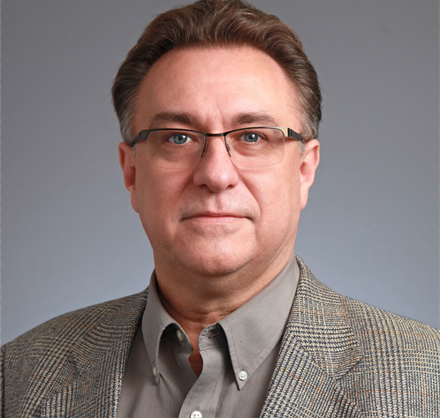


Meet our presenters
Amanda Cooper, MPH
Planning Specialist
Connect Consulting Services
Anthony L. Hurley, MEP, CPP®, PCI®, PSP®, CPD
Director, Emergency Management
Connect Consulting Services
Nora O’Brien, MPA, CEM
Founder and CEO
Connect Consulting Services
Gervean Williams
Director Health Center
Financial Training
Training and Technical Assistance
NACHC

Slide 7
BUSINESS CONTINUITY INSTITUTE
ENSURING
A HUMAN RESOURCES STRATEGY

Slide 8
OBJECTIVES
  Discuss the importance of employee wraparound services
  Provide an overview of staff management during an emergency and highlight incident response team roles
  Review succession planning and telecommuting policy
Notes:
Today we will build on what you learned during Sessions 1 and 2: Intro to Business Continuity Planning and Creating a Business Continuity Plan
Our goal today is to provide you with information on the best human resource strategies to implement during a disruption
We will discuss how best to support your employees by providing wraparound services
We’ll cover staff management during an emergency and discuss key incident response team roles
Finally, we will review what it means to have a successful succession plan in place as well as a brief overview of the practice of telecommuting

Slide 9
AGENDA
  Review wraparound services for employees
  Discuss staff management and identify key employees/roles
  Examine succession planning
  Review telecommuting
  Discuss federal and state regulations
Notes:
As I briefly mentioned in the previous slide, we will use some time to dive into what wraparound services are and how they can support your staff during a disaster
Next, I’ll provide you with an overview of how to manage staff during a disruption and this will include a brief review of the standard incident management team and their roles and responsibilities
Then we’ll move into succession planning
Followed by a review of the practice of telecommuting
And finally, I’ll briefly review federal and state regulations related to business continuity

Slide 10
WRAPAROUND SERVICES
FOR EMPLOYEES
  What is it?
  Comprehensive and holistic method of supporting individuals
  Wraparound places the employee in the center of a support network
  Why?
  Natural disasters, pandemics, and other disruptive events may cause stress and trauma to employees
Notes:
What is wraparound?
Comprehensive and holistic method of supporting individuals when they experience trauma or crises.
Wraparound places the employee in the center of a support network. Their support network may include close friends and family, medical providers, and employers.
Why?
Natural disasters, pandemics, and other disruptive events may cause stress and trauma to employees. Employees may not be able to focus on their jobs or come to work until they have a grasp on their situation, which will take time and support from everyone, including their employer.

Slide 11
WRAPAROUND STRATEGY
  Aims to “wrap-around” the employee
  Wraparound strategy may take multiple forms, including:
  Frequent communication
  Provide specifics about the future
  Support recovery
  Address survivor’s guilt
Notes:
The wraparound strategy aims to “wrap-around” the employee to ensure they have access to the resources they need.
When it pertains to employment, the wraparound strategy may take multiple forms, including:
Frequent communication through multiple channels: employees need to know what is going on and what is expected of them. Providing some sense of normalcy may help employees deal with changes caused by the disruption. Avoid making false promises, but ensure your messaging is supportive and hopeful. Use as many communication channels as possible to reach employees wherever they are, which may vary depending on the availability of power and access to computers and the internet. Check in regularly with employees and encourage them to do the same.
Be specific about the next steps: after the initial shock of the disruption wears off, employees will be interested in what is next. Your communication should include specific information on:
Office hours for the days/weeks ahead
Flexibility to work modified schedules (if applicable)
How to report time off due to the disaster
How often and in what manner employees need to communicate with their supervisor regarding their availability
Which parts of the building/office are functioning
Support recovery: employees recovering from a disaster or disruption will need support. If your organization can’t provide financial support, you can still make this difficult time a bit easier for employees by providing them with contact information of organizations that can assist them. These organizations may include churches, community centers, the American Red Cross, and other local disaster recovery agencies. It’s also important to remind employees that they have access to EAP (Employee Assistance Program). EAP can offer many benefits following a disaster.
Address survivor’s guilt: when people see suffering on a large scale they often feel helpless and guilty that others may have it worse. Remind your employees that guilt doesn’t help anyone or the situation. Rather than sit in the guilt, encourage employees to put their energy and emotions into their recovery or into helping others. As a reminder, some individuals may not be ready to do this as these types of disruptions can significantly impact mental health. Give individuals the space to recover and take care of themselves.

Slide 12
WRAPAROUND OUTCOMES
  Better recovery when wraparound services are executed well
  Individuals tend to have more positive outcomes
Notes:
Evidence shows that individuals experiencing trauma and crises recovery better when wraparound services are executed well.
People who participate in wraparound programs tend to have more positive outcomes than those that do not receive an opportunity to participate in a Wraparound program.
Some outcomes may include:
Better engagement with their job and staff
Enhanced empowerment
Improved coping and problem solving
Improved functioning in their job
Improved resilience and quality of life

Slide 13

COVID-19 Vaccine Clinic
Bartz-Altadonna Community Health Center
Notes:
On March 17, 2020, at the start of the pandemic and shut down in our communities, Bartz Leadership Team met, planned, and successfully pivoted clinic operations to include both internal and external screening protocols at each of our three sites. Included in these protocols, at our busiest site in Lancaster, was the complete closing of the main entrance and a conversion of an open Suite with a handwashing station, a place to record temperatures, and a pop-up indoor examination room using tents for further screening and isolation. At the Palmdale and California City locations, we utilized our mobile clinics for examination/isolation units. Each location was equipped with outdoor tents and heaters.
Bartz worked closely with our community partner, the Children’s Center of the Antelope Valley, to bring in additional staff and security guards to help manage the crowd and lines. A “clinical Provider of the day” was assigned with support staff to handle appointment confirmations and information collection from patients. Bartz identified the need for additional security and traffic control and ultimately created and began recruiting for the new position of Security Protocol Agent (SPA) who ultimately acquired greater responsibility within the COVID 19 Response Team.
A critical component to the COVID 19 Response Team and Bartz efforts to prevent the spread, was our implementation of internal staff screening protocols. A staff member was assigned to check and record temperatures daily upon arrival. Employees received intensive training regarding social distancing and our workspace was redesigned to allow employees to work with masks at a distance of 6 feet from each other. Telehealth allowed for Providers to limit time in the clinic, and departments rotated staff for offsite work. Bartz tested employees regularly and each prevention step received ongoing updates via huddles or memorandums as needed. Our secret weapon throughout this time has been our COVID 19 Team Lead who oversaw all aspects of the COVID 19 response throughout Bartz and shared a weekly recap to all staff that included agency, city, and county updates. They also provided updates and education at monthly Provider and Leadership Team meetings.
When transitioning from screening and testing to vaccinating, Bartz reached out to the cities that we operate in and offered our partnership and medical assistance to help coordinate mass distribution efforts. In addition, we pooled our resources with our partner agencies to maximize capacity within the workforce. Our Chief Medical Officer volunteered his time to manage and oversee Saturday vaccine clinics with the goal of utilizing only volunteers. This prevented the disruption of the clinic flow and care to our patients. By the time Bartz received notice of a significant delivery of vaccines, we had secured collaborations with the cities of Palmdale and California City for two large drive through venues. Both cities were in high need areas and worked with us and local government agencies to advocate for ongoing vaccines, space, supplies and dedicated volunteers. Utilizing a Bartz staff member as coordinator, a robust directory was created with community volunteers, both clinical and non-clinical. Weekly drive through clinics were held consistently at the Lancaster site and every 28 days, Bartz held large offsite drive through events in Palmdale and California City simultaneously.
Before each event, the Bartz team held extensive planning meetings with the cities and site leads and held volunteer training sessions with upwards of 70 volunteers. Debrief sessions with all involved were held and recommendations for improvement were implemented to improve on future events. To date Bartz has administered more than 4000 vaccines. Our success in responding to our community’s urgent health needs is our outstanding relationships with our community partners, our mission to heal, efficient operations, and our amazing staff who embody our Core Values of Compassion, Respect, Integrity, Accountability, and Teamwork.

Slide 14
KEY EMPLOYEES/ROLES
AND STAFF MANAGEMENT
Notes:
So now let us transition to our next topic – Key Employees and Roles and Staff Management

Slide 15
KEY EMPLOYEES AND ROLES
  A key employee is an employee with a major decision-making role
  Key employees also have key roles during a crisis
  During an emergency, key employees are identified by their incident roles
Notes:
A key employee is an employee with a major decision-making role in the organization. The designation ‘key employees’ is not just about titles but is about who is responsible for crucial roles within a organization’s operations.
Key employees also have key roles during a crisis as it relates to Business Continuity and recovery decisions.
During an emergency, key employees are identified and referred to as their incident role/title, which will likely differ from their everyday title/position. Key employees are referred to by their role/title because many key employees may fill a single incident role. Example, if emergency response activities are running 24 hours a day, you would need at last 2 employees to fill a 12-hour shift.

Slide 16
KEY EMPLOYEES AND ROLES
  Key employees, like others, may have different specific roles and responsibilities during or following an incident
  During a crisis, organizations may implement an incident
  management structure
Notes:
Key employees, like others, may have different specific roles and responsibilities during or following an incident. While some employees may fill an incident role similar to their everyday role, such as someone in accounts payable and receivable who will continue to monitor expenses during the incident, others may have an incident role vastly different from their everyday role.
One thing to note: it is recommended that an organization’s CEO not serve as the Incident Commander. This allows the CEO to focus on the overall center operations and board communications with a look toward recovery.
During a crisis or incident, organizations may implement an Incident Command structure, which is scalable depending on the incident. The basic incident command structure was developed by the US Fire Service as an efficient and effective way to manage an incident. The size and scope of the structure will vary based on the severity and type of incident.

Slide 17
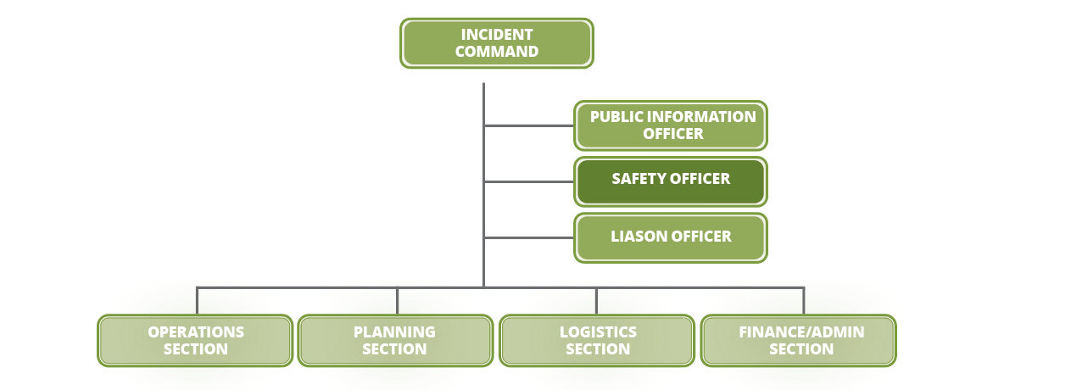
BASIC INCIDENT MANAGEMENT STRUCTURE
Notes:
The incident command structure is a standardized hierarchical structure that allows for a cooperative response by multiple organizations to organize and coordinate response activities.
The primary role of ICS is to establish planning and management functions for responders to work in a coordinated and systematic approach.
Incidents are identified by a number based on the size of the incident, the severity of the incident, and the number of resources involved. The scale is from 1 to 5 with a type 1 incident being catastrophic (Hurricane Katrina, Harvey, Sandy) to type 5 which would be a small event like a house fire.
The structure you see here would be appropriate for a type 3, 4, and 5 incident
Incident Commander
The Incident Commander (IC) is responsible for the overall management of the incident. The IC establishes the strategy and tactics for the incident response effort and has the ultimate respon­sibility for the success of all response and recovery activities. The IC role is filled at every incident, no matter how small or large and is selected by qualifications, experience, and level of authority within the organization. In collaboration with Section Chiefs, the IC determines incident objective and strategy, sets immediate priorities, and authorizes an Incident Action Plan.
Public Information Officer
The Public Information Officer (PIO) reports to the Incident Commander and is responsible for the development and release of information about the incident. The PIO conducts media briefings, develops messaging, distributes information to incident personnel, and works closely with other members of the IMT.
Safety Officer
The Safety Officer is responsible for monitoring and assessing hazardous and unsafe situations as well as developing measures for assuring personal safety. The Safety Officer reports directly to the IC and is the only person that can supersede the IC in the event of an unsafe situation.
Liaison Officer
The Liaison Officer’s (LO) role is to serve as the point of contact for assisting and coordinating activities between the Incident Commander and other healthcare providers and government agencies. The LO reports directly to the Incident Commander.
Operations Section Chief
The Operations Section Chief manages the incident’s tactical operations by directly supervising all resources assigned to the Operations Section. The function of Operations Section is to accomplish the response and recovery strategies by directing resources to execute tactical objectives. The Operations Section Chief directs all the incident tactical operations and assists the IMT in the development of the Incident Action Plan.
Planning Section Chief
The Planning Section Chief supervises the collection, evaluation, processing, and dissemination of the Incident Action Plan (IAP). The function of the Planning Section is to collect and evaluate information that is needed for preparation of the IAP. The Planning Section forecasts the probable course of events the incident may take and prepares alternative strategies for changes in or modifications to the IAP.
Logistics Section Chief
The Logistics Section Chief manages logistical needs and provides facilities, services, people, and materials in support of the incident. The Logistics Section is responsible for all service support requirements needed to facilitate effective and efficient incident management, including ordering resources from off-incident locations. This Section also provides facilities, security, transportation, supplies, equipment maintenance and fuel, food services, and communications and information technology support.
Finance/Administrative Section Chief
The Finance/Administration Section Chief is responsible for all financial, administrative, and cost analysis aspects of an incident. The Finance/Administration Section must fiscally manage the incident, including claims processing, contracting, and administrative functions.

Slide 18
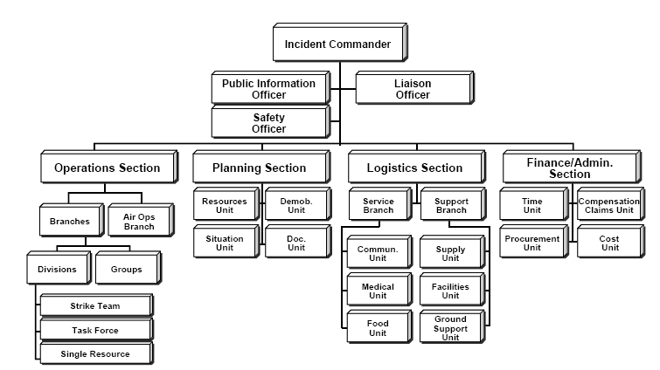
ADVANCED INCIDENT COMMAND STRUCTURE
Notes:
A type 2 or 1 event would likely have a structure like this
As you can see, it is much more in depth with additional positions under each Section
A reminder – the incident command structure is scalable. You want to only activate those positions that are needed at that time. You can add more staff anytime if the emergency warrants it.

Slide 19
SUCCESSION
PLANNING
Notes:
Let’s move on to our next topic – succession planning.
I’d like to take a quick poll, but first let me provide you with a brief scenario
Say you are in the middle of a response to an incident, let’s say you are 4 days into a national stay at home order. Everything is chaos. You are working with your team to figure out how to keep the health center open. Unexpectedly, a member of your senior leadership experiences a death in the family and will be unavailable for the foreseeable future. Who is going to take their place?

Slide 20

Notes:
Poll Title: Do not modify the notes in this section to avoid tampering with the Poll Everywhere activity.
More info at polleverywhere.com/support
Join instructions
https://www.polleverywhere.com/join_instructions

Slide 21
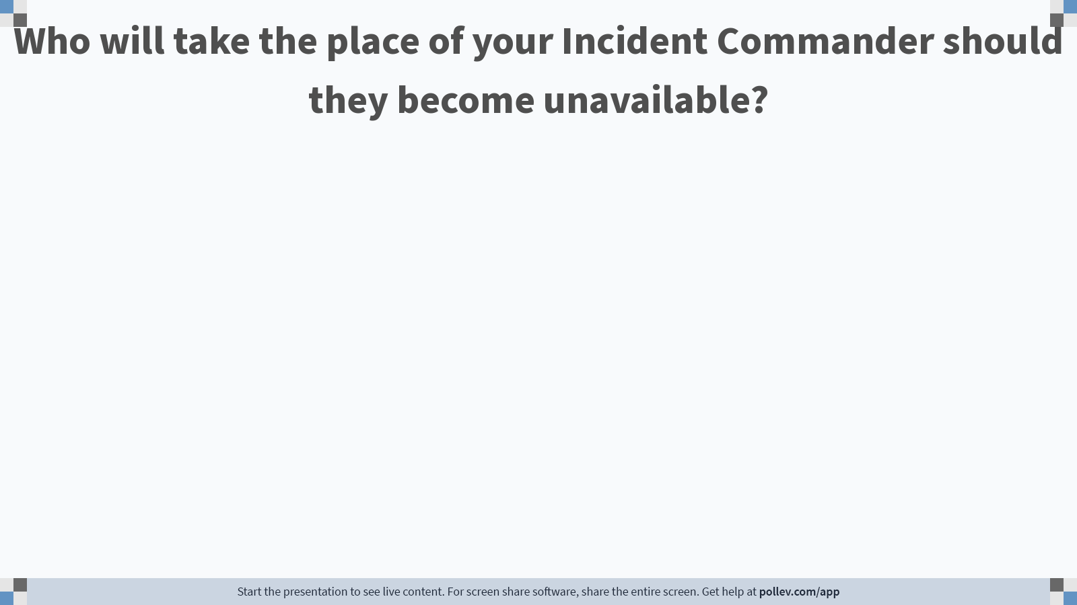
Notes:
Poll Title: Do not modify the notes in this section to avoid tampering with the Poll Everywhere activity.
More info at polleverywhere.com/support
Who will take the place of a member of senior leadership should they become unavailable?
https://www.polleverywhere.com/free_text_polls/w5tnSJt4LFUNPXTmafS9m

Slide 22
SUCCESSION PLANNING
  Process for preparing employees for new roles
  Ensures you will always have employees available for all key roles
  Many organizations place limits on leave availability
Notes:
The situation we just discussed is an issue related to succession planning.
Succession planning is a process for preparing employees for new roles.
This can be for everyday operations or for crisis operations. Here we are going to talk just about crisis operations.
It can also be defined as identifying and developing new leaders who can replace old leaders when they leave, retire or die.
In this process, you ensure that you will have a key roles fulfilled at all times
A successful succession plan will have key roles identified, as well as at least three individuals to serve in those roles.
Many organizations implement protocols that limit situations where no more than one of those key employees would unavailable at any one time

Slide 23
SUCCESSION PLANNING
  Key successors should only be assigned to one primary or alternate position
  Development plan can be utilized to groom the selected individual for their future role
  Selected individuals should be chosen based on their core competencies and backgrounds
Notes:
Key employee successors should only be assigned to one primary or alternate position to avoid competing requirements to fill a key position.
For the succession planning associated with normal operations, a development plan can be utilized to groom the selected individual for their future role.
Individuals that are selected to serve as a successor should be selected based on their skills, core competencies, and backgrounds, and not necessarily on their seniority within the health center
Homework – talk to your health center’s leadership to find out more about how your center’s succession planning works.

Slide 24
SUCCESSION PLANNING STEPS
  Pre-incident
  Identify key positions within your organization
  Identify the core competencies of each key position
  Develop job profiles and a description of the position's roles
  Implement recruiting initiatives
  Develop the selected employee
  Identify a successor to the position
Notes:
Identify key positions within your organization
Who keeps your health center running? Who pays the electricity? Who authorizes changes in policy and procedures? Who updates your software?
Identify the core competencies of each key position
Skill level, experience, any required certifications or licensure
Develop job profiles and a description of the position's roles
Do this just as you would if you were hiring someone new into this position
Implement recruiting initiatives
Again, let employees know you are recruiting individuals to serve as a successor for the position
Develop the new recruited employee, ensure you train on job specifics
Perhaps they could shadow someone who has this experience. Maybe someone retired or at another health center. Provide opportunities for formal training. FEMA training, online training, local and state government training
6. Appoint the successor to the position
This can be done in the same way you recruited the original employee, or you can appoint someone you feel meets the criteria

Slide 25
SUCCESSION PLANNING STEPS
  During the incident
  Assist with the transition as the position is ‘handed over’
  Document the transition
  Post - incident
  Evaluate effectiveness of succession plan
  Identify any changes that need to be made to succession duties
Notes:
During the incident
Assist with the transition as the position is ‘handed over’
It can be difficult when someone new steps into a leadership position, but supporting the successor during the disaster will benefit your health center, patients, and you
2. Document the transition to ensure that any required mentoring or coaching is provided when necessary
This will also help with documenting the incident for legal requirements and will add to the health center’s incident record of major decisions and changes

Slide 26
REMOTE WORK
Notes:
So now we are going to switch gears a bit while continuity to discuss how to manage HR issues during a disruption. Let’s talk about a popular topic in the workplace today, working remote or teleworking

Slide 27
REMOTE WORK AND TELECOMMUTING
  Remote work
  An employee is remotely located
  Temporary basis or permanent basis
  Telecommuting
  Employee may work onsite some of the time or may never come into the office
  Usually filled by candidates geographically close the business
  Both provide businesses the opportunity to help reduce the impact on the environment
  Has become a crucial step in reducing the spread of the virus
Notes:
Remote work and telecommuting are often used interchangeably, but there can be small differences between the two.
Remote work suggests that the employee is just that—remotely located. It’s not a technical definition, but it does imply that the employee is too far away from the company to come into the office. They may “work remotely” on a temporary basis, such as while traveling, or they might be a permanent remote worker.
Telecommuting, also called telework, can mean that the employee might be working on-site some of the time. However, they also might never come into the office. Most positions considered “telecommuting” are usually filled by candidates that are geographically close to the business.
Remote work and telecommuting has been viewed as an opportunity for businesses to help reduce the impact that commuters have on the environment.
With the arrival of COVID, it has become a crucial step in reducing the spread of the virus.
Now we know that not every position is eligible for remote work or telecommuting. Clinical staff are not able to do either as their skillsets are used in direct contact with patients. Nonetheless there are some positions in which remote work or telecommuting can work. For example, finance, IT, HR

Slide 28
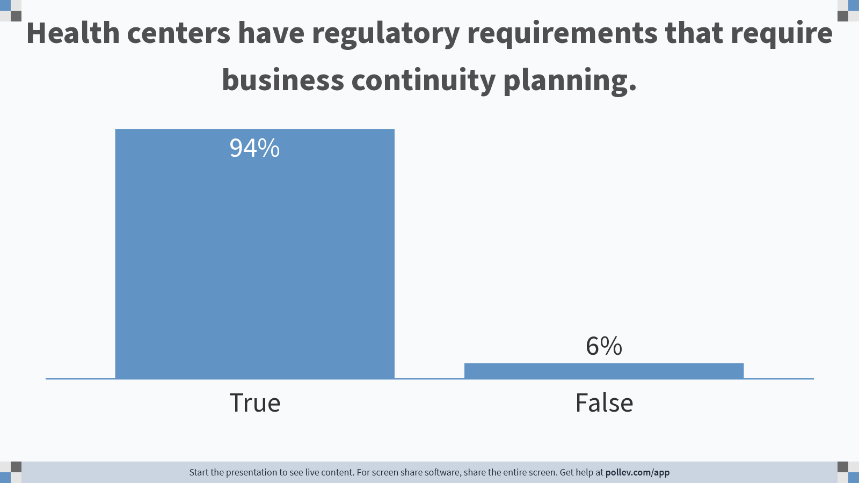
Notes:
Poll Title: Do not modify the notes in this section to avoid tampering with the Poll Everywhere activity.
More info at polleverywhere.com/support
Health centers have regulatory requirements that require business continuity planning.
https://www.polleverywhere.com/multiple_choice_polls/n1GPskUU5el1kVf31kaGT?flow=Default&onscreen=persist

Slide 29
REMOTE WORK IMPLEMENTATION
  STEP 1: Develop a Remote Work Policy
  A Remote Work Policy should include specific topics such as communication requirements and managerial oversite
  An evaluation of a remote worker’s performance should focus on work output and completion of objectives
Notes:
The first step in the implementation of having employees work remotely is the development of a Remote Work Policy (Telecommuting*)
A Remote Work Policy should include specific topics such as communication requirements and managerial oversite. It should also include a clause that the remote working program may be discontinued at will and at any time.
Human Resource experts agree that an evaluation of all remote workers' performance should focus on work output and completion of objectives rather than on time-based performance.

Slide 30
DEVELOPING A REMOTE WORK POLICY
  Objective
  Procedures
  Eligibility
  Equipment
  Security
  Time worked
  Remote Work Agreement
Notes:
Objective
Why are you creating a remote work policy?
What issues would the remote work policy solve?
Procedures
What procedures need to be in place for a remote work policy to work?
How often should staff check in with their supervisor?
How will you conduct virtual meetings?
Are there limitations to the remote work policy?
What is the process for requesting more office supplies?
Eligibility
What positions are eligible for remote work?
What are the requirements for eligiblity?
Equipment (computer and office supplies)
Identify all required equipment that staff must use in their job functions.
What are the maintenance requirements for equipment (e.g., computer software update)
Security (protection of proprietary and customer information)
How will your staff protect proprietary and patient information?
Are staff aware and trained in cybersecurity basics?
Do you have a cybersecurity plan?
Time worked (Fair Labor Standards Act)
Will the total number of hours or hours of operation change for employees who work remotely?
Will staff need approval to work overtime?
Can remote work be used as a substitute for child or adult care?
Remote Work Agreement
Remote work employees will need to sign an agreement.
The agreement should address:
Guidance on choosing the best location to work remotely
Expectations of the remote worker
Specific information on communication and meeting requirements between remote worker and supervisor
Identified work schedule for the remote worker
Length of time an employee is permitted to work remotely (the agreement should be no longer than 12 months, with the option to renew)
How to modify or terminate the remote work agreement
Acknowledgment of the Remote Worker Policy

Slide 31
FEDERAL AND STATE REGULATIONS
Notes:
Now I want to briefly touch on federal and state labor regulations

Slide 32
FEDERAL EMPLOYMENT
AND LABOR LAWS
  Federal legislation acts as umbrella laws for state-level implementation
  State legislation addresses legal concerns in the workplace
Notes:
Federal legislation acts as umbrella laws for state-level implementation. As an example, the minimum wage requirement in a particular state-enacted Shops and Establishments Acts must be in line with the Minimum Wage Act enacted at the federal level.
State legislation addresses a number of legal concerns which can arise in the workplace, ranging from standard labor disputes, to contractual questions, and even to discrimination and sexual harassment. Research would be required to determine state-specific employment laws, including minimum wage laws, whistleblower protection statutes, and more.

Slide 33
FEDERAL EMPLOYMENT
AND LABOR LAWS
  Affordable Care Act
  Americans with Disabilities Act
  Rehabilitation Act of 1973
  Age Discrimination in Employment
  Child Labor Laws
  Fair Credit Reporting Act
  Fair Labor Standards Act
  Family and Medical Leave Act
  National Labor Relations Act
  Occupational Safety and Health Act
  Retaliation and Whistleblower Laws
  Title Vll
  Wage and Hour Laws
  Worker Adjustment and Retraining Notification Act
Notes:
Affordable Care Act
Americans with Disabilities Act
Rehabilitation Act of 1973
Age Discrimination in Employment Act
Child Labor Laws
Fair Credit Reporting Act
Fair Labor Standards Act
Family and Medical Leave Act
National Labor Relations Act
Occupational Safety and Health Act
Retaliation and Whistleblower Laws
Title Vll (Race, National Origin, Religion and Sex discrimination)
Wage and Hour Laws
Worker Adjustment and Retraining Notification Act

Slide 34
FEDERAL EMPLOYMENT
AND LABOR LAWS
  State employment and labor laws include, but are not limited to:
  Child labor laws
  Minimum wage
  Minimum paid rest periods
  Minimum meal periods
  Payday requirements
  Prevailing wages
  Right to work
  Worker’s compensation

Slide 35
RESOURCES
CREATING A BUSINESS CONTINUITY PLAN
FOR YOUR HEALTH CENTER
https://www.nachc.org/clinical-matters/current-projects/building-capacity-of-community-health-centers-to-respond-to-covid-19/#crisis-business-continuity

Slide 36



CONNECT WITH US!
Connect Consulting Services Emergency Management and Business Continuity Planning | Nora O’Brien, MPA, CEM Founder and CEO | Amanda Cooper, MPH, CADAC/P Planning Specialist
Office: 916-758-3220 Fax: 916-750-2882 Email: Connect@ConnectConsulting.biz Schedule a Call with Connect Consulting Team About Connect Consulting | Office: 916-758-3220 Mobile: 916-806-7361 Email: Nora@ConnectConsulting.biz Schedule a Call with Nora O'Brien Nora O'Brien Bio | Office: 916-758-3220 Mobile: 916-541-7937 Email: Amanda@ConnectConsulting.biz Schedule a Call with Connect Consulting Team Amanda Cooper Bio

Slide 37

Thank you!
Questions?

Slide 38

THANK YOU TO ALL COMMUNITY HEALTH CENTERS
#ThankYouCHCs

