Slide 1
Preventing Heart Attacks and Strokes in Primary Care
Million Hearts Partner Call
October 27, 2020
Notes:
Chris

Slide 2
Million Hearts® 2022 Optimizing Care Goals
80% of patients ages 18 to 85 with a diagnosis of high blood pressure have it under control
80% of patients who need statin therapy receive it

Slide 4
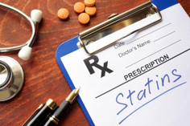
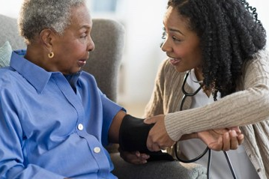
Year 3: Preventing Heart Attacks and Strokes in Primary Care
Increasing Appropriate Use of Statin Therapy for High Risk Groups - Continued Implementation
5 HCCNs – 22 health centers
Use Statin Roadmap
Test new tools/resources
Increase understanding of risk groups
Contribute to CDC Cholesterol Change Package
Improving BP Control for African Americans - Continued Implementation
5 HCCNs – 23 health centers
Use BPAA Roadmap
Leverage medication intensification measures
Test AA-specific patient engagement strategies
Implement/optimize use of SMBP
Notes:
Judy

Slide 5
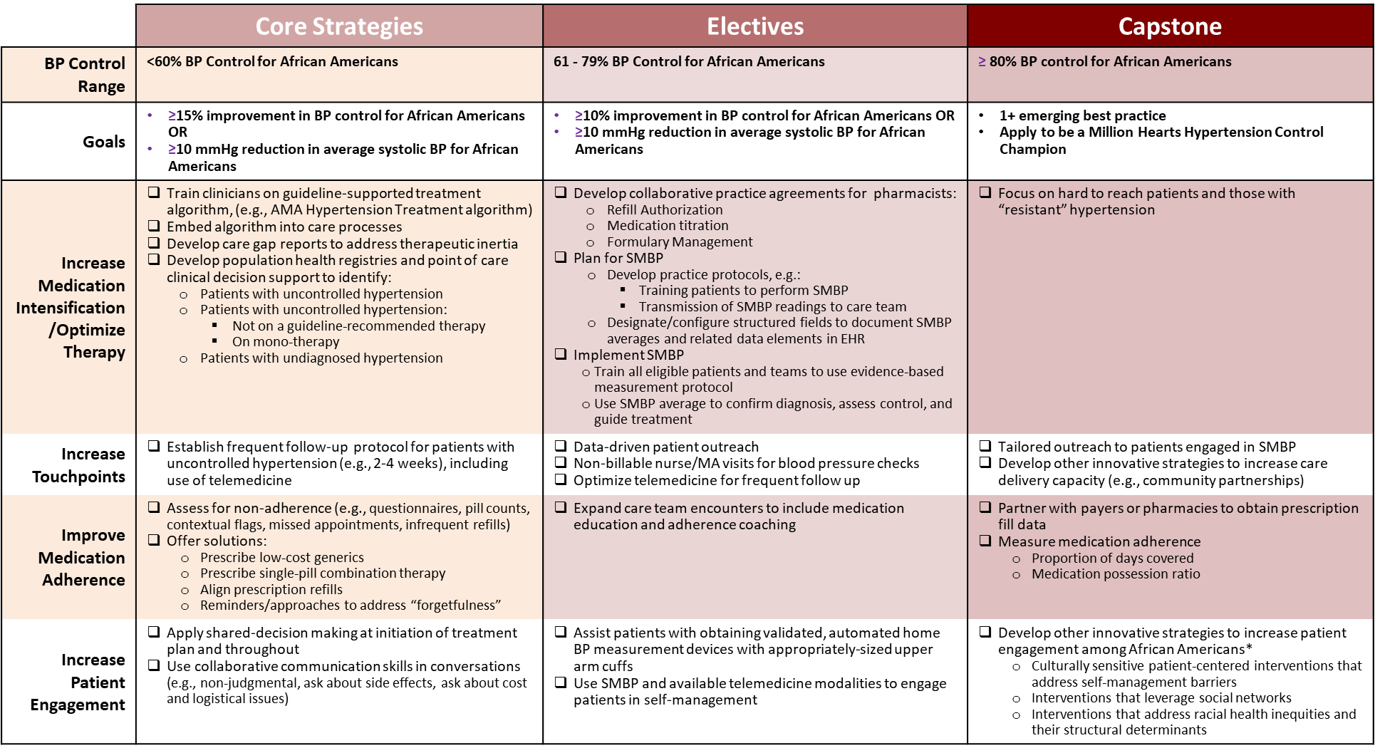
Interactive Roadmaps
Improving Blood Pressure Control for African Americans

Slide 6
Improving Use of Statin Therapy for High-Risk Patients

Slide 7
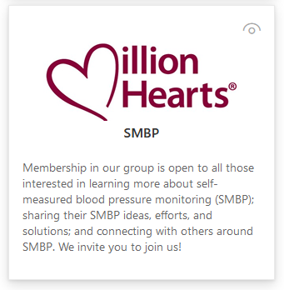
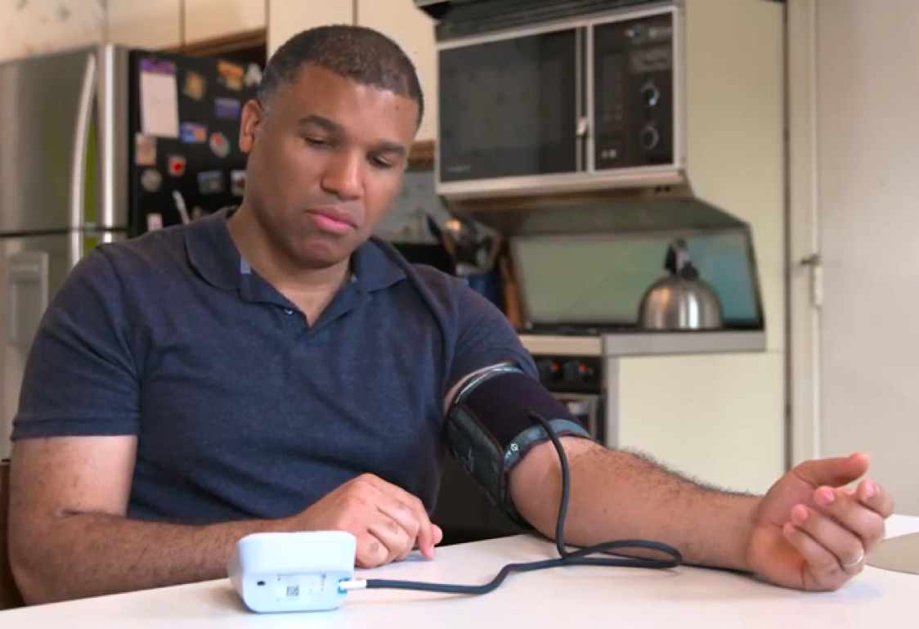
Year 3: Additional NACHC Million Hearts Projects
SMBP Forum & Online Learning Community
Continue supporting efforts to increase adoption and appropriate use of SMBP on a national scale through peer and expert sharing/learning opportunities:
Innovation Competition
By Application – open to safety net organizations (11/4/2020)
Shark Tank model
Test proposals to make impact on Million Hearts goals
Short timeline/light touch
Notes:
Judy

Slide 8
Additional New Resources
Preventing Heart Attacks and Strokes in Primary Care

Slide 9
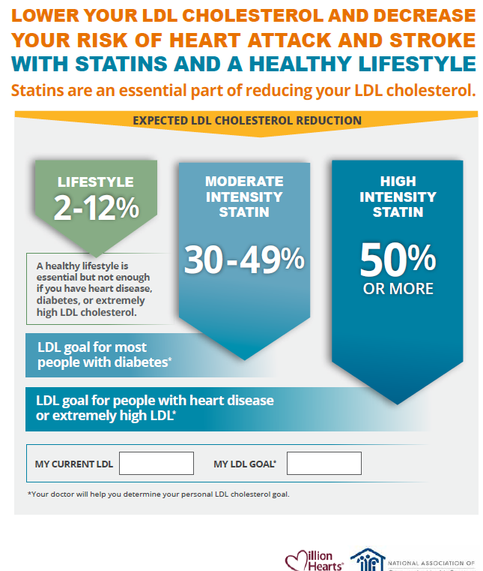
Additional New Statin Resources

Slide 10
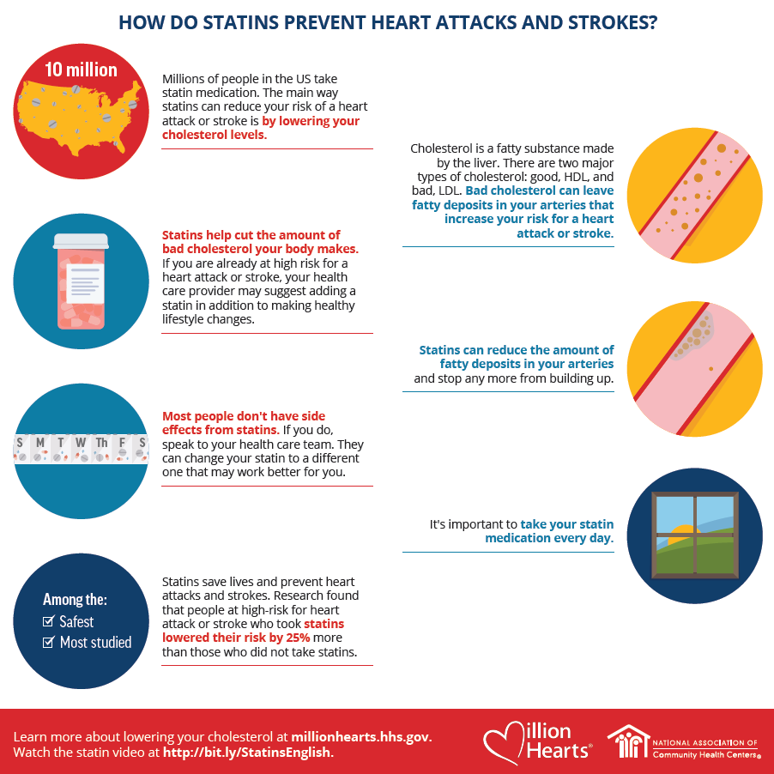
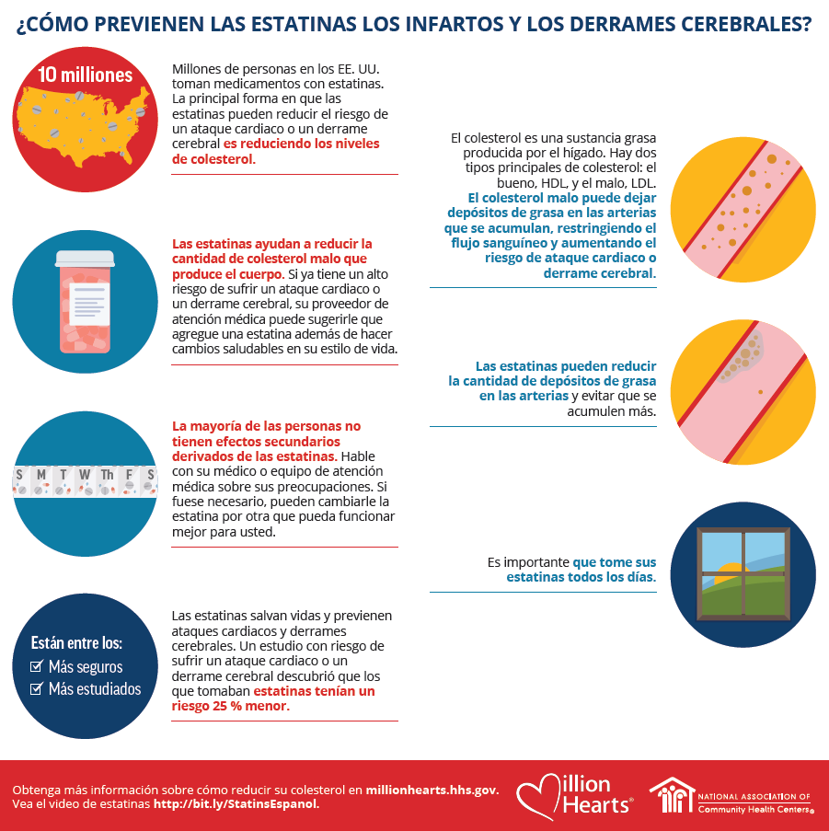
Link to animated Statin video

Slide 11
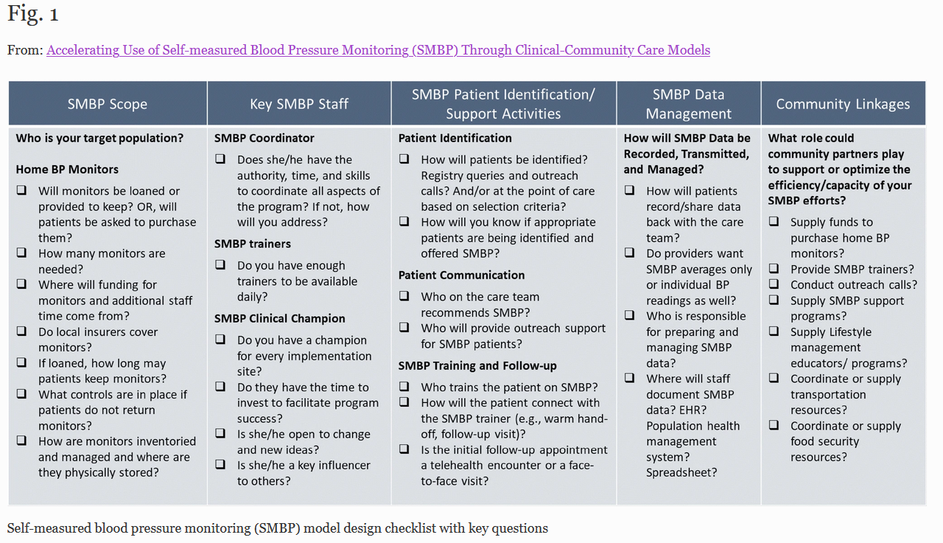
Planned Resources
SMBP Model Design Checklist

Slide 12
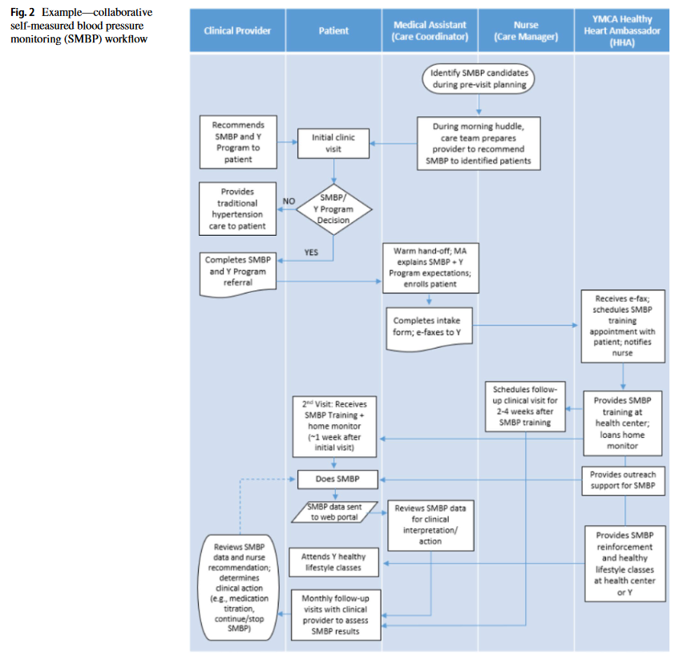
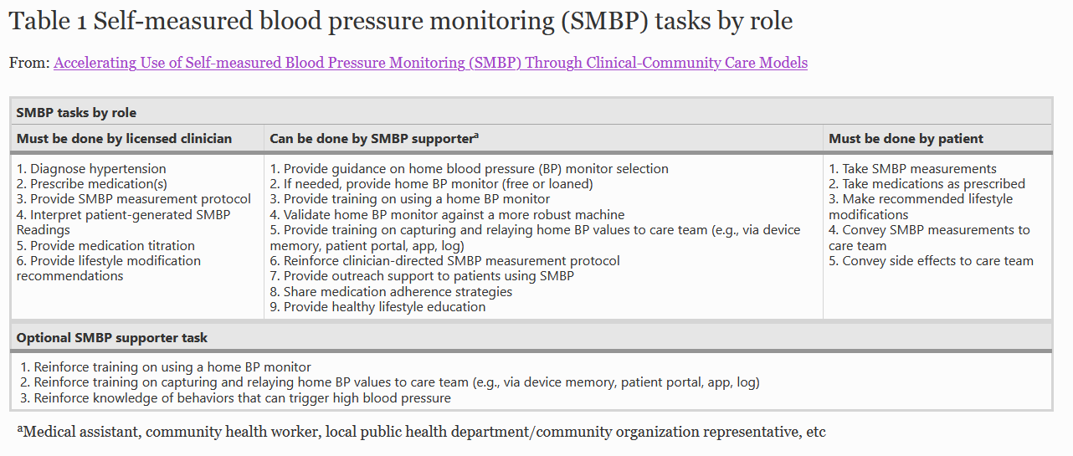
Planned Resources
SMBP Tasks by Role and Sample Workflow

