Slide 1
Combined Telemedicine WCC and Dental Recall Visits
Scott Wolpin
Eastern Shore Rural Health System

Slide 2
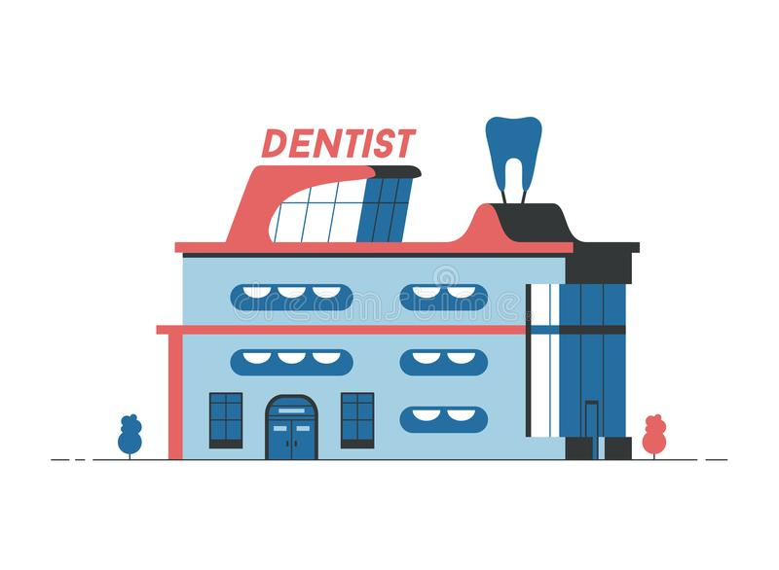

Why?
Works well for Medical and Dental Programs that are not co-located
Helps maintain social distancing in medical offices during COVID19
Convenient for working families
Improves Dentist-Physician relationship/communication
Notes:
Stay at home orders related to COVID19 has made it very challenging for children to attend WCCs prior to entering school. A unique integration model utilizing telemed is being employed at our health center. Over 600 children require a well child care visit before September but with social distancing restrictions and new infection control guidelines this need will be quite difficult for our pediatricians to meet.
Many children may not require immunizations or hands on assessments by the physician. Our school-based dental program is connecting with our physicians to complete these medical screenings during the child’s periodic dental visit.

Slide 3

Care Coordinator scans schedule for Telemed WCC/Periodic Recall Visit opportunites
(No children due for immunizations or hands-on doctoring)
BA confirms Telemed WCC/Periodic Recall Visit (acquires consent)
Schedule additional 15 min (This is the time for BA to update paperwork + Vitals acquired by DA
Dentist completes POE/Recare Visit
Physician is instant messaged when patient presents to dentist (Spark)
Face Time Telemed Visit
*HIPAA Compliant
*Notification of Enforcement Discretion for Telehealth Remote Communications During the COVID-19 Nationwide Public Health Emergency
Notes:
This is a our process flow

Slide 4
Dentistry’s Role
Incorporate assessments requested by the Physician (i.e. weight, height , BMI, vitals)
Reinforce importance of ongoing medical home and well visits
Help assure immunizations are up to date
Help promote referrals
Notes:
And the role of our team in these collaborative visits

Slide 5
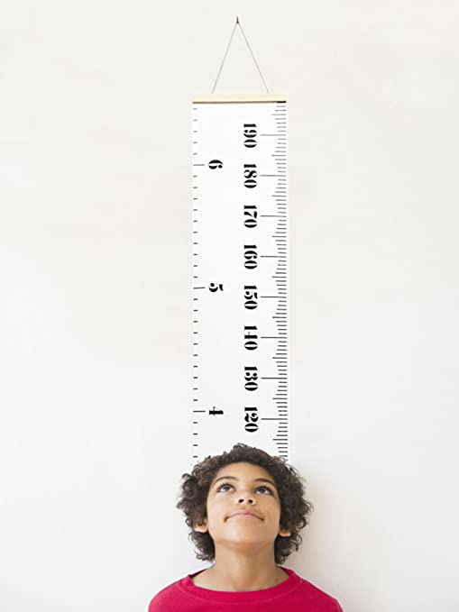
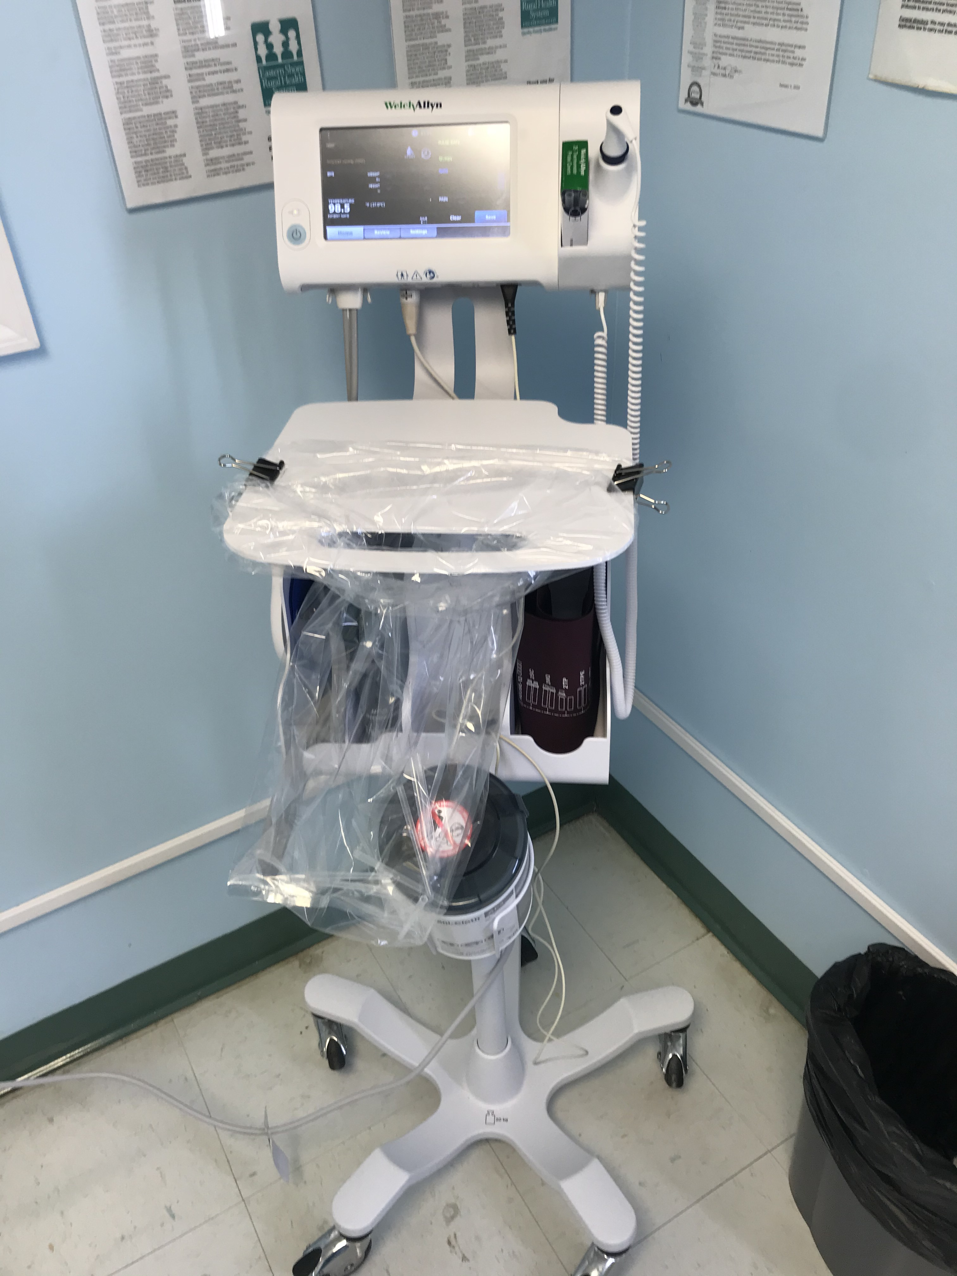
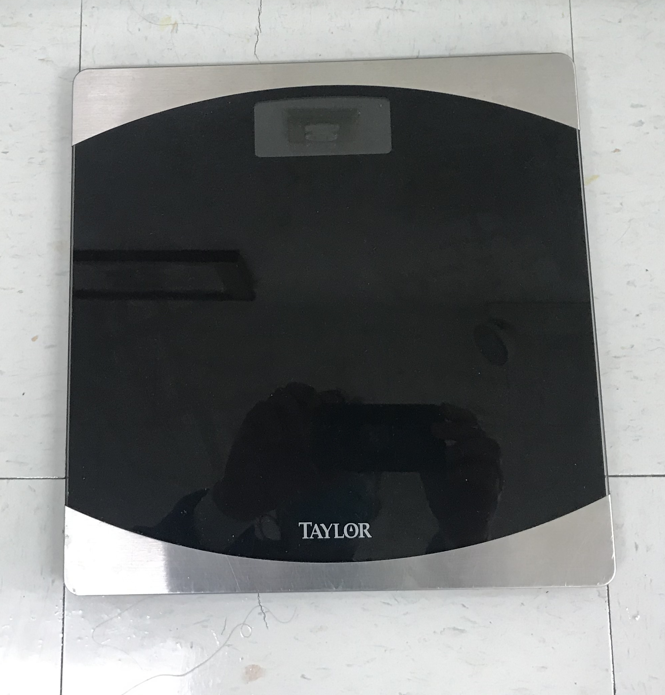
Equipment Needed

Slide 6
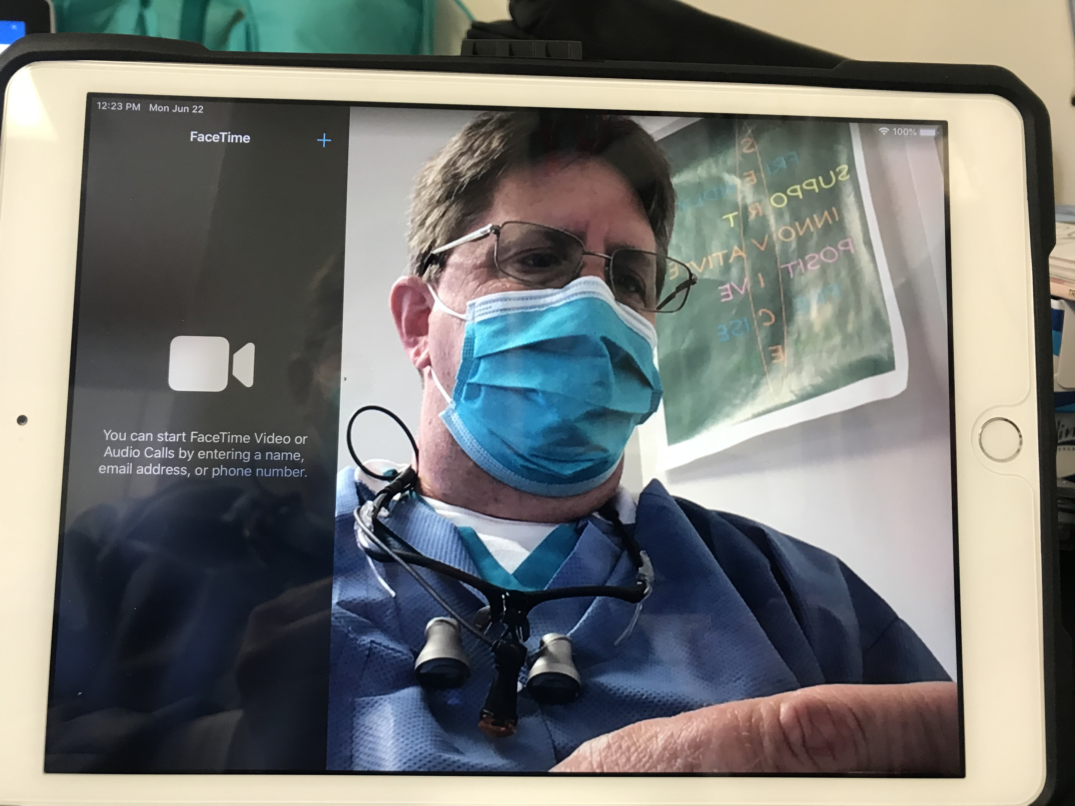
Notes:
The use of Ipad and FaceTime is comfortable for patients and there seems to be a therapeutic value to “seeing” each other during these virtual visits.

Slide 7
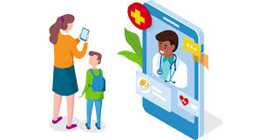
Challenges
Full integration between medical and dental technology is needed to effectively share health information (i.e. vitals)
Time coordination
Confidentiality (i.e. adolescents)
What happens after COVID19?

Slide 8
