Slide 1
Collaborative Programming to Improve
Hypertension in Primary Care:
Building Linkages from Clinic To Community
Presented by:
Affinia Healthcare
Sonia Deal, RN, MSN, LNHA, Director of Practice Transformation
Alexis Howell, PharmD
Felicia Standifer, RN
American Heart Association
Damon Broadus, MA
Notes:
Sonia Deal to do initial introduction after facilitator on topic discussion

Slide 2
Disclaimers/Conflict of Interests
There are no conflicts of interest to report or disclose.

Slide 3





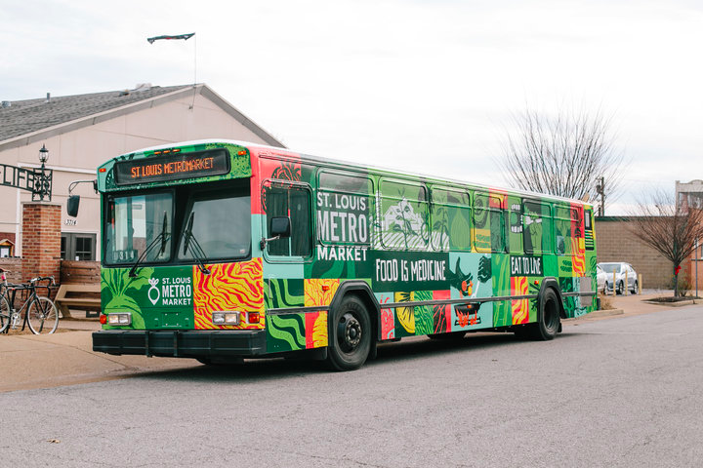
Presenters and Partners
Sonia Deal, RN, MSN, LNHA
Alexis Howell, PharmD
Felicia Standifer, RN
Damon Broadus, MS
Notes:
Each speaker to do brief introduction of name and organization

Slide 4
Objectives
Identify opportunities to form partnerships to build integrative self-measured blood pressure monitoring programs in communities.
Describe community programs aimed at improving blood pressure control and management.
Describe the process of creating a collaborative self-measured blood pressure program.
Identify the steps in implementing a self-measured blood pressure program.
Notes:
Sonia

Slide 5
American Heart Association
Heart Disease and Stroke Statistics 2018 At-a-Glance:
Cardiovascular disease, listed as the underlying cause of death, accounts for nearly 836,546 deaths in the US.
  That’s about 1 of every 3 deaths in the US.
About 2,300 Americans die of cardiovascular disease each day.
  An average of 1 death every 38 seconds.
Cardiovascular diseases claim more lives each year than all forms of cancer and Chronic Lower Respiratory Disease combined.
About 92.1 million American adults are living with some form of cardiovascular disease or the after-effects of stroke.
Notes:
Damon

Slide 6
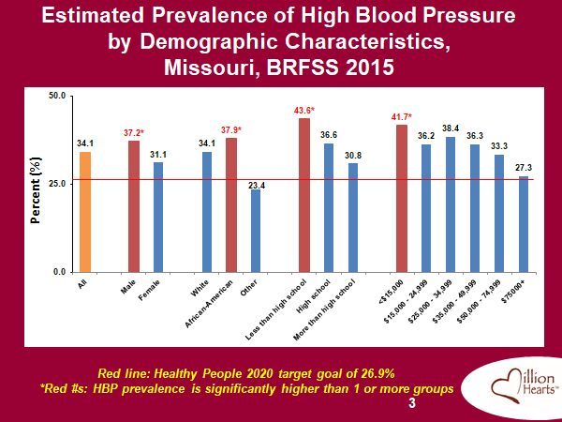
Prevalence of High Blood Pressure in Missouri
Notes:
Damon to discuss... I changed the title to match the slide on prevalence of high blood pressure.

Slide 7
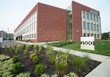
Affinia Healthcare
Community Health Center (FQHC) in St. Louis, MO
8 clinical sites, including school-based health centers
5 health centers within 20 minute proximity of downtown St. Louis
Approximately 43,000 patients
  approx. 8,000 diagnosed with HTN
    approx. 3,600 blood pressure controlled
Notes:
Sonia

Slide 8
TIMELINE
Phase 1 (May 2015)
  Affinia Healthcare participation in Million Hearts and Missouri Hiding In Plain Sight hypertension control program
    Hiding In Plain Sight (HIPS) was an initiative to identify patients with high blood pressure without diagnosis of hypertension and/or treatment for high blood pressure
  Developed Urgent Care internal process
    Patients visiting the Urgent Care with high blood pressure reading are scheduled for follow-up appointment with provider prior to leaving the urgent care
    If they’re not Affinia Healthcare patients, refer back to their primary care provider for follow-up
Notes:
Sonia- This is the progress of hypertension control at Affinia Healthcare over the years.

Slide 9
TIMELINE
Phase 2 (2016)
  HIPS continued
  Continuation of Urgent Care protocol
  Addition of Cardiologist/ Physician Champion for HTN (October)
    Created internal high blood pressure referral and follow-up
  Discussion of Pharmacist integration and utilization of Clinical Pharmacist for HTN follow-up
  Discussion with YMCA regarding implementation of BPSM program with Healthy Heart Ambassador
  Discussion with AHA on hypertension efforts (Fall 2016)

Slide 10
TIMELINE
Phase 3 (2017)
  Implementation of YMCA Healthy Heart Ambassdor at Lemp clinic site (Feb)
  Contacted by Comissioner of St. Louis City Department of Health (DOH)
  Held first collaborative team meeting
    Affinia Healthcare, YMCA, AHA, and City of St. Louis DOH
  Addition of Pharmacist-run HTN clinic at Lemp site
  Discussion of addressing food insecure communities with St. Louis MetroMarket (Nov)
  Created internal SMBP/HTN education curriculum (Nov)
    First cohort in Dec 2017

Slide 11
TIMELINE
Phase 4 (2018)
  Implemented hypertension education program across organization (total of 6 classes)
  Implemented St. Louis MetroMarket in Spring 2018
  Started assessing patients for Social Determinants of Health (SDOH)
    Utilization of the NACHC PRAPARE (The Protocol for Responding to and Assessing Patients’ Assets, Risks, and Experiences) tool
      Assesses for instability in:
        Housing
        Income
        Health Insurance
        Legal Issues
        Partner Violence, etc.

Slide 12
CURRENT STATUS
In discussions for:
  Food instability programs
  Cooking classes
Implemented:
  Check, change, control into total practice
  Goals to implement program in community setting
Seeking funding for:
  Food truck program
  Food delivery program
  Community health workers for education and assessing/ addressing SDOH

Slide 13
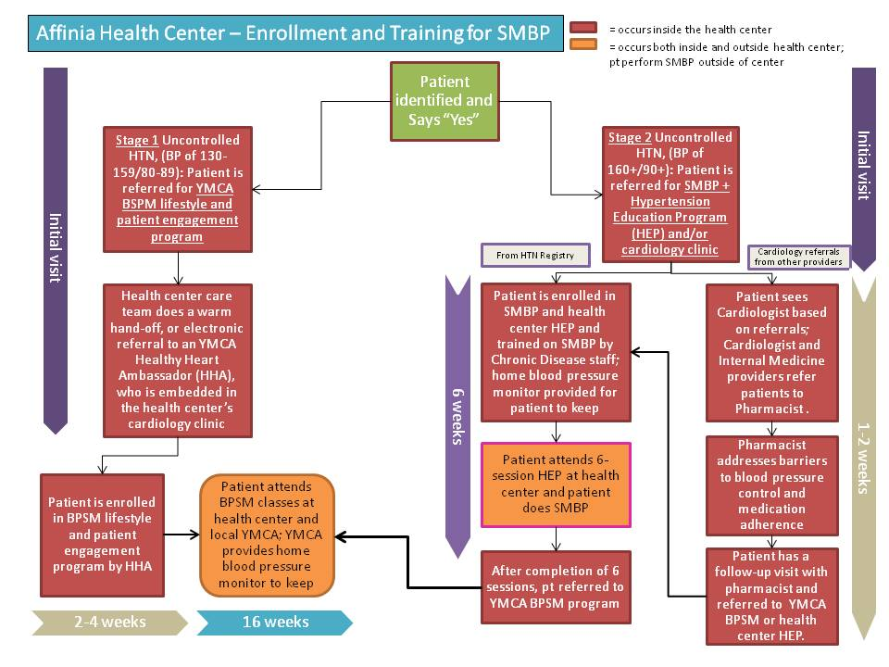
Affinia Healthcare SMBP Model
Notes:
Sonia- this is the model we use to determine which program to refer pt to.

Slide 14

American Heart Association
To achieve our goal of 15.2 million people having their blood pressure controlled to <130/80 we have to think of innovative solutions to help them get their blood pressure under control.
Work with organizations that conduct a complete community to clinic linkages program for patients with high blood pressure.
  The ideal program will be 2-6 months in length or be an on-going program.
  Components should include regular communication to participants, promotion of blood pressure monitoring and tracking by participants, education sessions, and distribution of videos or educational materials to participants.
  Participants should understand and agree to participate in the high blood pressure program.

Slide 15
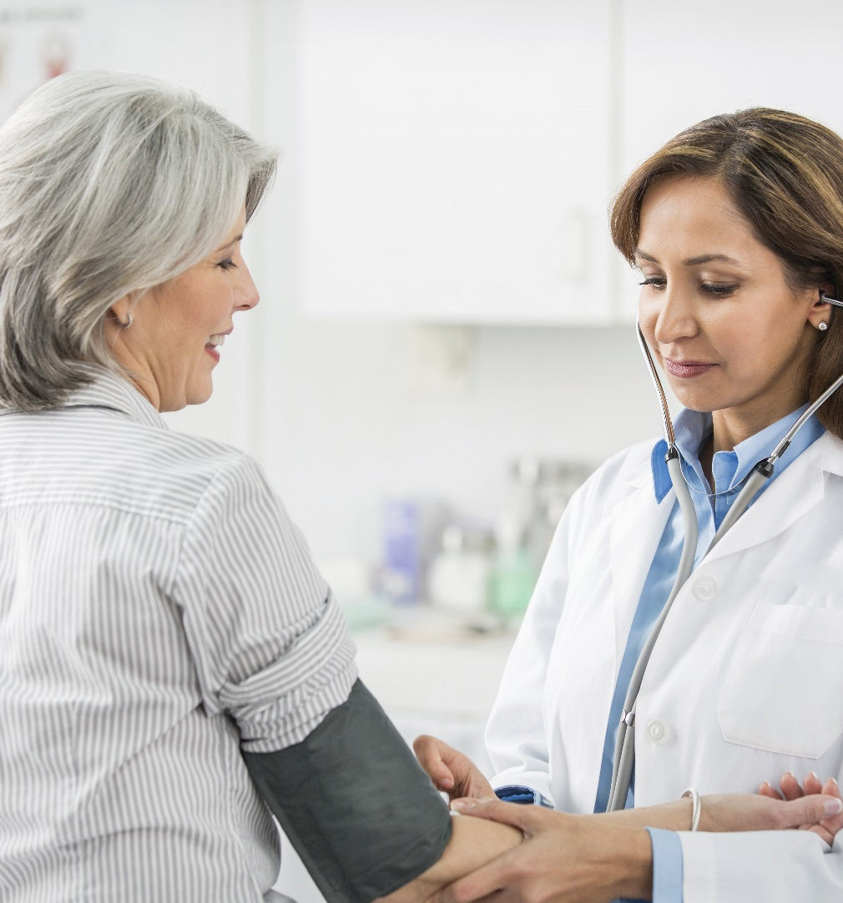
What is Target: BP?
✓
A call to action motivating medical practices, practitioners and health services organizations to prioritize blood pressure control
Recognition for healthcare providers who attain high levels of blood pressure control in their patient populations, particularly those who achieve 70, 80 percent or higher control
A source for tools and assets for healthcare providers to use in practice, including the AHA/ACC/CDC Hypertension Treatment Algorithm and the AMA’s M.A.P. Checklist
✓
✓
http://targetbp.org/
Notes:
To help address the issue of high blood pressure we developed Target: BP in 2015 in collaboration with the American Medical Association. Target: BP is a call to action motivating medical practices, practitioners and health services organizations to prioritize blood pressure control. Currently, we are recruiting primary care providers and healthcare clinics to join us in the fight to provide better treatment for patients with high blood pressure.
As an incentive we are going to provide recognition for healthcare providers who attain high levels of blood pressure control in their patient populations, particularly those who achieve 70 or 80 percent or higher control. We’ll also recognize those sites that have improved their control rates by 10% or more.
Key to the program is providing tools and resources for the sites to help them improve. We’ve partnered with the American Medical Association to develop these resources. We have a robust website with podcasts, videos, one-pagers, checklists and patient education resources. We’ll also be offering a series of webinars to show clinics how to implement system changes in their clinics to improve treatment.

Slide 16



Target: BP Improvement Program
M is for MEASURE blood pressure accurately every time
Proper measurement is critical to controlling blood pressure. Build a protocol to ensure accuracy of blood pressure readings.
A is for ACT rapidly to address high blood pressure readings
This step requires rapid action during a patient visit and prioritizes follow-up appointments and a clear treatment plan to help patients achieve blood pressure control.
P is for PARTNER with patients, families and communities to promote self-management
Real change comes when patients take ownership of their health. Engage with patients, their families & communities helps to promote sustainable lifestyle change, thus supporting the improvement of overall health.

Slide 17
  M is for MEASURE blood pressure accurately every time
  Proper measurement is critical to controlling blood pressure.
  Build a protocol to ensure accuracy of blood pressure readings.
Why is measuring blood pressure accurately important?
Uncertainty of patients’ true blood pressure is the leading cause for failure of a clinician to act on a high blood pressure in the office
Significant BP variability exists in all patients
Poor measurement technique decreases reliability of a patient’s BP, which can lead to poor clinical decisions, adversely affecting the health of a patient
How does this impact clinicians in practice?

Slide 18
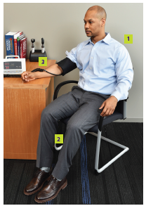
Correct patient position for BP measurement:
  M is for MEASURE blood pressure accurately every time
  Proper measurement is critical to controlling blood pressure.
  Build a protocol to ensure accuracy of blood pressure readings.
For screening BP measurement:
Automated, validated device
Sitting in a chair with back and arm supported (1)
Legs uncrossed, feet on the ground or a stool (2)
Cuff over a bare arm (3)
Correct cuff size
No talking or texting
If the screening BP is > 140/90 mm Hg, obtain
confirmatory BP measurements, same as above, plus:
Ensure patient has an empty bladder
Rest for at least five minutes
Obtain the average of at least three measurements

Slide 19
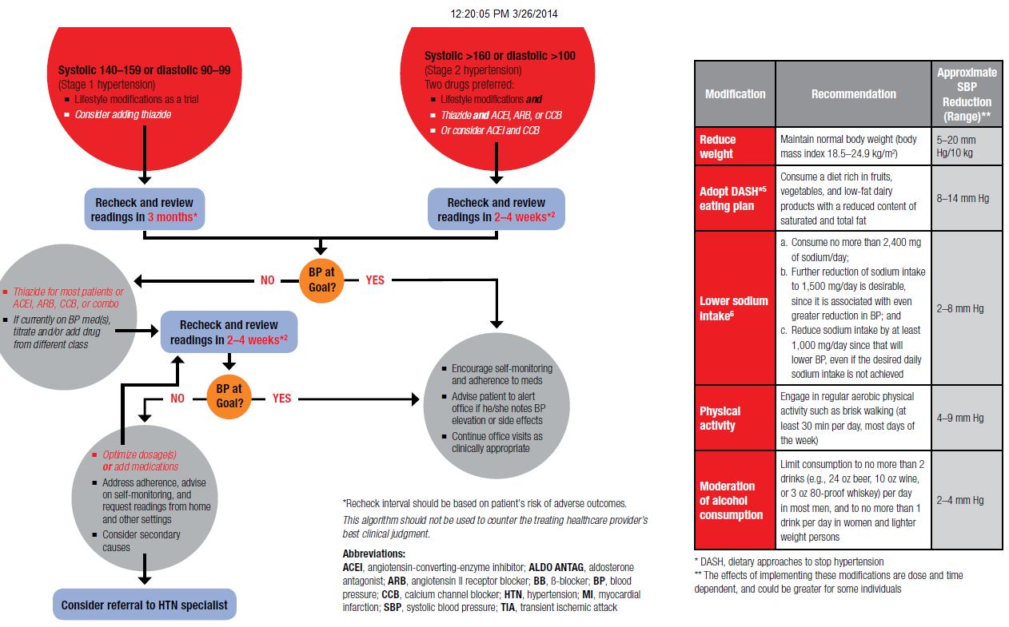
A is for ACT rapidly to address high blood pressure readings
This step requires rapid action during a patient visit and prioritizes follow-up appointments
and a clear treatment plan to help patients achieve blood pressure control.

Slide 20
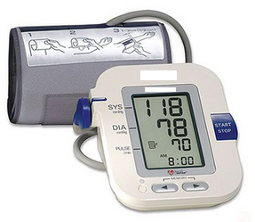
Empower patients to control their blood pressure
P is for PARTNER with patients, families & communities to promote self-management
Real change comes when patients take ownership of their health.
Engage with patients, their families and communities helps to promote
sustainable lifestyle change, thus supporting the improvement of overall health.
SMBP empowers patients to:
      Check their BP
Communicate results
Make adjustments between visits
Self-manage HTN
“…regular self-measurements
of blood pressure and a simple predetermined titration plan
for anti-hypertensive drugs,
is more effective in lowering systolic blood pressure than
is usual care…”
Richard J McManus, Jonathan Mant, Emma P Bray, Roger Holder et al. Telemonitoring and self-management in the control of hypertension (TASMINH2): a randomised controlled trial. Lancet 2010; 376: 163–72

Slide 21
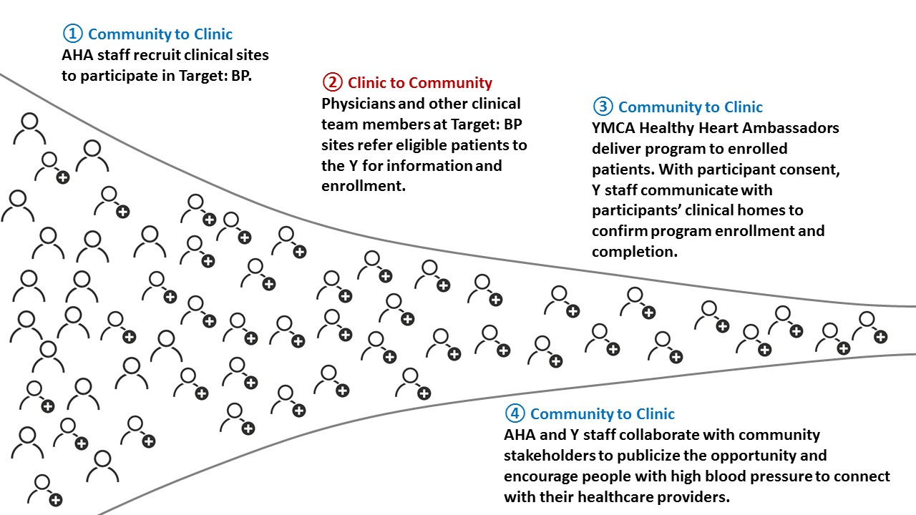
American Heart Association and YMCA
Collaborating to Increase Linkages
TWO Programs…. ONE Referral
Blood Pressure Self-Monitoring (BPSM)
Diabetes Prevention Program (DPP)

Slide 22
American Heart Association
The organization should utilize AHA education materials.
  This could be through a variety of ways: digitally, on-site materials, on-site BP kiosks, passed out within the organization, etc.
Sites should utilize Check.Change.Control. program by focusing on programs that reach large numbers of patients with high blood pressure such as working with community healthcare systems, pharmacy chains and grocery chains with on-site blood pressure kiosks.

Slide 23
Gateway Region YMCA
Mission: To put Christian principles into practice through programs that build a healthy spirit, mind and body for all
Community Integrated Health: Aims to intentionally strengthen the relationships between traditional health care systems and the Y in order to help all community members live their healthiest lives.
Notes:
Joyce

Slide 24
Gateway Region YMCA
YMCA’s Blood Pressure Self-Monitoring (BPSM) Program:
Evidence based, four-month program
Personalized support from a trained Healthy Heart Ambassador
Tips for maintaining cardiovascular health & nutrition education
Notes:
Joyce

Slide 25
Gateway Region YMCA
Referral Data since July 2018:
39 referrals
13 enrolled
4 completed (100% of those eligible)
Notes:
Joyce

Slide 26
St. Louis City Department of Health
Through NACHC inputs and guidance, partner with Affinia Healthcare, American Heart Association, YMCA, and St. Louis MetroMarket regarding the SMBP Model:
  Monthly SMBP Conference Calls
  Helped in submission of monthly SMBP Progress Reports
Notes:
Focus on men’s health
MetroMarket stop at building that hosts Father’s support center

Slide 27
St. Louis City Department of Health
Submission of monthly SMBP invoices
Support of stakeholders utilization of the plan
Attendance at in-state Million Hearts SMBP Stakeholder Meetings
Aid in development of documents to payers and health systems to support SMBP
Fiscal support for program needs and incentives

Slide 28
St. Louis MetroMarket
Notes:
Communal gathering place
-OFS gave food samples and did food demonstrations and education
-Indirect benefit of using bus as a marketing tool to draw community members

Slide 29

Notes:
Lucas

Slide 30

Metro Market Fresh Pass Program
Fresh Food Prescription
Hypertension Patients
Partnerships:
  Affinia Healthcare
  City of STL Dept. of Health
  American Heart Association
Weekly Stops @ 3 Locations
Results:
  12,000 lbs of food
  5,000 residents fed
Notes:
Lucas/Felicia: Lucas can expound on high level data from fresh passes

Slide 31
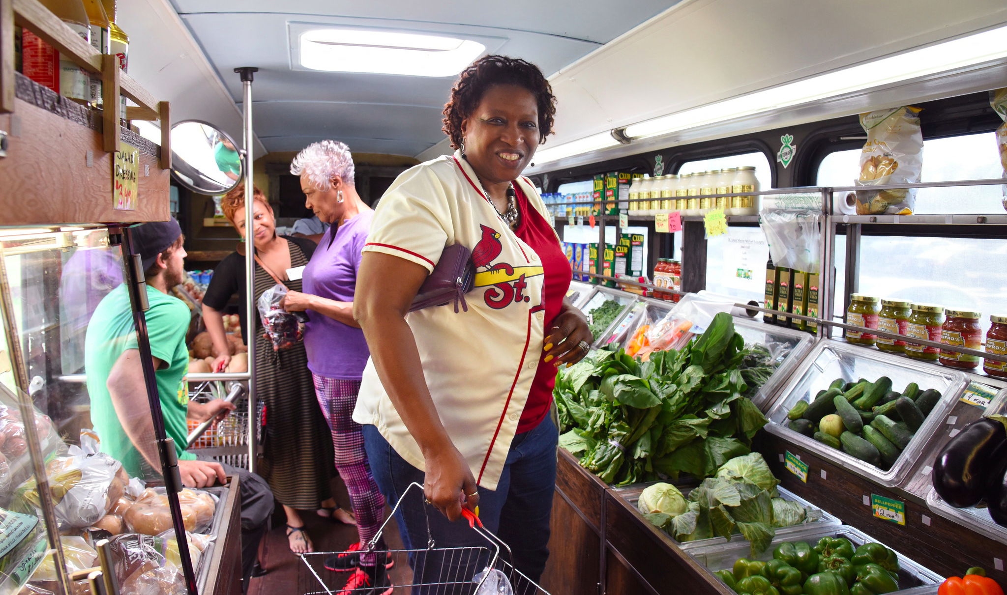

Slide 32

Notes:
Lucas- picture of the bus

Slide 33
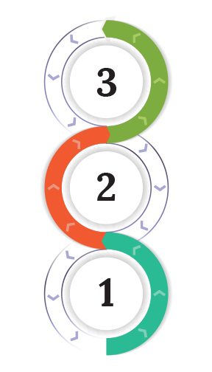
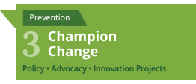
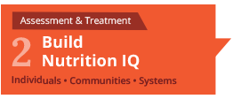

Operation Food Search
Mission: to nourish and educate our neighbors in need to heal the hurt of hunger.
Notes:
Carmen

Slide 34
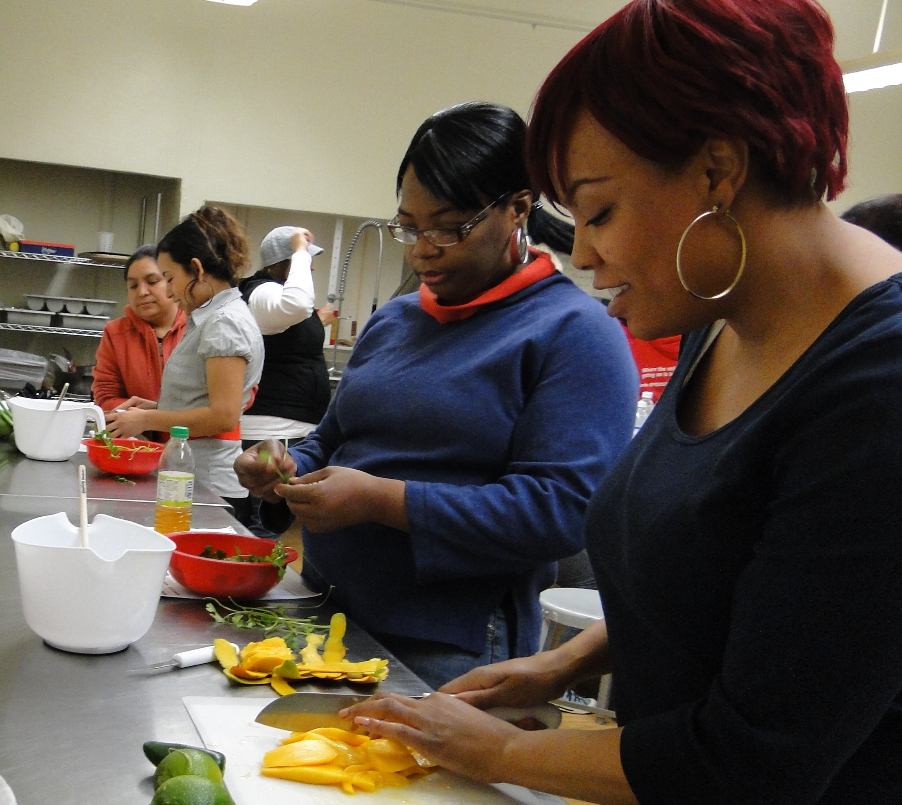

Operation Food Search at Affinia
Build Nutrition IQ:
  Cooking Matters 6-week Course
  Cooking Demonstrations & Nutrition Presentations
  Grocery Store Tours
Topic Focus: preparing dishes at home utilizing heart healthy & affordable ingredients to help improve dietary outcomes for patients who present with hypertension
Notes:
Carmen

Slide 35
Cooking Matters 6-Week Course Results
After the 6-week hands on nutrition focused cooking course, participants:
Eat more fresh fruits (22%), vegetables (80%-100%), and beans (33%)
Eat less meals from a fast food restaurant per week (50%)
Drink less soda or other sugary beverages (29%)
Choose low sodium options more often (25%)
Use the nutrition facts label to look for healthy foods more often (40%)
Gained confidence in using the same healthy ingredient in multiple meals (67%)
Eat from each food group each day (80%)
Eating dinner more often at home (40%)

Slide 36
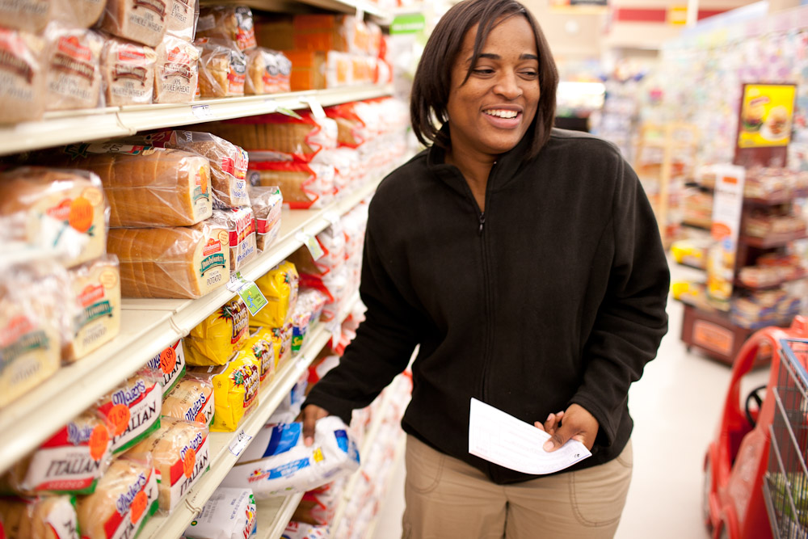
Cooking Matters at the Store Results
After the interactive grocery store tour, participants:
Compare unit prices to find the best deal
  60% are likely to try as a result of the tour
  20% already did this before the tour
Read ingredient lists to find whole grains
  60% are likely to try as a result of the tour
  20% already did this before the tour
Compare food labels to make healthy choices
  60% are likely to try as a result of the tour
  20% already did this before the tour
Choosing a wide variety of fruit and vegetables
  40% are likely to try as a result of the tour
  40% already did this before the tour

Slide 37
Pharmacist HTN Clinic
Pharmacist as a Provider
  Collaboration with Physicians, Physician Assistants, & Nurse Practitioners
  Protocol for HTN
Individual appointment with Pharmacist
  15 minute slots

Slide 38

Pharmacist HTN Clinic
FREE
  No copay since covered by a grant
Qualifying patients:
  Established with PCP
  Diagnosed with HTN
  Uncontrolled HTN

Slide 39
Pharmacist HTN Clinic
Education
  BP goals, risk factors, CVA/MI/CKD, etc.
Adherence Assessment
  Pharmacy calls for pick up dates
Medication Titration
  If needed, per guidelines/protocol
Follow up appointments every other week
  Until goal reached, then sent back to PCP
Notes:
Alexis/Felicia

Slide 40
Pharmacist HTN Clinic
11/2017 – 10/2018 Statistics:
Avg. Drop in SBP | 16mmHg
Avg. HTN Quiz Score Increase | 19%
Avg. No Show Rate | 21%
Total # Patients | 209
Total # Visits | 454
Notes:
Alexis

Slide 41
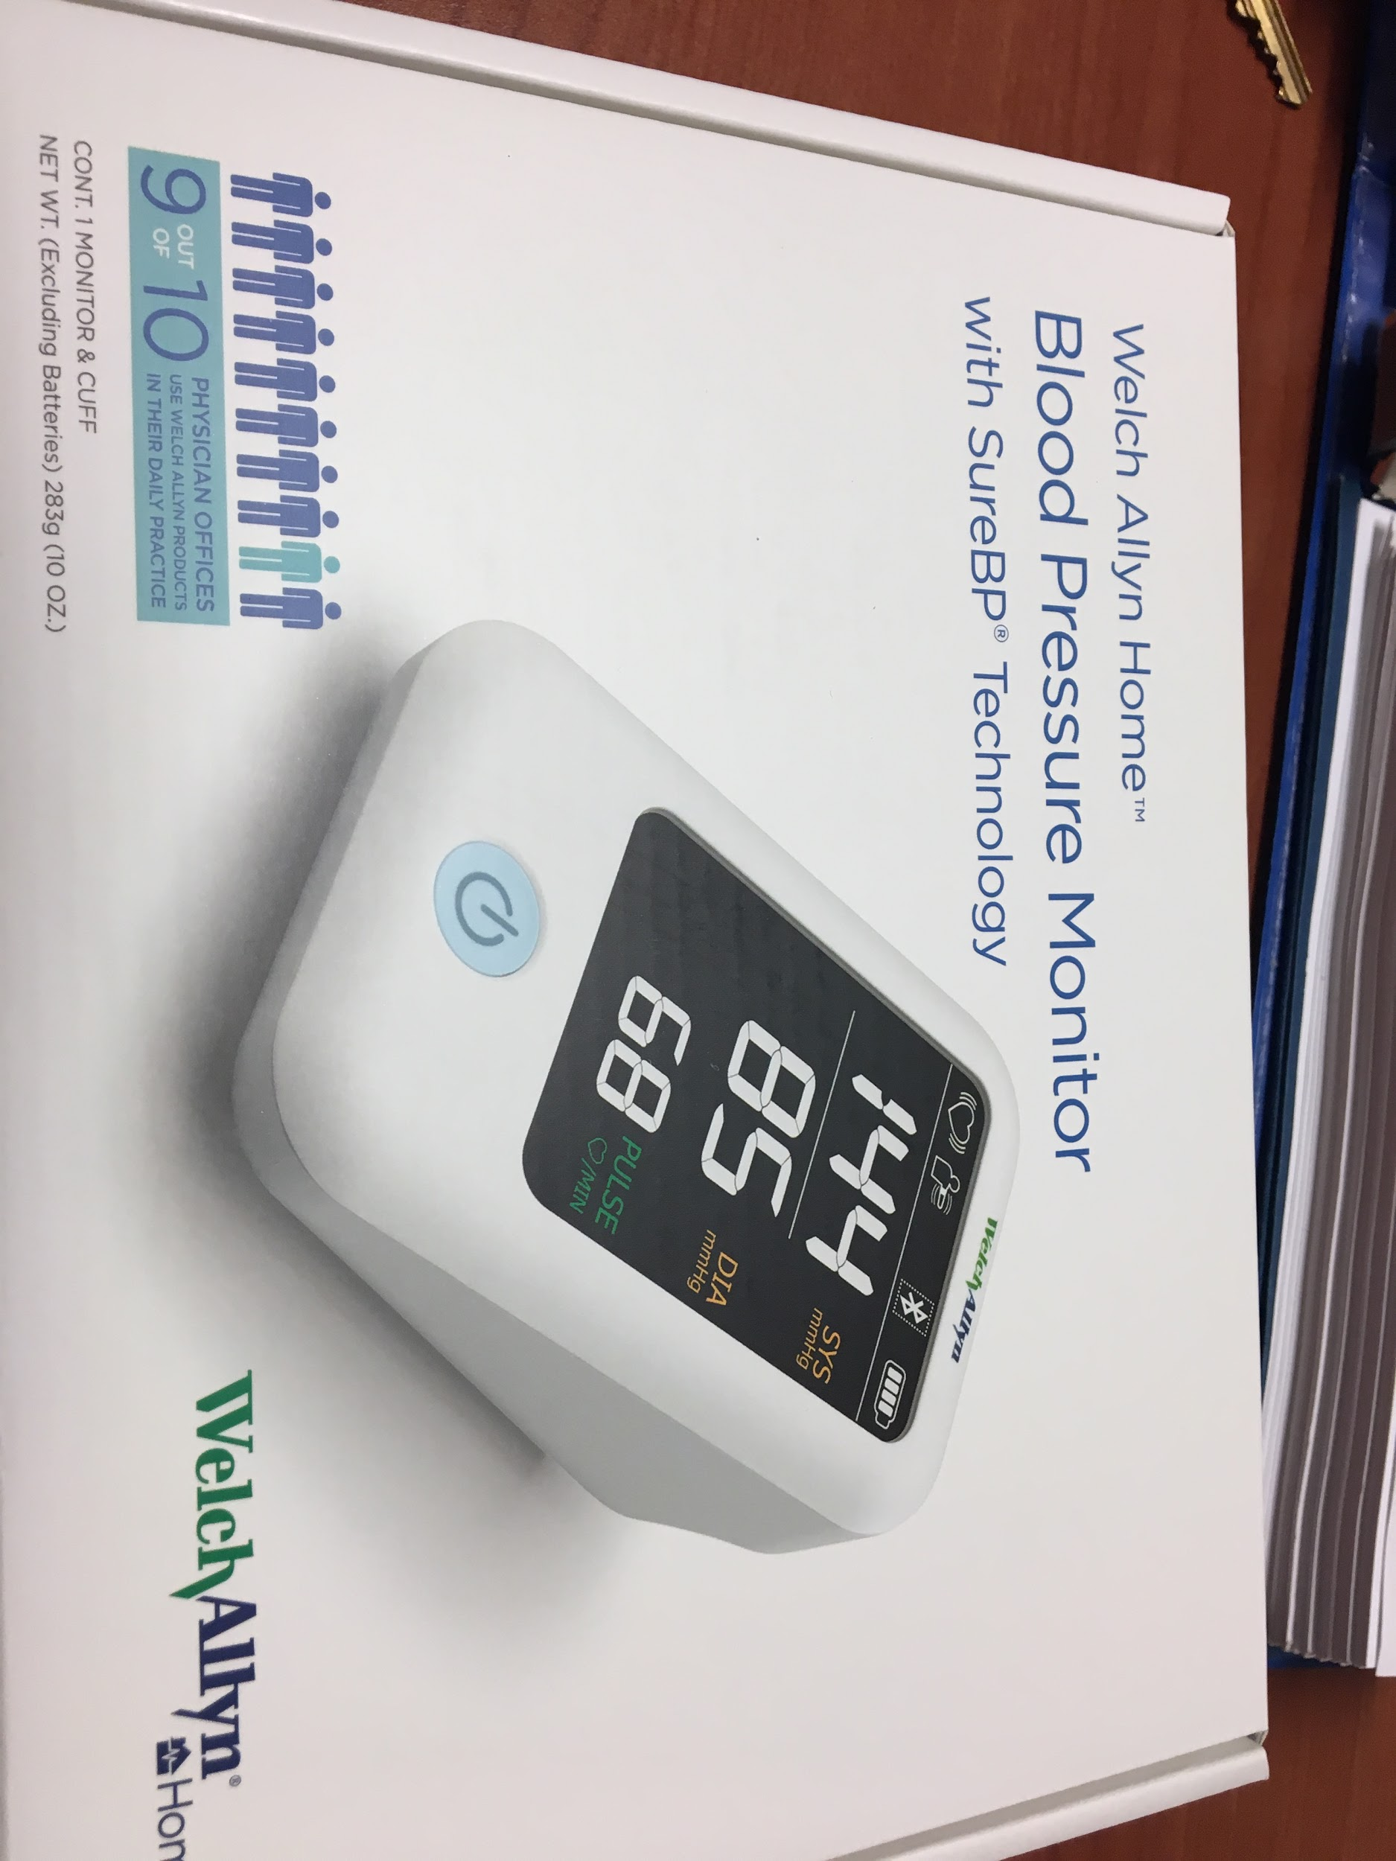
HTN Education Program
Six Sessions; every 2nd and 4th week of the month
Sessions are held as group education
During the 12 weeks:
  patient given BP cuff to track
  blood pressure during program
Notes:
Felicia/Sonia

Slide 42
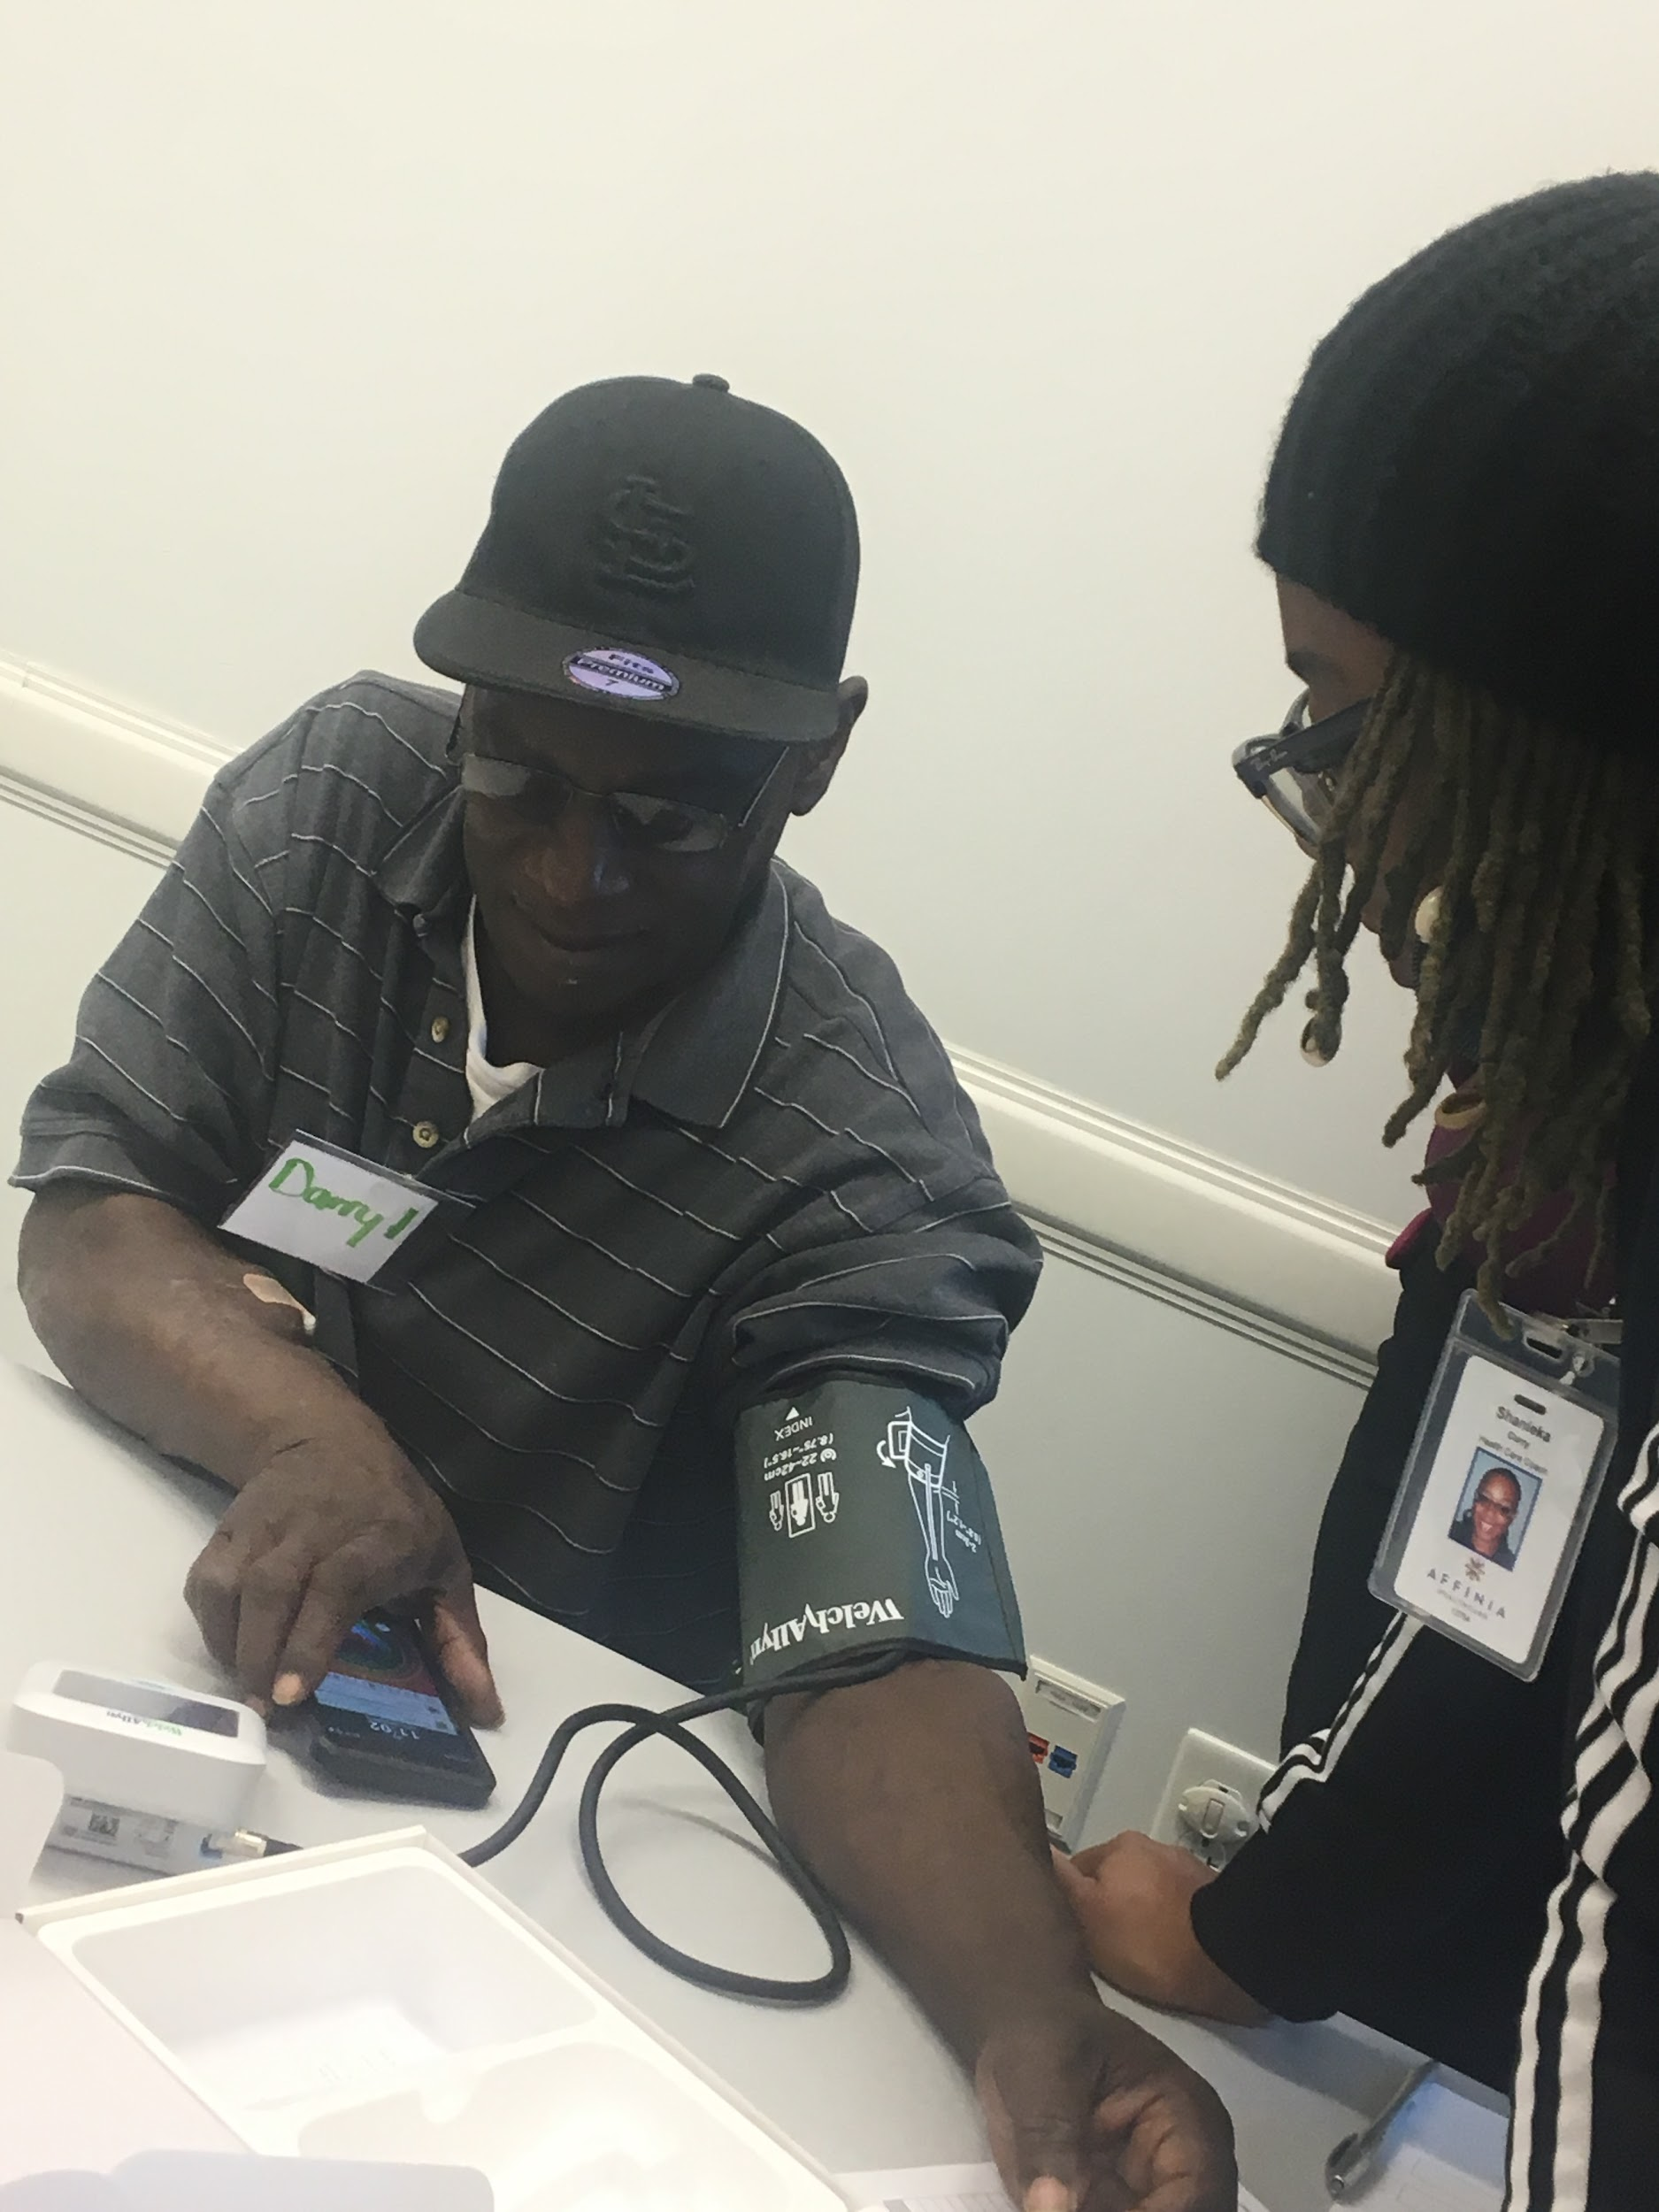
HTN Education Program
1st session:
  What is high blood pressure
  How it impacts total health
  Learn to use blood pressure cuff
2nd session:
  Medications
  Pharmacist is involved
Notes:
Felicia/Sonia:
1st week receive bp cuff and learn how to use it.
Following weeks the patients do a return demonstration every week with the blood pressure cuff given to them.
We also assess for social determinants of health using the PRAPARE tool at the first class.
This is an integrative program where we have the pharmacist, nutrition education, behavioral health, and other auxillary programming integrated into the sessions.

Slide 43
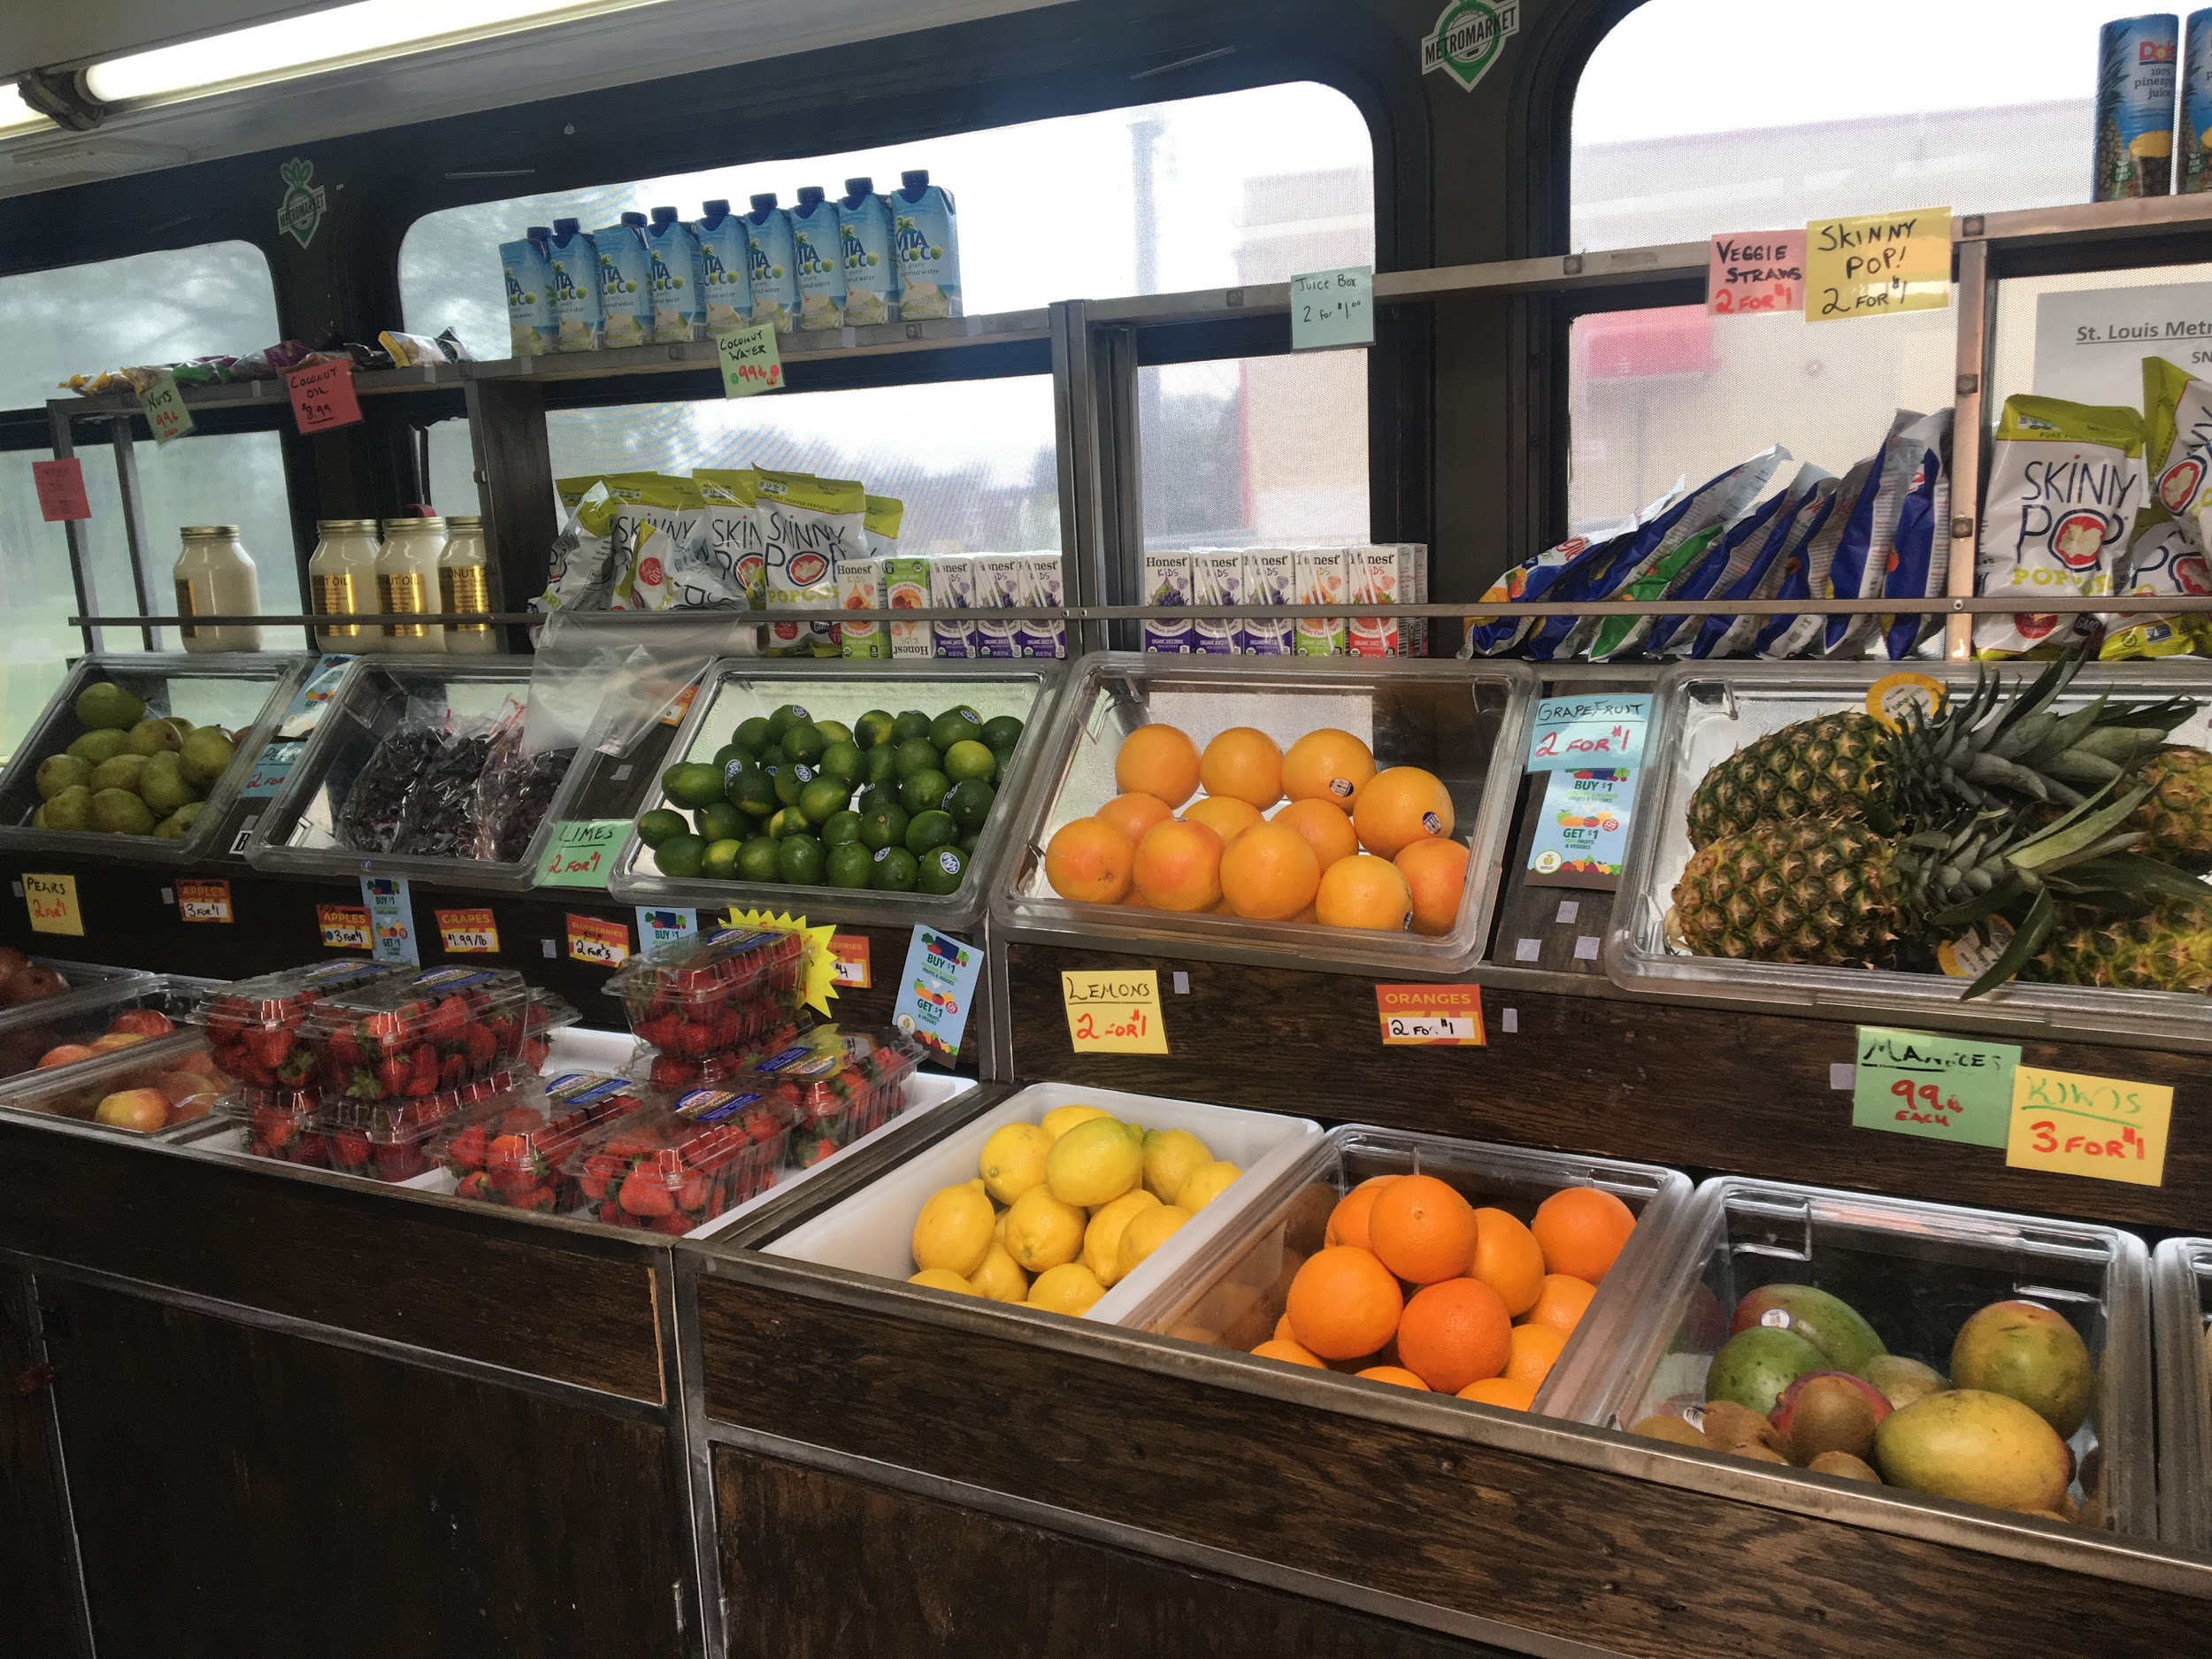
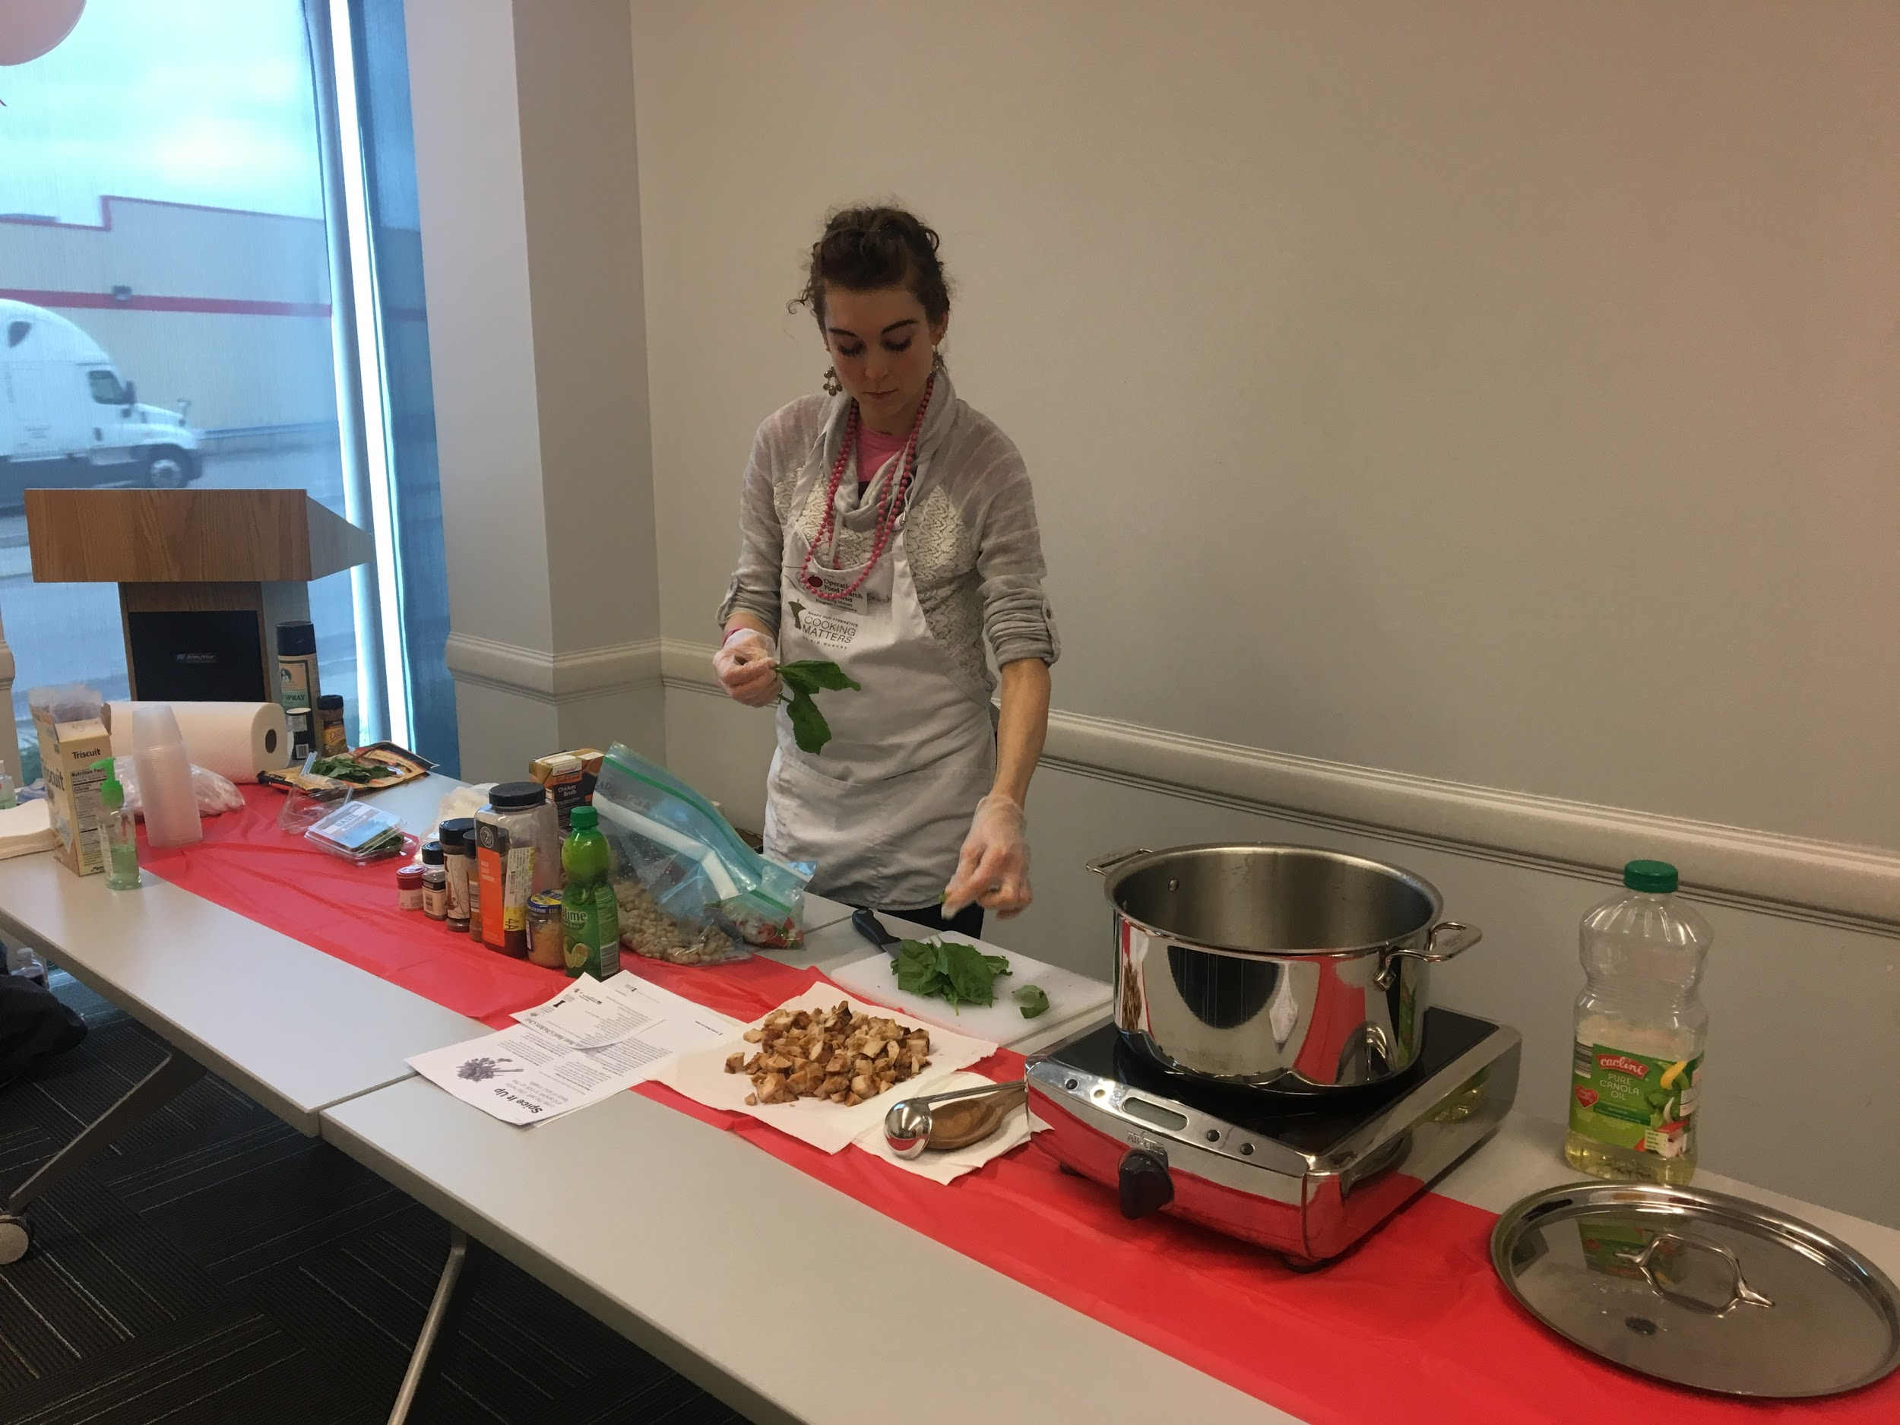
HTN Education Program
3rd and 4th sessions:
  Focuses on food and how it impacts blood pressure
  Includes nutrition instructions and cooking demonstrations
  Partnered with Operation
  Food Search
Notes:
Felicia/Sonia: We have Operation Food Search nutritionist do education on DASH diet and overall nutrition during 3rd week, and a cooking demonstration done the 4th week of the sessions.
Get to take their groceries home, and also get $10 shopping card for the 3rd session.
Cooking matters classes are done separately and is a 6-week session where they take groceries home to create meal from class every week.
These were funded through a grant with MFH.

Slide 44
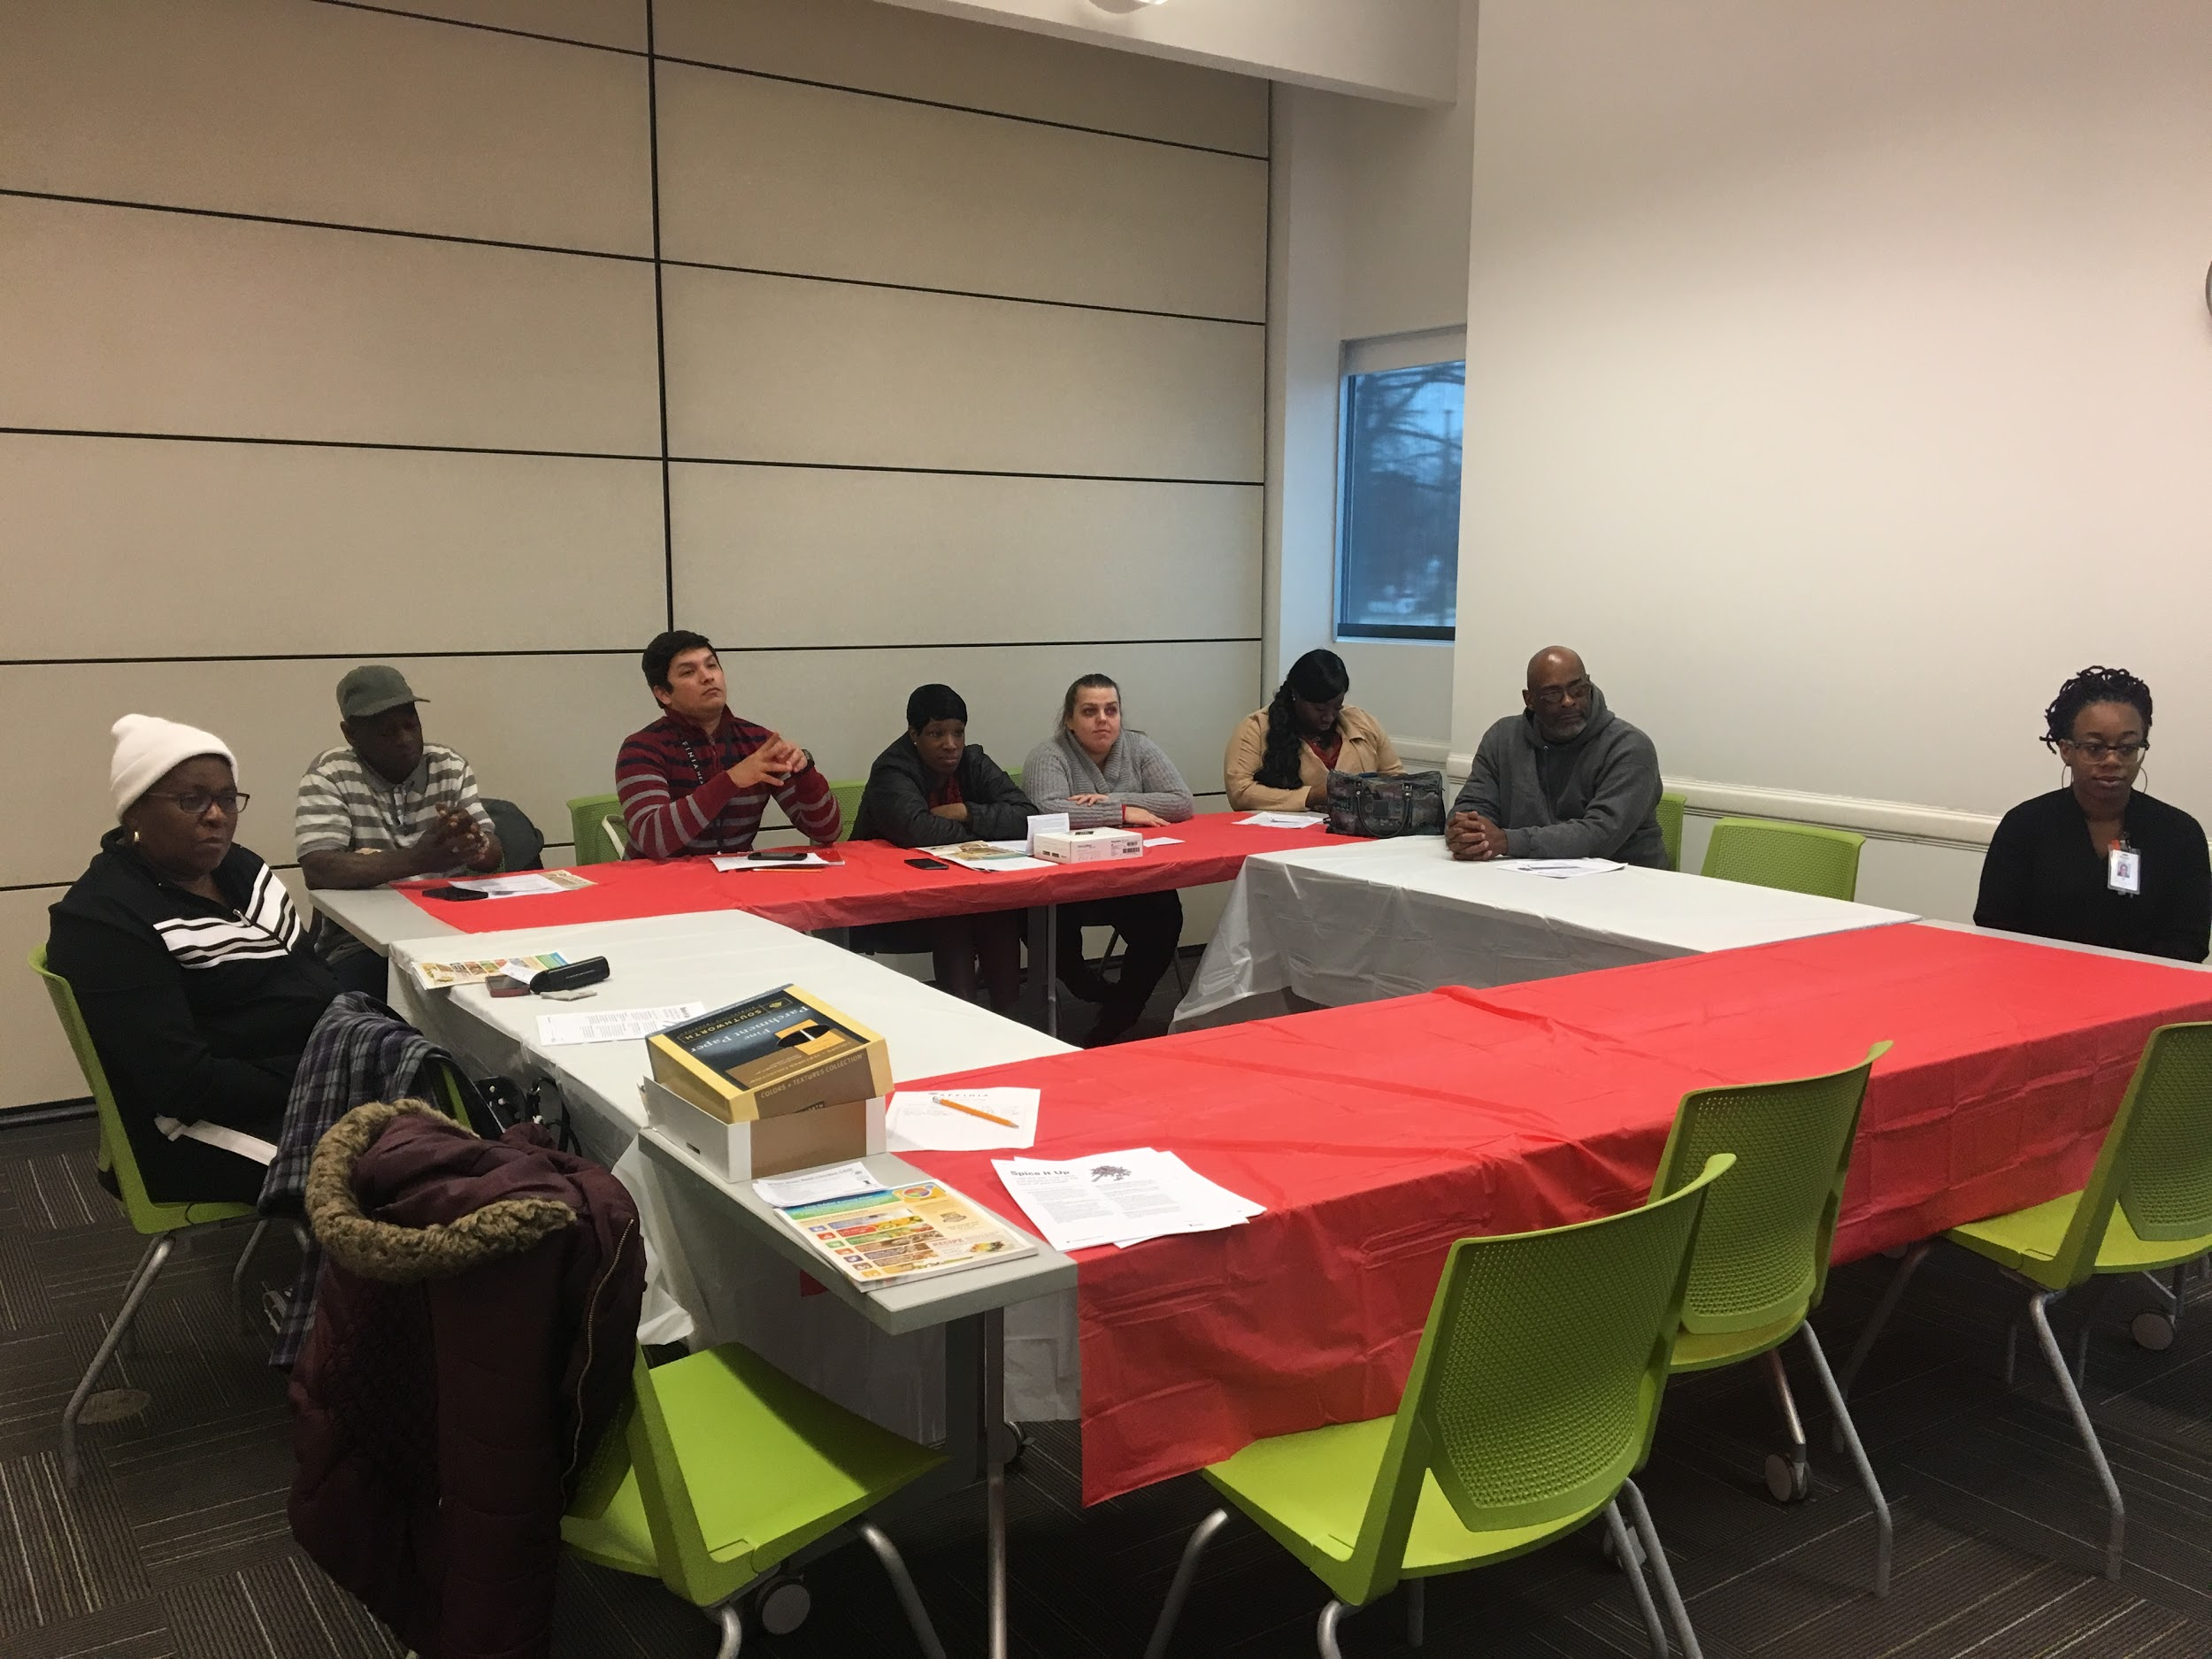
HTN Education Program
5th session:
  Integration of behavioral health and smoking cessation
6th session:
  Overview and assessment of final blood pressure and weight
Notes:
Felicia/Sonia:

Slide 45






Funding
Funding came from several sources for this programming:

Slide 46
SUCCESSES
Number of patients attending internal SMBP/Hypertension Education Group = 18
Avg. reduction of blood pressure = 14.7 mmHG (systolic) & 4.9 (diastolic)
Avg. reduction of weight = 5.2 lbs
INDIVIDUAL PATIENT SUCCESSES…
  Patient stopped smoking
  One patient had been to ED with BP of 200’s/100’s. Pt engaged because of the worker she encountered, and decided to come to the class. By the 5th session of the class, the patient’s blood pressure was 130’s/80’s

Slide 47
Pearls of Wisdom
COLLABORATION WORKS!!!! It is possible for organizations to simultaneously work on programs together
Define lanes early in collaboration to avoid confusion (it’s not a competition, but a collaboration).
Communication is important… take time to meet and understand expectations.
Have Patience putting the puzzle pieces together!

Slide 48
Challenges
Finalize the remaining pieces of the puzzle.
Update the model flow chart of the referral program (now that everyone’s roles are clearly defined).
Prioritize loaning/giving of blood pressure cuffs, due to limited resources.

Slide 49
Integrated SMBP Key Tasks | Who does this Task? (e.g., provider, MA, nurse care coordinator, CHW, Healthy Heart Ambassador, Wellness staff, etc.) | When is the Task done? (e.g., at initial appointment, at F/U visit 1-2 weeks after initial appointment, after SMBP use, etc.) | Where is the Task done? (e.g., at the health center, YMCA, patient’s home, or via telephone, etc.)
1. Identifies candidates for SMBP | Health Coach, provider, pharmacist | Registry monthly, at visit | Health Center
2. Recommends SMBP to patients with hypertension | Provider, pharmacist, Health coach, BHC | During and After visit | Health center chronic disease team, telephonic
3. Refers patients with hypertension to health center SMBP program | Provider, pharmacist, Health coach, BHC | During clinic, during visits, after visits | Telephonic, at visit, face-to face
4. Enroll patients with hypertension in SMBP | Health Coach and YMCA | At education group sessions, during appointment/visit | At health center
5. Provide a home BP monitor (for free or through a loaner program) | Health Coach and YMCA | At education session, during appointment/visit | At health center
6. Train patients with hypertension to use a home BP monitor | Health Coach and YMCA | At education session, during appointment/visit | At health center
7. Validate home BP monitor against a more robust machine | Provider and team | At education session, during appointment/visit | At health center
8. Train patients with hypertension to capture and relay SMBP readings to clinician via clinician-indicated mode (e.g. home monitor memory, patient portal, 3rd party app) | Health Coach and YMCA | At education session, during appointment/visit | At health center
9. Reinforce clinician-directed SMBP measurement protocol (e.g. 2x/day for 7 days) and measurement techniques | Health coach, pharmacist, BHC | At education session, during appointment/visit | At health center
10. Share medication adherence strategies (e.g. apps, pill boxes) | Pharmacist | At pharmacist appointment and education sessions | At health center
11. Prepare SMBP data for clinical interpretation and action (e.g., batching/averaging readings and entering data into EHR or other tool for provider use) | Nurse, Pharmacist, Health Coach | At education sessions | At health center in EHR
12. Refer patients to community/public health resources that provide SMBP support and/or lifestyle modification programs | Health coach, pharmacist, BHC, provider | At education session, during appointment/visit | Telephonic, electronic referral, at health center
13. Provide lifestyle modification education | Health Coach and YMCA | At education session, during appointment/visit | At health center
14. Communicate with community/public health resources re: patient participation in SMBP support and/or lifestyle modification programs, and exchange data, if applicable. | Health coach, Nurse, Pharmacist, Cardiologist | At visit, at education session, at appointment | Telephonic, electronic referrals, emails, and at health center
Notes:
Affinia Healthcare worked with the Missouri Primary Care Association who assisted with SMBP implementation using these spreadsheets

Slide 50
8. Train patients with hypertension to capture and relay SMBP readings to clinician via clinician-indicated mode (e.g. home monitor memory, patient portal, 3rd party app) | Health Coach and YMCA | At education session, during appointment/visit | At health center
9. Reinforce clinician-directed SMBP measurement protocol (e.g. 2x/day for 7 days) and measurement techniques | Health coach, pharmacist, BHC | At education session, during appointment/visit | At health center
10. Share medication adherence strategies (e.g. apps, pill boxes) | Pharmacist | At pharmacist appointment and education sessions | At health center
11. Prepare SMBP data for clinical interpretation and action (e.g., batching/averaging readings and entering data into EHR or other tool for provider use) | Nurse, Pharmacist, Health Coach | At education sessions | At health center in EHR
12. Refer patients to community/public health resources that provide SMBP support and/or lifestyle modification programs | Health coach, pharmacist, BHC, provider | At education session, during appointment/visit | Telephonic, electronic referral, at health center
13. Provide lifestyle modification education | Health Coach and YMCA | At education session, during appointment/visit | At health center
14. Communicate with community/public health resources re: patient participation in SMBP support and/or lifestyle modification programs, and exchange data, if applicable. | Health coach, Nurse, Pharmacist, Cardiologist | At visit, at education session, at appointment | Telephonic, electronic referrals, emails, and at health center

Slide 51

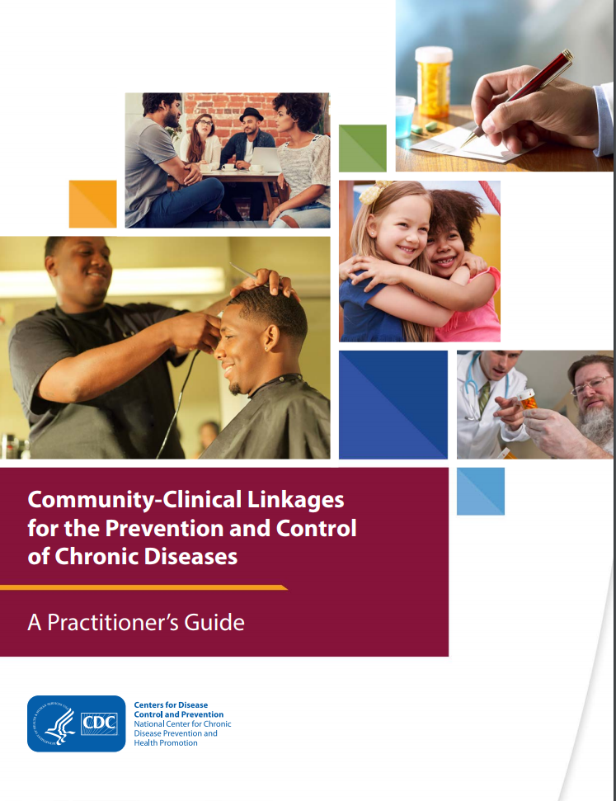
CCL Toolkit Structure
The toolkit is organized using the framework outlined in the Practitioner’s Guide. Use the drop down menu for each strategy!
  Learn about community and clinical sectors
  Identify and engage key stakeholders from community and clinical sectors
  Negotiate and agree on goals and objectives of the linkage
  Know which operational structure to implement
  Aim to coordinate and manage the linkage
  Grow the linkage with sustainability in mind
  Evaluate the linkage

Slide 52
Q & A

