Slide 1
Come to the Table:
Module 4
A Pediatric Primary Care Healthy Weight Initiative
Wednesday, February 22, 2023

Slide 2
NACHC’s STRATEGIC PILLARS
To learn more about NACHC’s Strategic Pillars visit https://www.nachc.org/about/about-nachc/

Slide 4

RECORDING DISCLAIMER
This Zoom Meeting service includes a feature that allows audio and any documents and other materials exchanged or viewed during the session to be recorded
By joining this session, you automatically consent to such recordings​

Slide 5
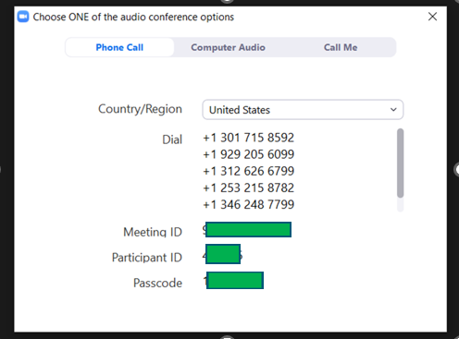
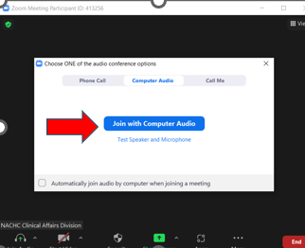
AUDIO CONNECTIONS
Option 1: “Phone Call”
Follow the unique process on your screen using your phone
Option 2: “Call Using Computer Audio ”
You must have computer speakers
and a microphone

Slide 6

MUTE / VIDEO
All attendee’s will be automatically muted and video will be disabled
During today’s webinar, you will be able to see and hear all panelists including slide deck and video

Slide 7

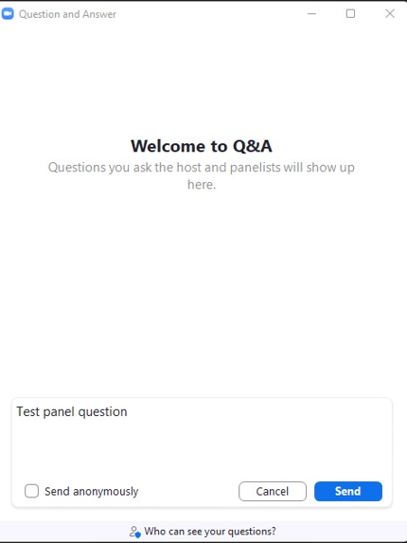
Q&A
Enter your question into the Q&A box, then click Send.
Select Send Anonymously if you do not want your name attached to your question in the Q&A.

Slide 8

FRIENDLY REMINDERS
All attendee lines have been MUTED and video has been DISABLED
We encourage you to submit your questions into the Q&A BOX, this will be open for the duration of this event
Post event SURVEY will be distributed

Slide 9
Meet Your Chefs!
Nita Mohanty, MD
Rick Reifenberg, MD
Jennie McLaurin, MD

Slide 10
Poll Question
Do you currently prescribe Anti-Obesity Medication to pediatric patients?

Slide 11
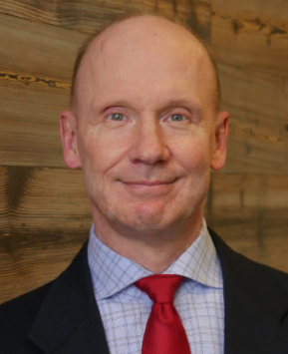
Rick Reifenberg, MD, FAAP, FACP
Chief Medical Officer
HealthNet Community Health Centers
Indianapolis, IN

Slide 12

Practical Approaches to Obesity Treatment
Rick Reifenberg, MD, FAAP, FACP
Chief Medical Officer
HealthNet Community Health Centers
Indianapolis, IN
February 2023

Slide 14
Pediatric Obesity
BMI <=85% is “healthy weight” age >2-18
BMI between 85-94% is Overweight
BMI >= 95% to <120% of the 95% is Class I Obesity
BMI >=120 to <140% of the 95% is Class II Obesity
BMI >140% of the 95% is Class III Obesity
Document in EHR Problem List, PMHx
Note Trend: Increasing, Stable, Decreasing?

Slide 15
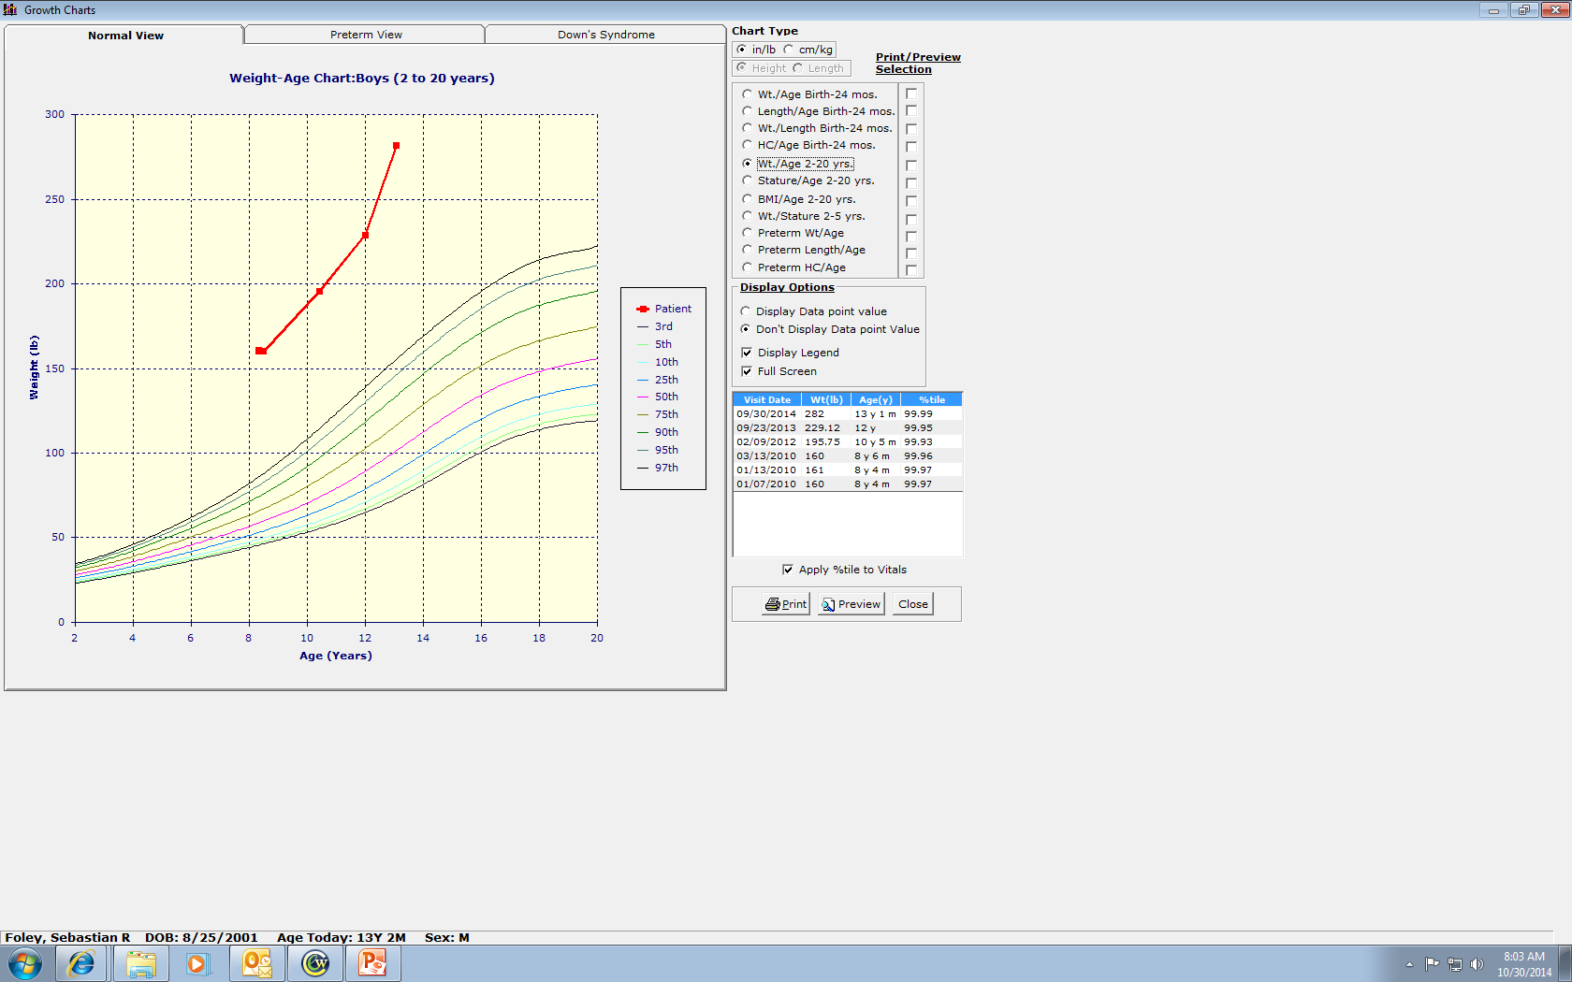
Typical Growth Chart

Slide 16
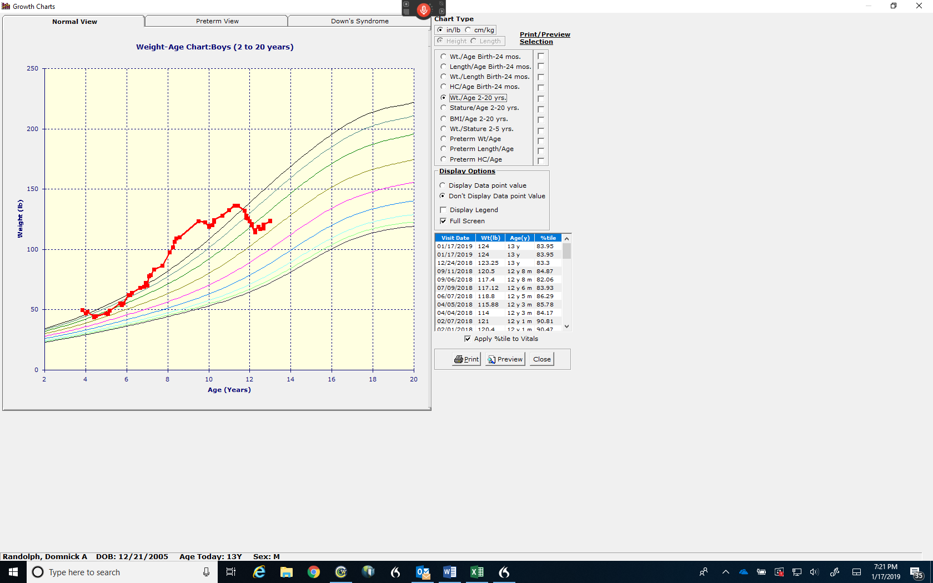
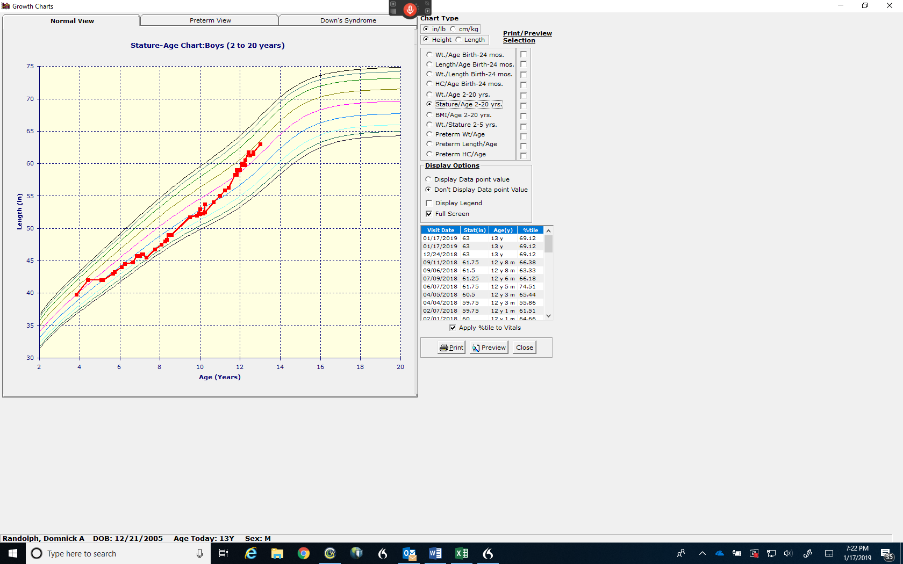
Secondary Obesity – Very Rare!

Slide 17
Weight Management Program description
  Medically supervised weight management program that started in January 2012 at a large, urban FQHC
  Patient ages: 4 y/o and above (children and adults)
  Visits: Initial intake visit and then monthly visits for a minimum follow-up of 3 months (longest over 10 years!)
  Common co-morbidities at presentation:
    Elevated BP or HTN, fatty liver, dyslipidemia
    Insulin resistance, Pre-diabetes, Diabetes type 2
    Depression/anxiety, victim of bullying, eating disorders
    Back and lower extremity joint pain, fatigue, OSA, PCOS, fertility issues
Notes:
17

Slide 18
Weight Management Program description
  Identify goals and take detailed dietary/exercise history, physical exam (e.g. acanthosis nigricans), use customized EMR templates
  Measures: are weight, height, BMI, BP (including % for age/height/gender), waist circumference in older teens/adults on initial and all subsequent visits
  Initial labs: CMP (fatty liver, glucose), lipids, HgbA1c, TSH, occasionally insulin level, cortisol, genetic tests (e.g., PWS)
  Dietitian visit
  Program booklet and personalized written treatment plan
  Monthly Health and Wellness email (Constant Contact) sent to distribution list for patient or for parent if patient is < 18 y/o
Notes:
18

Slide 19
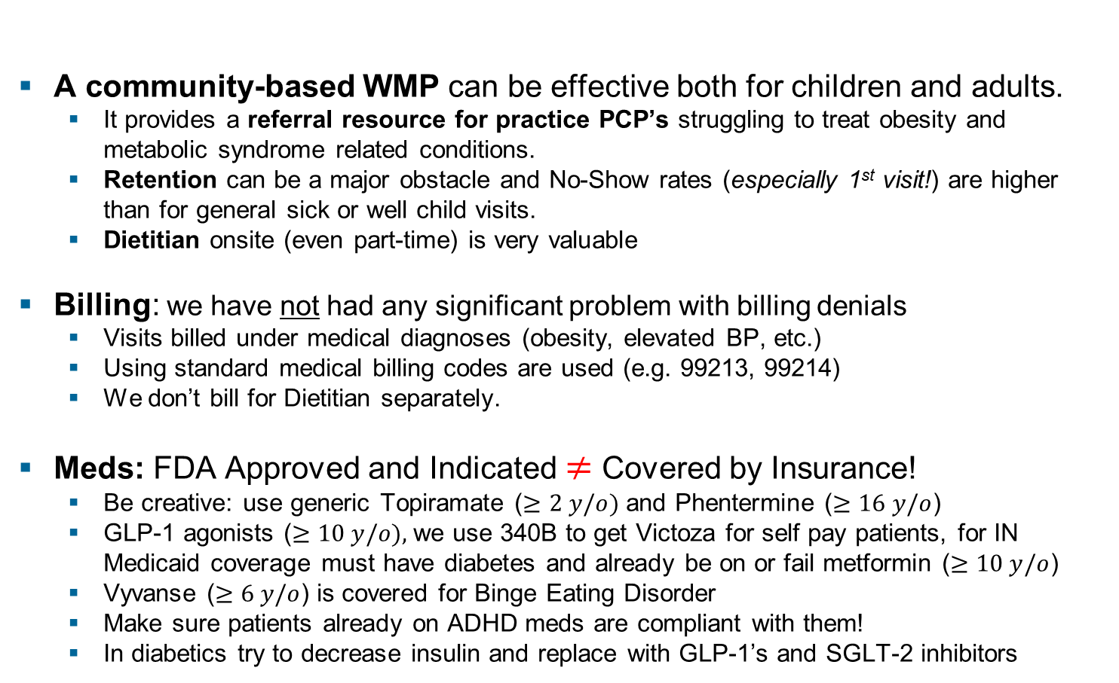
Weight Management Program Conclusions
A community-based WMP can be effective both for children and adults.
  It provides a referral resource for practice PCP’s struggling to treat obesity and metabolic syndrome related conditions.
  Retention can be a major obstacle and No-Show rates (especially 1st visit!) are higher than for general sick or well child visits.
  Dietitian onsite (even part-time) is very valuable
Billing: we have not had any significant problem with billing denials
  Visits billed under medical diagnoses (obesity, elevated BP, etc.)
  Using standard medical billing codes are used (e.g. 99213, 99214)
  We don’t bill for Dietitian separately.
Meds: FDA Approved and Indicated $≠$ Covered by Insurance!
  Be creative: use generic Topiramate ($≥2 y/o)$ and Phentermine ($≥16 y/o$)
  GLP-1 agonists ($≥10 y/o),$we use 340B to get Victoza for self pay patients, for IN Medicaid coverage must have diabetes and already be on or fail metformin ($≥10 y/o$)
  Vyvanse ($≥6 y/o$) is covered for Binge Eating Disorder
  Make sure patients already on ADHD meds are compliant with them!
  In diabetics try to decrease insulin and replace with GLP-1’s and SGLT-2 inhibitors
Notes:
19

Slide 20
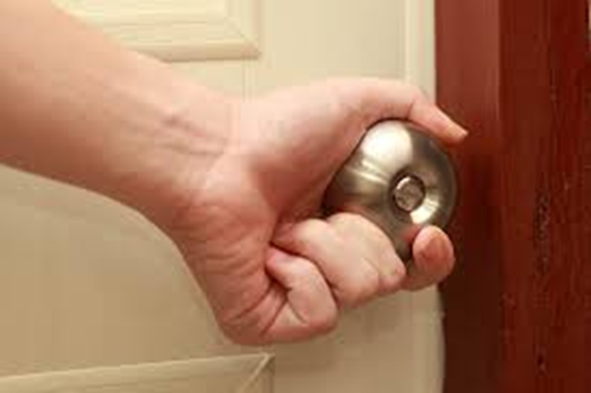
Real World Obesity Treatment Tip
Rarely occurs as the chief complaint…..

Slide 21
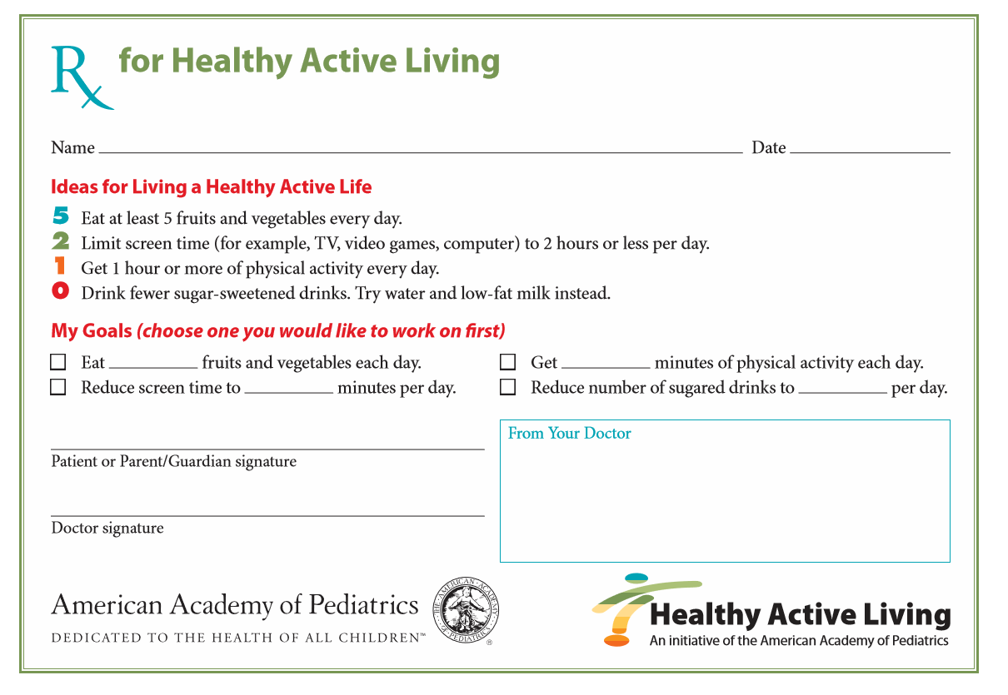
Start with a Simple Patient Handout

Slide 22
Summary – Take Home Points
  Ask for permission to discuss weight the first time the topic is addressed.
  Look for iatrogenic causes of weight gain and mitigate them whenever possible (meds like high dose insulin, Depo-Provera, many Psychiatric meds). Likely ~20% obesity influenced by meds!
  First intervention can be a simple, one page handout with practical tips and invitation to return for focused visit on weight loss
  Dietary history – focus on timing of eating, skipped meals followed by unhealthy overeating later, drinks with calories, frequency of eating out, snacking
  Develop specific, realistic goals and give to patient in writing
Notes:
22

Slide 23
Summary – Take Home Points
  Eating plan - usually involves planned meals, drinks without calories, 5 servings vegetable/fruits/day, limiting starchy carb foods servings and increasing protein and healthy fats, possibly intermittent fasting (8 hours on/16 hours off), eating at the table and without screens!
  Exercise plan – start with walking ~20-30 minutes a day in adults and then increase and add strength exercises. In kids use 60 minutes of active play. Free exercise videos on YouTube are great way to expand options. For kids we give out free jump ropes, soccer/basketballs, footballs, frisbees, etc.
  Medications – Consider when not meeting goals with diet/exercise. Effective meds should result in at least 5-10% weight loss. In cases that have also failed medications then I offer referral to Bariatric surgery.
  Ask for patient’s commitment to a plan over time, starting with returning to next scheduled visit. I see patients monthly for minimum of 3 months.
Notes:
23

Slide 24
Contact Information
  Rick Reifenberg, MD, FAAP, FACP
  Chief Medical Officer
  HealthNet Community Health Centers
  Indianapolis, IN
  rick.reifenberg@indyhealthnet.org
Notes:
24

Slide 26
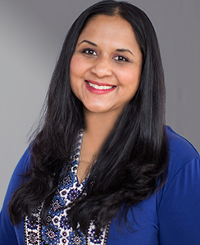
Nita Mohanty, MD
Chief Research Officer
Alliance Chicago

Slide 27
A “Deep Dish” of Data
Nivedita Mohanty, MD
February 22, 2023

Slide 28
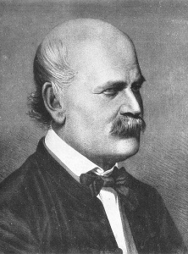
Notes:
Data Driven Insights: Ignaz Semmelweis inspired modern day handwashing.

Slide 29
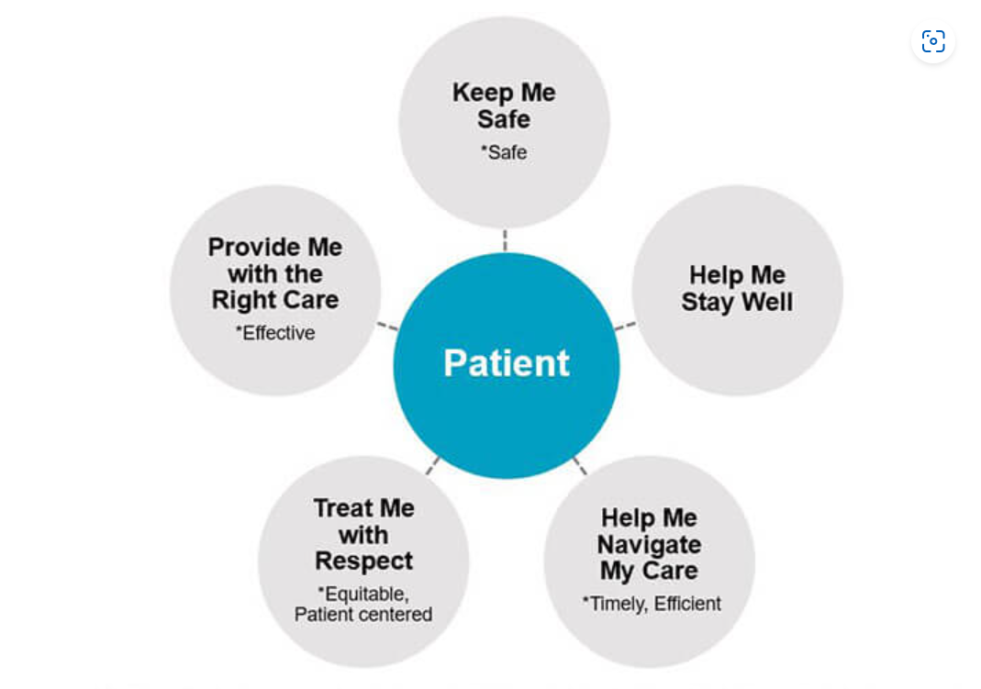
Domains of Quality Care:
The STEEEP Framework
Safe
Timely
Efficient
Effective
Equitable
Patient-Centered
Institute of Medicine (IOM). Crossing the Quality Chasm: A New Health System for the 21st Century. Washington, D.C: National Academy Press; 2001.
Institute for Healthcare Improvement Core Components of Quality from the Patient’s Perspective

Slide 30
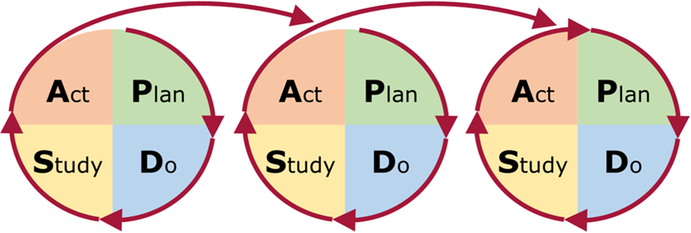



Data and Measurement Matter!

Slide 31
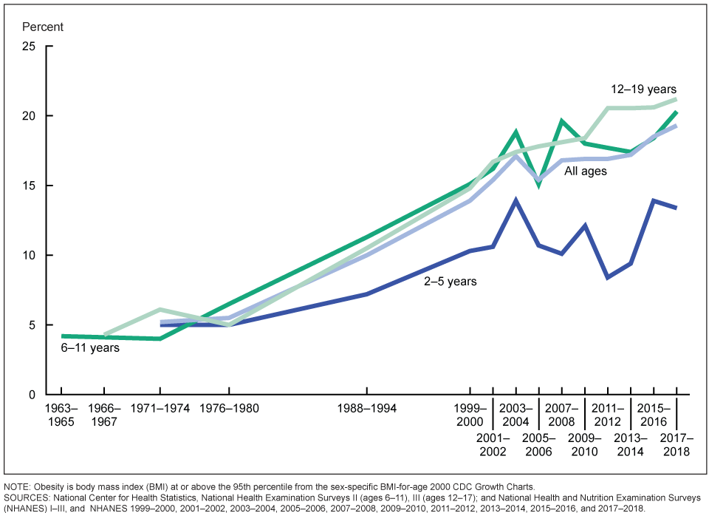
      FQHC Data from the Alliance network:
      Over 50% w/ BMI classification of: Overweight or Obese​
      1 in 3 children start kindergarten with high BMI​
      (Compared with 1 in 5 in a national cohort)
​
The risk of obesity and related chronic diseases is the highest it has ever been.

Slide 32
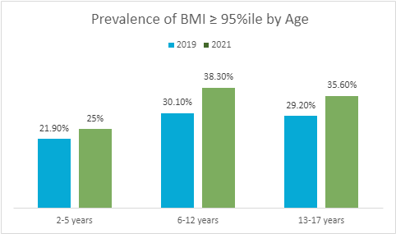
Obesity Prevalence by Age Group across CHCs in the Alliance Network
Notable increase in the prevalence of obesity from 2019 to 2021 across all age groups
  Largest increase in obesity prevalence for the 6- to 12-year-old group

Slide 33
Metabolic Risk Factor Screening Results – 2021

Slide 34

Quality Improvement:
Interventions and Change Ideas

Slide 35
Quality Improvement
A framework used to systematically improve care

Slide 36
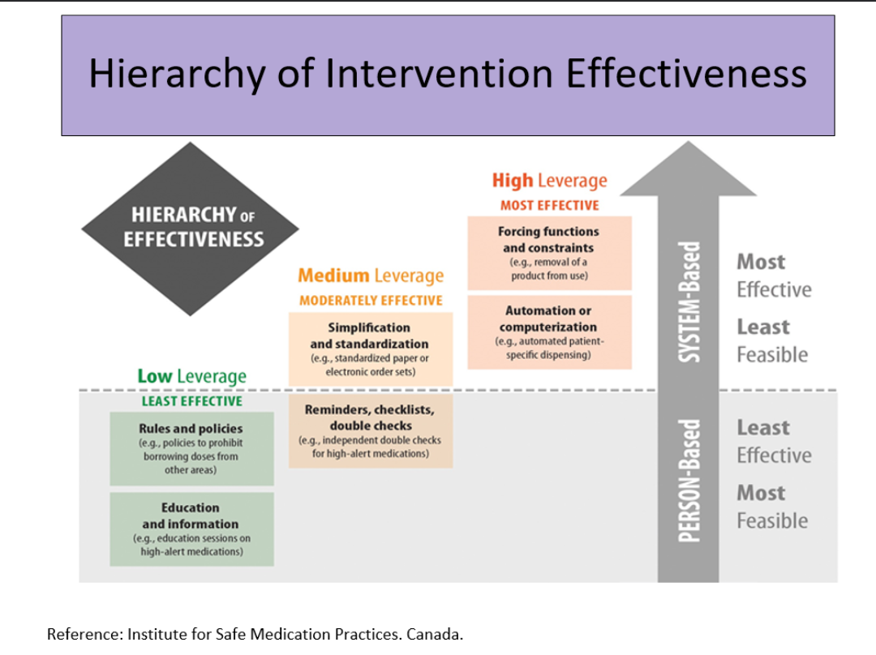
Some Practice-level
interventions are more effective than others!

Slide 37
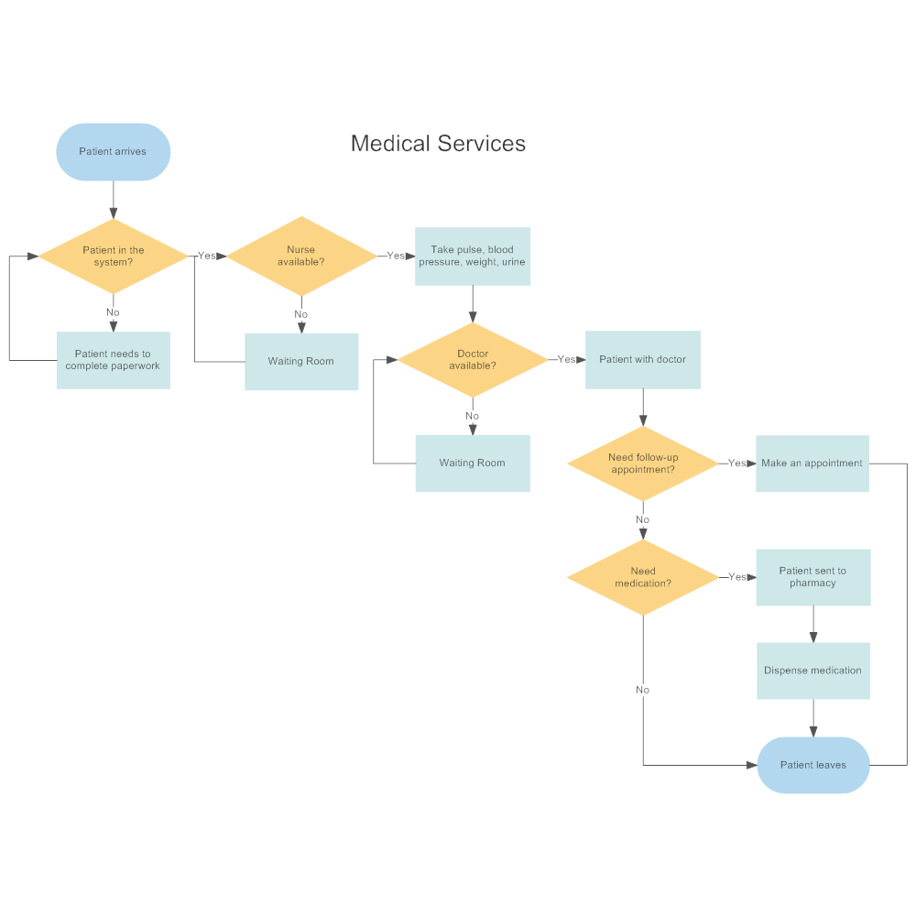
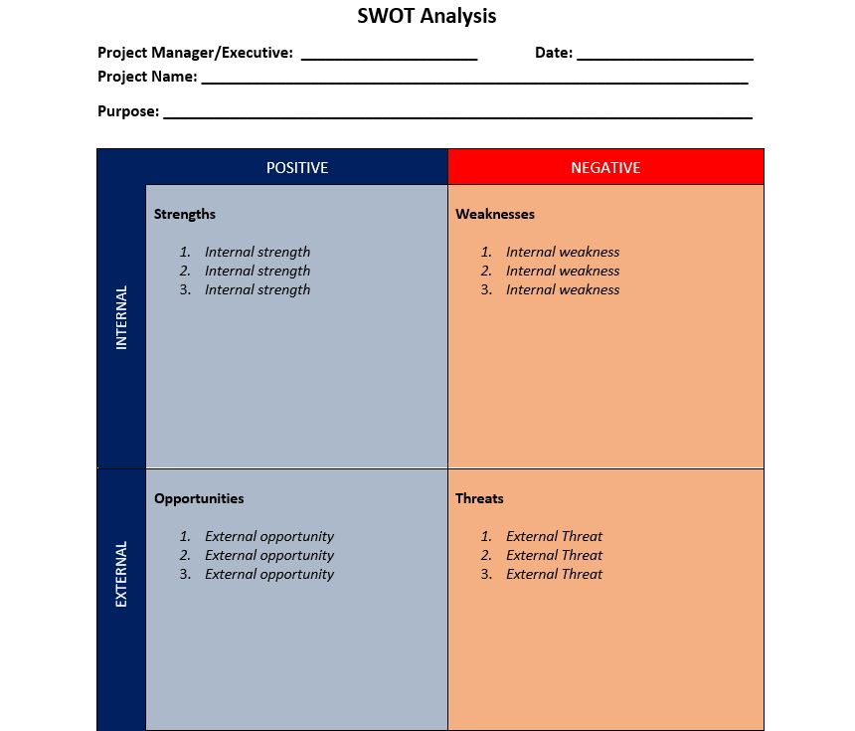
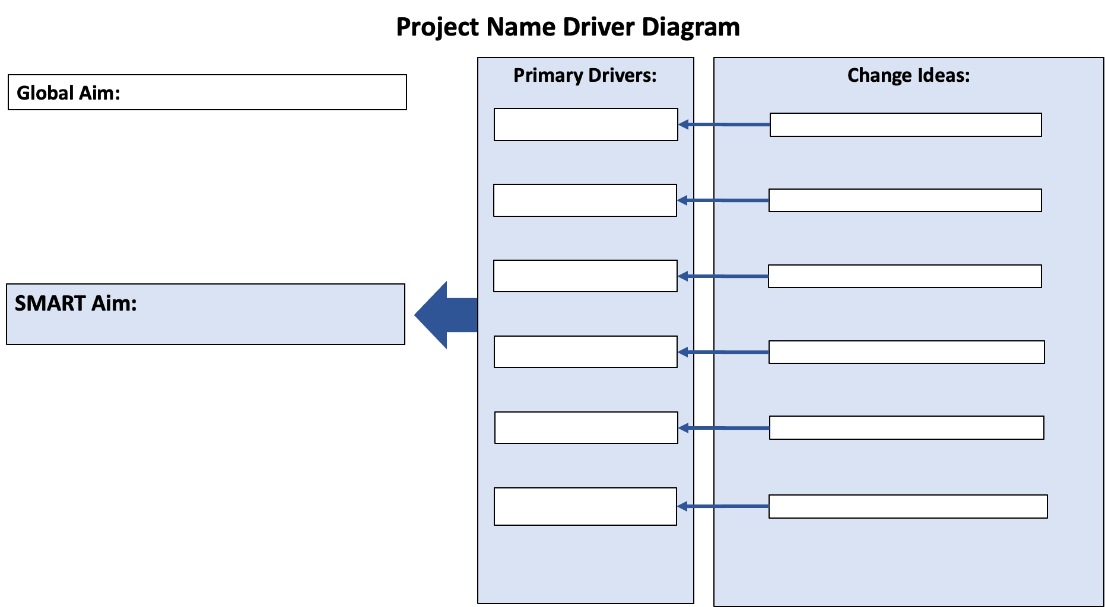
Quality Improvement Tools
Process Maps Driver Diagrams SWOT Analysis

Slide 38
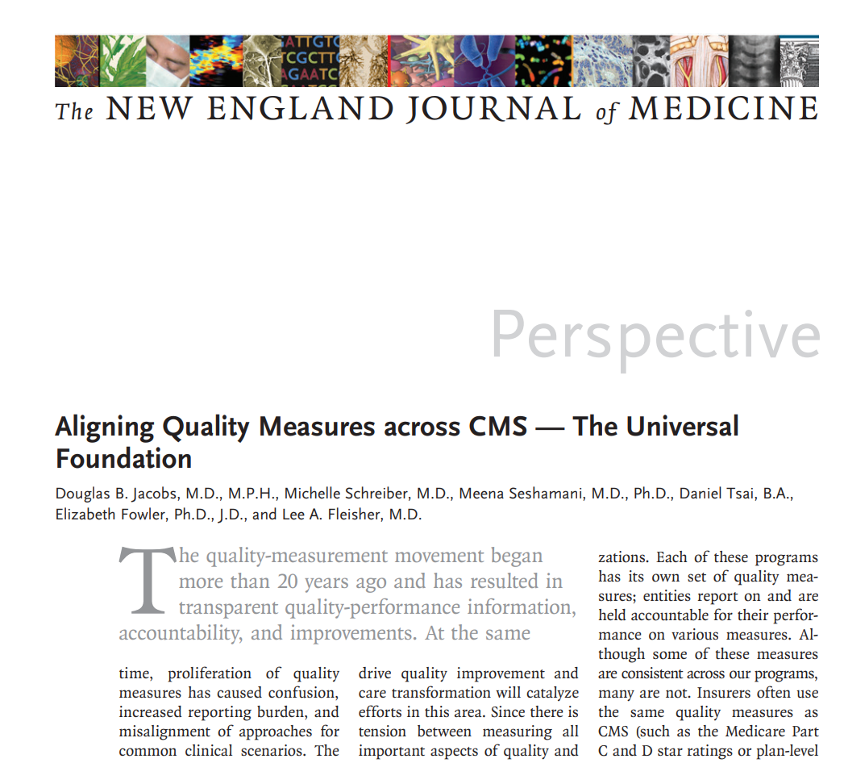
Quality Measures:
“Tools that help us measure or quantify health care processes, outcomes, patient perceptions, and organizational structure and/or systems”
Jacobs, D. B., Schreiber, M., Seshamani, M., Tsai, D., Fowler, E., & Fleisher, L. A. (2023). Aligning Quality Measures across CMS—The Universal Foundation. New England Journal of Medicine.

Slide 39
Quality Measures
We need better measures for weight management!
Current Pediatric Quality Measure related to Weight and Nutrition and Physical Activity Counseling are not optimal:
  Subject to Gaming: EMR check boxes
  Non-specific: in terms of an actual intervention or quality of counseling

Slide 40
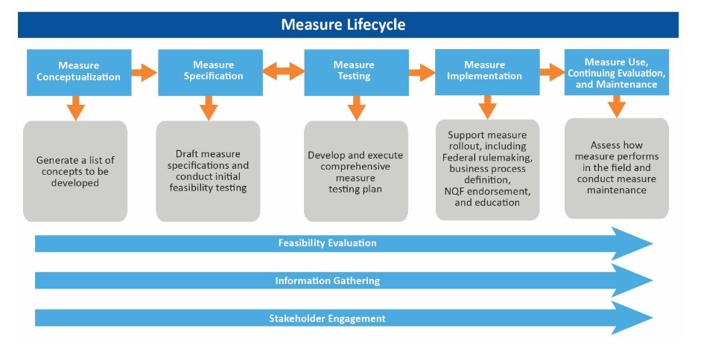
The Opportunity: NEW Quality Measures
*CMS Quality Measurement Development Process
Quality Measure Development | CMS

Slide 41
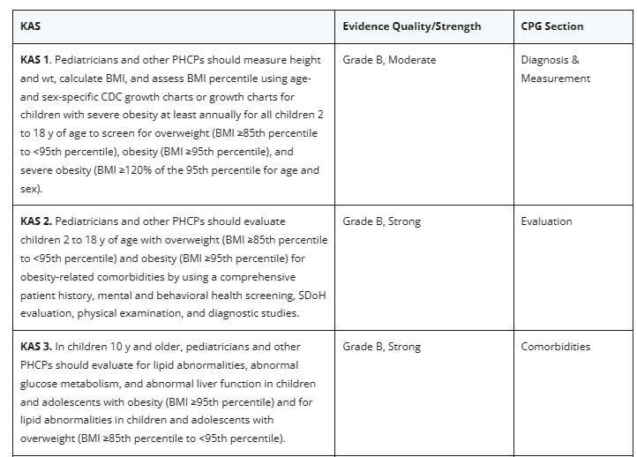
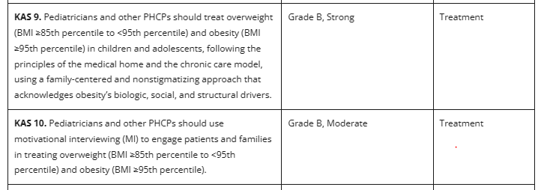
New Clinical Practice Guidelines and Action Statements
Executive Summary: Clinical Practice Guideline for the Evaluation and Treatment of Children and Adolescents With Obesity | Pediatrics | American Academy of Pediatrics (aap.org)

Slide 42

THANK YOU!
Questions? Ideas?
nmohanty@alliancechicago.org

Slide 43

CME Credit
1.0 Credit per each session – Please email nsmith@nachc.com for survey link if you are watching a recorded version of this session (available until June 30th, 2023)
You must attend the session in order to apply for CME. The name on the evaluation and attendance list will be cross-matched to ensure participation.
An evaluation must be submitted through the NACHC evaluation link provided to gain credit.
Though through AAFP, these credits can be submitted by the participant to other credentialing bodies for credit:
  American Academy of Physician Assistants (AAPA)
  National Commission on Certification of Physician Assistants (NCCPA)
  American Nurses Credentialing Center (ANCC)
  American Academy of Nurse Practitioners Certification Board (AANPCB)
  American Association of Medical Assistants (AAMA)
  American Board of Family Medicine (ABFM)
  American Board of Emergency Medicine (ABEM)
  American Board of Preventative Medicine (ABPM)
  American Board of Urology (ABU)

Slide 44
QUESTIONS?

Slide 45
CME Credit
1.0 Credit per each session – Please email nsmith@nachc.com for survey link if you are watching a recorded version of this session (available until June 30th, 2023)
You must attend the session in order to apply for CME. The name on the evaluation and attendance list will be cross-matched to ensure participation.
An evaluation must be submitted through the NACHC evaluation link provided to gain credit.
Though through AAFP, these credits can be submitted by the participant to other credentialing bodies for credit:
  American Academy of Physician Assistants (AAPA)
  National Commission on Certification of Physician Assistants (NCCPA)
  American Nurses Credentialing Center (ANCC)
  American Academy of Nurse Practitioners Certification Board (AANPCB)
  American Association of Medical Assistants (AAMA)
  American Board of Family Medicine (ABFM)
  American Board of Emergency Medicine (ABEM)
  American Board of Preventative Medicine (ABPM)
  American Board of Urology (ABU)

