Slide 1
“Did You Knows” and Quick Tips to Prevent Heart
Attacks and Strokes
Notes:
This Did You Knows and Quick Tips slide set distills down the most important information, ideas, and actions to prevent heart attacks and strokes into a format that can be digested quickly and used through a variety of communication channels.
We hope this helps you and your organization reach your busy clinicians and care teams with the right information, in a format that works for you to achieve your improvement goals. This slide deck complements the document also called "Did You Knows and Quick Tips to Prevent Heart Attacks and Strokes".
The slides include talking points to make the content easy to deliver. You may use one or a few slides at a time or mix and match them – use them any way you like within other learnings and presentations, etc. We hope you find this resource useful and look forward to any feedback you might have. Please send comments to: nachcmillionhearts@nachc.org
Please click here for the latest version of this PPT.
Thank you!
The NACHC Million Hearts Team

Slide 2
▼PURPOSE
Assist PCAs and health centers in training care teams on blood pressure control and management with patients. Provide evidence-based content that can be digested quickly and used for trainings or in email/newsletter communications.
Notes:
Together, heart disease and stroke are among the most widespread and costly health problems facing the nation, accounting for over $316.6 billion in health care expenditures and lost productivity annually (CDC, 2019). High blood pressure or hypertension, is the leading risk factor for cardiovascular disease (CVD). CVD accounts for 1-in-6 US health care dollars spent – almost $1 billion per day—and for 800,000 deaths every year, almost a third of US deaths.
Fortunately, we know the most effective evidence-based interventions to improve blood pressure control. The challenge is in ensuring our clinicians and care teams are doing the things that have the most impact for their patients with hypertension. Achieving optimal blood pressure control requires several key strategies to be delivered by clinicians with other care team members. Sometimes, increasing knowledge and awareness is what is needed – but more often, changing attitudes and beliefs is key to adoption. For this reason, this "Did You Knows and Quick Tips" slide set includes references to the latest research, condensed into important bits of information, supported by relevant tools and resources.
Specifically, this "Did You Knows and Quick Tips" slide set distills the most useful information, ideas, and actions to improve blood pressure control in a format that can be used through a variety of communication channels. We hope this helps you and your organization reach your busy clinicians and care teams with the right information, in the right amount, in a format that works – and ultimately enables you to achieve your blood pressure control goals!
Sources:
Benjamin EJ, Virani SS, Callaway CW, et al.; American Heart Association Council on Epidemiology and Prevention Statistics Committee and Stroke Statistics Subcommittee. Heart disease and stroke statistics—2018 update: a report from the American Heart Association. Circulation. 2018;137:e67–492.
Yoon PW, Gillespie CD, George MG, Wall HK. Control of hypertension among adults--National Health and Nutrition Examination Survey, United States, 2005-2008. MMWR Suppl. 2012 Jun 15;61(2):19-25.

Slide 3
IMPROVING
BLOOD PRESSURE
CONTROL
For Clinicians
Notes:
The first set of slides focuses on improving blood pressure control and is intended for clinician audiences.

Slide 4
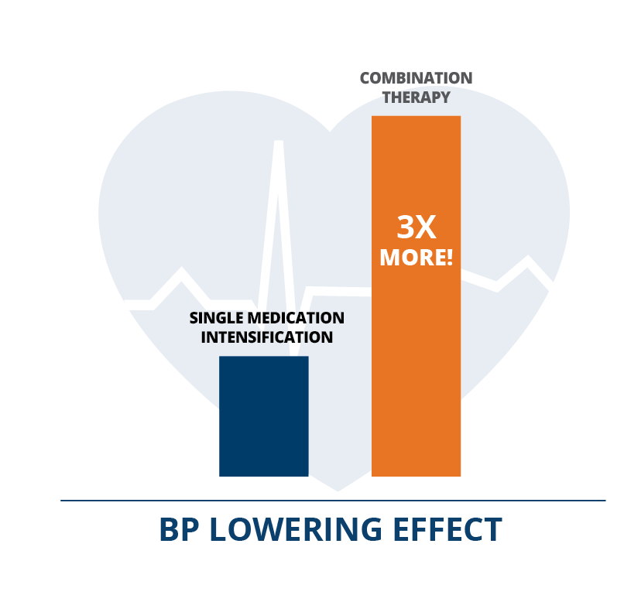
Did you know?
Combination therapy results in 3x more BP lowering effect compared to increasing dosage of a single class of anti-hypertensive medication and is available in your formulary:
Medication Intensification: What’s the Rx? (14 min. video) | NACHC, CDC, AMA
Fixed-Dose Combination Antihypertension Medication Coverage by State Medicaid and Medicaid Managed Care Organizations | hhs.gov; 2022
Clinical outcomes in hypertensive patients treated with a single-pill fixed-dose combination of renin-angiotensin system inhibitor and thiazide diuretic | PubMed (nih.gov)
Notes:
Healthy lifestyle behaviors are important for everyone's cardiovascular health, but for people with uncontrolled blood pressure over 140/90 mmHg, intensifying treatment with medication is indicated.
Unfortunately, therapeutic inertia – or a lack of treatment intensification when indicated – is not only common, it's a leading barrier to controlling blood pressure. One factor is the way training in the 1980s through 2010s taught clinicians to initiate treatment with a single medication class and then continue to increase the dosage to the maximum, before considering another class. This stepped approach - using monotherapy - is no longer the gold standard in hypertension treatment. Not only is this approach less effective in controlling blood pressure than initiating treatment with lower doses of two medication classes, but higher doses of a single medication class may result in more side effects. When patients are started on monotherapy, they are also much more likely to stay uncontrolled years later. – We now know most people need two or more anti-hypertensive medications to achieve control.
Combination therapy leverages the therapeutic effect of each medication class because a medication initiated at half-standard dose will have 80% of the BP lowering effects of that same medication class at a standard dose. Adding a second class of medication has 3 times the BP lowering effect as up-titrating a single class of anti-hypertensive medication - and patients experience fewer side effects.
You may be concerned about adding pills to your patients’ regimen or question if combination therapy will be covered by your patients’ insurance. The good news is that combination therapy may not mean adding more pills to a patient’s regimen, because fixed-dose or single-pill combination therapy is widely available. It is now on most formularies.
To understand what combination therapies are covered by Medicaid and Medicaid Managed Care organizations in your state, take a look at the FDC Coverage resource hyperlinked here.

Slide 5
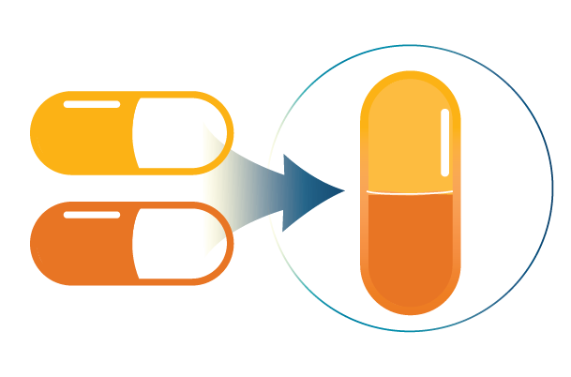
Did you know?
Medication nonadherence is mainly due to cost and complex medication regimens. An effective solution to address these barriers is using fixed-dose combinations (FDCs), or the combining of two or more medications in one pill
Medication Intensification: What’s the Rx? (14 min. video) | NACHC, CDC, AMA
Fixed-Dose Combination Antihypertensive Medication Coverage by State Medicaid and Medicaid Managed Organizations | (hhs.gov)
Clinical outcomes in hypertensive patients treated with a single-pill fixed-dose combination of renin-angiotensin system inhibitor and thiazide diuretic | PubMed (nih.gov)
Notes:
Most people with hypertension want to adhere to their medications but they may not because of cost or the complexity of their medication regimens. Considering this, wouldn’t prescribing combination therapy with two or more medication classes negatively impact medication adherence?
Not necessarily! An effective solution is using fixed-dose combinations (FDCs), where two or more medications are combined into one pill. This means the patient still has one pill to treat their hypertension with the benefit of increased numbers of medication classes.
These FDCs are often available in generic forms or through discount programs and they are often available as first-tier or preferred on formularies. This means they are useful and effective in real-world primary care settings. If you haven’t already, update your treatment protocols today to include FDCs as first line medications.

Slide 6
Quick Tip
Consider using a thiazide/thiazide-like diuretic or a calcium channel blocker as part of your prescribing protocols when initiating with combination therapy or adding a medication class to treat uncontrolled hypertension. This is demonstrated to be more effective for African Americans with hypertension and works for all patients with hypertension.
2017 Guideline for the Prevention, Detection, Evaluation, and Management of High Blood Pressure in Adults: FAQs; see FAQ #44: How should we treat African-American patients with hypertension?
AMA Hypertension Medication Treatment Protocol (2020)
Notes:
According to the latest hypertension treatment guideline, African-American patients with hypertension who do not have heart failure or chronic kidney disease, benefit from a thiazide-type diuretic or a calcium channel blocker as part of their initial anti-hypertensive treatment. This is true for patients who also have diabetes.
Two or more anti-hypertensive medications (ACEi or ARB and CCB) are recommended to achieve a blood pressure target of <130/80 mmHg in most adults, especially in African American adults with hypertension. Therefore, consider using a T/TLD or CCB as part of your prescribing protocols when initiating treatment with combination therapy or adding a class of medication to treat uncontrolled hypertension. This approach has been shown to be more effective for African Americans with hypertension and it works for all patients with hypertension. This standardized approach is practical and equitable for all patients.

Slide 7
Did you know?
Repeated blood pressure (BP) measurements are more representative of true BP. Improper and infrequent office BP measurement can lead to inaccurate classification, overestimation of a patient’s true BP, unnecessary treatment, and misinterpretation of the true prevalence of hypertension.
BP measurement competency | AMA (ama-assn.org, 2020)
Association of Repeated Measurements With Blood Pressure Control in Primary Care | Abstract - Europe PMC
Notes:
Often a single blood pressure measurement is used to diagnose and manage hypertension in busy clinics. However, repeated BP measurements have been shown to be more representative of a person’s true blood pressure. Using a single BP measurement or using improper technique can lead to inaccurate classification, overestimation of a patient’s true BP, unnecessary treatment, and misinterpretation of the true prevalence of hypertension.
There is no consensus for the number of measurements recommended at a single visit, but research has shown that when only the first reading was considered for diagnosis, rather than the mean or average of two or three additional readings, there was a 63% higher prevalence of hypertension. The mean of the 2nd and 3rd measurements was 3.6 mmHg lower for systolic BP and 2.4 lower for diastolic BP, on average, when compared to the initial BP reading.
Focusing on accurate technique and using evidence-based protocols (i.e., repeating BP measurements) can increase trust in BP data, reduce overtreatment, and reduce therapeutic inertia for patients who truly have uncontrolled blood pressure. It is also a “low hanging fruit” intervention to improve performance on BP control quality measures.

Slide 8
Did you know?
Even if you measure BP in the clinic accurately, it may not reflect a person’s true BP. Out-of-office blood pressure measurements averaged over several days provide a better gauge of BP because they reflect a pattern of readings, may eliminate the white coat effect, and can identify masked hypertension. Out-of-office BP measurement is also a better indicator of a person’s risk for a cardiovascular event.
2017 Guideline for High Blood Pressure in Adults | American College of Cardiology (acc.org),
See Part 1, Section 2.
Role of Ambulatory and Home Blood Pressure Monitoring in Clinical Practice: A Narrative Review Annals of Internal Medicine: Vol 163, No 9 (acpjournals.org)
Notes:
Hypertension is usually diagnosed and treated based on blood pressure readings obtained in the clinic setting. However, blood pressure may differ considerably when measured outside the clinic setting.
Over the past few decades, evidence has grown to show the average of several days worth of out-of-office blood pressure measurements provide a better gauge of BP than clinic-based readings. Self-measured blood pressure monitoring (SMBP), where a patient takes their own blood pressure morning and evening, ideally for seven days, but for at least 3 days, is the recommended practice.
Out-of-office measurements based on a pattern of readings over several days eliminates white coat effect and can identify masked hypertension. Out of office BP measurement also has a stronger association with cardiovascular disease outcomes than clinic blood pressure measurement.

Slide 9
Quick Tip
“Treat hypertension with the same urgency
as an infectious disease.”
—Dr. Johan Torres
Chief Medical Information Officer/Senior Medical Director
Miami Beach Community Health Center
You can make this work by fortifying your hypertension treatment protocol and using team-based care.
80% HYPERTENSION CONTROL: A Three-Pillar Practical Approach | Case Study, NACHC with Miami Beach Community Health Center
Interdisciplinary Team-based Care: Tips for Effective Chronic Disease Management (15 min. video) | NACHC with Community Health Center, Inc.
Hypertension Management Program (HMP) Toolkit: Adaptation Tips | cdc.gov; 2021
Notes:
Hypertension (HTN) is endemic and an epidemic in the United States. Nearly half of all adults in the U.S. (45%) are diagnosed with HTN or take medication for HTN^{1,2}. Sustained, elevated blood pressure puts patients at risk for strokes, heart attacks, kidney failure, and death (^{3–5)}. In 2019 alone, high blood pressure contributed to over 1,300 deaths each day (⁶⁾ . Costs linked to high blood pressure equal about $131 billion each year in the United States (⁷⁾.
Tackling this problem requires correct identification and control. Of the 75 million Americans with this condition, approximately 11 million don’t know they have it, so they are not receiving treatment (⁸⁾. In health centers, hypertension is the most prevalent chronic condition. Close to 5 million patients (nearly one quarter of all adult health center patients) are diagnosed with high blood pressure, yet 37% of them don’t have it under control.
How can we make a difference in addressing the hypertension epidemic? By treating hypertension with the same urgency as an infectious disease.
Practical ways to do this include fortifying your hypertension treatment protocol and using team-based care.
I want to highlight how one health center did this. Miami Beach Community Health Center used a three-pillar approach: (1) they strengthened their hypertension treatment protocol to ensure repeat BP measurements occurred with any patient who had a reading over 140/90 mmHg, (2) they considered treatment intensification at every visit, regardless of the reason, and (3) they established a tiered follow-up visit protocol depending on how elevated the patients BP is. For example, they follow-up every 2-3 days with those who have the highest BPs, every week for patients whose BP are over 160/100 mmHg, and every 2 weeks for patients whose BP range is over 140/90 but under 160/100 mmHg. They combined their fortified protocol with telemedicine visits, and use their population health team to build relationships with patients through proactive scheduling, outreach, and medication adherence conversations. They also arrange transportation, if necessary. The results? They maintained 80% BP control through the pandemic.
References
Centers for Disease Control and Prevention. Hypertension Prevalence in the U.S. | Million Hearts®. Centers for Disease Control and Prevention. Published February 5, 2020. Accessed December 4, 2020. https://millionhearts.hhs.gov/data-reports/hypertension-prevalence.html
American Heart Association and American Medical Association. Target:BP. Published 2020. Accessed November 4, 2020. https://targetbp.org/
Carey RM, Calhoun DA, Bakris GL, et al. Resistant Hypertension: Detection, Evaluation, and Management: A Scientific Statement From the American Heart Association. Hypertension. 2018;72(5):e53-e90. doi:10.1161/HYP.0000000000000084.
Kochanek KD, Murphy SL, Xu J, Arias E. National Vital Statistics Reports. Deaths: Final Data for 2017. National Vital Statistics Reports. 2019;68(9):77.
Whelton Paul K., Carey Robert M., Aronow Wilbert S., et al. 2017 ACC/AHA/AAPA/ABC/ACPM/AGS/APhA/ASH/ASPC/NMA/PCNA Guideline for the Prevention, Detection, Evaluation, and Management of High Blood Pressure in Adults: A Report of the American College of Cardiology/American Heart Association Task Force on Clinical Practice Guidelines. Hypertension. 2018;71(6):e13-e115. doi:10.1161/HYP.0000000000000065.
Centers for Disease Control and Prevention. High Blood Pressure/Learn About High Blood Pressure/Hypertension Statistics and Maps/Facts About Hypertension. Centers for Disease Control and Prevention. Published September 8, 2020. Accessed November 4, 2020. https://www.cdc.gov/bloodpressure/facts.htm
Kirkland EB, Heincelman M, Bishu KG, et al. Trends in Healthcare Expenditures Among US Adults With Hypertension: National Estimates, 2003-2014. J Am Heart Assoc. 2018;7(11). doi:10.1161/JAHA.118.008731.
Centers for Disease Control and Prevention. Million Hearts® Undiagnosed Hypertension. Centers for Disease Control and Prevention. Published November 8, 2019. Accessed December 4, 2020. https://millionhearts.hhs.gov/tools-protocols/undiagnosed-hypertension.html

Slide 10
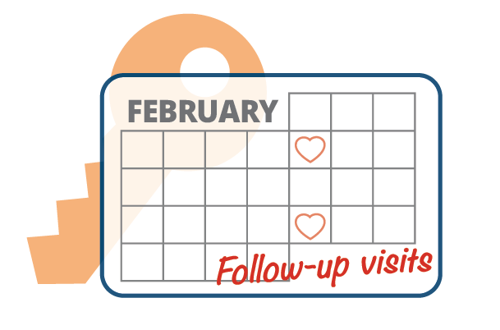
Did you know?
Some practices have gotten their average time to BP control down to less than 40 days. One key factor is the follow-up interval. Adults with uncontrolled hypertension (≥140/90 mmHg) should have a follow-up visit every 2 to 4 weeks until they are at control.
2017 Guideline for the Prevention, Detection, Evaluation, and Management of High Blood Pressure in Adults: Guidelines Made Simple; see p. 14
Clinic-based strategies to reach United States Million Hearts 2022 blood pressure control goals: a simulation study | nih.gov
Notes:
Sometimes it’s a real challenge to de-implement or change a process that used to be a best practice but no longer is … follow-up interval is one of these processes.
The old way to do things was to have a patient with uncontrolled hypertension come back every three months. Now we know this is not an effective or efficient way to get patients to control. It leaves people at risk for heart attack and stroke for intervals that are too long. The latest hypertension clinical guideline is clear that adults with uncontrolled hypertension (>=140/90 mmHg) should have a follow-up visit every 2 to 4 weeks until they reach control.
Some practices have gotten their average time to BP control down to 40 days by focusing on the follow-up interval. This goal is nearly impossible if patients are stuck in a 3-month follow-up cycle.
Neighborhood Health in Escondido, CA, reduced their average time to BP control to 39.1 days in 2022. A major reason why is that they implemented a 2-4 week follow-up protocol. Miami Beach Community Health Center established a tiered follow-up visit protocol depending on how elevated the patients' BP is – They follow up every 2-3 days with patients who have very high BPs, every week for patients whose BP are over 160/100 mmHg, and every 2 weeks for patients whose BP range is over 140/90 but under 160/100 mmHg. The result: they maintained 80% blood pressure control all through 2020 and 2021 – the toughest years of the pandemic.
Updating follow-up intervals for patients with uncontrolled hypertension prevents heart attacks and strokes and saves lives.

Slide 11
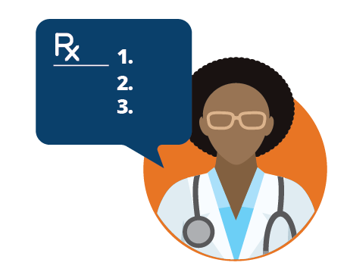
Did you know?
Medication adherence is critical to successful hypertension control for many patients. However, only 51% of Americans treated for hypertension take their medications as prescribed in the long-term. Effective communication doubles the odds of your patients taking their medications properly.
Medication Adherence: Improve Patient Outcomes and Reduce Costs | Health Care Quality | AMA STEPS Forward | AMA Ed Hub (ama-assn.org)
Help Patients Take Blood Pressure Medicines as Directed (1 min. 25 sec. video - YouTube) | Million Hearts
Hypertension Control Change Package (hhs.gov) – p. 16, see section: Ensure the care team is skilled in supporting patient medication adherence
Notes:
Medication adherence, when a patient takes their prescribed medications properly and consistantly, is critical to successful hypertension control for most patients. Unfortunately, only about half of Americans with hypertension are adherent to their medications. Approximately a quarter of new prescriptions are not even filled.
What can you do?
Always consider medication nonadherence first as a reason a patient’s condition is not under control. The key to addressing medication adherence is effective communication. In fact, effective communication has been shown to double the odds of a patient taking their medications properly.
Develop a process to routinely ask about medication adherence.
Create a shame- and blame-free environment to discuss medications with the patients.
Identify why the patient is not taking their medication. Be considerate in your response and thank them for sharing their behavior.
Tailor the adherence solution to the individual patient and involve them in developing their treatment plan. Patients who are included in decisions about their medications are more likely to adhere to their treatment plan.
Addressing medication nonadherence is critical for patient health and safety and will allow your practice to deliver the most effective care possible. Take a look at the resources on this slide for more information-

Slide 12
Quick Tip
Involve pharmacists in patient care to improve long-term blood pressure control and to decrease racial and socioeconomic disparities.
The benefits of physician-pharmacist collaboration | MDedge Family Medicine
Physician-Pharmacist Collaborative Management: Narrowing the Socioeconomic Blood Pressure Gap | nih.gov
Notes:
Using a physician-pharmacist collaborative management model has been shown to have significantly positive effects on blood pressure control. It is also a valuable way to decrease racial and socioeconomic disparities in blood pressure outcomes. In these care models, pharmacists are responsible for activities such as obtaining medication histories, identifying barriers to adherence, providing patient education, and adjusting medication regimens.
A 2017 study found that pharmacists embedded in primary care clinics reduced health disparities by improving blood pressure control in high risk racial and socioeconomic individuals, compared with a control group receiving usual care. In this particular study, the most effective strategies occurred when 1) pharmacists were embedded in the medical office and had set schedules to see patients, 2) other staff such as medical assistants roomed the patients, which was more cost effective than having the pharmacist perform this function, 3) pharmacists comprehensively assessed the reasons for lack of BP control, 4) medications were intensified whenever BP was not controlled and there were no contraindications to intensification (such as nonadherence), 5) pharmacists saw the patients at least monthly when BP was not controlled, 6) extensive patient education was provided and 7) home monitoring of BP was often suggested to encourage self-management.
Until pharmacists are fully recognized as independent providers, clinical pharmacy services can be reimbursed under a collaborative practice agreement with a physician or through the “incident to” billing model.

Slide 13
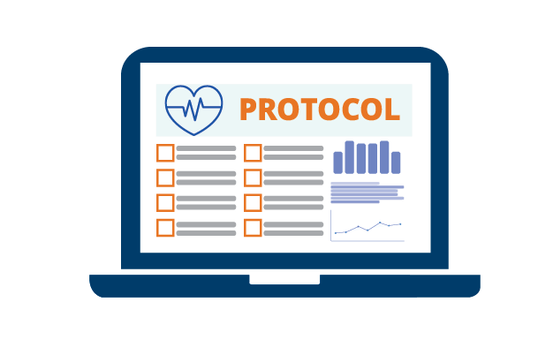
Did you know?
You can reduce disparities in blood pressure control
and increase health equity in hypertension management by systematically applying a hypertension treatment protocol and using data to identify care gaps.
Hypertension Control Change Package –
see p. 10 – Deploy HTN treatment protocols and
algorithms | hhs.gov
AMA Doc Talk: Closing the BP control gap (23 min. video) | Omny.fm
Ensuring Health Equity in Preventing Cardiovascular Disease
(13 min. video) | NACHC
Notes:
Racial and ethnic minority groups suffer disproportionately from cardiovascular disease and have higher rates of mortality from cardiovascular disease. The greatest disparity that exists today is in hypertension-related mortality, where African Americans have the highest rate of hypertension-related CVD deaths compared to other groups.
Evidence shows a hypertension medication treatment protocol that prioritizes combination therapies with a thiazide-type diuretic or a calcium channel blocker benefits African Americans, and all people, more than other therapies (the AMA’s Hypertension Medication Treatment Protocol offers more detail). This approach is recommended in the latest 2017 Hypertension Guideline.
It is also important to use data that identifies care gaps and social drivers of health so issues can be illuminated and addressed.

Slide 14
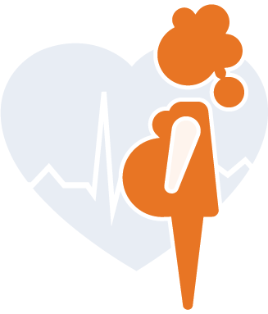
Did you know?
Hypertension is a leading cause maternal morbidity and mortality. Taking the time to treat hypertension during pregnancy, after delivery, and through the woman’s life course is key to improving maternal health in the U.S.
Hypertensive Disorders of Pregnancy | Million Hearts®
NACHC Million Hearts® Dec 2022 SMBP Forum: Self-Measured Blood Pressure Monitoring to Address Hypertensive Disorders of Pregnancy (1 hr. video)
Notes:
Hypertensive disorders of pregnancy are a leading cause of maternal mortality, and can put both mother and baby at risk for problems during pregnancy (1). High blood pressure can also cause problems during and after delivery. Importantly, hypertensive disorders of pregnancy are often preventable and treatable.
In the U.S., high blood pressure is noted for one in every 12-17 pregnancies among women aged 20 to 44 (2). Approximately 15% of women are affected by hypertensive disorders of pregnancy during their reproductive years, resulting, in part, from advanced age at first pregnancy and the high prevalence of obesity and other cardiometabolic risk factors (^{1,3).} Taking the time to treat hypertension during pregnancy, after delivery, and throughout a woman’s life is key to improving maternal health in the United States.
References:
Garovic VD, Dechend R, Easterling T, et al. Hypertension in Pregnancy: Diagnosis, Blood Pressure Goals, and Pharmacotherapy: A Scientific Statement From the American Heart Association. Hypertension. 2022 Feb;79(2):e21-e41.
Centers for Disease Control and Prevention. High Blood Pressure During Pregnancy. Accessed January 13, https://www.cdc.gov/bloodpressure/pregnancy.htm
Garovic VD, White WM, Vaughan L, et al. Incidence and Long-Term Outcomes of Hypertensive Disorders of Pregnancy. J Am Coll Cardiol. 2020 May 12;75(18):2323-2334

Slide 15
IMPROVING
BLOOD PRESSURE
CONTROL
For Care Teams
Notes:
These slides focus on improving blood pressure control and is intended for care teams.
Care teams may include all members of your staff who support clinical providers in managing hypertension, i.e., nurses, pharmacists, medical assistants, community health workers, etc.

Slide 16

Quick Tip
“Don’t just measure BP at every visit, address it – every patient
encounter is an opportunity to prevent a heart attack or stroke.”
—Dr. Laurence Sperling, Executive Director, Million Hearts®.
Every care team member has an important role. Consider care team scorecards and merit incentives for the full care team that include addressing elevated BP.
The Surgeon General’s Call to Action to Control Hypertension Fact Sheet for Health Care Professionals | cdc.gov
Hypertension Control Change Package—p. 20, see section – Regularly provide a dashboard with BP goals, metrics, and performance | hhs.gov
Improving hypertension control and cardiovascular health: An urgent call to action for nursing (14 min. video) | NACHC, CDC, AMA | Hannan - 2022 - Worldviews on Evidence-Based Nursing - Wiley Online Library
Notes:
We’ve gotten so used to measuring blood pressure at every visit that it may feel like just a mechanical part of the rooming process – like something we do and record but don’t necessarily act upon, especially if the visit is for something else.
However, even during COVID, cardiovascular disease remained the leading cause of death – with hypertension as the leading risk factor for CVD. We need to renew our sense of urgency and remember, “don’t just measure BP at every visit, address it – every patient encounter is an opportunity to prevent a heart attack or a stroke.” These are the words of Dr. Laurence Sperling who currently serves as the Executive Director of the national Million Hearts initiative, which aims to prevent one million heart attacks and strokes by 2027.
Addressing BP at every visit is not something a clinician can accomplish very easily alone – it requires a team effort. Every care team member has an important role. A few ways to make sure everyone contributes to this effort and everyone’s contribution is valued include using care team scorecards and merit incentives. Think about activities like repeating a blood pressure measurement when the initial reading is elevated, using pre-visit planning to identify patients whose last BP was elevated, and ensuring the clinician is aware of patients with elevated BPs with prompts to address it.

Slide 17
Did you know?
Taking a patient’s blood pressure without their arm supported at heart level can add 10 mmHg to their reading? Also, taking a BP measurement over clothing can add 5 – 50 mmHg. Accurate BP measurements are essential to identify people with hypertension and prompt quick clinical action.
How to measure blood pressure accurately
(1 min. video) | AMA
In-Office Blood Pressure Measurement Graphic | Target:BP (targetbp.org)
Hypertension Control Change Package, see section – Provide guidance on measuring BP accurately | hhs.gov
Notes:
Common positioning and preparation errors can add millimeters of mercury to measurements and result in inaccurate blood pressure readings.
On average, taking a patient’s blood pressure without their arm supported at heart level can add 10 mmHg to their reading. Taking a BP measurement over clothing can add anywhere from 5 to 50 mmHg. Unsupported back and feet adds 6 mmHg. Crossed legs add 2-8 mmHg, and using a cuff that is too small adds 2-10 mmHg. Also, patients should be asked if they need to use the restroom because a full bladder adds 10 mmHg. Talking with the patient or requiring them to do active listening adds an additional 10 mmHg. This is true when we put a thermometer in a patient's mouth or a pulse oximeter on their finger while they are having their blood pressure measured.
If a care team isn’t focused on accurate measurements, then the data these readings generate are not taken as seriously and people with hypertension may be missed or misidentified. Further, when clinicians don’t trust that BP measurements in the office are accurate, they may not act quickly to address elevated BPs.
Care teams play a powerful role in ensuring people receive care that can prevent heart attacks and strokes -- and save lives.
Sources:
Pickering. et al. Recommendations for Blood Pressure Measurement in Humans and Experimental Animals Part 1: Blood Pressure Measurement in Humans. Circulation. 2005;111: 697-716.
Handler J. The importance of accurate blood pressure measurement. The Permanente Journal/Summer 2009/Volume 13 No. 3 51

Slide 18
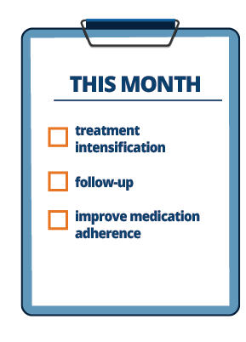
Did you know?
Three of the most impactful strategies to improve hypertension outcomes are rapid treatment intensification, increasing frequency of follow-up, and improving medication adherence. Which one of these can you focus on this month?
Clinic-based strategies to reach United States Million Hearts 2022 blood pressure control goals: a simulation study | nih.gov
BPAA-Roadmap_08252021.pdf | nachc.org
Notes:
An important simulation study by Brandon Bellows and colleagues found that out of all the actions and interventions in our toolkit to address hypertension, the three most impactful ones are: rapidly intensifying treatment for people with uncontrolled blood pressure, following up with them every 2-4 weeks until they are at control, and ensuring they adhere to their prescribed medications.
Which one of these can your care team focus on this month?

Slide 19
Did you know?
Factors affecting a person’s ability to take their medications may be related to cost, complexity of regimen, ability to receive 90-day and automatic refills, lack of trust in the healthcare system, and other patient concerns that are often from misinformation. Learn some strategies to overcome these obstacles.
Hypertension Control Change Package – see p. 20, Provide patient supports for medication adherence | hhs.gov
NACHC Million Hearts Learning Lab: Session 3 Ensuring Health Equity in Preventing CVD Pre-Work (13 min. video)
Notes:
Medication adherence is a complex issue. There are many factors that affect a person’s ability to take their medications. For example:
The cost of medicine can be a barrier to adherence. Patients may not fill prescriptions in the first place or they may ration what they have to extend their supply.
Screen for social drivers of health and use motivational interviewing techniques to uncover if cost is a factor. Offer generic alternatives, discount coupons, etc., when possible.
The complexity of a patient’s medication regimen may be part of the issue – the greater number and frequency of different medications prescribed, the more likely a patient is to be nonadherent.
Consider using single pill combinations, when possible, streamline dosing and refills with other medications, and offer patients pill organizers like blister packs or pill boxes.
Having to refill a prescription every 30 days may pose a significant challenge, especially for patients who have transportation barriers, work multiple jobs, or have childcare challenges. 30-day prescriptions tend to reduce adherence.
Consider 90-day automatic refills for patients whose medication is stable or offer delivery options, if available. Patients may be suspicious of their doctor’s motives when certain medications are prescribed because of pharmaceutical marketing campaigns, or if mistrust the health care system in general due to historical inequities. Invest in building relationships with patients and engage them in developing their treatment plan to develop trust.
Some patients may not understand the need for medicine, especially when hypertension doesn’t cause a patient to feel any different – with or without medicine.
Educate patients on what they can expect to help them stick to their medication regimen.
What are some other strategies you can think of?

Slide 20
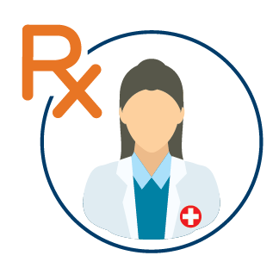
Did you know?
Pharmacists are well-positioned to provide patient support that can make a significant difference in medication adherence.
Tailored Pharmacy-Based Interventions to Improve Medication Adherence | cdc.gov
Hypertension Control Change Package, p. 8 - see section – Expand the HTN care team | hhs.gov
Notes:
Pharmacists are well-positioned to provide patient support that can make a significant difference in medication adherence.
Pharmacists can play an important role in interviewing patients or using assessment tools to identify adherence barriers. For example, as part of the care team they can conduct medication counseling or motivational interviewing sessions. They can use the results from their assessment to develop and deliver tailored guidance and services to patients that aim to reduce identified barriers. They can also provide education, share tools such as pillboxes, medication cards, and calendars.
Pharmacists can seamlessly synchronize medication refills and enhance follow-up encounters.

Slide 21
Quick Tip
Messaging matters! A savvy care team member already knows that a patient with uncontrolled hypertension likely needs an additional medication class to achieve blood pressure control.
Rather than asking the primary care provider what they want to do, ask them which medication they would like to add – and offer two evidence-based options.
Hypertension Medication Treatment Protocol | AMA; 2020
Notes:
Care team members are invaluable for optimal treatment. For example, care team members can help clinicians by reminding them to intensify hypertension treatment for a patient whose blood pressure continues to be uncontrolled.
Communication – and how we deliver messages – is an essential skill when helping to inform a primary care provider's decision-making process.
How a suggestion or decision option is phrased really matters! A savvy care team member already knows that a patient with uncontrolled hypertension likely needs an additional medication class added to achieve blood pressure control. Rather than asking a provider what they want to do, ask them, “Which medication would you like to add?” – then offer two evidence-based options. For exapmle: “The patient is already prescribed an ACE inhibitor, would you like to add a thiazide or a calcium channel blocker?” OR “would you like to switch them to combination therapy [insert medication name, e.g., Lotensin]?”

Slide 22
Did you know?
Nationally and in our Million Hearts project, 17% of patients with uncontrolled hypertension are on no medication and 30% are on only one medication. NACHC's process measures identify the proportion of patients with uncontrolled blood pressure (≥140/90 mmHg) on no anti-hypertensive therapy and on monotherapy. Using these measures can help drive improvement and increase health equity by identifying care gaps and disparities in treatment.
Improving Blood Pressure Control in African Americans Monitoring Measures and Data Workbook
Notes:
We’re all familiar with the controlling high blood pressure quality measure, which is important in assessing whether we are reaching our blood pressure goals across our patient population. However, we also need to monitor whether we are doing the most important things that enable our patients to achieve control.
The most impactful action we can take is to act rapidly to intensify treatment for those patients with Stage 2 (>=140/90 mmHg) uncontrolled hypertension (^{1).} Process measures, like looking at the proportion of our patients with uncontrolled hypertension who are not on anti-hypertensive therapy and the proportion on monotherapy – a single drug class – are important ways to evaluate if we are intensifying treatment in ways that yield the results we hope for.
NACHC has created process measures you can use (see link). These measures can help drive improvement and increase health equity by identifying care gaps and disparities in treatment.
1. Bellows BK, Ruiz-Negrón N, Bibbins-Domingo K, et al. Clinic-Based Strategies to Reach United States Million Hearts 2022 Blood Pressure Control Goals. Circ Cardiovasc Qual Outcomes. 2019;12(6):e005624. doi:10.1161/CIRCOUTCOMES.118.005624

Slide 23
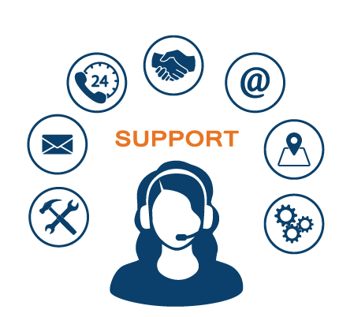
Did you know?
Self-measured blood pressure monitoring (SMBP) is most effective when paired with clinical supports such as patient education, training, electronic or web-based tools, and follow-up outreach.
Self-Measurement: How patients and care teams are bringing blood pressure to control (13 min video) | NACHC
SMBP Implementation Toolkit | NACHC, 2022
Hypertension Control Change Package, p. 20 - see section— Provide patient supports for SMBP monitoring | hhs.gov
Notes:
Did you know that self-measured blood pressure monitoring or SMBP is most effective when paired with clinical supports?
What does that mean? In this case, SMBP is only considered an evidence-based strategy to improve hypertension outcomes when it is combined with supporting activities. These include patient education, training, electronic or web-based tools, and follow-up. If SMBP is implemented in isolation – in other words, if a patient receives or is instructed to purchase a home blood pressure monitor to take their blood pressure at home without clinical support or is disconnected from their care team and clinical action like medication, studies show it does not result in improved blood pressure outcomes beyond usual care (^{1).}
Care team engagement is the secret sauce to making SMBP work.
1. Bryant, K. B., Sheppard, J. P., Ruiz-Negrón, N., Kronish, I. M., Fontil, V., King, J. B., Pletcher, M. J., Bibbins-Domingo, K., Moran, A. E., McManus, R. J., & Bellows, B. K. (2020). Impact of Self-Monitoring of Blood Pressure on Processes of Hypertension Care and Long-Term Blood Pressure Control. Journal of the American Heart Association, 9(15), e016174. https://doi.org/10.1161/JAHA.120.016174

Slide 24
Quick Tip
SMBP is not intended to be used in perpetuity. Use SMBP to diagnose hypertension, titrate medications, and before follow-up appointments. Patients can take their blood pressure occasionally in between visits, but having a patient continuously take their BP twice in the morning and evening is not sustainable nor desirable.
Sample SMBP Workflow | Health Federation of Philadelphia
Notes:
One reason SMBP or Self-measured blood pressure monitoring programs “fail” is when SMBP is not used properly.
SMBP is an important tool in the hypertension management to help with diagnosing hypertension, titrating medications, and assessing blood pressure before and after appointments. It is not intended to be used endlessly. Imagine if your own care team asked you to take your blood pressure at home twice in the morning and night every day with no end in sight?! We would all likely slide off the interest wagon…keep your patients engaged and get the most out of SMBP by using it deliberately for 7-day periods to rule out white coat effect, properly diagnose hypertension, and learn if medication changes are successful. Just prior to follow-up appointments, SMBP is recommended as well.
Patients can take their BP occasionally in between visits on their own, but set them up to use SMBP successfully and let them know when to use results to inform clinical action.

Slide 25
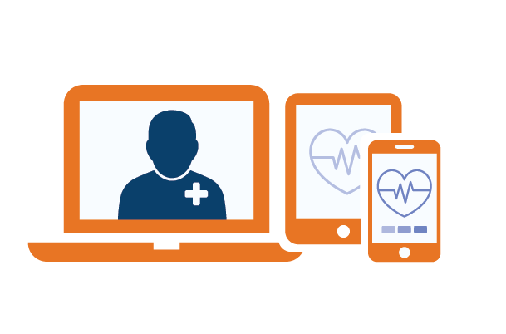
Quick Tip
Use telehealth and technology to make your SMBP program practical and sustainable in your practice.
Clinical Case Study: Implementing a
SMBP Program, scroll forward to
19 min.,30 sec. | Health Federation of Philadelphia
Health IT Checklist for Blood Pressure Telemonitoring Software
SMBP Implementation Toolkit | NACHC
Notes:
SMBP requires communication and follow-up to support patients, and it involves retrieving data from patients to inform clinical decisions. All of these activities takes staff time – especially if your SMBP program is based on face-to-face encounters for every touch point and you manage SMBP data manually.
Telehealth is an easier option to check in with a patient. Telehealth works well after a face-to-face visit to ensure a patient understands how to take their BP at home. Telehealth is also great for medication adjustment.
Using a smartphone app that communicates with the home blood pressure monitor makes data flow into a portal that your clinic can access, easy. Some sites even have these data flowing right into their population health management system or EHR. If blood pressure readings can be pushed to the portal, care team members can learn about a patient's measurements in real-time. You don’t have to wait for a follow up appointments. The data can be averaged prior to the patient’s appointment – rather than receiving a paper log and having to do math really fast. Bluetooth-enabled devices also mean BP measurements are recorded accurately and consistently, so clinicians can feel confident in the data.
For more information about how to leverage telehealth and technology so SMBP is practical and sustainable, check any of these resources for details.

Slide 26
Did you know?
Offering self-measured blood pressure monitoring (SMBP) can help ensure health equity in achieving hypertension outcomes because it can mitigate barriers like transportation, work conflicts, or lack of childcare.
Use of Self-Measured Blood Pressure Monitoring to Improve Hypertension Equity | SpringerLink
How Do We Jump-Start Self-measured Blood Pressure Monitoring in the United States? Addressing Barriers
Beyond the Published Literature | PubMed (nih.gov)
An Opportunity to Better Address Hypertension in Women: Self-Measured Blood Pressure Monitoring | Journal of Women’s Health (liebertpub.com)
Notes:
We know hypertension management can require frequent encounters, especially when a patient’s blood pressure is not yet controlled.
SMBP helps mitigate several barriers to an office visit, like when patients don’t have reliable transportation or must take public transportation to reach the clinic. Or if patients work hours that make it difficult to schedule a face-to-face appointment. Or when childcare becomes a barrier to visiting the clinic. Using SMBP along with telehealth can expand access to care substantially for many people. SMBP presents a real opportunity to make big dents in how we can help our patients manage their hypertension.

