Slide 1
STEPPING BACK FROM
THE CULTURE OF BUSY
Peer to Peer Engagement—
Responding to Evolving Workplace Culture

Slide 2
Welcome & Introductions
Speaker Name
Title| Organization Name| email address
Short Speaker Bio
(add here)

Slide 3

3 Deep Breaths

Slide 4

Culture of Busy is Not Sustainable
Burnout
Staffing shortages with
no end in site
Workers leaving the field
Not financially sustainable to stay the course
Notes:
A 2021 Washington Post/Kaiser Family Foundation survey found that 55% of frontline workers reported feeling burned out and 62% reported some mental health repercussions from the pandemic. https://www.kff.org/report-section/kff-the-washington-post-frontline-health-care-workers-survey-toll-of-the-pandemic/ ​
NACHC early 2022 study of FQHCs found that 68% of clinics surveyed had lost between 5-25% of their workforce as a result of pandemic-related stressors; 3rd solution (after increased federal funding and expanded billing) was an investment in wellness practices for the workforce.
​
By 2025, McKinsey estimates that the US may have a gap of between 200,000 to 450,000 nurses available for direct patient care, equating to a 10 to 20 percent gap. To meet this demand, the US would need more than double the number of new graduates entering and staying in the nursing workforce every year for the next three years straight.” https://www.mckinsey.com/~/media/McKinsey/Email/Shortlist/180/2022-06-03b.html?cid=other-eml-shl-mip-mck&hlkid=960da0c4cafc4695b3250c8ec9d23578&hctky=13540617&hdpid=da264c9c-7579-4803-8c5c-d16cedef4757

Slide 5

Health Centers are Innovators
Flexible leaders open to feedback and change
Rethink workflows for more flexibility and control
Protect time and space to regulate impact of stress and moral injury
Connection and co-regulation spaces to discuss the ‘why’
Bring cultural values, human needs, and healing practices into workplace
Notes:
We need to take in best practices from brave, trauma-informed health care leaders if we are going to sustain this work.​
​
Good news - is that many health clinics already have key qualities needed

Slide 6

Who are the Brave Leaders?
“I define a leader as anyone who takes responsibility for finding the potential in people and processes, and who has the courage to develop that potential.” —Brene Brown
Curious
Compassionate and warm
Calm
Empower, Voice, and Choice
Accountable
Notes:
Research notes on trauma-informed leader behaviors -Adapted from Trauma Informed Oregon
​
Curious about delivering care differently to meet the complex needs of the community​
Compassionate and warm - emotionally intelligent, inquire about staff wellbeing​
Calm in the face of crisis and regulate the distress of change​
Empower, Voice, and Choice - validate the expertise of employees and consumers, building feedback loops to listen, seek to give choices to consumers and employees​
Accountable communicate transparently and maintain consistency and predictability​
​
​
Worker qualities versus titles

Slide 7

Using Quality Improvement to do Less
Consider new use for efficiencies
  LEAN Thinking - creating needed value with fewer resources and less waste
  PDSA – Plan, Do, Study, Act
Provider and staff buy in for QI
Notes:
Ask for examples from the group

Slide 8

Data is Power!
Turnover in physician workforce costs $979 million annually - with $260 million (27%) attributable to burnout
68% of FQHCs in early 2022 had lost 5-25% of their workforce as a result of pandemic-related stressors
Employee satisfaction data
Training evaluations
Retention and turnover rates
Absences
Consumer satisfaction data
Time and cost to recruit for new positions
What data do your health centers have to inspire leaders to push back from the culture of busy?
Notes:
NACHC & Star2Center’s turnover calculator: ​STAR² Center Financial Assessment for Provider Turnover Tool – CHCWorkforce

Slide 9

Understanding Stress is Key to Understanding Behavior
Amygdala (emotional brain): smoke alarm
Reacts before you’re aware of it
Initiates stress response
Prefrontal Cortex (thinking brain): watch tower
Is the fire really happening?
Can turn stress response down/off
Notes:
Key:​
when the emotional brain overwhelms the thinking brain, dysregulated behavior results (flipping our lid; bursting out; shutting down; etc.)​
if we can get the thinking brain online in time, it can support slowing down the stress response which enables us to more accurately assess the risk and decide what to do next (versus reacting automatically)​
the thinking brain is helped in these efforts by body-based (also called somatic) calming exercises, which we will talk more about later

Slide 10
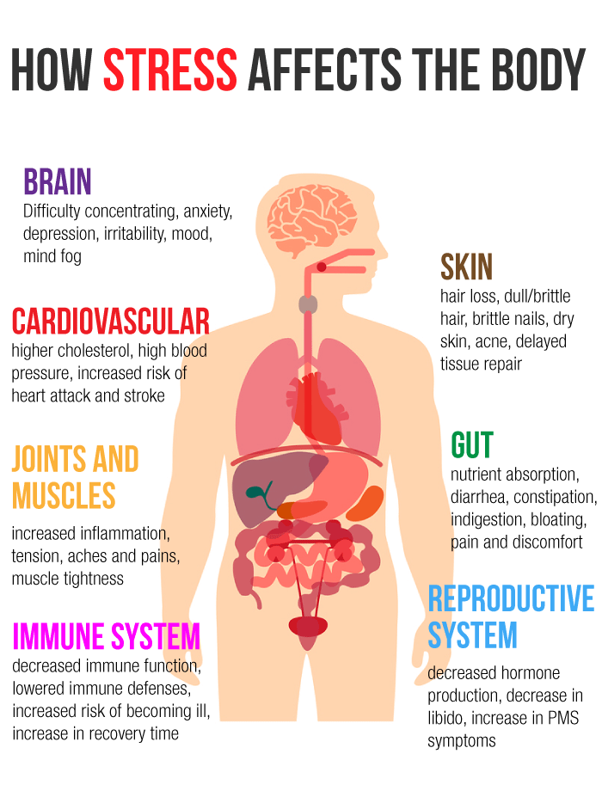
Stress in the Body
Acute stress + fight/flight/freeze
Chronic stress: lasting impacts
Our brain AND our body remember stressful situations and can become highly reactive
Notes:
A recap of flight or flight video – use this as an opportunity to highlight the body systems engaged​ in the stress response -
Image credit: https://www.greensborochiropractor.net/body-signals-stress/

Slide 11
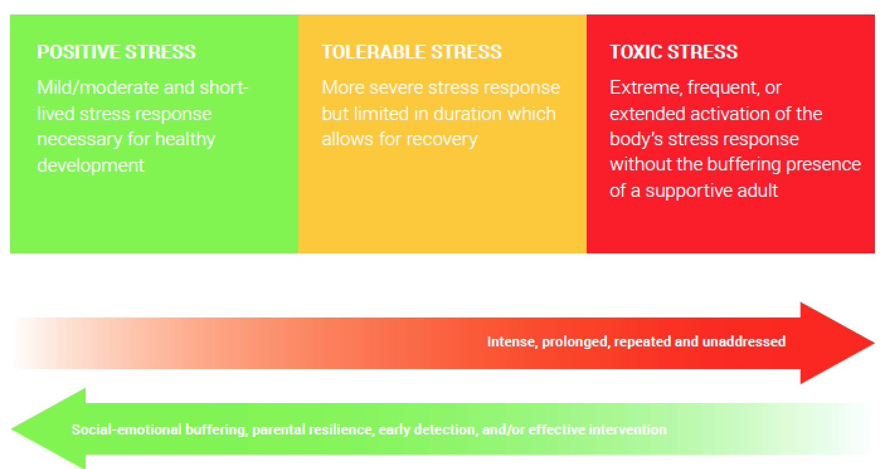
Continuum of Stress
Notes:
Stress is a merely a demand on one or more of our body’s many physiological systems; hunger, thirst, cold, working out, a big project at work – are all stressors. Our body has a host of ‘stress-response’ capabilities that help us manage these challenges and keep us in ‘equilibrium.’ ​
​
Stress is essential to healthy development, and it is the essential element of building resilience. ​
​
The key factor in determining whether stress is positive or destructive is the pattern of stress​
​
This slide depicts a continuum of stress, from positive to toxic stress. As noted on the left side of this chart, when stress is mild/moderate, short-lived and controllable, it can be positive, and leads to resilience. ​
​
When stress is more prolonged and severe, as noted in the middle box, we call that tolerable stress. Tolerable stress might result from working on a project for 10 days in a row, but then being able to take extra days off after the work is finished. ​
​
Moving to the box on the right, toxic stress involves demands on us that are intense, prolonged, repeated and unaddressed. Many people are experiencing toxic stress right now. It is taxing and leads to hypervigilance. We become worn down physically. We struggle to focus and concentrate and to take in information, especially information that requires our frontal cortex, or the thinking part of our brain. ​
​
The bottom line is toxic stress changes our biology as it can over-activate the stress response system, wearing down the body and brain over time. ​
And people with a history of adverse childhood experiences are especially vulnerable to the impact of toxic stress.​
Thus, it is very important that as staff and leaders, we manage our own stress and we partner with our clients to do the same.​
​
​
​
​
​
​
​
​
​

Slide 12



Three Ways to Regulate
Top down
Bottom up
With other people
Notes:
Three ways to regulate:​
1. Top down – use our cortex​
Pause between a stimulus and action​
Mindfulness​
Repeating core beliefs – “This will not last forever”​
2. Bottom up: somatosensory, rhythmic, repetitive interventions – we need to rely on this more often when experiencing toxic stress because we can’t access our frontal cortex​
Walking and other exercise​
Focused breathing​
Music and dance​
Breathing ​
In context with other people – the dosing of connection can be quite small to make a difference​
Just one best friend – 43% more likely to receive praise, 27% more likely to feel heard, Burnout reduced by 41%​
Source: Perry, B. (2020). Neurosequential Network. Retrieved from https://www.neurosequential.com/covid-19-resources​
​
​
​
​

Slide 13


Regulation Techniques at Work
Top-Down
To do list
Gratitude practice
Setting boundaries and re-prioritizing
Self-care assessment
Positive mantras
Reconnect with your “Why”
Bottom-Up
Mindful breathing
Music
Movement and exercise
Calm spaces
Visualize calm/safe space
Hand on heart and belly
Free Head Space or Calm App for employees

Slide 14

Co-Regulation Will Save Us!
Mentor and buddy systems
Debrief challenging events
Opportunities to connect during meetings
  Check-ins
  Mentimeters
  Icebreakers
  Shout outs
Acknowledging loss & celebrating wins
Monthly or quarterly lunches
We are hardwired to
connect with others,
it's what gives purpose
and meaning to our lives,
and without it
there is suffering.
- Brene Brown

Slide 15

Systemic Approaches to Regulation
Increase Psychological Safety:
Recognize contributions
Explain the “why” behind decisions
Acknowledge what you don’t know
Encourage expression of disagreement
Set clear limits and expectations
Resist Overstimulation:
Utilize flexible scheduling
Close Friday afternoons for non-clinical work
Reduce workloads of non-essential duties
Provide training to address workforce (in)efficiencies
Partner with national, regional, and local resources that support the work

Slide 16

Working with communities
The SAMHSA-funded Opioid Response Network (ORN) assists states, organizations and individuals by providing the resources and technical assistance they need locally to address the opioid crisis and stimulant use.
Technical assistance is available to support the evidence-based prevention, treatment and recovery of opioid use disorders and stimulant use disorders.
The ORN provides local, experienced consultants in prevention, treatment and recovery to communities and organizations to help address this opioid crisis and stimulant use.
ORN accepts requests for education and training.
Each state/territory has a designated team, led by a regional Technology Transfer Specialist (TTS), who is an expert in implementing evidence-based practices.
To ask questions or
submit a request for technical assistance:
www.OpioidResponseNetwork.org
Email: mailto:orn@aaap.org
Funding for this initiative was made possible (in part) by grant no. 1H79TI083343 from SAMHSA. The views expressed in written conference materials or publications and by speakers and moderators do not necessarily reflect the official policies of the Department of Health and Human Services; nor does mention of trade names, commercial practices, or organizations imply endorsement by the U.S. Government.

Slide 17

Action Planning Session
Review the worksheet:
  Which of your health centers are thriving and which are surviving?
  Which health center has a brave leader you can connect with?
  What data might you help them collect?
  What’s a pain point to help them start focusing on within the culture of busy?
  What do you want to start asking or knowing about your health centers?
Chat/share responses with a small group

Slide 18



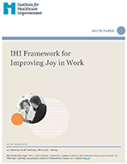
Resources for Health Centers
Fostering Resilience and Recovery: A change package for advancing trauma informed primary care.
Facilitator resources to build the capacity of helping professional, caregivers and the systems in which they serve.
PCA Workforce Wellness Toolkit
- Resource for wellbeing
-Moral injury and burnout conversations
- Space between joy and burnout
Notes:
IHI framework for “Joy in Work”

Slide 19
THANK YOU!

