Slide 1
Micro Resilience Practices
Regulate, Relate, Reason

Slide 2



Three Ways to Regulate:
Bottom up somatosensory, meditation, rhythmic physical activity
Top down
use our brain
With
other people
Notes:
Three ways to regulate:
1. Top down – use our cortex
Pause between a stimulus and action
Mindfulness
Repeating core beliefs – “This will not last forever”
2. Bottom up: somatosensory, rhythmic, repetitive interventions – we need to rely on this more often when experiencing toxic stress because we can’t access our frontal cortex
Walking and other exercise
Focused breathing
Music and dance
Breathing
In context with other people – the dosing of connection can be quite small to make a difference
Perry, B. (2020). Neurosequential Network. Retrieved from https://www.neurosequential.com/covid-19-resources.

Slide 3
Index of Regulation Practices for
Workplace Meetings
Music
Grounding/Breathing
Hand Breathing
5-4-3-2-1
Humor
"Take yourself to safety" visualization
Team building exercises
Shouts outs and acknowledgements
Debrief challenging incidents
Practice building psychological safety
Practice deep listening

Slide 4

Grounding and Breathing
This Photo by Unknown Author is licensed under CC BY-NC
Notes:
You can use simple breathing technique like these:
https://www.youtube.com/watch?v=4BmcV--IpNY

Slide 5

Breathing and Observing 101
Link: Happify https://www.youtube.com/watch?v=o-kMJBWk9E0

Slide 6
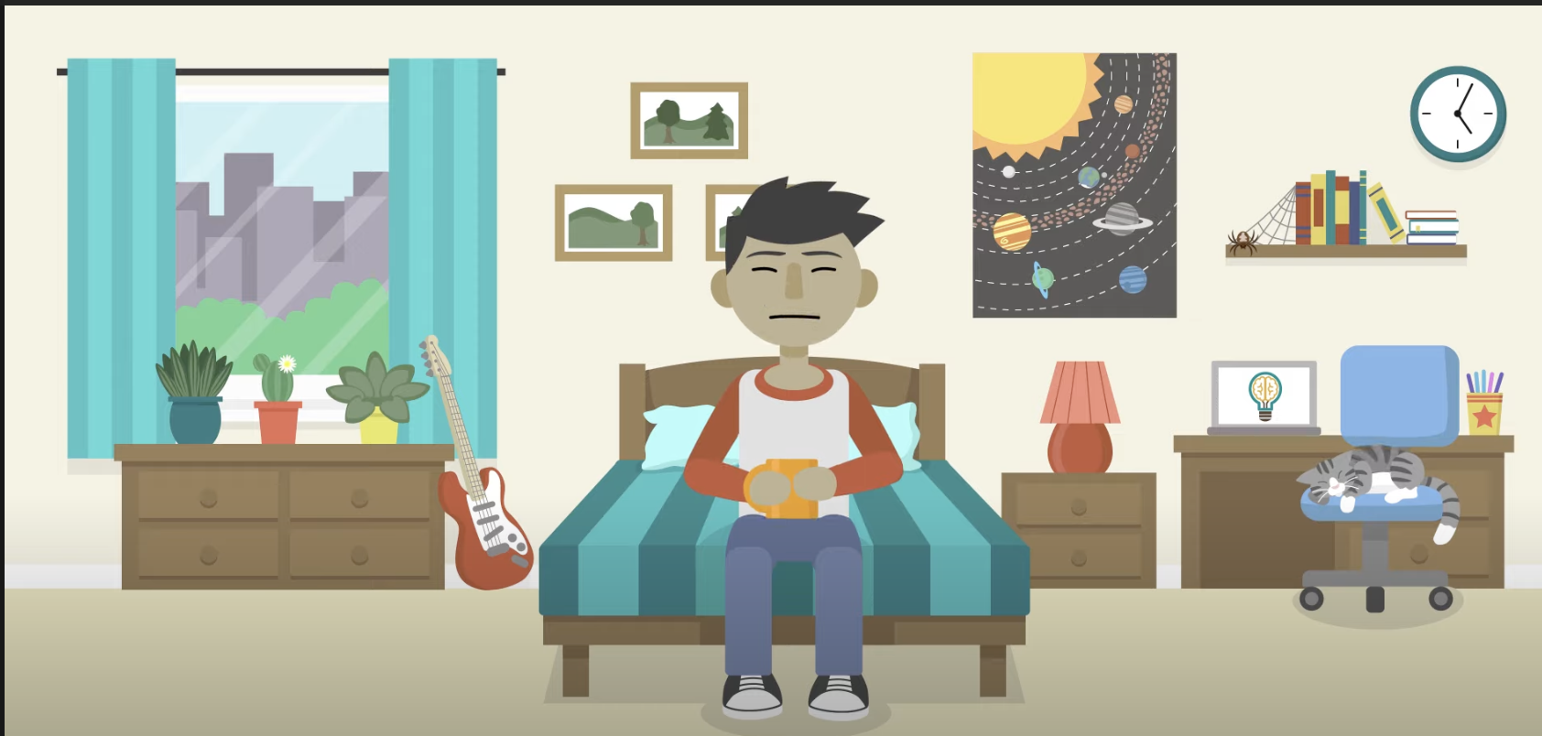
5 – 4 – 3 – 2 – 1 Method
Link: The Partnership In Education https://www.youtube.com/watch?v=30VMIEmA114

Slide 7

SUPPORTING EMPLOYEE WELLNESS:
MINI-MINDFULNESS
Use the STOP method for redirecting back to the present moment.
S = Stop what you’re doing right now.
T = Take a few deep breaths. Allow your body to take the breath it needs
in its natural rhythm of being alive.
O = Observe your body and notice if there’s any tension or tightness anywhere. Observe what’s going on in your mind and if you’re feeling distracted or settled in the present moment. Observing means to just be aware of our experience in this moment: physically, emotionally, and mentally.
P = Proceed means just thinking about the questions “What’s most important for me to pay attention to right now?” or “What am I needing right now?”

Slide 8
What is psychological safety?
“The belief that one will not be punished or humiliated for speaking up with ideas, questions, concerns or mistakes”.
A 2016 Google study found that the most important factor for successful teams is psychological safety.

Slide 9
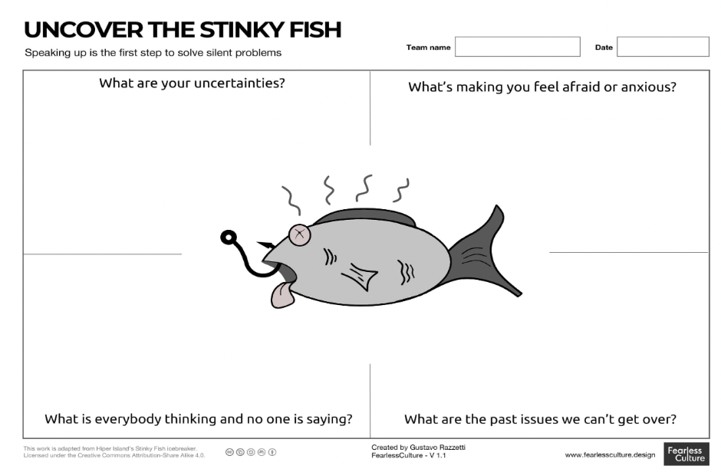
Build Safe Space for Colleagues to
Voice “Silent Problems”
Make Implicit Explicit:
Ask people to list problems that are being avoided
Regulate Yourself:
No interruptions rule and
No Blame or Shame
Acknowledge Your Role:
What are we all doing that perpetuates this problem?
What do you control and what do you not control?
What can you start and stop doing?
Notes:
Source: Fearless Culture https://www.fearlessculture.design/blog-posts/exercises-to-promote-psychological-safety-in-your-organization

Slide 10
Aligning with Values AND Deep Listening Practice
Partner A speaks first for 1-2 min, answering one of these questions:
What values lead you to do this work?
What are you worried about?
Partner B listens silently, noting Partner A’s nonverbal indicators: body, tone, movement, facial expression, etc.
Partner B provides a 30 second reflection: I heard that you are worried about X, really heard your voice change, your body slump, etc.
Swap roles
Discuss the experience
If time: Repeat exercise with question: What are you grateful for?

Slide 11
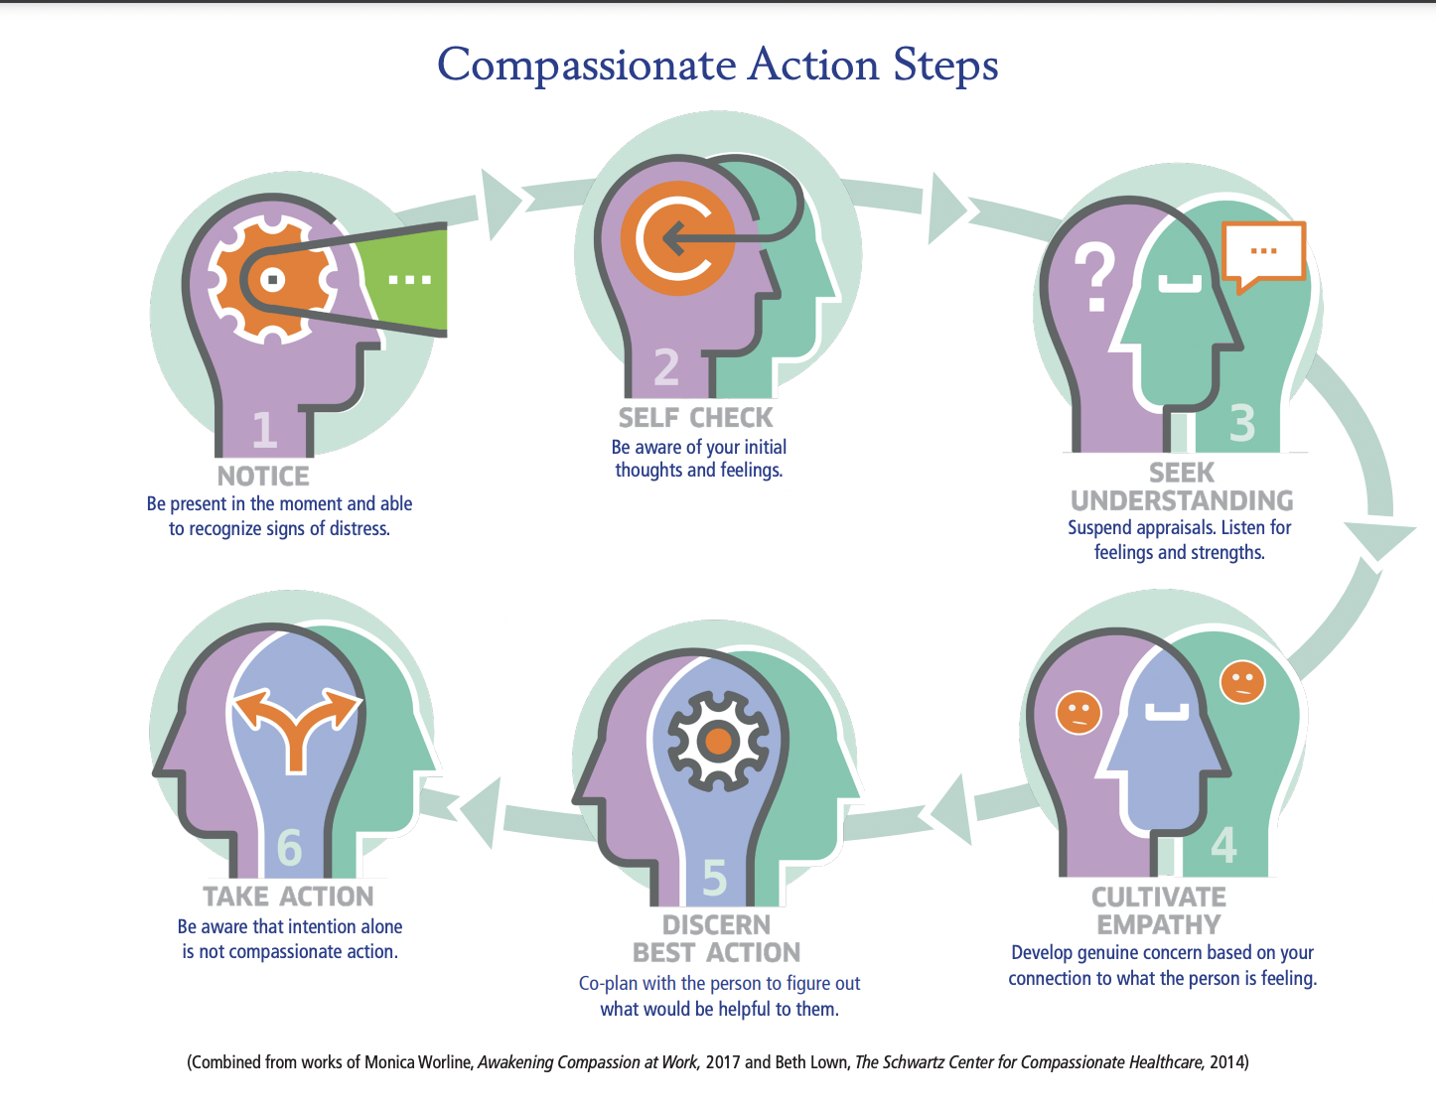

Slide 12
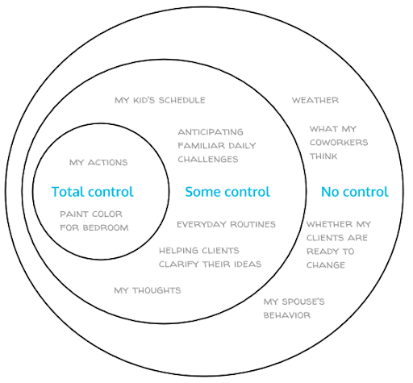
SUPPORTING EMPLOYEE WELLNESS
We will inherently feel stressed:
  naming and coping with that stress will make you, the people you care about, and your community stronger.
Practical suggestions
  Check-in and connect with others
  Remember what’s within your control vs. outside of it
  Create a schedule/routine and
  stick to it
  Identify your self-care “non-negotiables”
  Don’t watch the news or talk to others about stressors before bed

Slide 13

Take Yourself to Safety: Visualize a Safe Place
Lead through a script or show Underwater Video: https://www.youtube.com/watch?v=CwRvM2TfYbs

Slide 14
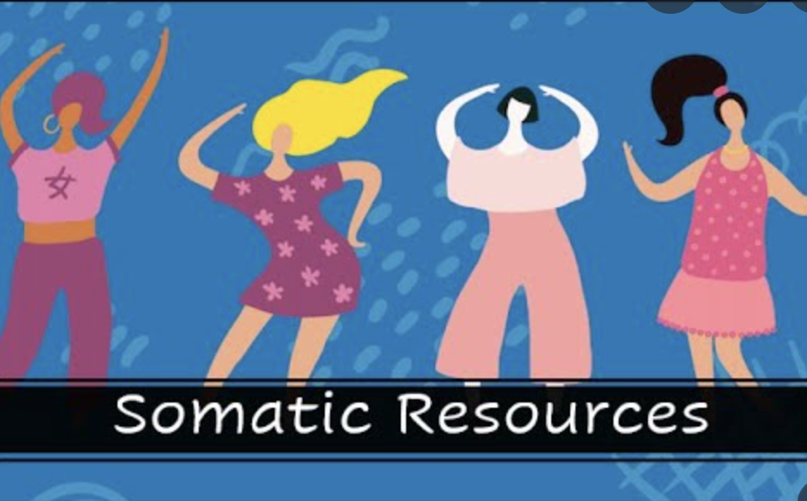
Somatic Resources to De-Escalate
& Re-Enter Window of Tolerance
Hand on heart, hand on belly
Give yourself a hug
Wrap yourself in a blanket
In a seated position with feet flat on the floor, cross arms, and place each palm on inside of opposite knee
Stand on your own two feet grounding
Hold a soft pillow
Build a boundary around you (bathtub, bathroom, pillow fort)
Push against a wall

Slide 15
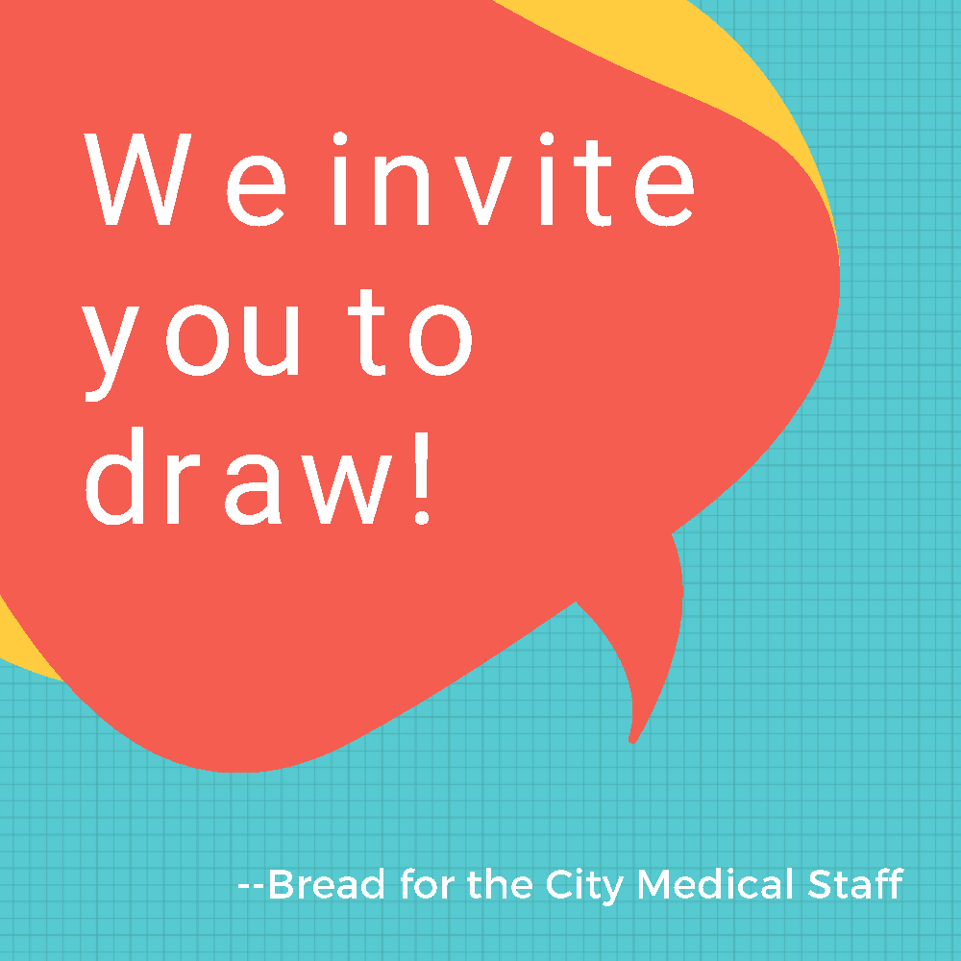
Resources to Build More Resiliency Practices Within the Clinic
Deep breathing & grounding practice
Sharing stories of client and employee successes during meetings
Music and/or art in the waiting areas
Encouraging 5 min walks/breaks throughout the day
Holding collaborative debriefs following stressful incidents
Starting meetings with self-affirmations

Slide 16
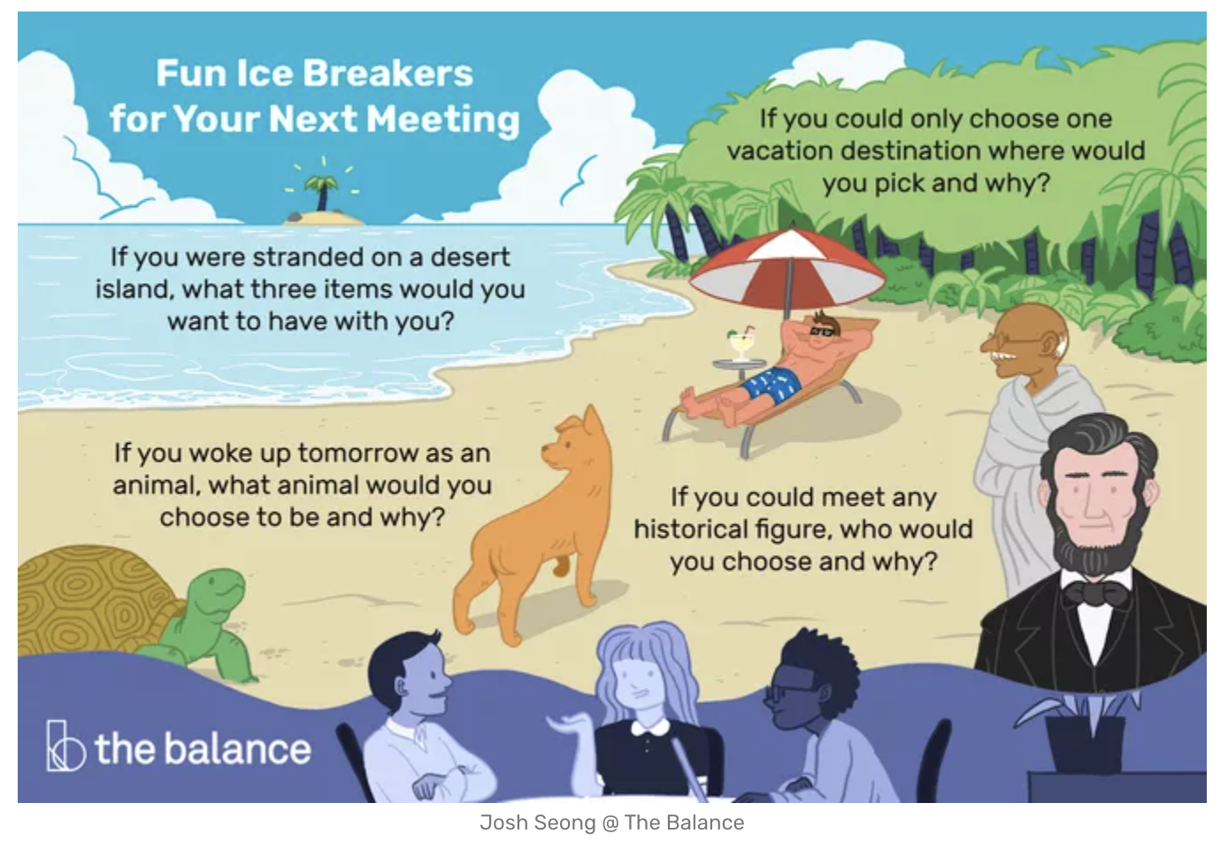
Regulating with Others: Ice Breakers
What word describes your state of being right now?
What do you need to do to be able to be present for this meeting?
What is the best human interaction you had this week?
What do you need to take care of yourself this weekend? Anything anyone in here can do to help?

Slide 17
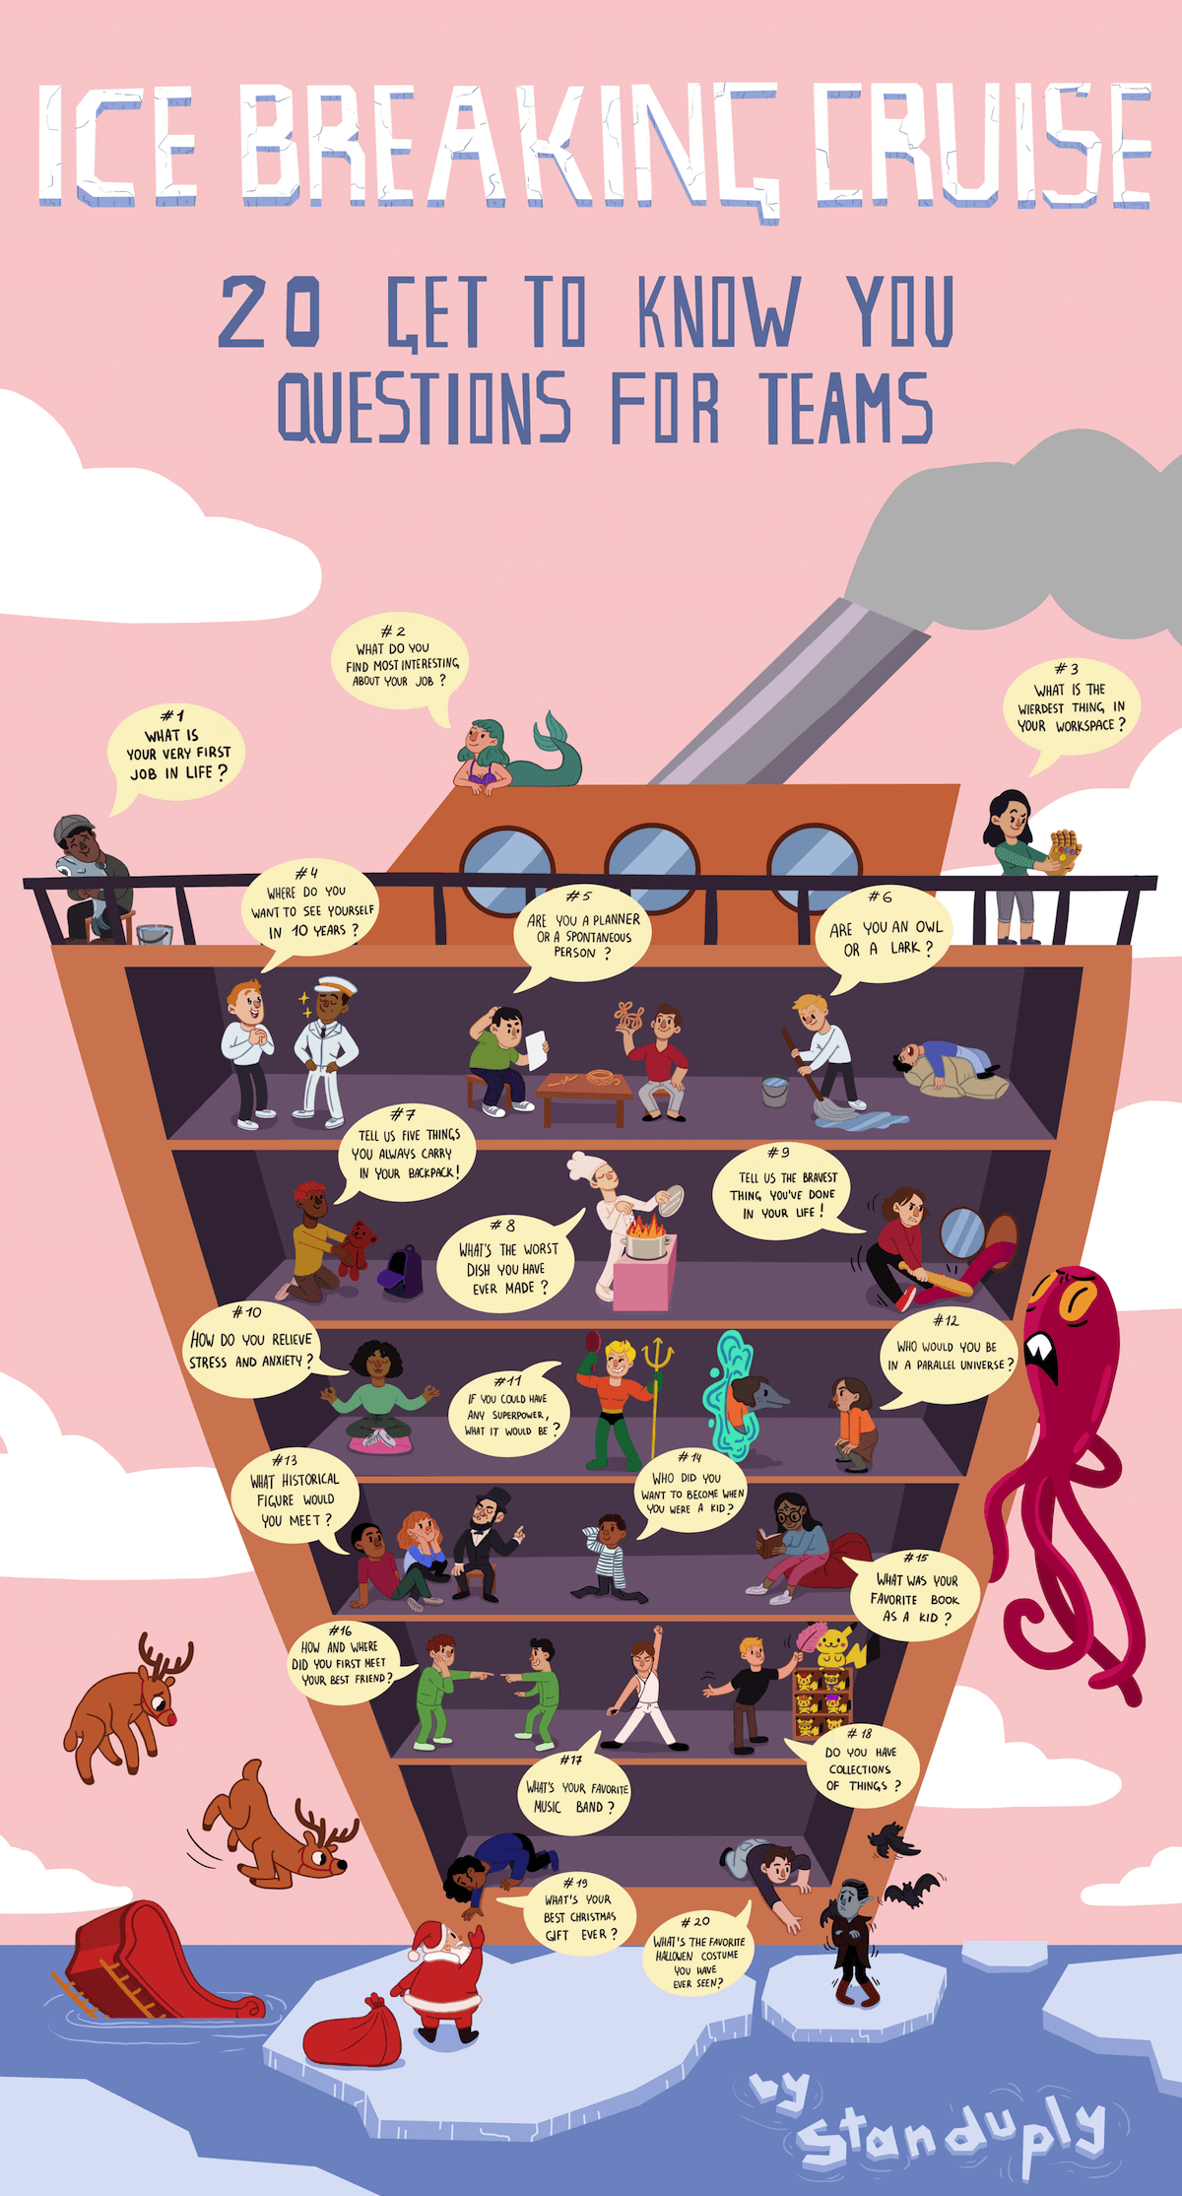

Regulating with Others: Team Building
Shout Outs and Notes of Gratitude
Ball Throwing – All Team, Learn Names
Circle – All Team
Countdown Exercise
Thinking, Seeing, Feeling Exercise in groups of 3
Strings – direct communication all group
If I had One Million Dollars…
Team Building Games by Herman Otten You Tube Channel: https://www.youtube.com/channel/UCtvhnnNkENAuo270Z-n2MFw
Book: https://www.amazon.com/dp/B08CMYCDJY?geniuslink=true

Slide 18
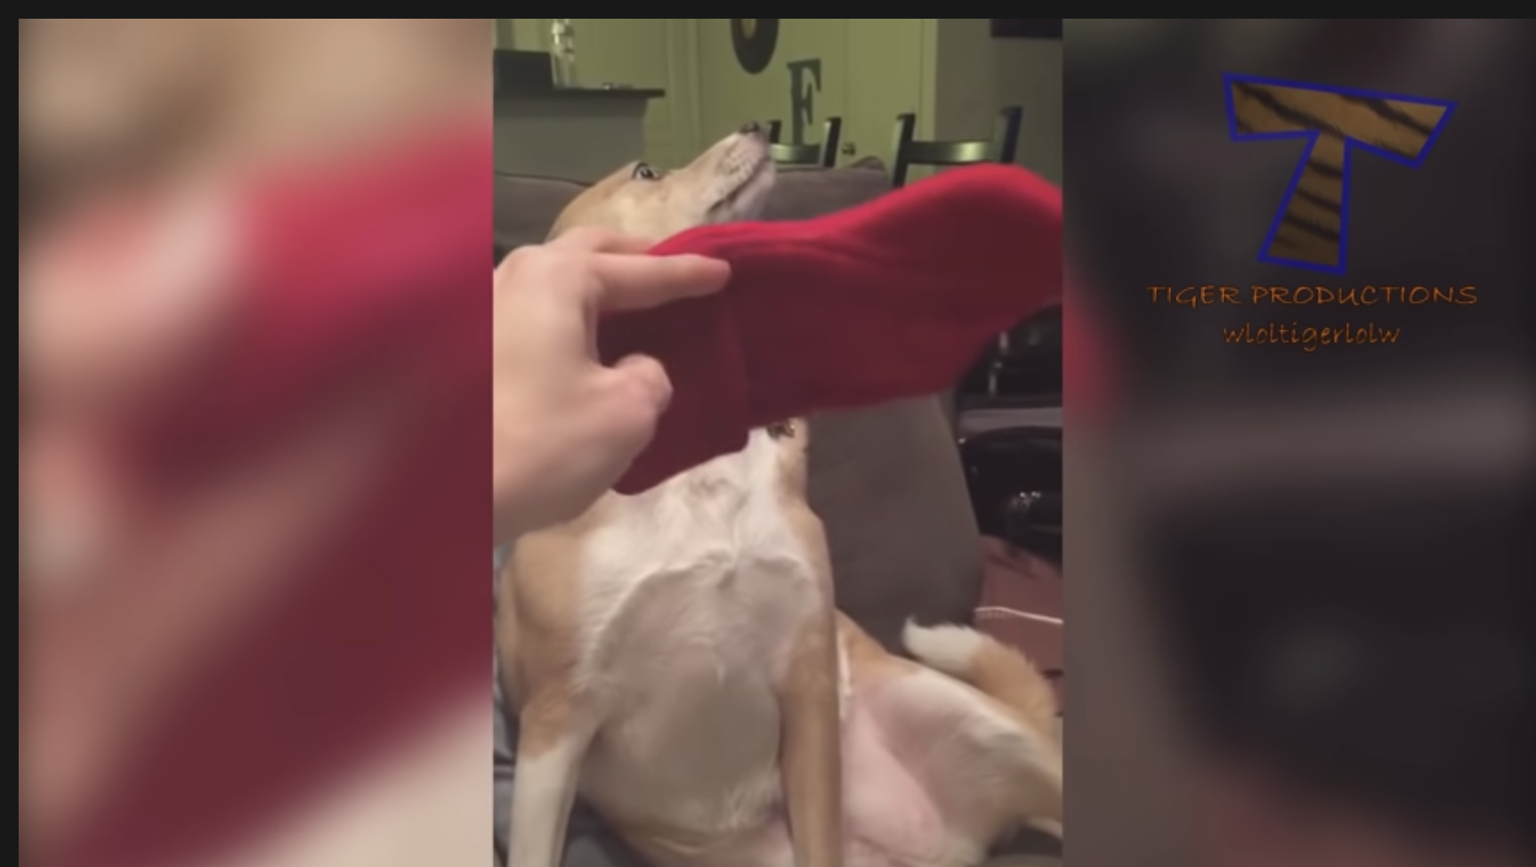
Regulating with Others: Humor
YouTube: Tiger Productions, Animal Humor
https://www.youtube.com/watch?v=0HrbvMv4kQ0

Slide 19
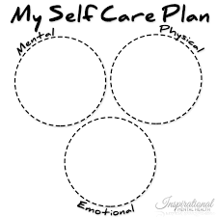
Professional Quality of Life Scale (PROQOL)
COMPASSION SATISFACTION AND COMPASSION FATIGUE (PROQOL) VERSION 5 (2009)
Take 5 min to start the self-care assessment and make a plan to take the PROQOL this week.
Identify 1 thing you will commit to doing next week.
Identify one way that a colleague can help you.
Group or partner share.
Self Care Assessments: https://socialwork.buffalo.edu/content/dam/socialwork/home/self-care-kit/self-care-assessment.pdf
https://compassionresiliencetoolkit.org//media/PC_Section1_SelfCompassionScale.pdf
Notes:
Making a commitment to attend to all the domains of your life, including your physical and psychological health, emotional and spiritual needs, and relationships

Slide 20

Do One New Healing Practice this Week
Identify 1 thing you will commit to doing this week
Identify one way that someone in this room can help you

