Slide 1

Taking Care of the Compassionate Care Team
Conversations About Moral Resilience and Moral Distress
Gerri Lamb, PhD, RN, FAAN
Center for Advancing Interprofessional Practice, Education and Research
Arizona State University
Daniel Miller, MD
Chief Graduate Medical Education & Behavioral Health Integration
Hudson River Health Care, NY
June 23, 2020

Slide 3
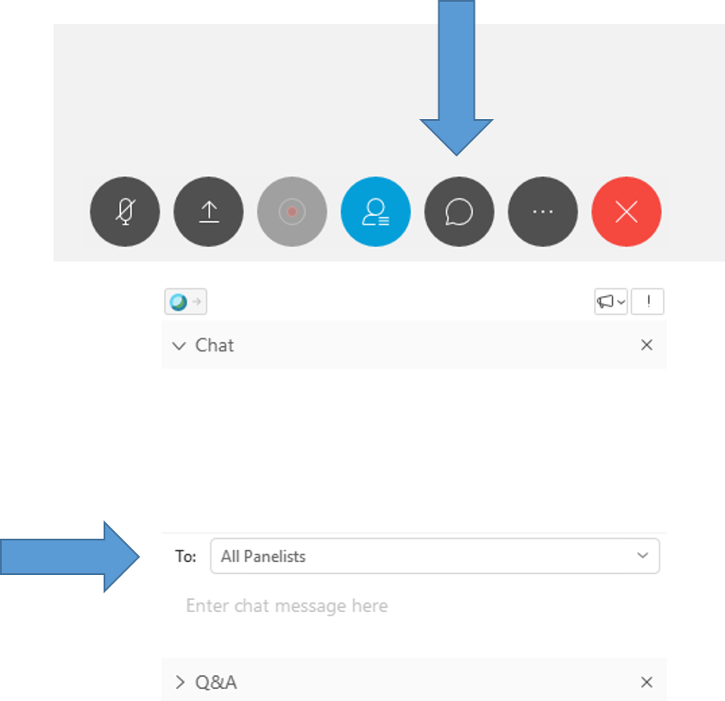
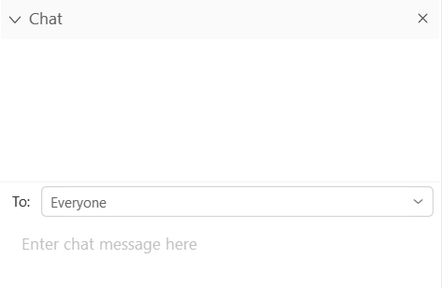
ASKING QUESTIONS VIA CHAT
The chat feature is available to ask questions or make comments anytime.
Click the chat button at the bottom of the WebEx window to open the chat box on the bottom righthand side of the window.
Choose “Everyone”, as appropriate.
- Type your question.
- Click “Enter” to send your question.

Slide 4
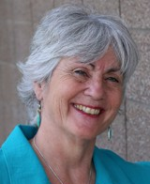


Gerri Lamb, PhD, RN, FAAN
Gerri Lamb, PhD, RN, FAAN, is the Founding Director of ASU’s Center for Advancing Interprofessional Practice, Education & Research and Professor at the Edson College of Nursing and Health Innovation. Her interprofessional practice and research focus is on care coordination for vulnerable and underserved populations.

Slide 5
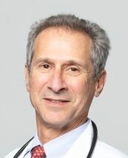

Daniel Miller, MD
Dr. Daniel Miller is a practicing Family Physician and the Chief of Graduate Medical Education and Behavioral Health Integration for Hudson River HealthCare (HRHCare), a not-for-profit, New York State licensed, Federally Qualified Health Center (FQHC) with 43 sites serving approximately 225,000 patients living throughout New York’s Hudson Valley, Long Island and New York City.

Slide 6
DISCLOSURES
No disclosures to report
The content of this activity may include discussion of off label or investigative drug uses. The faculty is aware that it is their responsibility to disclose this information.

Slide 7
TARGET AUDIENCE
Health care providers across the care continuum
Health professions faculty, preceptors and students
Health care administrators

Slide 8
EDUCATIONAL OBJECTIVES
Explore the role of moral resilience in bolstering team reserves and capacity.
Describe the common signs and symptoms associated with moral distress.
Recognize the experience of moral distress in the context of justice and institutional and systemic racism
Identify clinical situations that can trigger moral distress in primary care teams.
List five strategies members of primary care teams can use to prevent and ameliorate moral distress in team members.
https://ipe.asu.edu/team-care-connections

Slide 9

Session 2
Reducing Talent Burnout & Increasing Workforce Resiliency
Thursday, June 25 | 1:00 pm – 2:00 pm EDT
Visit www.nachc.org to learn more and join the event.

Slide 10
Clinical workforce wellness – and importance of caring teams

Slide 11
Conversations About Moral Distress and Moral Injury Digital Magazine
Developers:
Gerri Lamb, Lise McCoy, Yvonne Price, Nina Karamehmedovic, Jody Thompson
Collaborators:
  Arizona State University, A.T. Still University & National Association of Community Health Centers
Advisors:
  Kathy McNamara & Caryn Bernstein, National Association of Community Health Centers
  Dan Miller, Grace Wang, Bill Nash, Cynda Rushton, Nancy Johnson
This publication was supported by the Health Resources and Services Administration (HRSA) of the U.S. Department of Health and Human Services under Grant No. U30CS16089, as a part of an award totaling $6,375,000 with 75% financed with non-governmental sources. The contents are those of the authors and do not necessarily represent the official views of, nor endorsement, by HRSA, HHS, or the U.S. Government.

Slide 12

INTRO
Distress
Moral Distress
you know the right thing to do but you’re not able to do it
Courage
MORAL
Resilience
Moral Courage
courage to do the right thing in spite of the risks
Healing
Moral Resilience
ability and willingness to take right action in the face of moral or ethical adversity
Injury

Slide 13
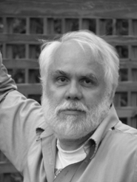
MORAL DISTRESS
You know the right thing to do,
but you’re not able to do it.
– Andrew Jameton, 1984

Slide 14
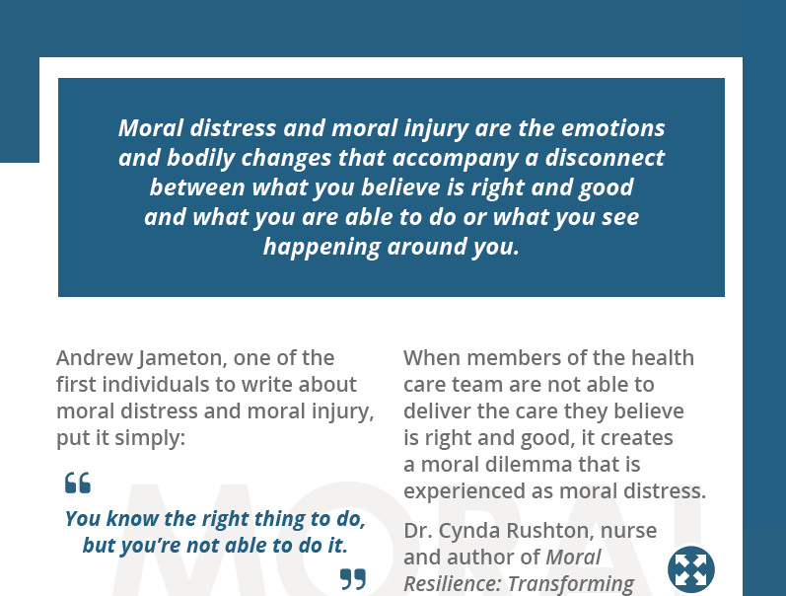
Moral Distress and Moral Injury

Slide 15
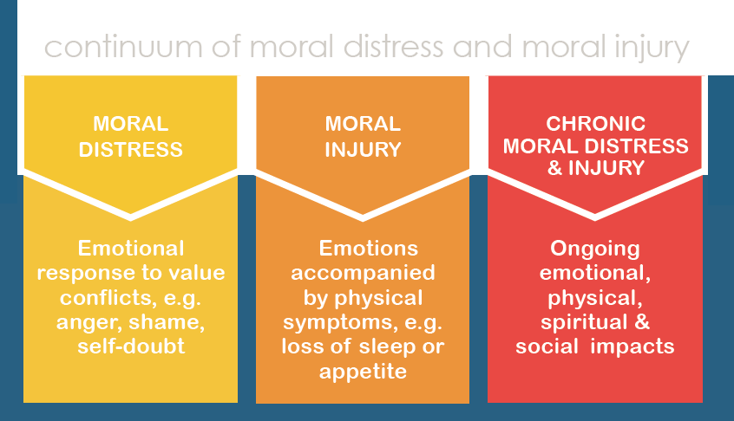
Continuum of moral distress

Slide 16
MORAL DISTRESS And BurnOUT
Burnout is a syndrome characterized by high emotional exhaustion, high depersonalization (i.e. cynicism), and a low sense of personal accomplishment from work.
Research shows that between 35 and 54 percent of U.S. nurses and physicians have substantial symptoms of burnout; similarly the prevalence of burnout ranges between 45 and 60 percent for medical students and residents.
National Academies of Sciences, Engineering and Medicine, 2019, p. 1

Slide 17

History of Moral Distress and Moral Injury

Slide 18
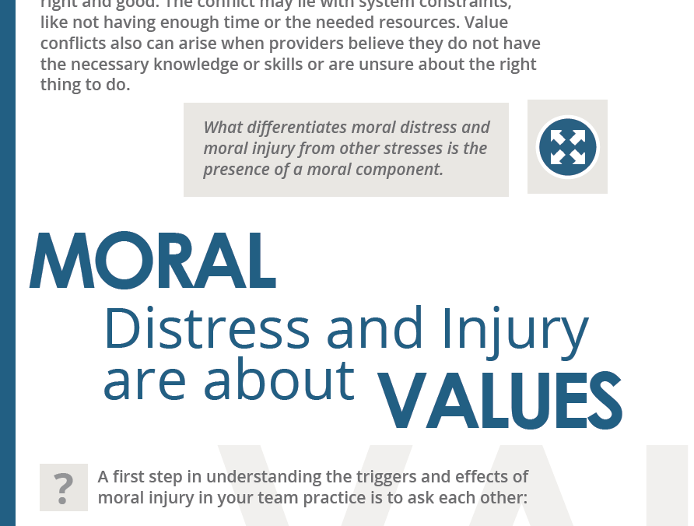
about Values AND Personal Integrity

Slide 19

JUSTICE

Slide 20



JUSTICE
VALUES

Slide 21
ACTIONS
ALIGNMENT
VALUES

Slide 22

ACTIONS
MORAL DISTRESS
VALUES

Slide 23

MORAL DISTRESS

Slide 24

MORAL DISTRESS
RACISM

Slide 25
ACTIONS
MORAL DISTRESS
ALIGNMENT
VALUES

Slide 26
MORAL COURAGE
ACTIONS
ALIGNMENT
VALUES

Slide 27
MORAL DISTRESS
You know the right thing to do,
but you’re not able to do it.
– Andrew Jameton, 1984

Slide 28
Continuum of moral distress

Slide 29
What does moral distress SOUND like in practice?
I go home at night feeling like I’m failing my patients.
We’ve got 15 minutes to see our patients – no matter what. This guy is homeless, he’s got no food, he can’t afford his meds. What can I possibly do in 15 minutes to make a difference?
All these regulations, all this hoop jumping. There are so many delays in getting what my patients need. It’s so frustrating. It hurts your soul.

Slide 30
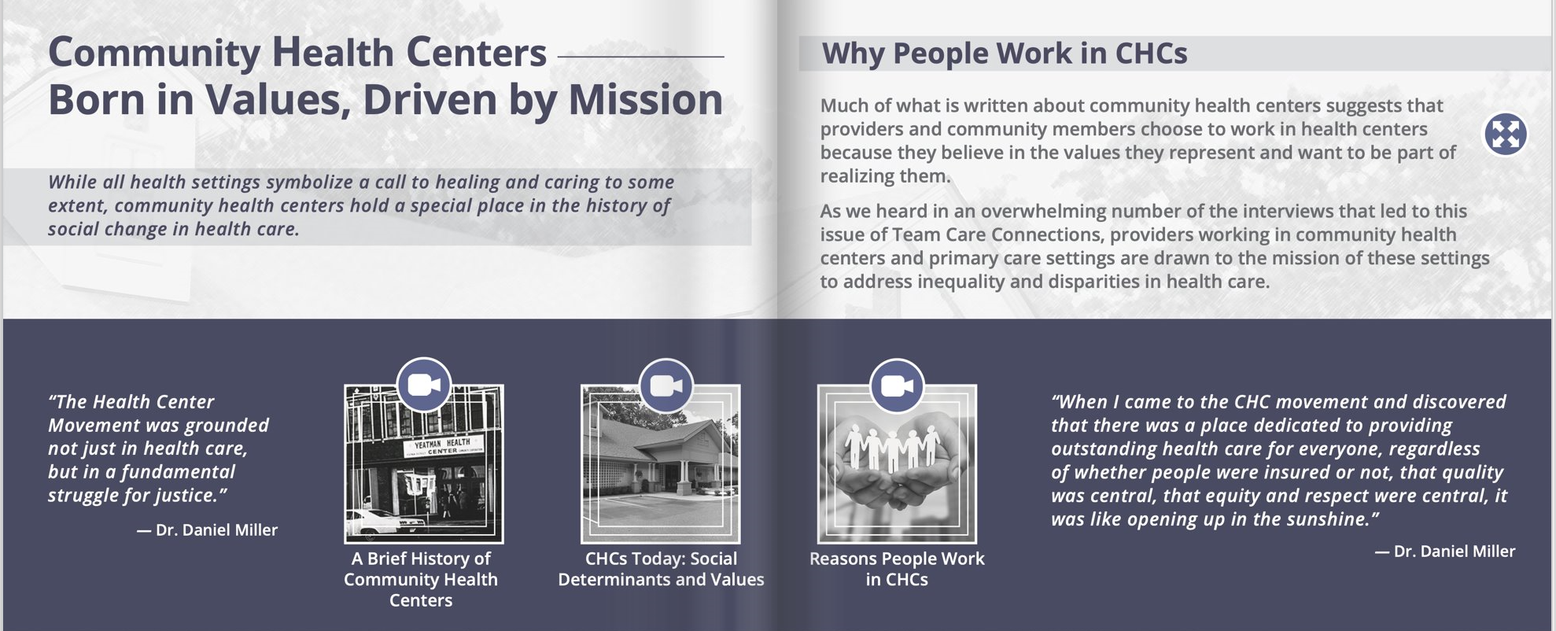
“Where you work matters”

Slide 31
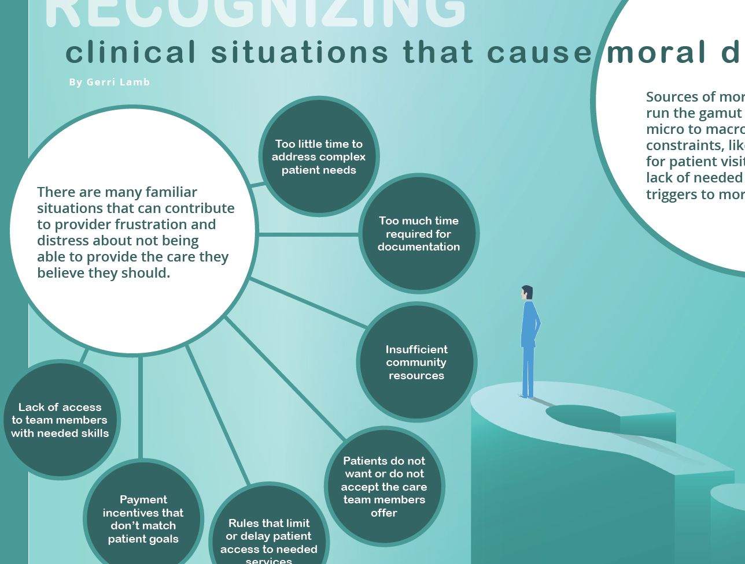
CLINICAL SCENARIOS ASSOCIATED WITH MORAL DISTRESS

Slide 32
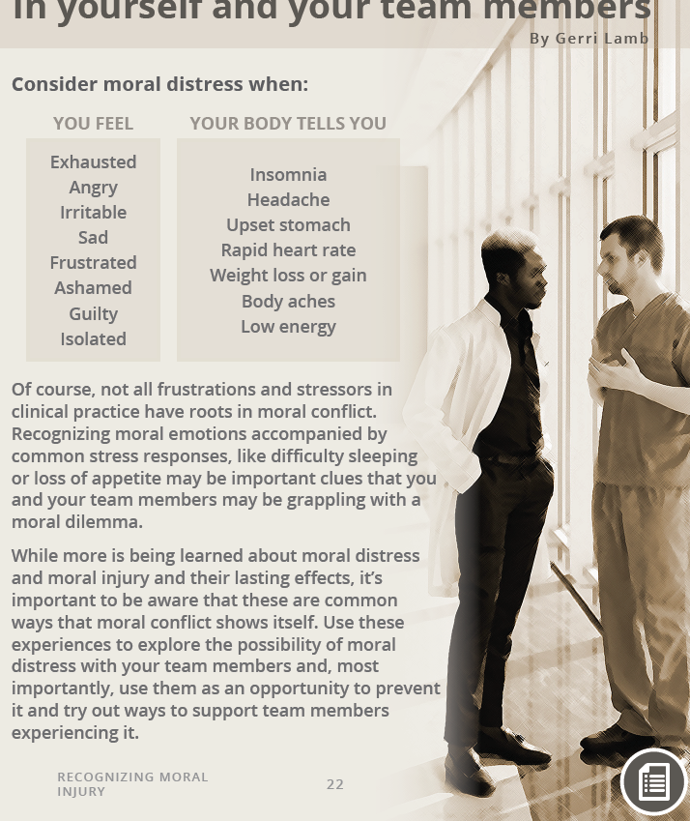
Recognizing clues in team members
“Health care people focus on patients. We put our patients first. We don’t pay a lot of attention to what we’re feeling. In fact, we’re probably the last ones to attend to ourselves.”
— Dr. Bill Nash

Slide 33
Five things YOU CAN DO TO PREVENT AND LESSEN MORAL Distress
Name it
Find time to talk about it
Recognize early cues
Educate clinical teams about preventive strategies
Try team exercises in “Conversations about Moral Distress and Moral Injury”

Slide 34
WHAT YOU CAN DO
Name it.
“We have to be able to describe moral injury better so we can talk and educate people about it.”
– Volunteers of America, Moral Injury Convenings
https://www.voa.org/moral-injury-center/moral-injury-convenings

Slide 35

Name it strategies to consider
Encourage team members to recall a situation in which they felt their values were challenged in a way that stayed with them that they continue to think about:
  What was happening?
  What was at stake?
  What did the experience feel like?
  What did your team do?

Slide 36
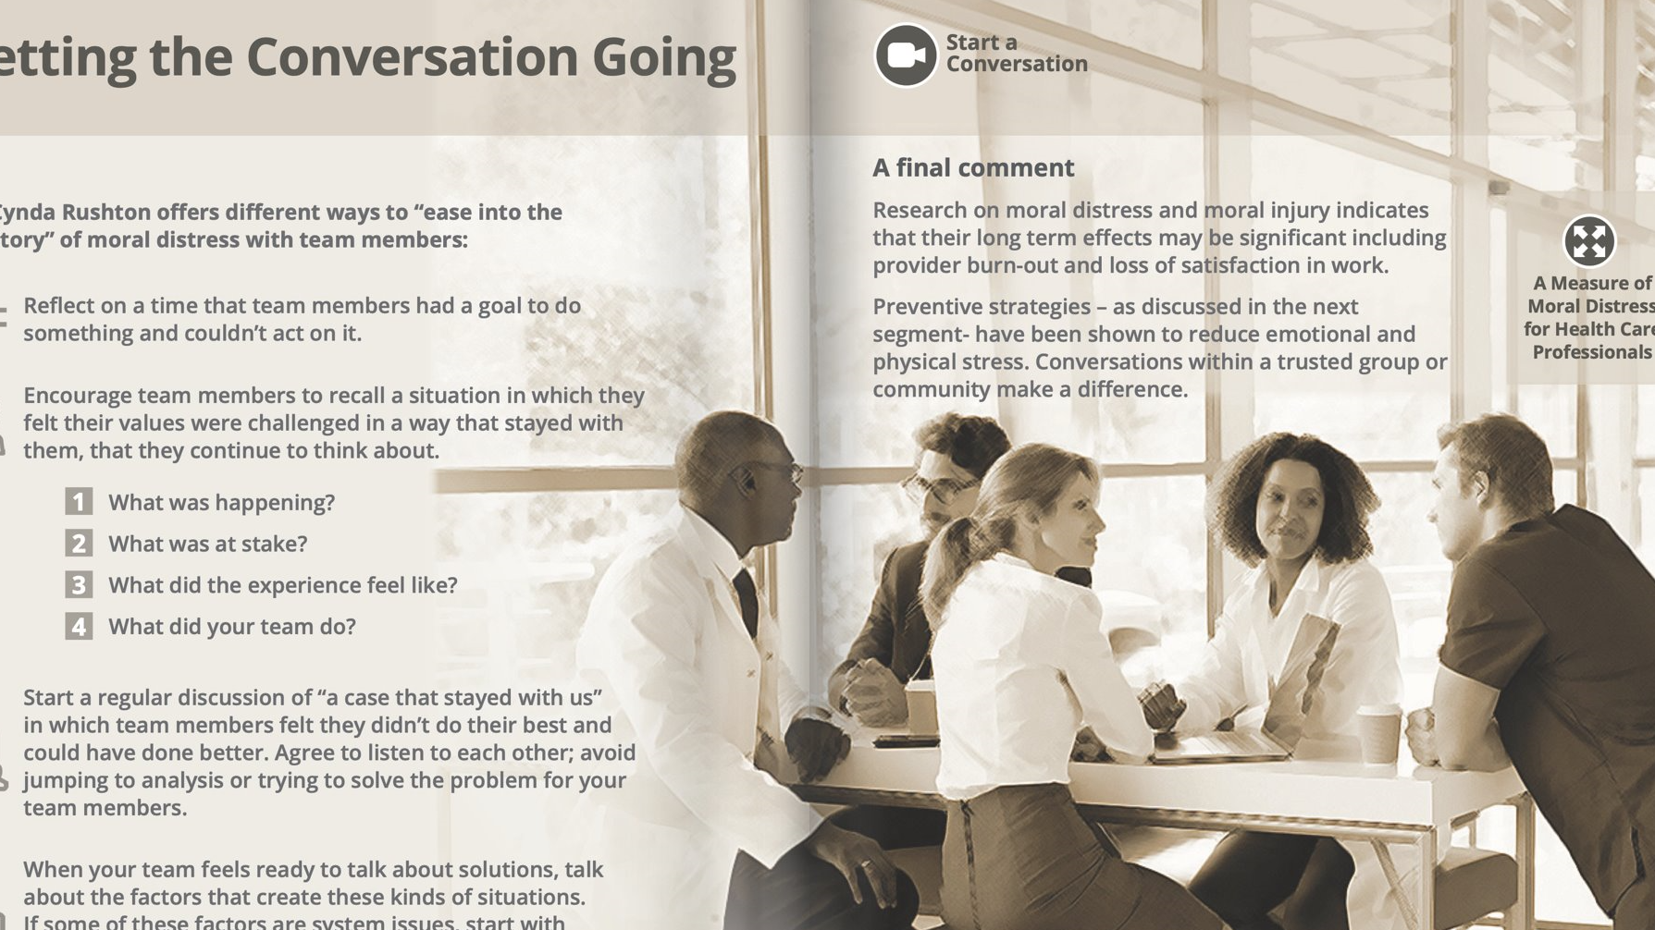
Help clinicians find time to talk about it
“We have to think about how we provide opportunities for those really important conversations so that we can assure that we're taking the best care of our patients.”
— Nancy Johnson, CEO

Slide 37

Help clinicians find time strategies to consider
Carve out a practice time for team meetings
Reduce administrative burden on providers so they can focus on taking care of patients
Task specific team members to facilitate conversations about challenging and frustrating situations that are root of moral distress

Slide 38
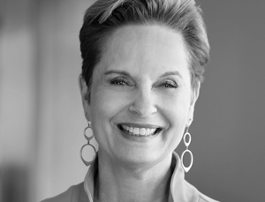
Recognize it early to take action
“If we can recognize those symptoms as early as possible and take proactive action to address them, I think we have the opportunity to actually strengthen our moral resilience, to be able to navigate these situations with integrity and without so much cost to ourselves or to the people that we're serving.”
– Cynda Rushton, PhD, RN, FAAN
Author of Moral Resilience, 2018

Slide 39

Recognize it early to take action strategies to consider
Listen to ‘moral emotions’ - ones that convey how a provider feels when they believe something ‘should’ happen
  Use of words ‘should’ or ‘ought’ are important clues that values are at stake
  Emotions that range from anger to guilt and shame
Look for ‘clues’ to situations that generate moral conflict
  Knowing the right thing to do but experiencing constraints to doing it
  Believing the care being provided is not consistent with what ‘should’ happen
Talk about factors that create these kinds of situations and possible solutions
  Start with solutions that are within the control of your team
  Identify solutions that will require leadership and broader organizational engagement

Slide 40

Educate your team
Recognize signs and symptoms.
Buddy up to watch out for each other.
Create a safe place to talk.
Develop team cues for asking about and acknowledging moral distress.
Listen closely for recurring situations that “stay with” team members.
Implement quick successes within the control of your team.
Engage administrators in solving system level issues that contribute to moral distress and moral injury.

Slide 41
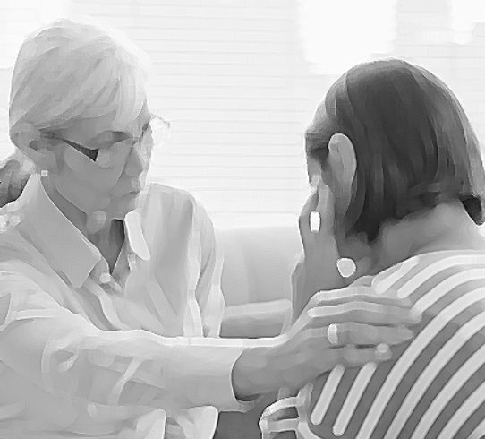
what teams can do strategies to consider
Buddy Up!
Dr Nash suggests buddying up with another team member to work out a plan of how to check on each other, for example, ask questions like:
“How and what do you want me to do if something happens to you, one of your patients has a bad outcome and I recognize maybe you withdrawing a little bit, pulling away, getting grumpy, whatever? What would you want me to do? What should I say?”
Plan for it!

Slide 42

Ultimately a Call to ACTION

Slide 43

Of your team.
take care.
Of yourself.

Slide 44
Closing thoughts
Awareness of moral distress and moral injury is growing – a good thing for early recognition and action.
The emotional and physical impact can be very significant.
Once recognized, there are many things team members can do to support each other.
Recognize moral distress as a symptom of values misalignment and ultimately a call to action

Slide 45
An Invitation
We would like to work with individuals and teams willing to try out one or more activities in Conversations about Moral Distress and Moral Injury and help us evaluate its usefulness and impact.
If you would be interested in working with us, please write your email address and name in the chat box.
Thank you!
https://ipe.asu.edu/team-care-connections

Slide 46
For Information or to receive the magazine
Email
Gerri.Lamb@asu.edu
cshuler@nachc.com
Email
teamcareconnections@asu.edu
Visit us on the web
ipe.asu.edu/team-care-connections

Slide 47



Q & A

Slide 48


Thank you

Slide 49
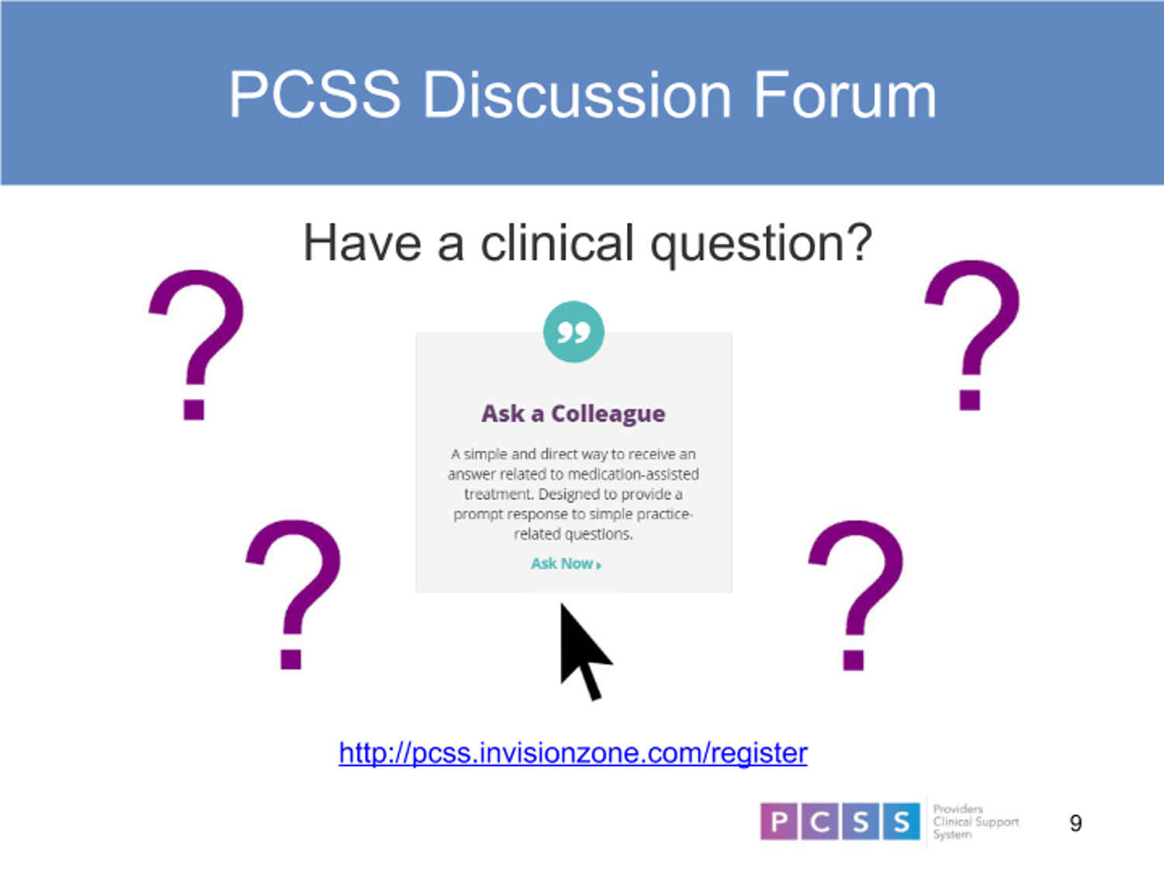

Slide 50
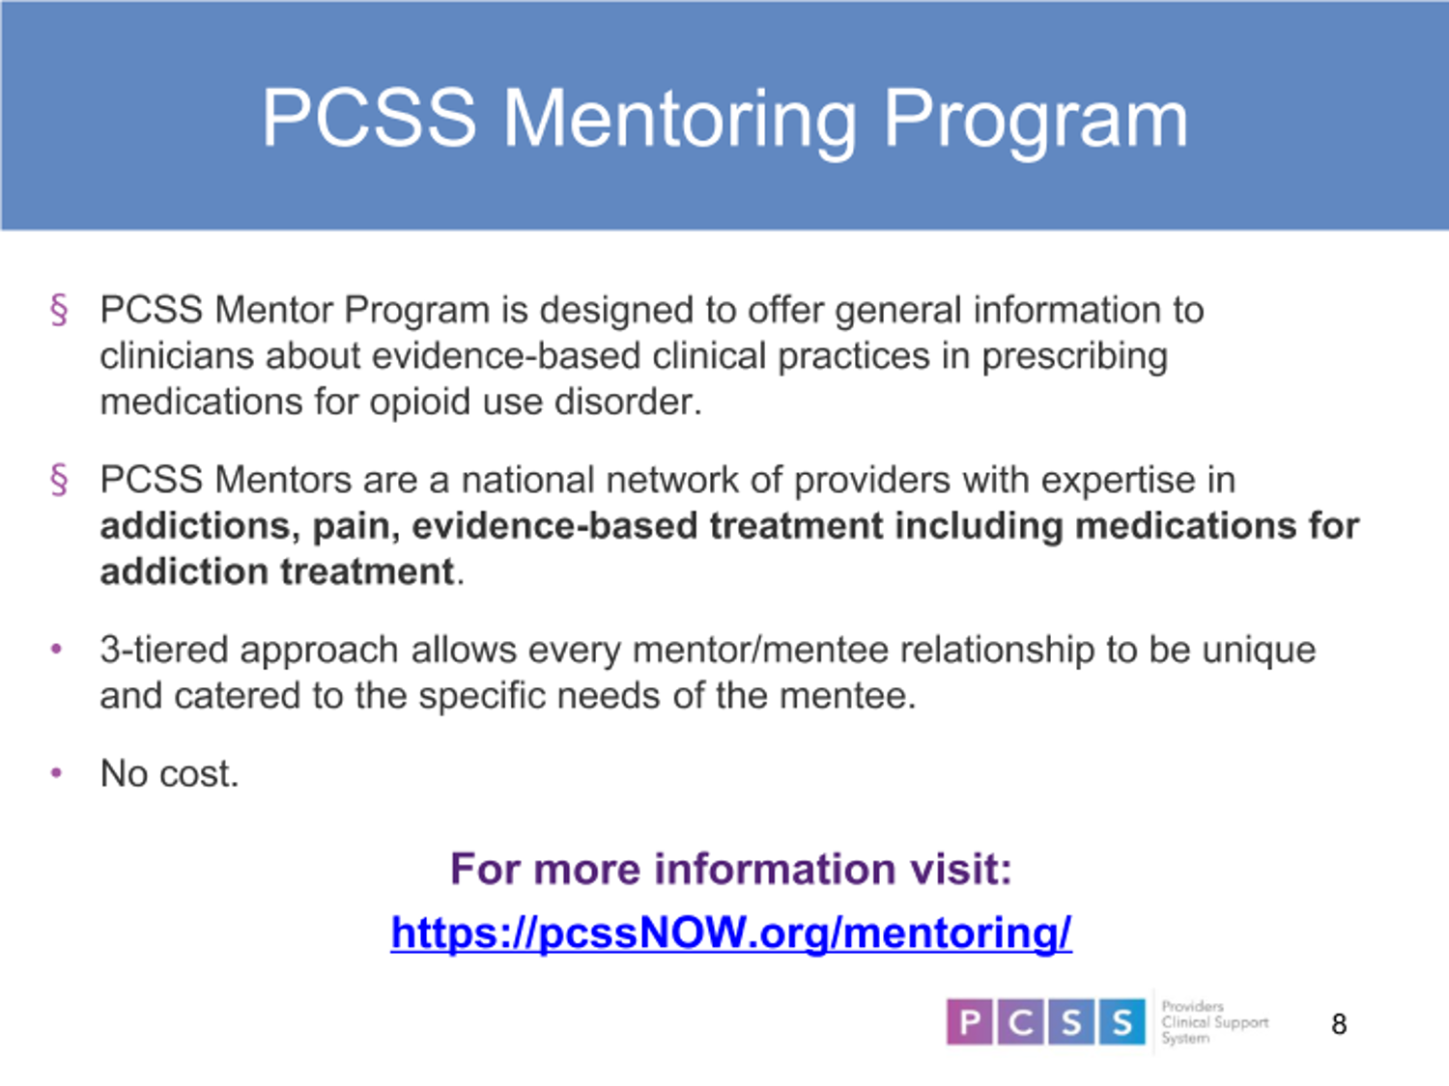

Slide 51


Slide 52
