Slide 1


Taking Care of the Compassionate Care Team
Conversations About Moral Distress And Moral Injury
Gerri Lamb, PhD, RN, FAAN
Arizona State University Center for Advancing Interprofessional Practice, Education and Research
March 26, 2020

Slide 3

Important Webinar Logistics
Your phone line is currently muted and will remain muted for the duration of the webinar.
This call is being recorded.
If you need technical assistance, contact:
  NACHC Staff: Frances Jones | fjones@nachc.com
  WebEx: 1-866-229-3239
    Access Code/Event Number: 794 571 225
    Password: NachcWeb1

Slide 4
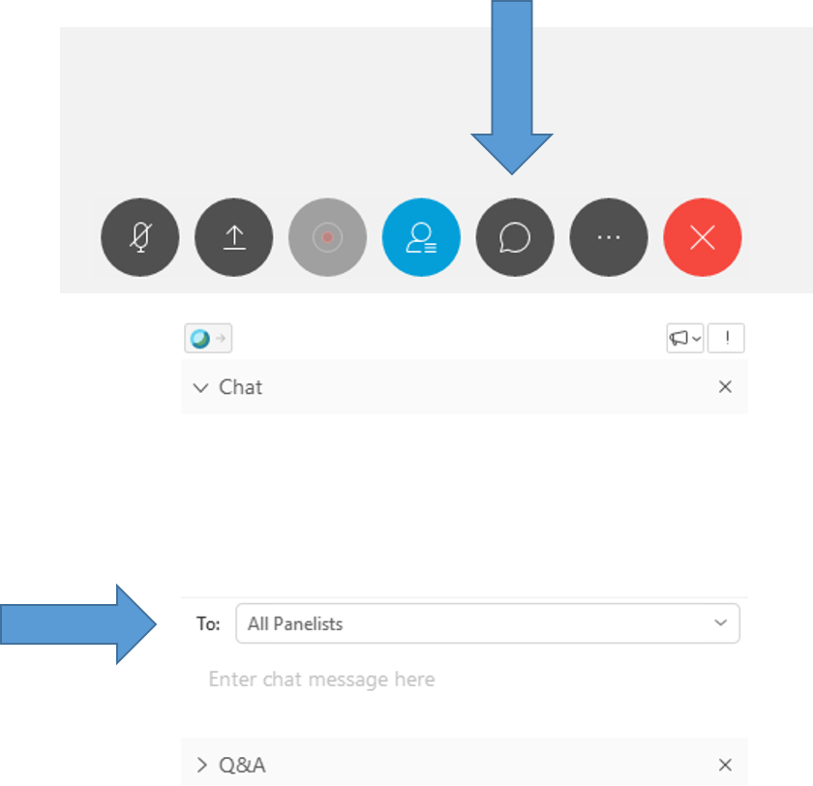
To Ask a Question
Click the Chat button at the bottom of the WebEx window, which will open the chat box on the bottom righthand side of the window.
Choose “All Panelists” or “All Participants”, as appropriate.
Type your question.
Click “Enter” to send your question.

Slide 5
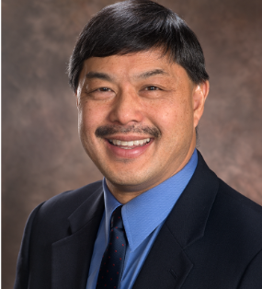
INTRODUCTION
Ron Yee, MD, MBA, FAAFP
Chief Medical Officer, National Association of Community Health Centers

Slide 6
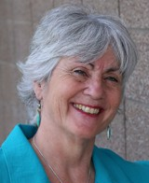

Gerri Lamb, PhD, RN, FAAN
Gerri Lamb, PhD, RN, FAAN, is the Founding Director of ASU’s Center for Advancing Interprofessional Practice, Education & Research and Professor at the Edson College of Nursing and Health Innovation. In this role, she is committed to supporting the growth of interprofessional initiatives at ASU in collaboration with much-valued academic and clinical partners. She also works to connect local and state activities to the national IPE community in her role as past chair of the American Interprofessional Health Collaborative and liaison to the National Center for Interprofessional Practice and Education Nexus Innovations Incubator. Her interprofessional practice and research focus is on care coordination for vulnerable and underserved populations.

Slide 7
DISCLOSURES
No disclosures to report
The content of this activity may include discussion of off label or investigative drug uses. The faculty is aware that it is their responsibility to disclose this information.

Slide 8
TARGET AUDIENCE
Health care providers across the care continuum
Health professions faculty, preceptors and students
Health care administrators
The overarching goal of PCSS is to train healthcare professionals in evidence-based practices for the prevention and treatment of opioid use disorders, particularly in prescribing medications, as well as for the prevention and treatment of substance use disorders.

Slide 9
EDUCATIONAL OBJECTIVES
At the conclusion of this activity, participants should be able to:
Describe the common signs and symptoms associated with moral distress and moral injury.
Identify clinical situations that can trigger moral distress and moral injury in primary care practices.
List five strategies members of primary care teams can use to prevent and ameliorate moral distress and moral injury in team members.

Slide 10
Clinical workforce wellness – and importance of caring teams

Slide 11
Mentimeter Q1
GO TO WWW.MENTI.COM + USE CODE 84 92 1
How much do you know about moral distress and moral injury?
  Nothing – I have not heard of them before
  A little bit – I’ve heard them mentioned, but don’t know much
  Some – I know what they are and why they are important
  A lot – I know quite a bit about them

Slide 12
Acknowledgements
Collaborators:
  Arizona State University, A.T. Still University & National Association of Community Health Centers
Advisors:
  Kathy McNamara & Caryn Bernstein, National Association of Community Health Centers
  Dan Miller, Grace Wang, Bill Nash, Cynda Rushton, Nancy Johnson
This publication was supported by the Health Resources and Services Administration (HRSA) of the U.S. Department of Health and Human Services under Grant No. U30CS16089, as a part of an award totaling $6,375,000 with 75% financed with non-governmental sources. The contents are those of the authors and do not necessarily represent the official views of, nor endorsement, by HRSA, HHS, or the U.S. Government.

Slide 13
PROJECT TEAM
Gerri Lamb, PI
Jody Steehler
Project Assistant
Yvonne Price
Sr. Instructional Designer
Nina Karamehmedovic
Project Manager
Lise McCoy,
Co-PI

Slide 14
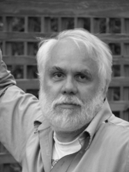
MORAL DISTRESS
You know the right thing to do,
but you’re not able to do it.
– Andrew Jameton, 1984

Slide 15
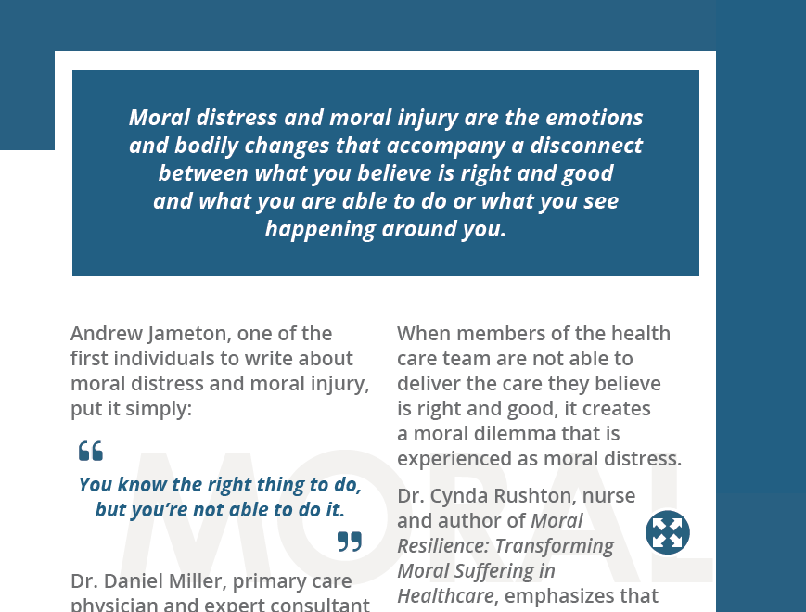
Moral Distress and Moral Injury

Slide 16
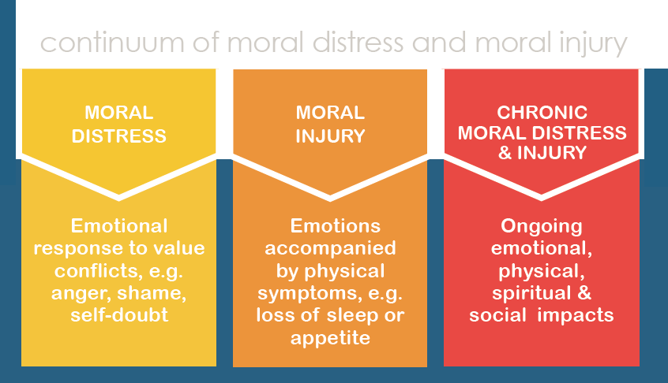
Continuum of moral distress

Slide 17
MORAL DISTRESS And BurnOUT
Burnout is a syndrome characterized by high emotional exhaustion, high depersonalization (i.e. cynicism), and a low sense of personal accomplishment from work.
Research shows that between 35 and 54 percent of U.S. nurses and physicians have substantial symptoms of burnout; similarly the prevalence of burnout ranges between 45 and 60 percent for medical students and residents.
National Academies of Sciences, Engineering and Medicine, 2019, p. 1

Slide 18

History of Moral Distress and Moral Injury

Slide 19
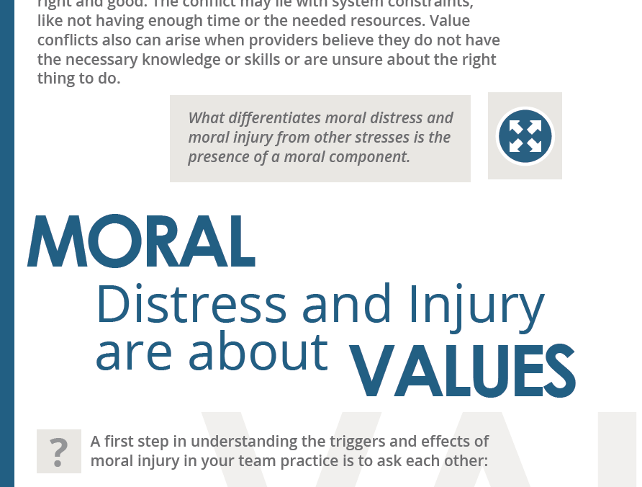
about Values AND Personal Integrity

Slide 20
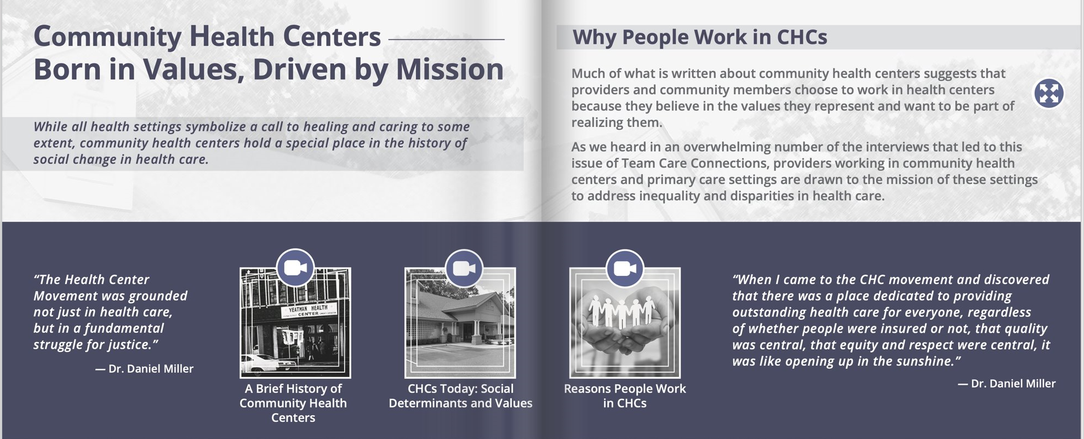
“Where you work matters”

Slide 21
What does moral distress SOUND like in practice?
I go home at night feeling like I’m failing my patients.
We’ve got 15 minutes to see our patients – no matter what. This guy is homeless, he’s got no food, he can’t afford his meds. What can I possibly do in 15 minutes to make a difference?
All these regulations, all this hoop jumping. There are so many delays in getting what my patients need. It’s so frustrating. It hurts your soul.

Slide 22
Mentimeter Q2
GO TO WWW.MENTI.COM + USE CODE 84 92 1
Do you think you or your team members have experienced moral distress?
  No – I don’t think so
  Maybe – I have to think more about it
  Yes – I recognize these feelings in myself or my team members

Slide 23
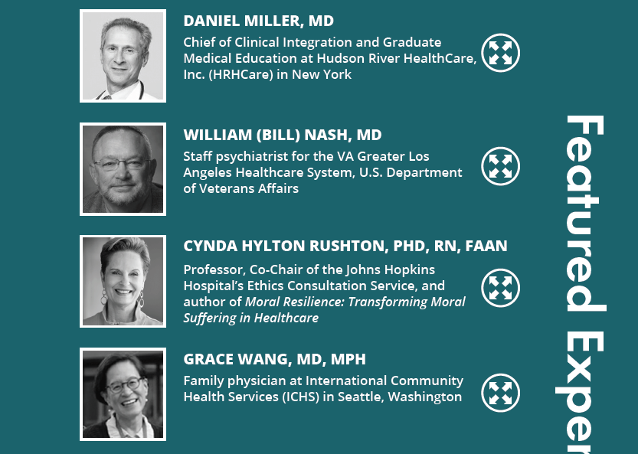
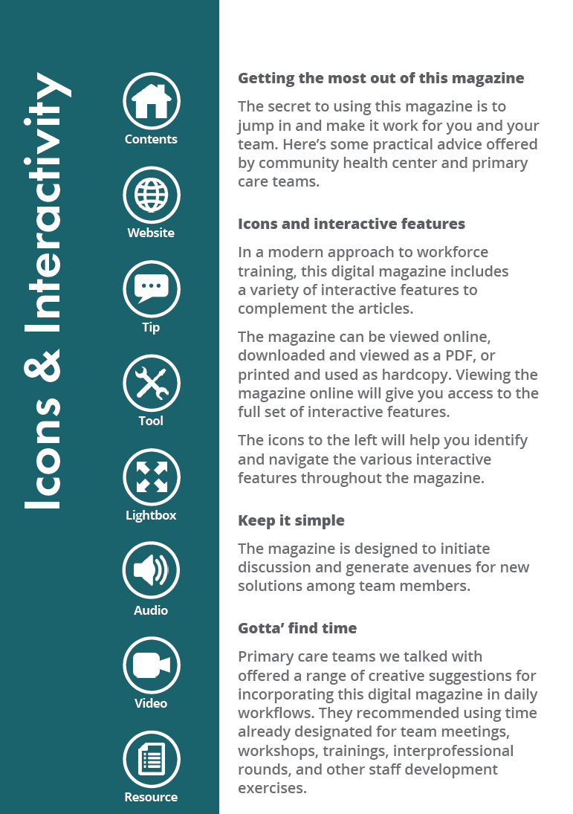
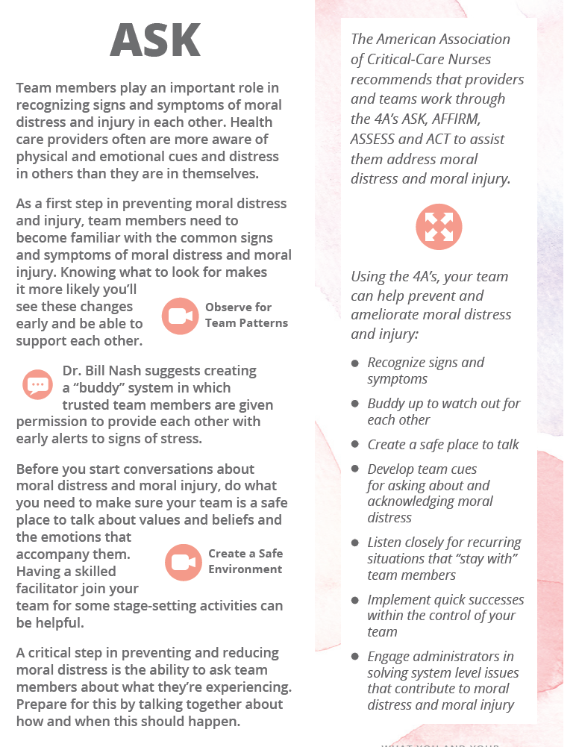

“Team Care Connections offers a modern, real-time way for providers to think and learn about teamwork together.”
A digital training magazine for health care teams
Engaging features complement articles
Icons throughout provide a map to interactive features
Videos, expert commentary, lightboxes, tips and tools take magazine reading to the next level

Slide 24
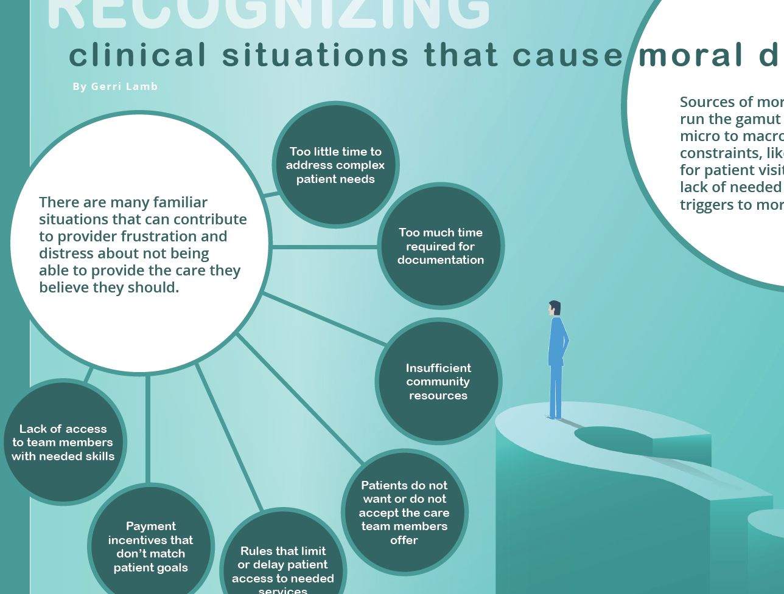
CLINICAL SCENARIOS ASSOCIATED WITH MORAL DISTRESS

Slide 25
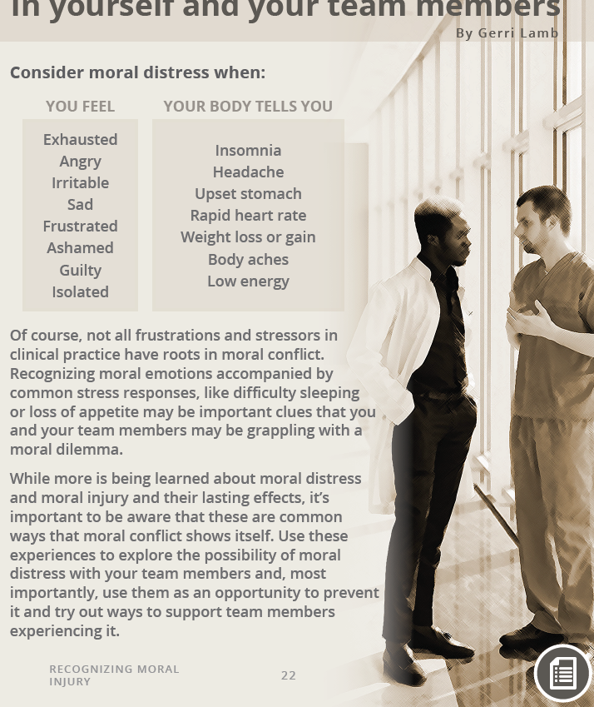
Recognizing clues in team members
“Health care people focus on patients. We put our patients first. We don’t pay a lot of attention to what we’re feeling. In fact, we’re probably the last ones to attend to ourselves.”
— Dr. Bill Nash

Slide 26
Let’s do a preview
Go to ipe.asu.edu/team-care-connections
Scroll down and click on the February 2020 issue →

Slide 27
Mentimeter Q3
GO TO WWW.MENTI.COM + USE CODE 84 92 1
Which of the exercises and resources do you think your team would be most likely to try? (Please check all that apply)
  Short video interviews with experts
  Ideas for starting team conversations
  Self-assessment measures and tools
  Articles about the topic or what other teams do

Slide 28
Five things YOU CAN DO TO PREVENT AND LESSEN MORAL Distress
Name it
Find time to talk about it
Recognize early cues
Educate clinical teams about preventive strategies
Try team exercises in “Conversations about Moral Distress and Moral Injury”

Slide 29
WHAT YOU CAN DO
Name it.
“We have to be able to describe moral injury better so we can talk and educate people about it.”
– Volunteers of America, Moral Injury Convenings
https://www.voa.org/moral-injury-center/moral-injury-convenings

Slide 30

Name it strategies to consider
Encourage team members to recall a situation in which they felt their values were challenged in a way that stayed with them that they continue to think about:
  What was happening?
  What was at stake?
  What did the experience feel like?
  What did your team do?

Slide 31
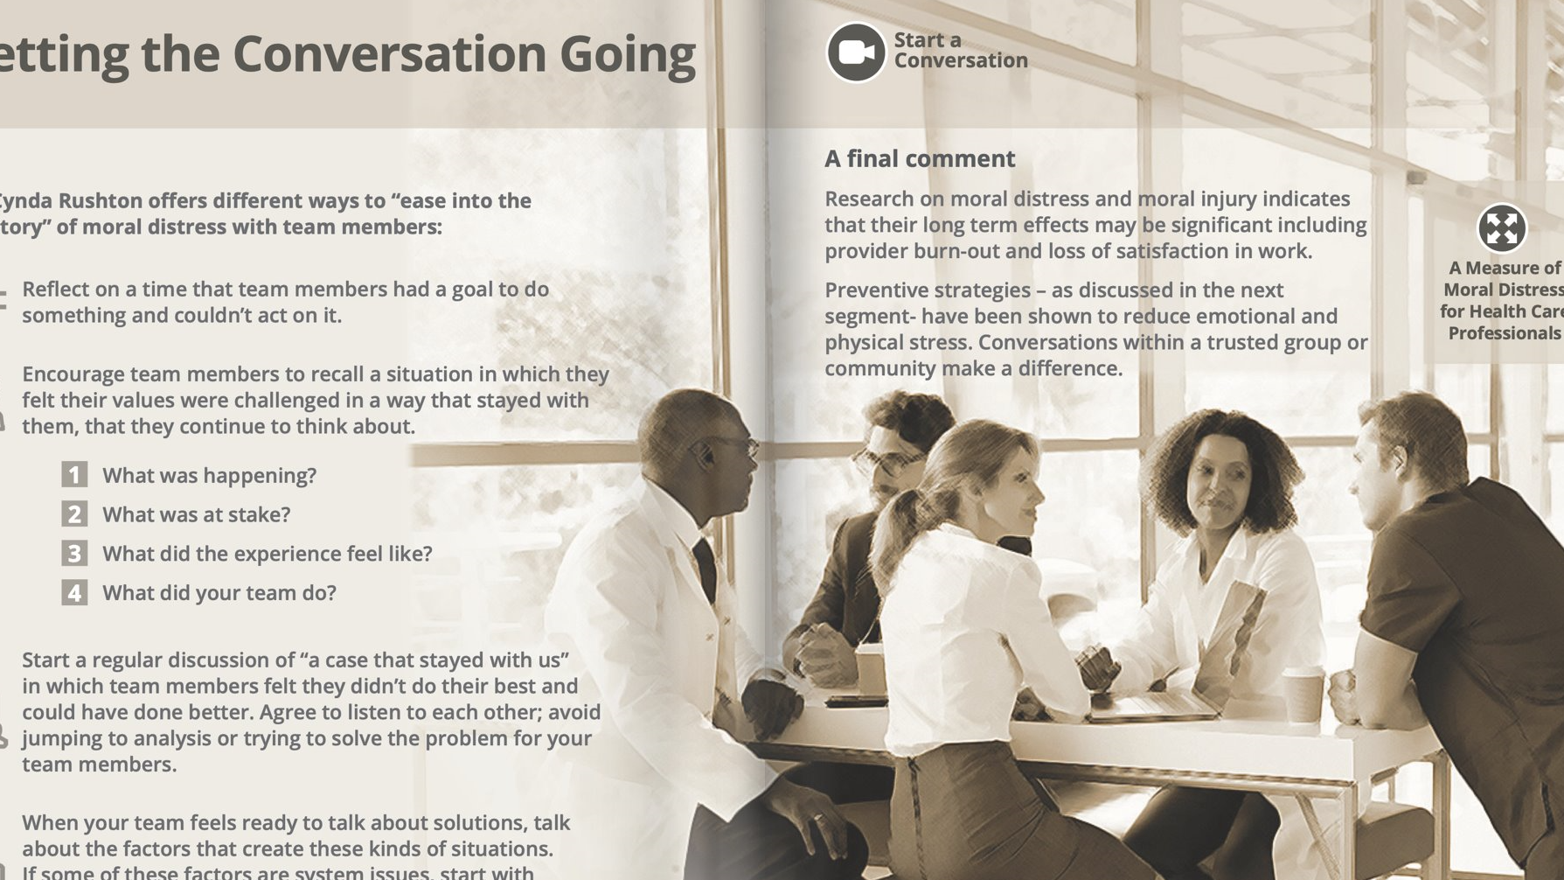
Help clinicians find time to talk about it
“We have to think about how we provide opportunities for those really important conversations so that we can assure that we're taking the best care of our patients.”
— Nancy Johnson, CEO

Slide 32

Help clinicians find time strategies to consider
Carve out a practice time for team meetings
Reduce administrative burden on providers so they can focus on taking care of patients
Task specific team members to facilitate conversations about challenging and frustrating situations that are root of moral distress

Slide 33
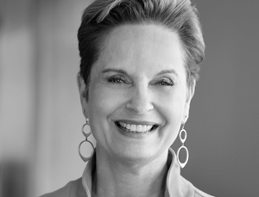
Recognize it early to take action
“If we can recognize those symptoms as early as possible and take proactive action to address them, I think we have the opportunity to actually strengthen our moral resilience, to be able to navigate these situations with integrity and without so much cost to ourselves or to the people that we're serving.”
– Cynda Rushton, PhD, RN, FAAN
Author of Moral Resilience, 2018

Slide 34

Recognize it early to take action strategies to consider
Listen to ‘moral emotions’ - ones that convey how a provider feels when they believe something ‘should’ happen
  Use of words ‘should’ or ‘ought’ are important clues that values are at stake
  Emotions that range from anger to guilt and shame
Look for ‘clues’ to situations that generate moral conflict
  Knowing the right thing to do but experiencing constraints to doing it
  Believing the care being provided is not consistent with what ‘should’ happen
Talk about factors that create these kinds of situations and possible solutions
  Start with solutions that are within the control of your team
  Identify solutions that will require leadership and broader organizational engagement

Slide 35

Educate your team
Recognize signs and symptoms.
Buddy up to watch out for each other.
Create a safe place to talk.
Develop team cues for asking about and acknowledging moral distress.
Listen closely for recurring situations that “stay with” team members.
Implement quick successes within the control of your team.
Engage administrators in solving system level issues that contribute to moral distress and moral injury.

Slide 36
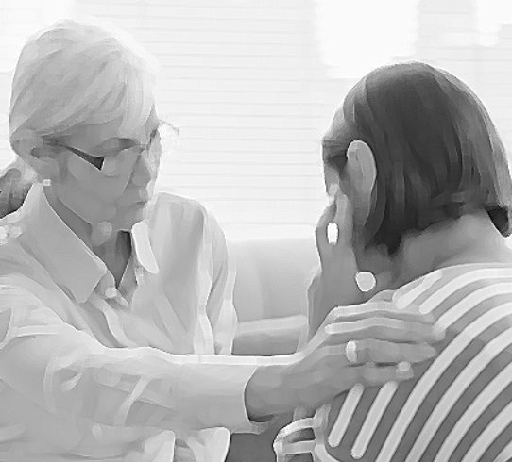
what teams can do strategies to consider
Buddy Up!
Dr. Nash suggests buddying up with another team member to work out a plan of how to check on each other, for example, ask questions like:
“How and what do you want me to do if something happens to you, one of your patients has a bad outcome and I recognize maybe you withdrawing a little bit, pulling away, getting grumpy, whatever? What would you want me to do? What should I say?”
Plan for it!

Slide 37
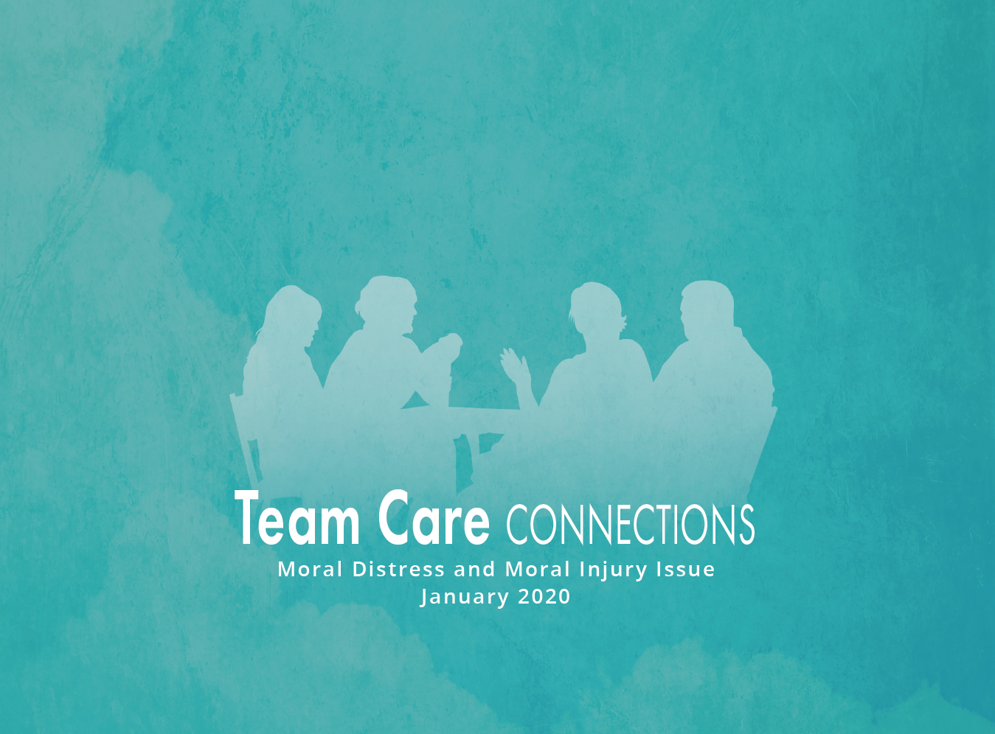
Try team exercises

Slide 38




Try team exercises strategies to consider
What are your team’s common barriers to delivering care consistent with your shared values?

Slide 39
Mentimeter Q4
GO TO WWW.MENTI.COM + USE CODE 84 92 1
Now that you’ve had a chance to see a few selections from Conversations about Moral Distress and Moral Injury, when do you think you could use it? (Please check all that apply)
  New staff orientation
  Team meetings
  Staff workshops

Slide 40
Closing thoughts
Awareness of moral distress and moral injury is growing – a good thing for early recognition and action.
The emotional and physical impact can be very significant.
Once recognized, there are many things team members can do to support each other.
Don’t overlook the role of leaders - they play a critical role in creating cultures that encourage conversation and team well-being.

Slide 41

Of your team.
take care.
Of yourself.

Slide 42
Mentimeter Q5 - An Invitation
GO TO WWW.MENTI.COM + USE CODE 84 92 1
We would like to work with individuals and teams willing to try out one or more activities in Conversations about Moral Distress and Moral Injury and help us evaluate its usefulness and impact.
If you would be interested in working with us, please write your email address and name in the boxes in Mentimeter. Thank you!

Slide 43
For Information or to receive the magazine
Email
Gerri.Lamb@asu.edu
cshuler@nachc.com
Email
teamcareconnections@asu.edu
Visit us on the web
ipe.asu.edu/team-care-connections

Slide 44
Q & A

Slide 45

Thank you

Slide 46
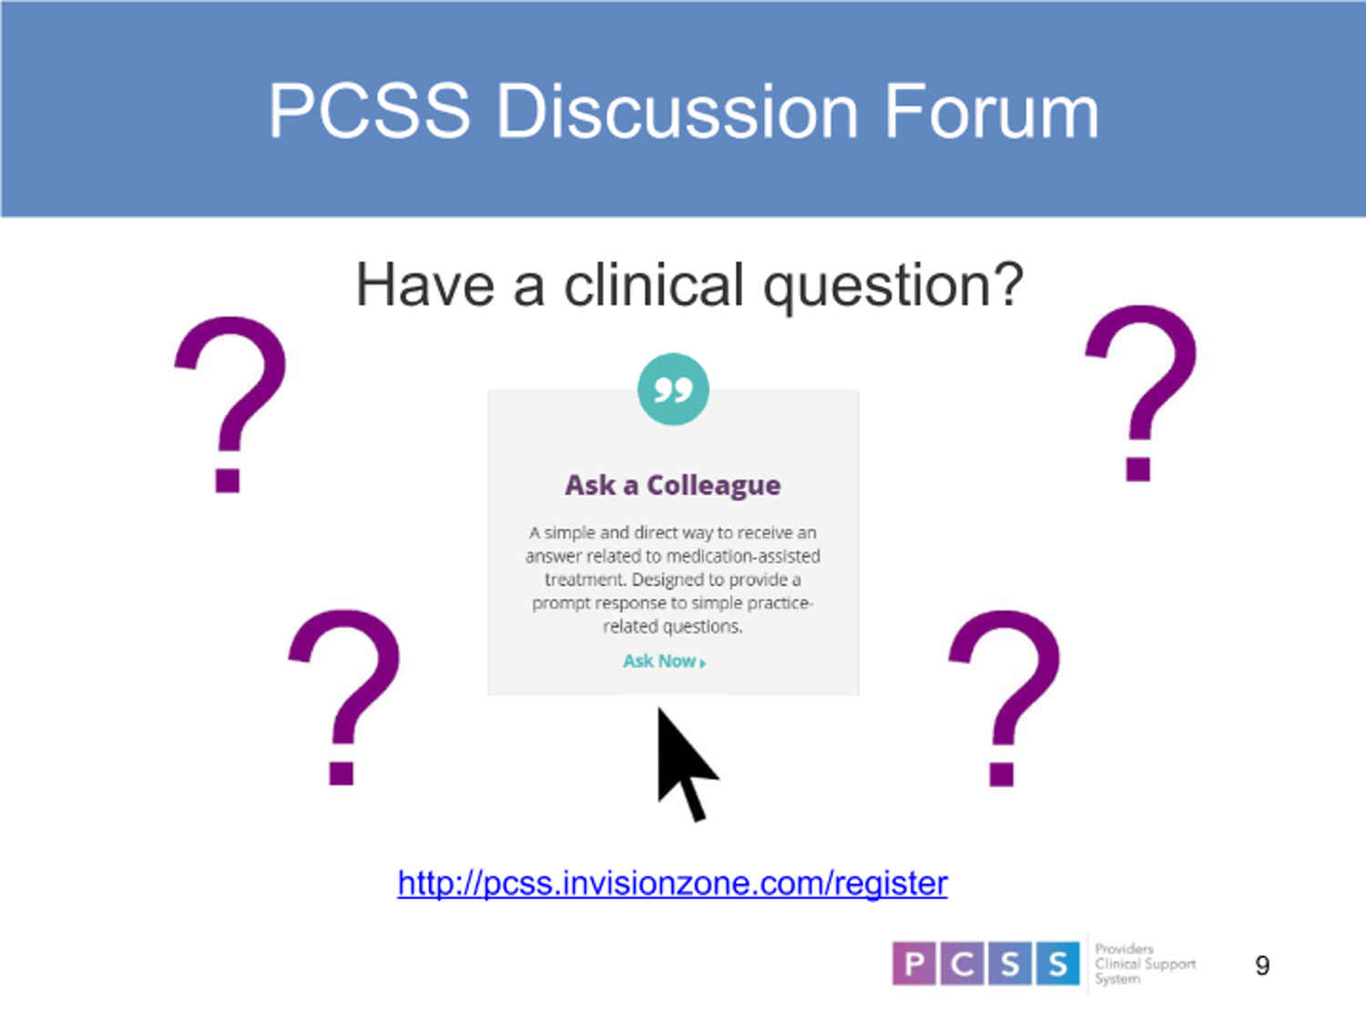

Slide 47
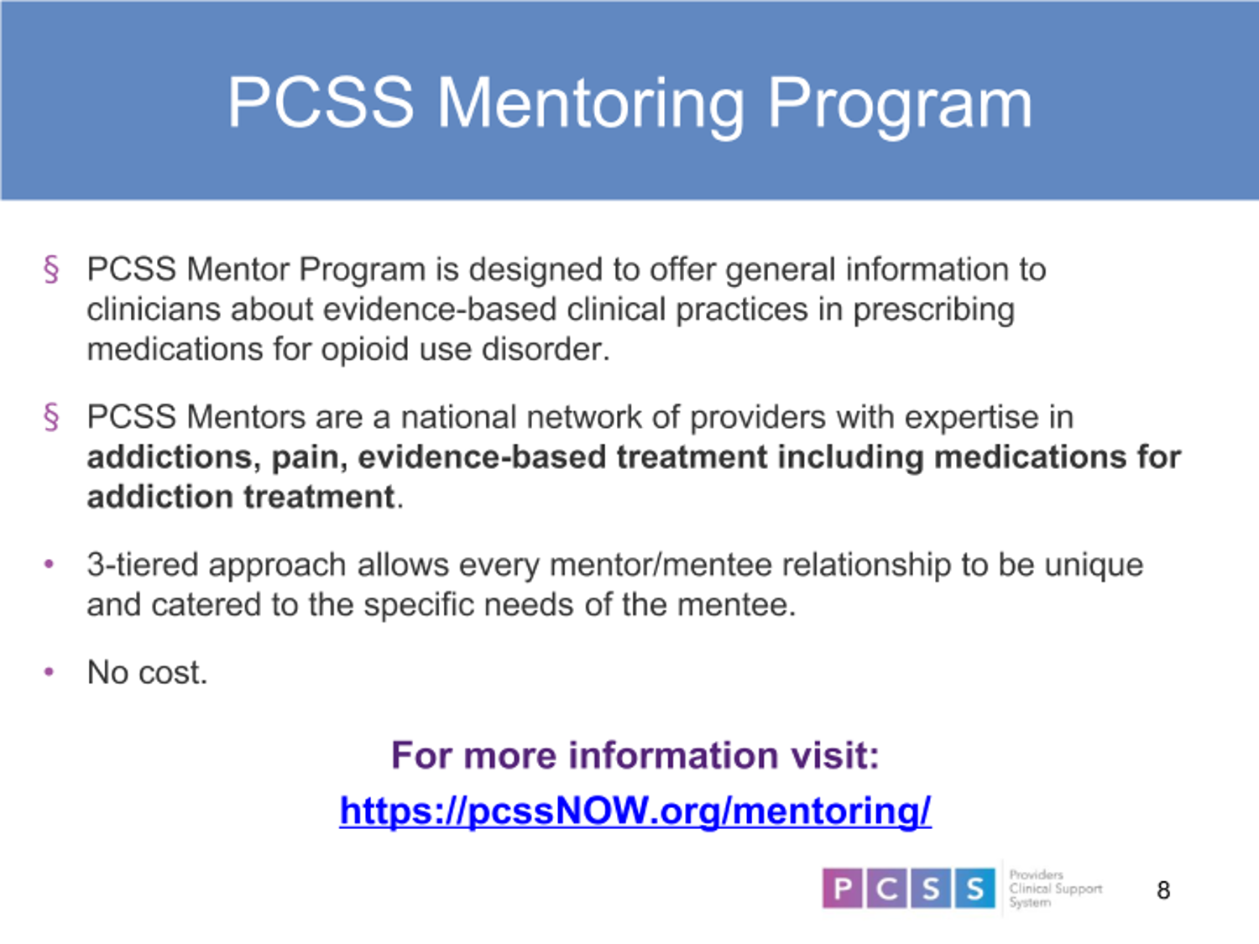

Slide 48
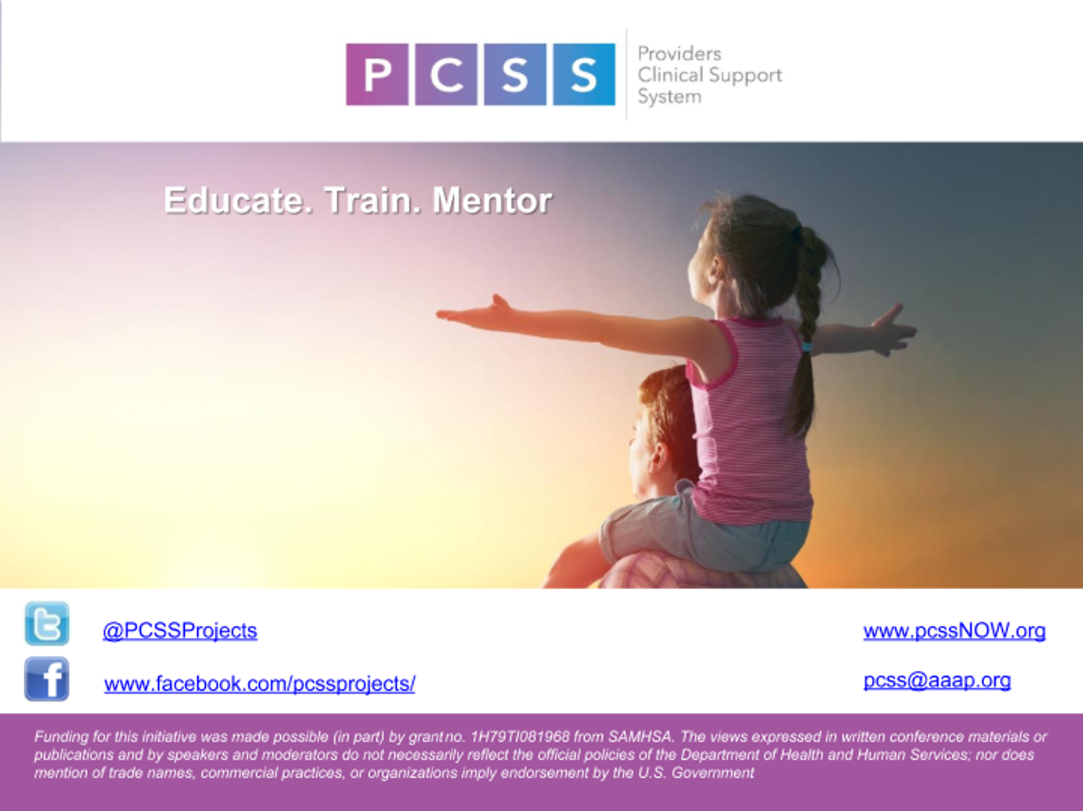

Slide 49
